Slide 1
IT Incident Analysis
Executive Summary & Results Walkthrough
February 2026 · Data as of 22 Feb 2026

Slide 2
Dataset Overview
150
309
30
399
Total Incidents
Remediation Items (RIs)
Controls Defined
Control–RI Mappings
18% open
49% open
8 with zero coverage
many-to-many

Slide 3
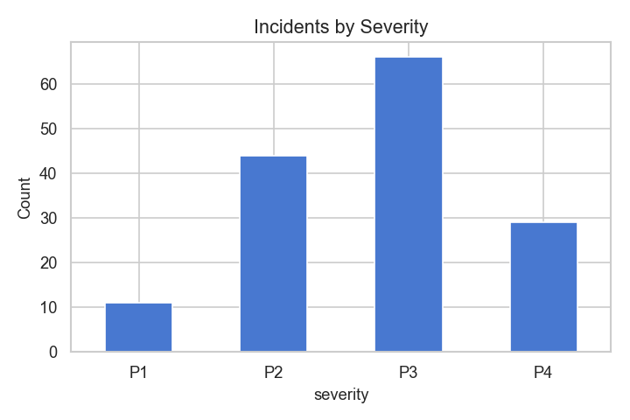
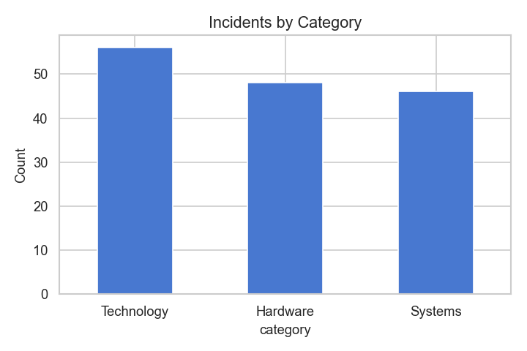
Incident Breakdown
By Severity
By Category
💡 Majority of incidents are P2–P3 severity across all three categories — no single category dominates risk exposure.

Slide 4
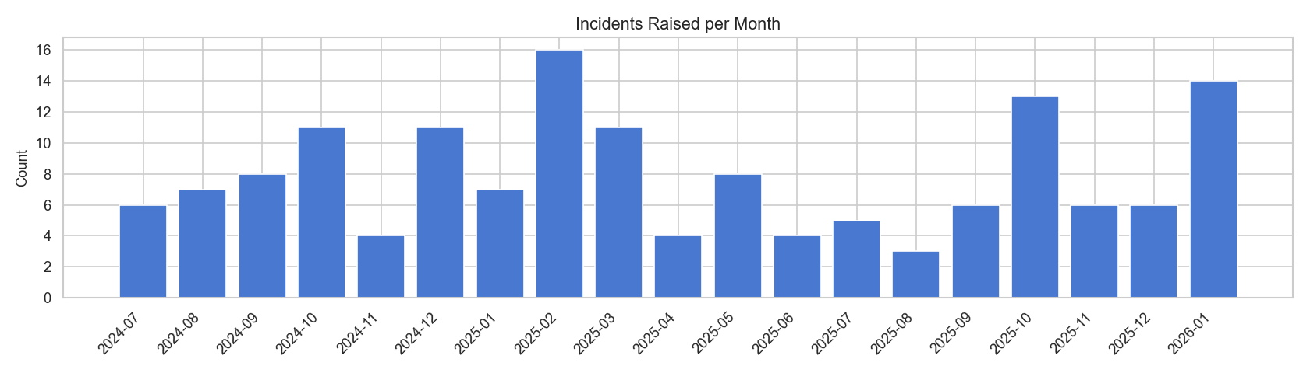
Incident Volume — Monthly Trend
⚠️ Monitor monthly volume for upward trends. Sustained increases may indicate systemic gaps in change or patch management processes.

Slide 5
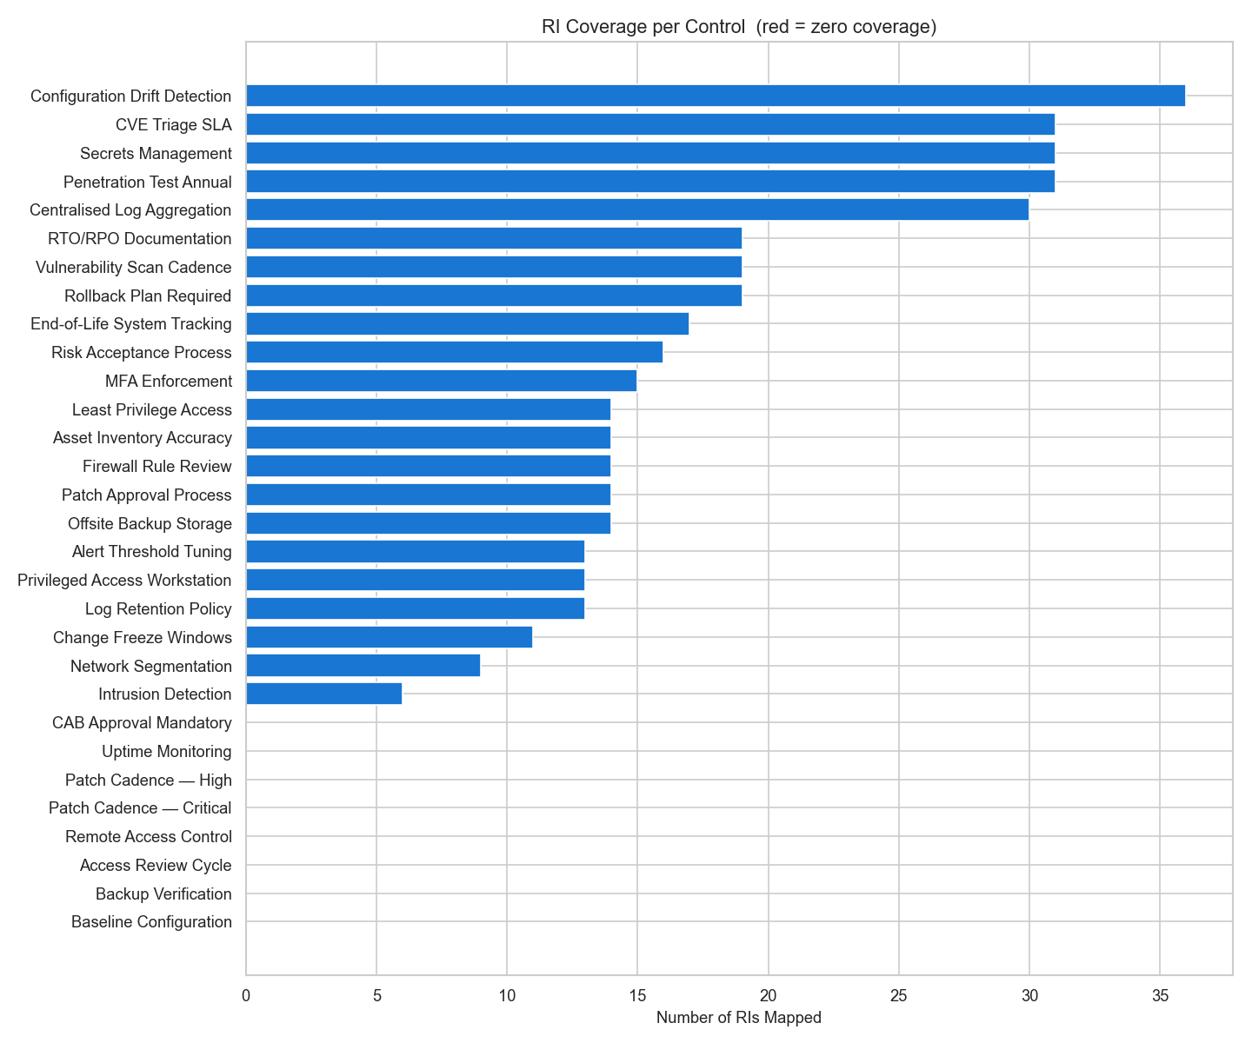
Control Coverage Gaps
8 controls with ZERO RI coverage:
CTL-003 Access Review Cycle (Access Mgmt)
CTL-005 Patch Cadence – Critical (Patch Mgmt)
CTL-006 Patch Cadence – High (Patch Mgmt)
CTL-012 Uptime Monitoring (Logging & Monitoring)
CTL-016 Remote Access Control (Network Security)
CTL-017 Backup Verification (Backup & Recovery)
CTL-020 Baseline Configuration (Config Mgmt)
CTL-025 CAB Approval Mandatory (Change Control)

Slide 6
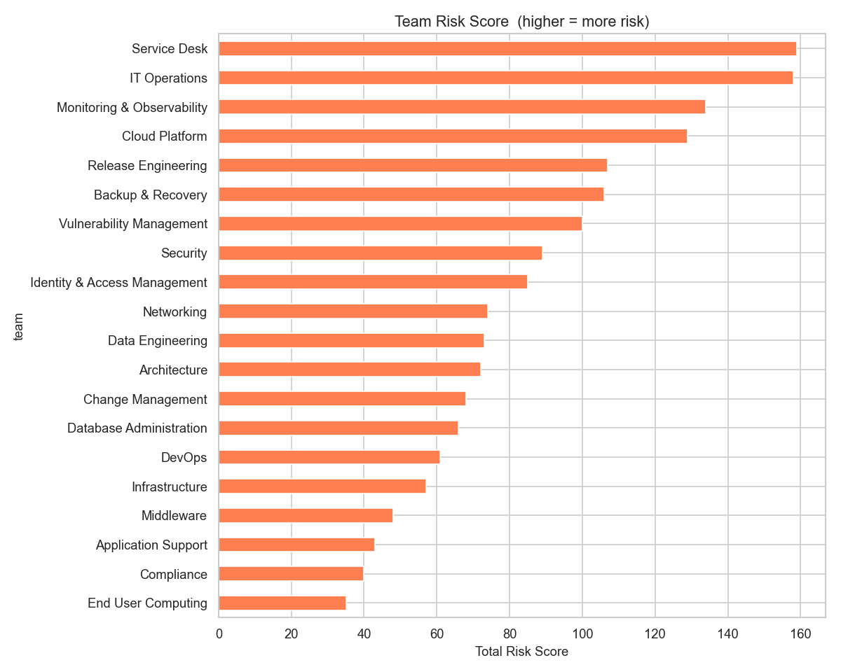
Team Risk Ranking
Rank | Team | Risk Score
1 | Service Desk | 159
2 | IT Operations | 158
3 | Monitoring & Observability | 134
4 | Cloud Platform | 129
5 | Release Engineering | 107
Score formula: (incidents×1) + (severity×2) + (open RIs×3) + (control gaps×4)

Slide 7
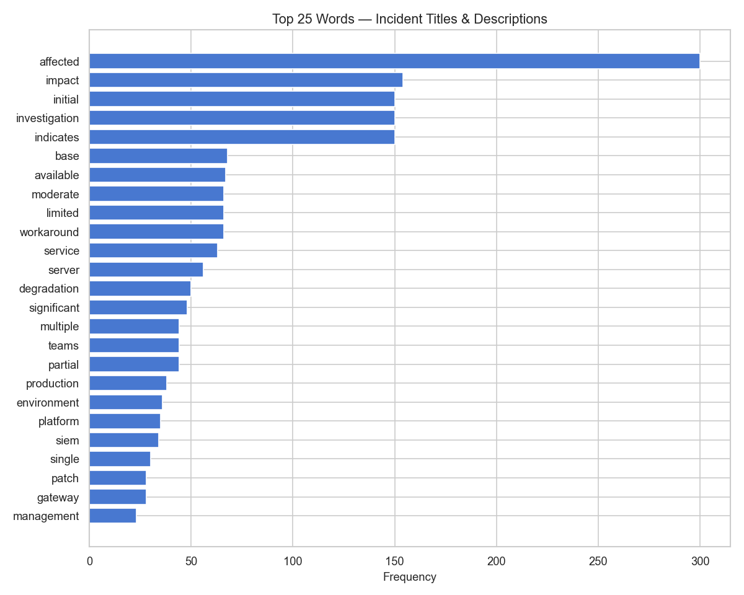
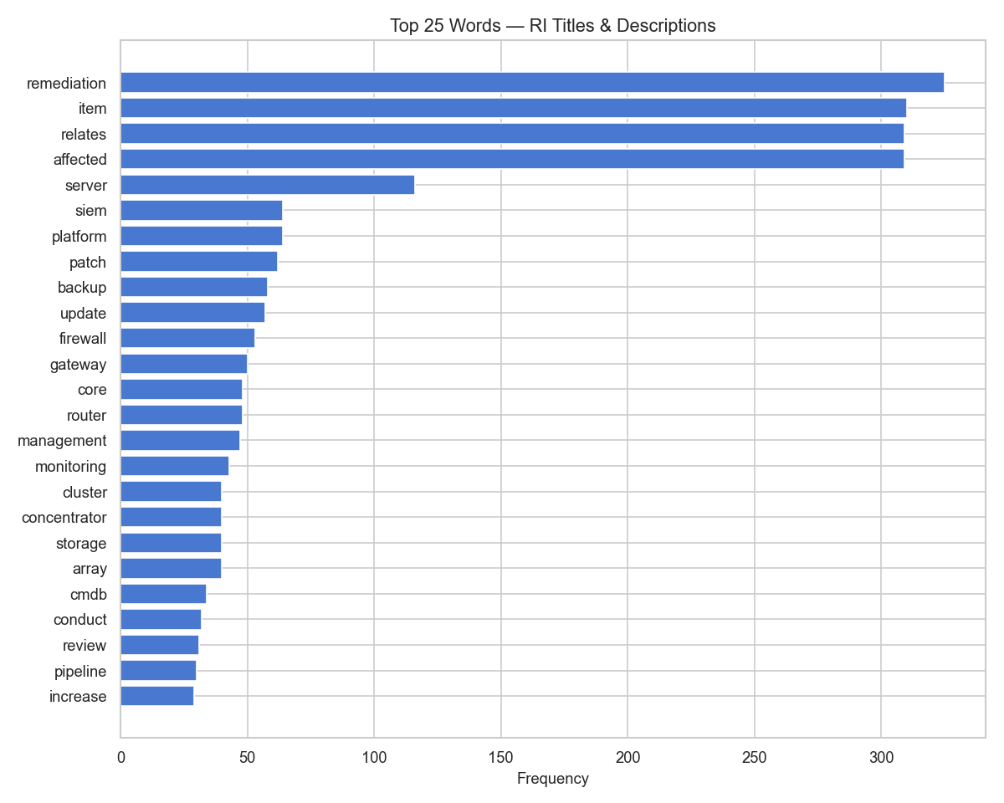
Recurring Themes in Incidents & RIs
Incident titles & descriptions
Remediation item text
💡 Top themes — 'affected', 'impact', 'investigation' — suggest most incidents are reactive. Proactive prevention measures may reduce volume.

Slide 8
Recommendations
01
02
Close zero-coverage control gaps
Prioritise Service Desk & IT Operations
Create targeted RIs for all 8 controls with zero coverage — especially CTL-017 (Backup Verification) and CTL-025 (CAB Approval), which pose the highest operational risk.
These teams hold the top two risk scores (159, 158). Schedule a rapid review of open RIs and assign dedicated resource to drive closure before next reporting cycle.
03
04
Reduce open RI backlog (49% open)
Shift from reactive to proactive posture
Nearly half of all RIs are open. Introduce a weekly triage cadence to identify blockers and push stale items to closure or formal acceptance.
Recurring themes ('investigation', 'impact') indicate a reactive culture. Invest in monitoring & alerting automation and pre-emptive patching to reduce incident volume.

Slide 9
Next Steps
Assign owners to zero-coverage controls (Week 1)
Service Desk & IT Ops risk review meeting (Week 1)
Introduce weekly RI triage cadence (Week 2)
Re-run analysis monthly to track improvement (Ongoing)
Questions? Contact the Risk & Compliance team.

