Slide 1
Project CheckPoint 3

Slide 2
We finish:
Split large file into small chunks and upload to different chunk server (depend on the remaining storage of the chunk server).
The address of each chunk is kept by a .json file.
The master server also process a content page for the large file.

Slide 3
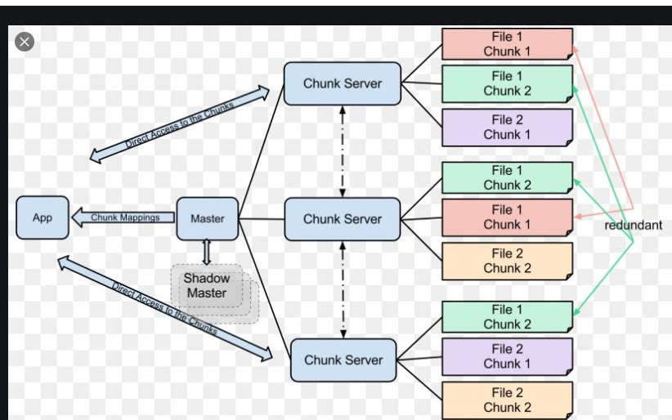
Our Architecture

Slide 4
Fault Tolerance (Will be implemented later)
Election mechanism -- select new master when current fails.
Vice master mechanism -- select the vice master to keep the master table’s replica

