Slide 1
Enhancing Ile-de-France Agent-Based Model Automotive Fleet Projection and Low Emissions Zone Model
Pierre Michel, Azise Oumar Diallo, Alexandre Chasse & Guoxi Feng
IFP Energies nouvelles
MATSim User Meeting
June 17, 2024

Slide 2
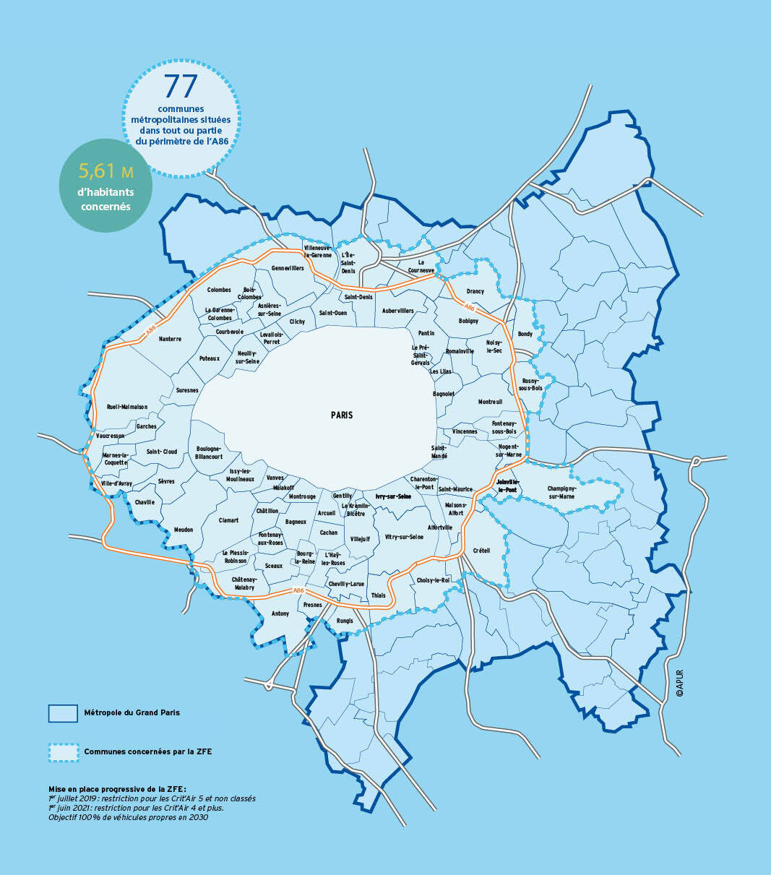
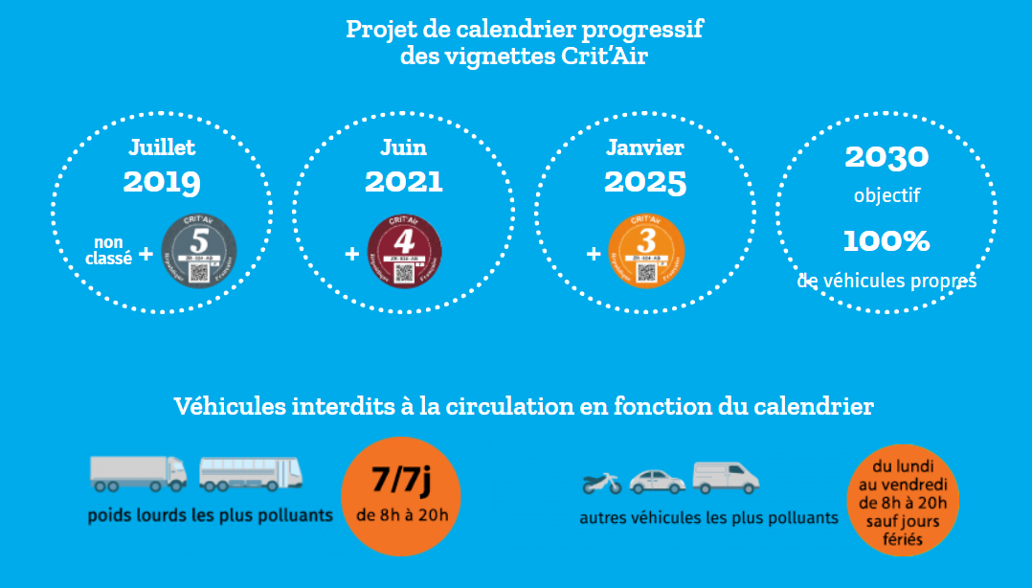
Context
In France, cities where pollutant emissions thresholds defined by WHO are exceeded must implement a Low Emission Zone (LEZ)
In Paris, the LEZ legislation includes
a perimeter and times slots where vehicles circulation is restricted,
a schedule for future restrictions,
and exemptions.
The classification of vehicles in LEZ is determined by the Crit’Air system, which itself is based on the vehicle's Euro emission standard
Next vehicles restrictions is C3 in 2025
The next restriction will affect some or all vehicles classified as C2 with C2 including all diesel vehicles
2030 objective of 100% of clean vehicles should be specified
*https://www.zonefaiblesemissionsmetropolitaine.fr/

Slide 3
Introduction
2022
Crit’Air 4 and 5 restrictions
Objective: evaluate the pollutant emissions reduction from various prospective scenarios of people's compliance with the Low Emission Zone (LEZ) until 2030
A restrictions schedule until 2030 is considered : very optimistic for improving air quality and very restrictive in terms of vehicles restrictions.
An evolution of the automotive fleet until 2030 methodology is introduced.
MATSim coupled with HEBFA is used to calculate vehicle pollutant and GHG emissions.
Several scenarios are defined and evaluated to quantify the impact of individuals adaptation to the LEZ such as switching to authorized vehicles and modal shift towards public transportation.
Modeled schedule of
light vehicles restrictions
2025
Crit’Air 3, 4 and 5 restrictions
2027 ➔ End of diesel
Crit’Air 2 to 5 restrictions
2030 ➔ End of combustion engine
Crit’Air 1 to 5 restrictions

Slide 4
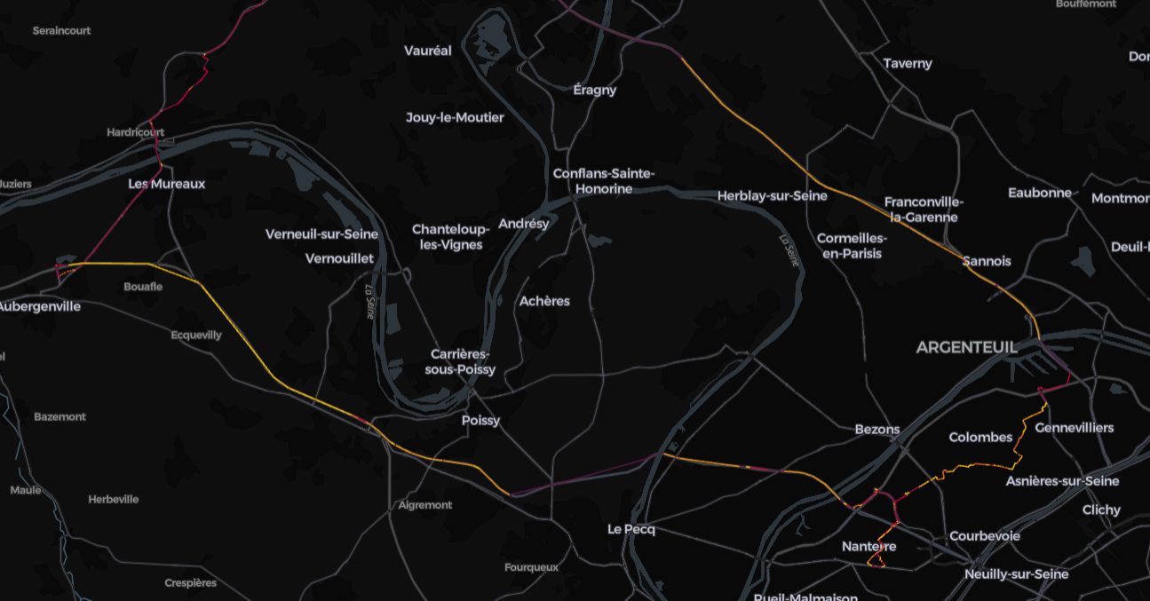
Simulation Framework
Tools and outputs
Eqasim generates Ile-de-France* population, travel demand and light vehicle fleet
The approach allows to assign a vehicle to each agent while retaining an age and energy distribution
MATSim to model agent vehicle use and simulate change of behavior with the LEZ
MATSim emissions contribution coupled with HEFBA to calculate pollutant (NO_{X} and particles) and GHG (CO₂e) emissions simulation with HBEFA factors
eqasim
IdF population
IdF trave demand
MATSim
Agent displacements
Agent LEZ behavior
Emissions contribution
NO_{X} and particles pollutant emissions
GHG (CO₂e) emissions
Vehicle fleet
Road network
*Hörl, S. and M. Balac (2021) Synthetic population and travel demand for Paris and Île-de-France based on open and publicly available data, Transportation Research Part C, 130, 103291.
NO_{X} emissions for one agent vehicle from MATSim

Slide 5
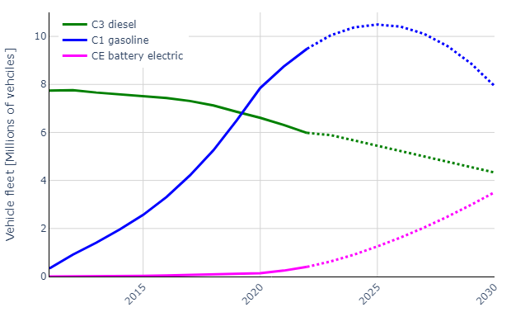
Fleet generation in 2022 and projection until 2030
The current fleet is defined using vehicle registration open-data* in France
Definition of a local projection methodology until 2030:
for each fuel type including petrol, diesel, electric, diesel hybrid, petrol hybrid, and plug-in hybrid
and for each Crit’Air sticker
a projection of the vehicle fleet is conducted using a least squares method to model the trend that best predicts the fleet after 2022 based on French vehicle fleet open-data (SDES data)
Several trends are defined
Linear decrease for all diesel vehicles
Linear decrease for all Crit’Air 2 petrol vehicles
Parabolic trend for Crit’Air 1 petrol vehicles
Exponential growth for Crit’Air 1 PHEVs
Exponential growth for Crit’Air E BEVs
*https://www.statistiques.developpement-durable.gouv.fr/donnees-sur-le-parc-automobile-francais-au-1er-janvier-2023

Slide 6
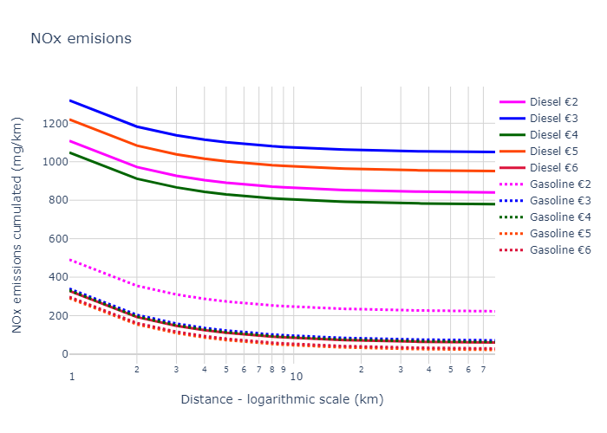
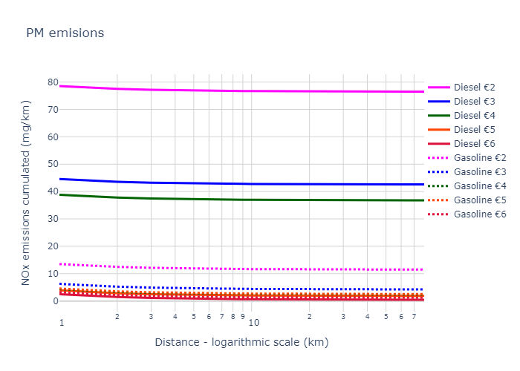
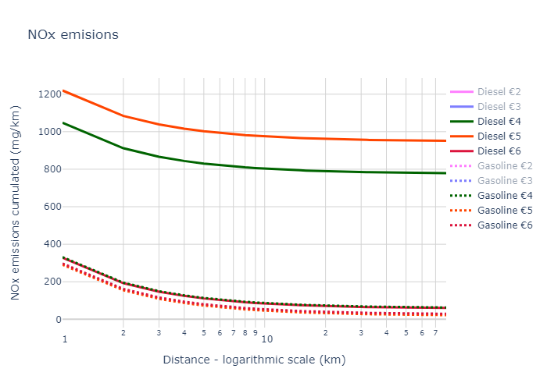
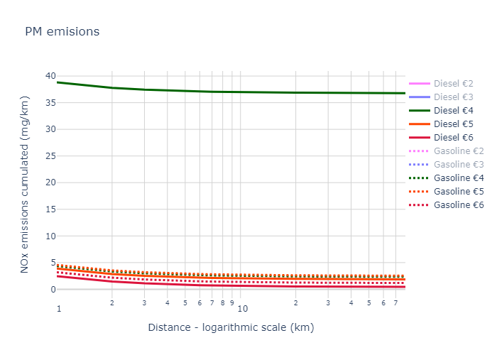

Modeling emissions using HBEFA emission factors
Diesel vehicles particles emissions are higher than gasoline vehicles before €5
In 2025 Crit’Air 3 vehicles restrictions corresponding to diesel €4 vehicles
➔important particles reduction
Diesel vehicles NO_{X} emissions are higher than gasoline vehicles before €6
When diesel vehicles €2 should be restricted in the LEZ?
➔important NO_{X} reduction
 | Crit’Air 1 | Crit’Air 2 | Crit’Air 3 | Crit’Air 4 | Crit’Air 5 | Non-classified
LEZ year | ? (2030) | ? (2027) | 2025 | 2021 | 2019
Gasoline | Euro 5 & 6 | Euro 4 | Euro 2 & 3 |  |  | Euro 1 and older
Diesel |  | Euro 5 & 6 | Euro 4 | Euro 3 | Euro 2 | Euro 1 and older

Slide 7
Scenarios definitions
3 scenarios
A reference simulation is performed without LEZ modeling to quantify the impact of natural fleet evolution on emission
➔Agents impacted by the LEZ are identified i.e., individuals using vehicles banned from circulation in the LEZ area in the reference simulation
Scenarios to model and evaluate emissions impact of changes in individuals' mobility behavior in the face of the implementation of measures restricting the use of private cars, such as the LEZ
➔Different behaviors exist for an agent to adapt himself to the LEZ, with some proportions hypothesis
Maintain the trip with another vehicle not affected by the restrictions (40% of impacted agents)
Switch to public transport (30% of impacted agents)
Switch to other modes, change their route to circumvent the LEZ, abandon the trip or commit fraud
Reference
Natural fleet evolution
Switch to PT
Vehicle change
LEZ impacted agent identification
Switching agents to public transports identified
Vehicle reassignments to a compliant vehicle in LEZ

Slide 8
LEZ impacted Agents switching to public transport
Objective of shifting 30% of the individuals impacted by the Low Emission Zone (LEZ) towards public transportation
identification of individuals based on trips likely to be made using public transportation.
Ratio between public transportation and car travel durations lower than 2.4 for home <-> work commuting trips
Rejection of individuals whose travel time by public transportation exceeds the 95th percentile, which is 1 hour and 38 minutes (on average 46 minutes in the Île-de-France region)
 | Agents switching to PT [thousands] | PT modal share [%] | PT modal share relative increase [%]
2022 | 29 | 20,26 | 1,1
2025 | 82 | 20,67 | 3,1
2027 | 208 | 21,65 | 7,9
2030 | 473 | 23,63 | 17,9

Slide 9
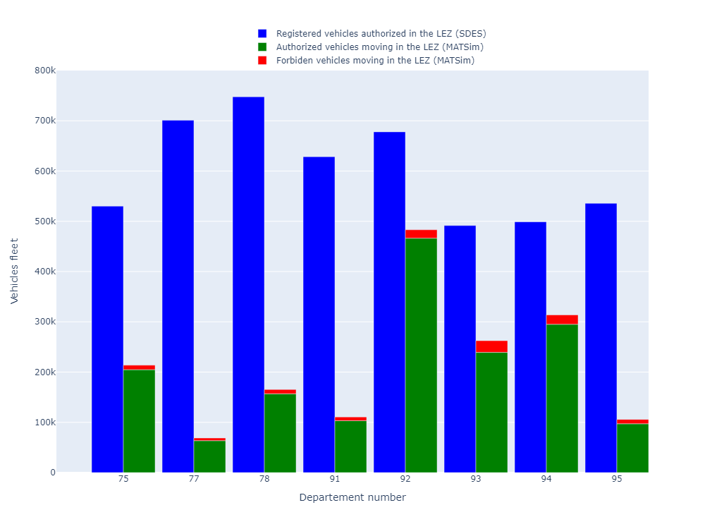
LEZ impacted agents prohibited vehicles reassignment
2025 vehicle reassignment example
Once LEZ impacted agents are identified, non-compliant vehicles are replaced based on ZFE-m compliant engine technologies distribution in each department
LEZ compliant vehicle stocks (blue bars) are checked to ensure that reassigned vehicles (red bars) are physically available for agents.
Reassignments in 2022 and 2025 are straightforward with sufficient vehicles available.
Reassignments in 2027 are sensible because all vehicles available in the stock are allocated to the agents
2030 reassignment is a theoretical case with a shortage of vehicles because only electric vehicles are considered

Slide 10
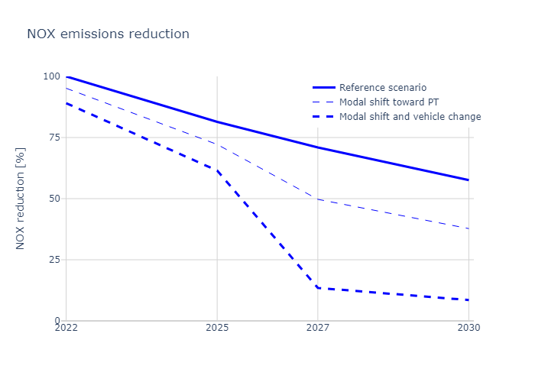
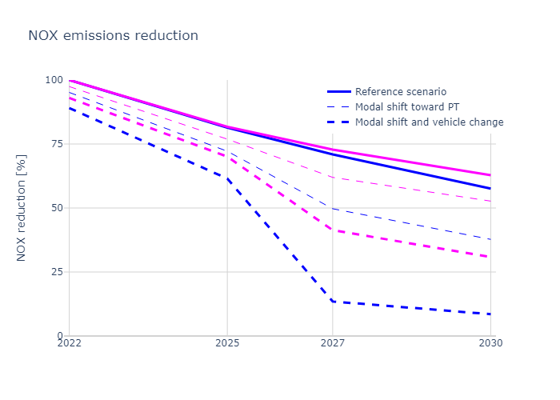
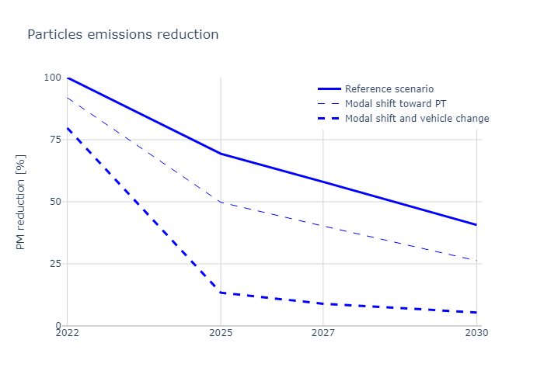
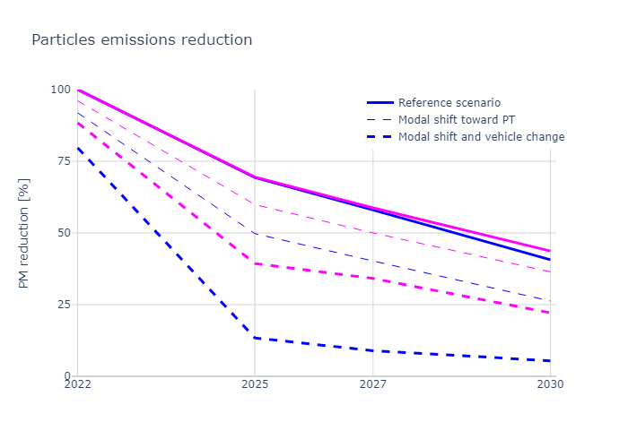
Results
In the LEZ perimeter, natural evolution of the vehicle fleet reduces NO_{X} and particles emissions by about respectively 5% and 6% per year
LEZ implementation achieve important pollutant emissions reduction especially
Particles emissions in 2025 when the circulation of Crit'Air 3 vehicles is banned
NO_{X} emissions in 2027 when the circulation of Crit'Air 2 vehicles is banned
In the Ile-de-France perimeter, same conclusions can be drawn with less significant reductions confirming that the low-emission zone (ZFE) has an important impact on pollution reduction even outside its area of application

Slide 11
Conclusions
3 mains contributions
A phenomenological method to project the future vehicle fleet on a territory
MATSim as a Digital Twin to model each trip performed by a population to calculate emissions by considering the vehicle age and energy source and the trip taken by the vehicles
Simulate prospectives scenarios to analyze the impact of individuals’ adaptation to the LEZ including modal shifts to public transport and vehicle changes to compliant vehicles

Slide 12
Perspectives
MATSim scenario amelioration
For the time horizon, model the population changes and the new public transport lines
Model remaining individuals' adaptation to the LEZ : switch to other modes, change their route to circumvent the LEZ, abandon the trip
Model fraud i.e. trips with non-compliant vehicles
Calculate other transport emissions mainly emitted by
the passenger transport (autocar and bus)
and the merchandises transport (low commercial vehicles and heavy-duty vehicles)
Model other geographic and temporal restrictions
Perform local emissions analysis
Rebound effect in the LEZ periphery

Slide 13



Find us on:
www.ifpenergiesnouvelles.com
@IFPENinnovation

