Slide 1
Metropolis-Hastings based synthesis of all-day round trips from origin-destination matrices and limited population segmentation
Franz-Xaver Rupprecht (1), Georgia Charalampidou (1), Gunnar Flötteröd (2)
(1) Institute of Transport Studies, University of Natural Resources and Life Sciences, Vienna, Austria.
(2) Department of Communication and Transport Systems Linköping University, Sweden
& The Swedish National Road and Transport Research Institute.

Slide 2
Scope
Population synthesis
Travel demand modeling
Traffic assignment
Household
formation, car ownership
Activity scheduling
Socio-demographics
Travel choices: route, mode, time
Primary location choice (home work)
Secondary location choice
MATSim demand generation
MATSim run

Slide 3
Scope
Population synthesis
Travel demand modeling
Traffic assignment
Gigantic joint distribution P(socio-demographics,
choices upstream of MATSim)
Household
formation, car ownership
Activity scheduling
Socio-demographics
Travel choices: route, mode, time
Primary location choice (home work)
Secondary location choice (all other)
MATSim demand generation
MATSim run

Slide 4
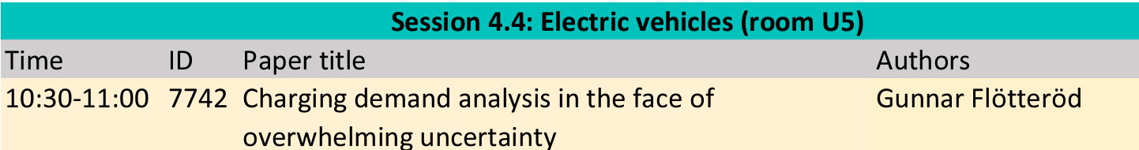
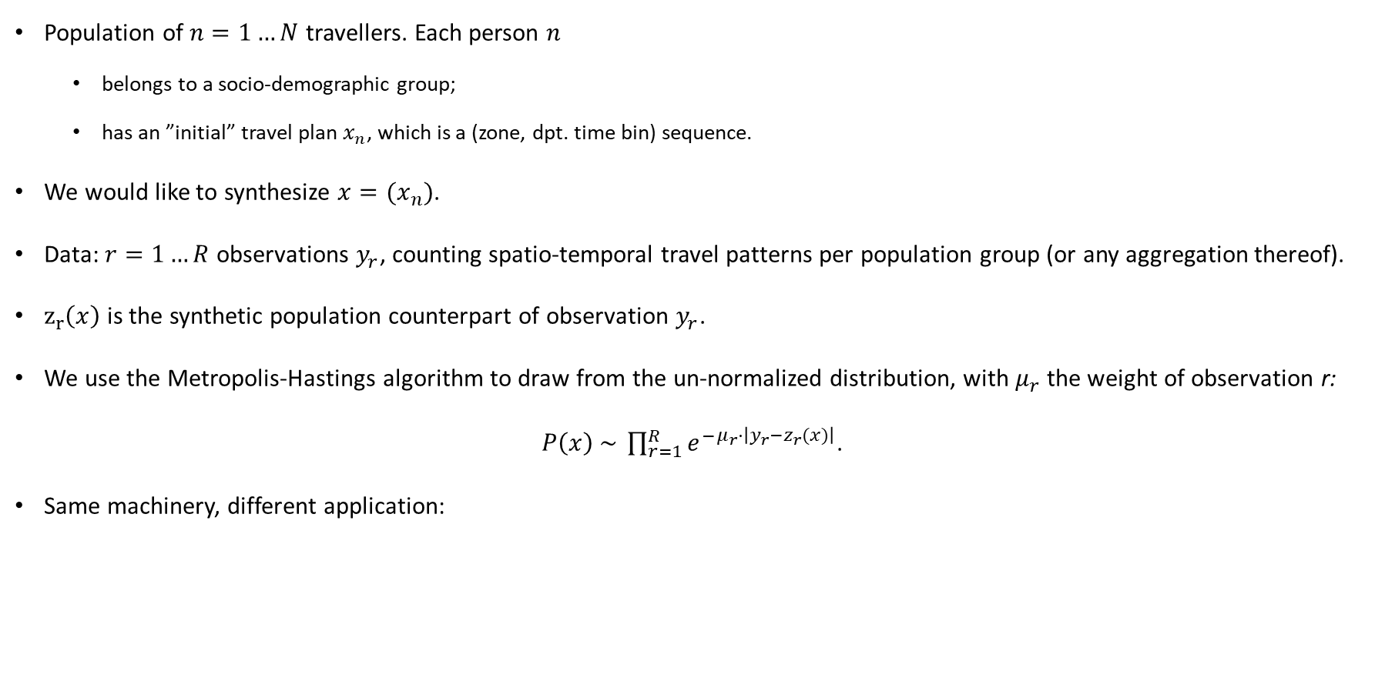
Framework
Population of $n=1…N$ travellers. Each person $n$
belongs to a socio-demographic group;
has an ”initial” travel plan $x_{n}$, which is a (zone, dpt. time bin) sequence.
We would like to synthesize ${x=(x}_{n})$.
Data: $r=1…R$ observations $y_{r}$, counting spatio-temporal travel patterns per population group (or any aggregation thereof).
$z_{r}\left(x\right)$ is the synthetic population counterpart of observation $y_{r}$.
We use the Metropolis-Hastings algorithm to draw from the un-normalized distribution, with $μ_{r}$ the weight of observation r:
$P\left(x\right) \sim \prod_{r=1}^{R}{{e^{−}}^{μ_{r}⋅\left|y_{r}−z_{r}(x)\right|}}$.
Same machinery, different application:

Slide 5
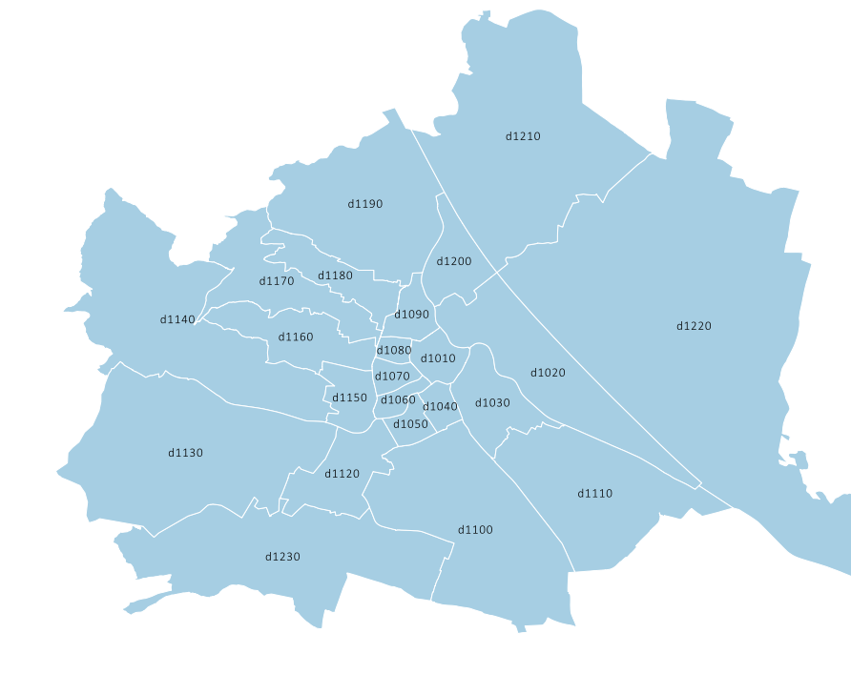
Scenario definition
Spatial resolution: 23 zones
Temporal resolution: 24 hours
Maximum 4 locations visited in one round trip
Synthetic population of car only round-trip makers
(focus more on upstream travel patterns than socio-demographics)
BOKU

Slide 6
Stage 1: Only physical constraints
Round trips shall be completed within 24 hours.
Arrival time shall be before departure time.
Round trips shall be uniformly distributed over the number of visited locations.

Slide 7
Stage 1: Model without behavioural information

Slide 8
Stage 2: Adding OD matrix reproduction
Reproduce static (24 hour) matrix obtained from a Visum model.

Slide 9
Stage 2: Adding OD matrix reproduction

Slide 10
Stage 3: Adding population segmentation and home locations
Reproduce the number of population group members living in each zone.
pop group | lower limit | upper limit | occupation | car access
pop group 06 | 19 years | 35 years | working | yes
pop group 07 | 19 years | 35 years | other | yes
pop group 08 | 35 years | 65 years | working | yes
pop group 09 | 35 years | 65 years | other | yes
pop group 14 | 65 years | no upper limit | not specified | yes

Slide 11
Stage 3: Adding population segmentation and home locations

Slide 12
Stage 4: Adding staying-at-home-over-night condition
Creating a more realistic activity time structure of the population.
Agents shall spend 10 hours between 7 pm and 7 am at their home location.

Slide 13
Stage 4: Adding staying-at-home-over-night condition

Slide 14
Stage 5: Adding work episodes
Data source: Number of working places per zone.
Recall: We know which round trip makers are working.
Workers shall spend 9 hours between 7 am and 7 pm at a work location.

Slide 15
Stage 5: Adding work episodes

Slide 16
Stage 5: Adding work episodes

Slide 17
Summary
General-purpose population sampling machinery using Metropolis Hastings algorithm.
Clear separation of modelling assumptions and sampling realizations.
In hindsight surprisingly simple and flexible machinery.
https://github.com/vtisweden/matsim-projects/tree/master/od2roundtrips
franz.rupprecht@boku.ac.at

Slide 18
Metropolis-Hastings based synthesis of all-day round trips from origin-destination matrices and limited population segmentation
Franz-Xaver Rupprecht (1), Georgia Charalampidou (1), Gunnar Flötteröd (2)
(1) Institute of Transport Studies, University of Natural Resources and Life Sciences, Vienna, Austria.
(2) Department of Communication and Transport Systems Linköping University, Sweden
& The Swedish National Road and Transport Research Institute.

Slide 19
Shares of RT visiting 2, 3 resp. 4 locations

Slide 20
Shares of RT visiting 2, 3 resp. 4 locations
number of visited locations | 2 | 3 | 4
share in the model | 67% | 24% | 11%
share in the ÖU travel survey | 72% | 16% | 8%

Slide 21
Stability of reproduction quality

