Slide 1
Introduction
Chapter 1

Slide 2
Introduction (Slide 1 of 3)
Three developments spurred recent explosive growth in the use of analytical methods in business applications:
First development:
Technological advances—scanner technology, data collection through e-commerce, Internet social networks, and data generated from personal electronic devices—produce incredible amounts of data for businesses.
Businesses want to use these data to improve the efficiency and profitability of their operations, better understand their customers, price their products more effectively, and gain a competitive advantage.

Slide 3
Introduction (Slide 2 of 3)
Three developments spurred recent explosive growth in the use of analytical methods in business applications (cont.):
Second development:
Ongoing research has resulted in numerous methodological developments, including:
Advances in computational approaches to effectively handle and explore massive amounts of data.
Faster algorithms for optimization and simulation.
More effective approaches for visualizing data.

Slide 4
Introduction (Slide 3 of 3)
Three developments spurred recent explosive growth in the use of analytical methods in business applications (cont.):
Third development:
The methodological developments were paired with an explosion in computing power and storage capability.
Better computing hardware, parallel computing, and cloud computing have enabled businesses to solve big problems faster and more accurately than ever before.
Notes:
Cloud computing, the more recent development, is the remote use of hardware and software over the Internet.

Slide 5
Decision Making

Slide 6
Decision Making (Slide 1 of 4)
Managers’ responsibility:
To make strategic, tactical, or operational decisions.
Strategic decisions:
Involve higher-level issues concerned with the overall direction of the organization.
Define the organization’s overall goals and aspirations for the future.

Slide 7
Decision Making (Slide 2 of 4)
Tactical decisions:
Concern how the organization should achieve the goals and objectives set by its strategy.
Are usually the responsibility of midlevel management.
Operational decisions:
Affect how the firm is run from day to day.
Are the domain of operations managers, who are the closest to the customer.

Slide 8
Decision Making (Slide 3 of 4)
Decision making can be defined as the following process:
Identify and define the problem.
Determine the criteria that will be used to evaluate alternative solutions.
Determine the set of alternative solutions.
Evaluate the alternatives.
Choose an alternative.
Notes:
Consider the case of the Thoroughbred Running Company (TRC). Historically, TRC had been a catalog-based retail seller of running shoes and apparel. TRC sales revenue grew quickly as it changed its emphasis from catalog-based sales to Internet-based sales.
Recently, TRC decided that it should also establish retail stores in the malls and downtown areas of major cities. This is a strategic decision that will take the firm in a new direction that it hopes will complement its Internet-based strategy.
TRC middle managers will therefore have to make a variety of tactical decisions in support of this strategic decision, including how many new stores to open this year, where to open these new stores, how many distribution centers will be needed to support the new stores, and where to locate these distribution centers.
Operations managers in the stores will need to make day-to-day decisions regarding, for instance, how many pairs of each model and size of shoes to order
from the distribution centers and how to schedule their sales personnel.

Slide 9
Decision Making (Slide 4 of 4)
Common approaches to making decisions include:
Tradition.
Intuition.
Rules of thumb.
Using the relevant data available.

Slide 10
Business Analytics Defined

Slide 11
Business Analytics Defined (Slide 1 of 2)
Business analytics:
Scientific process of transforming data into insight for making better decisions.
Used for data-driven or fact-based decision making, which is often seen as more objective than other alternatives for decision making.

Slide 12
Business Analytics Defined (Slide 2 of 2)
Tools of business analytics can aid decision making by:
Creating insights from data.
Improving our ability to more accurately forecast for planning.
Helping us quantify risk.
Yielding better alternatives through analysis and optimization.

Slide 13
A Categorization of Analytical Methods and Models
Descriptive Analytics
Predictive Analytics
Prescriptive Analytics

Slide 14
A Categorization of Analytical Methods and Models (Slide 1 of 8)
Descriptive Analytics:
Descriptive analytics: Encompasses the set of techniques that describes what has happened in the past; examples include:
Data queries.
Reports.
Descriptive statistics.
Data visualization (including data dashboards).
Data-mining techniques.
Basic what-if spreadsheet models.
Data query: A request for information with certain characteristics from a database.

Slide 15
A Categorization of Analytical Methods and Models (Slide 2 of 8)
Descriptive Analytics (cont.):
Data dashboards: Collections of tables, charts, maps, and summary statistics that are updated as new data become available.
Uses of dashboards:
To help management monitor specific aspects of the company’s performance related to their decision-making responsibilities.
For corporate-level managers, daily data dashboards might summarize sales by region, current inventory levels, and other company-wide metrics.
Front-line managers may view dashboards that contain metrics related to staffing levels, local inventory levels, and short-term sales forecasts.

Slide 16
A Categorization of Analytical Methods and Models (Slide 3 of 8)
Descriptive Analytics (cont.):
Data mining: The use of analytical techniques for better understanding patterns and relationships that exist in large data sets.
Examples of data-mining techniques include:
Cluster analysis.
Sentiment analysis.

Slide 17
A Categorization of Analytical Methods and Models (Slide 4 of 8)
Predictive Analytics:
Predictive analytics: Consists of techniques that use models constructed from past data to predict the future or ascertain the impact of one variable on another.
Survey data and past purchase behavior may be used to help predict the market share of a new product.

Slide 18
A Categorization of Analytical Methods and Models (Slide 5 of 8)
Predictive Analytics (cont.):
Techniques used in Predictive Analytics include:
Linear regression.
Time series analysis.
Data mining is used to find patterns or relationships among elements of the data in a large database; often used in predictive analytics.
Simulation involves the use of probability and statistics to construct a computer model to study the impact of uncertainty on a decision.
Notes:
Example for Data Mining:
A large grocery store chain might be interested in developing a new targeted marketing campaign that offers a discount coupon on potato chips.
By studying historical point-of-sale data, the store may be able to use data mining to predict which customers are the most likely to respond to an offer on discounted chips by purchasing higher-margin items such as beer or soft drinks in addition to the chips, thus increasing the store’s overall revenue.
Example for Simulation:
Banks often use simulation to model investment and default risk in order to stress-test financial models.
Used in the pharmaceutical industry to assess the risk of introducing a new drug.

Slide 19
A Categorization of Analytical Methods and Models (Slide 6 of 8)
Prescriptive Analytics:
Prescriptive Analytics: Indicates a best course of action to take:
Provide a forecast or prediction, but do not provide a decision.
A forecast or prediction, when combined with a rule, becomes a prescriptive model.
Prescriptive models that rely on a rule or set of rules are often referred to as rule-based models.

Slide 20
A Categorization of Analytical Methods and Models (Slide 7 of 8)
Prescriptive Analytics (cont.):
Model | Field | Purpose
Portfolio models | Finance | Use historical investment return data to determine the mix of investments that yield the highest expected return while controlling or limiting exposure to risk.
Supply network design models | Operations | Provide the cost-minimizing plant and distribution center locations subject to meeting the customer service requirements.
Price-markdown models | Retailing | Use historical data to yield revenue-maximizing discount levels and the timing of discount offers when goods have not sold as planned.
Optimization models: Models that give the best decision subject to constraints of the situation.

Slide 21
A Categorization of Analytical Methods and Models (Slide 8 of 8)
Prescriptive Analytics (cont.):
Simulation optimization: Combines the use of probability and statistics to model uncertainty with optimization techniques to find good decisions in highly complex and highly uncertain settings.
Decision analysis:
Used to develop an optimal strategy when a decision maker is faced with several decision alternatives and an uncertain set of future events.
Employs utility theory, which assigns values to outcomes based on the decision maker’s attitude toward risk, loss, and other factors.

Slide 22
Big Data
Volume
Velocity
Variety
Veracity

Slide 23
Big Data (Slide 1 of 7)
Big data: Any set of data that is too large or too complex to be handled by standard data-processing techniques and typical desktop software.
IBM describes the phenomenon of big data through the four Vs (as shown in Figure 1.1):
Volume.
Velocity.
Variety.
Veracity.
Notes:
Walmart handles over one million purchase transactions per hour.
Facebook processes more than 250 million picture uploads per day.

Slide 24
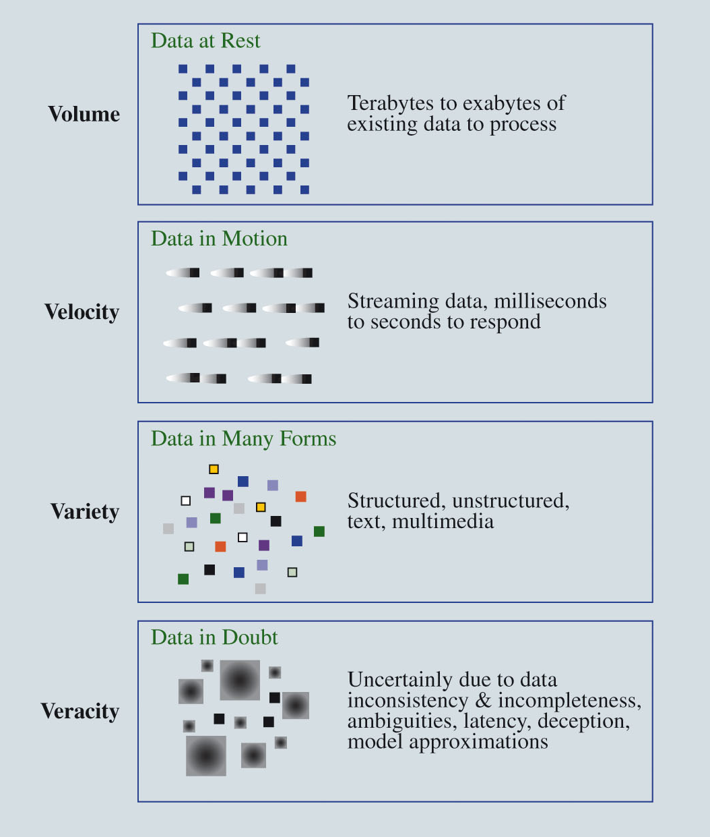
Big Data (Slide 2 of 7)
Figure 1.1: The 4 Vs of Big Data
Source: IBM

Slide 25
Big Data (Slide 3 of 7)
Volume:
Because data are collected electronically, we are able to collect more of it.
To be useful, these data must be stored, and this storage has led to vast quantities of data.
Velocity:
Real-time capture and analysis of data present unique challenges both in how data are stored and the speed with which those data can be analyzed for decision making.

Slide 26
Big Data (Slide 4 of 7)
Variety:
More complicated types of data are now available and are proving to be of great value to businesses.
Text data are collected by monitoring what is being said about a company’s products or services on social media platforms.
Audio data are collected from service calls.
Video data are collected by in-store video cameras and used to analyze shopping behavior.
Analyzing information generated by these nontraditional sources is more complicated in part because of the processing required to transform the data into a numerical form that can be analyzed.

Slide 27
Big Data (Slide 5 of 7)
Veracity:
Veracity has to do with how much uncertainty is in the data.
Inconsistencies in units of measure and the lack of reliability of responses in terms of bias also increase the complexity of the data.

Slide 28
Big Data (Slide 6 of 7)
Represents opportunities.
Presents challenges in terms of data storage and processing, security, and available analytical talent.
The four Vs have led to new technologies:
Hadoop: An open-source programming environment that supports big data processing through distributed storage and processing on clusters of computers.
MapReduce: A programming model used within Hadoop that performs two major steps: the map step and the reduce step.

Slide 29
Big Data (Slide 7 of 7)
Data security, the protection of stored data from destructive forces or unauthorized users, is of critical importance to companies.
The complexities of the 4 Vs have increased the demand for analysts, but a shortage of qualified analysts has made hiring more challenging.
More companies are searching for data scientists, who know how to process and analyze massive amounts of data.
The Internet of Things (IoT) is the technology that allows data, collected from sensors in all types of machines, to be sent over the Internet to repositories where it can be stored and analyzed.

Slide 30
Business Analytics in Practice
Financial Analytics
Human Resource (HR) Analytics
Marketing Analytics
Health Care Analytics
Supply-Chain Analytics
Analytics for Government and Nonprofits
Sports Analytics
Web Analytics

Slide 31
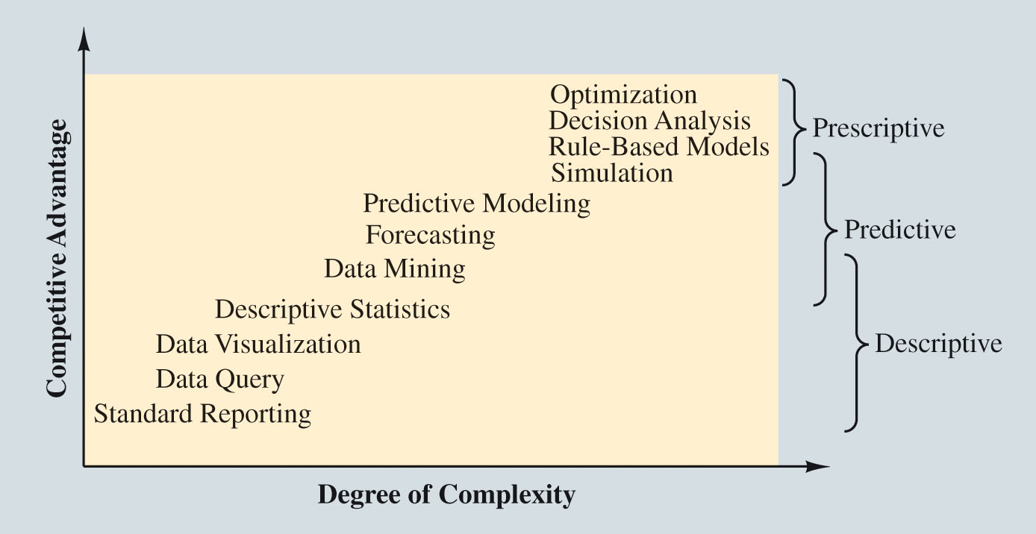
Business Analytics in Practice (Slide 1 of 11)
Figure 1.2: The Spectrum of Business Analytics
Source: Adapted from SAS

Slide 32
Business Analytics in Practice (Slide 2 of 11)
Predictive and prescriptive analytics are sometimes referred to as advanced analytics.
Financial Analytics:
Use of predictive models to:
Forecast financial performance.
Assess the risk of investment portfolios and projects.
Construct financial instruments such as derivatives.
Construct optimal portfolios of investments.
Allocate assets.
Create optimal capital budgeting plans.
Simulation is also often used to assess risk in the financial sector.

Slide 33
Business Analytics in Practice (Slide 3 of 11)
Human Resource (HR) Analytics:
New area of application for analytics.
The HR function is charged with ensuring that the organization:
Has the mix of skill sets necessary to meet its needs.
Is hiring the highest-quality talent and providing an environment that retains it.
Achieves its organizational diversity goals.
Notes:
Example for Human Resource (HR) Analytics:
Google has analyzed substantial data on its own employees to determine the characteristics of great leaders, to assess factors that contribute to productivity, and to evaluate potential new hires.
Google also uses predictive analytics to continually update its forecast of future employee turnover and retention.

Slide 34
Business Analytics in Practice (Slide 4 of 11)
Marketing Analytics:
Marketing is one of the fastest-growing areas for the application of analytics.
A better understanding of consumer behavior through the use of scanner data and data generated from social media has led to an increased interest in marketing analytics.

Slide 35
Business Analytics in Practice (Slide 5 of 11)
Marketing Analytics (cont.):
A better understanding of consumer behavior through marketing analytics leads to:
Better use of advertising budgets.
More effective pricing strategies.
Improved forecasting of demand.
Improved product-line management.
Increased customer satisfaction and loyalty.
Notes:
Example of high-impact marketing analytics:
Automobile manufacturer Chrysler teamed with J.D. Power and Associates to develop an innovate set of predictive models to support its pricing decisions for automobiles.
These models help Chrysler to better understand the ramifications of proposed pricing structures (a combination of manufacturer’s suggested retail price, interest rate offers, and rebates) and, as a result, to improve its pricing decisions.
The models have generated an estimated annual savings of $500 million.

Slide 36
Business Analytics in Practice (Slide 6 of 11)
Health Care Analytics:
Descriptive, predictive, and prescriptive analytics are used to improve:
Patient, staff, and facility scheduling.
Patient flow.
Purchasing.
Inventory control.
Use of prescriptive analytics for diagnosis and treatment may prove to be the most important application of analytics in health care.
Notes:
Example for use of prescriptive analytics for diagnosis and treatment:
Working with the Georgia Institute of Technology, Memorial Sloan-Kettering Cancer Center developed a real-time prescriptive model to determine the optimal placement of radioactive seeds for the treatment of prostate cancer.
Using the new model, 20–30% fewer seeds are needed, resulting in a faster and less invasive procedure.

Slide 37
Business Analytics in Practice (Slide 7 of 11)
Supply-Chain Analytics:
The core service of companies such as UPS and FedEx is the efficient delivery of goods, and analytics has long been used to achieve efficiency.
The optimal sorting of goods, vehicle and staff scheduling, and vehicle routing are all key to profitability for logistics companies such as UPS and FedEx.
Companies can benefit from better inventory and processing control and more efficient supply chains.
Notes:
Example for supply chain analytics:
ConAgra Foods uses predictive and prescriptive analytics to better plan capacity utilization by incorporating the inherent uncertainty in commodities pricing.
ConAgra realized a 100% return on its investment in analytics in under three months—an unheard of result for a major technology investment.

Slide 38
Business Analytics in Practice (Slide 8 of 11)
Analytics for Government and Nonprofits:
Analytics for government to:
Drive out inefficiencies.
Increase the effectiveness and accountability of programs.
Analytics for nonprofit agencies to ensure their effectiveness and accountability to their donors and clients.
Notes:
Example of analytics for government agencies:
The New York State Department has worked with IBM to use prescriptive analytics in the development of a more effective approach to tax collection. The result was an increase in collections from delinquent payers of $83 million over two years.
Example of analytics for nonprofit agencies:
Catholic Relief Services (CRS) is the official international humanitarian agency of the U.S. Catholic community. The CRS mission is to provide relief for the victims of both natural and human-made disasters and to help people in need around the world through its health, educational, and agricultural programs.
CRS uses an analytical spreadsheet model to assist in the allocation of its annual budget based on the impact that its various relief efforts and programs will have in different countries.

Slide 39
Business Analytics in Practice (Slide 9 of 11)
Sports Analytics
Professional sports teams use to:
Assess players for the amateur drafts.
Decide how much to offer players in contract negotiations.
Professional motorcycle racing teams use sophisticated optimization for gearbox design to gain competitive advantage.
Teams use to assist with on-field decisions such as which pitchers to use in various games of a MLB playoff series.

Slide 40
Business Analytics in Practice (Slide 10 of 11)
Sports Analytics (cont.):
The use of analytics for off-the-field business decisions is increasing rapidly.
Using prescriptive analytics, franchises across several major sports dynamically adjust ticket prices throughout the season to reflect the relative attractiveness and potential demand for each game.

Slide 41
Business Analytics in Practice (Slide 11 of 11)
Web Analytics:
The analysis of online activity, which includes, but is not limited to, visits to web sites and social media sites such as Facebook and LinkedIn.
Leading companies apply descriptive and advanced analytics to data collected in online experiments to determine the best way to:
Configure web sites.
Position ads.
Utilize social networks for the promotion of products and services.
Notes:
Online experimentation involves exposing various subgroups to different versions of a web site and tracking the results.
Because of the massive pool of Internet users, experiments can be conducted without risking the disruption of the overall business of the company.
Such experiments are proving to be invaluable because they enable the company to use trial-and-error in determining statistically what makes a difference in their web site traffic and sales.

Slide 42
Extraction, transformation, and loading (ETL)
Traditionally ETL is a data warehouse process that extracts information from internal and external databases, transforms the information using a common set of enterprise definitions, and loads the information into a data warehouse.

Slide 43
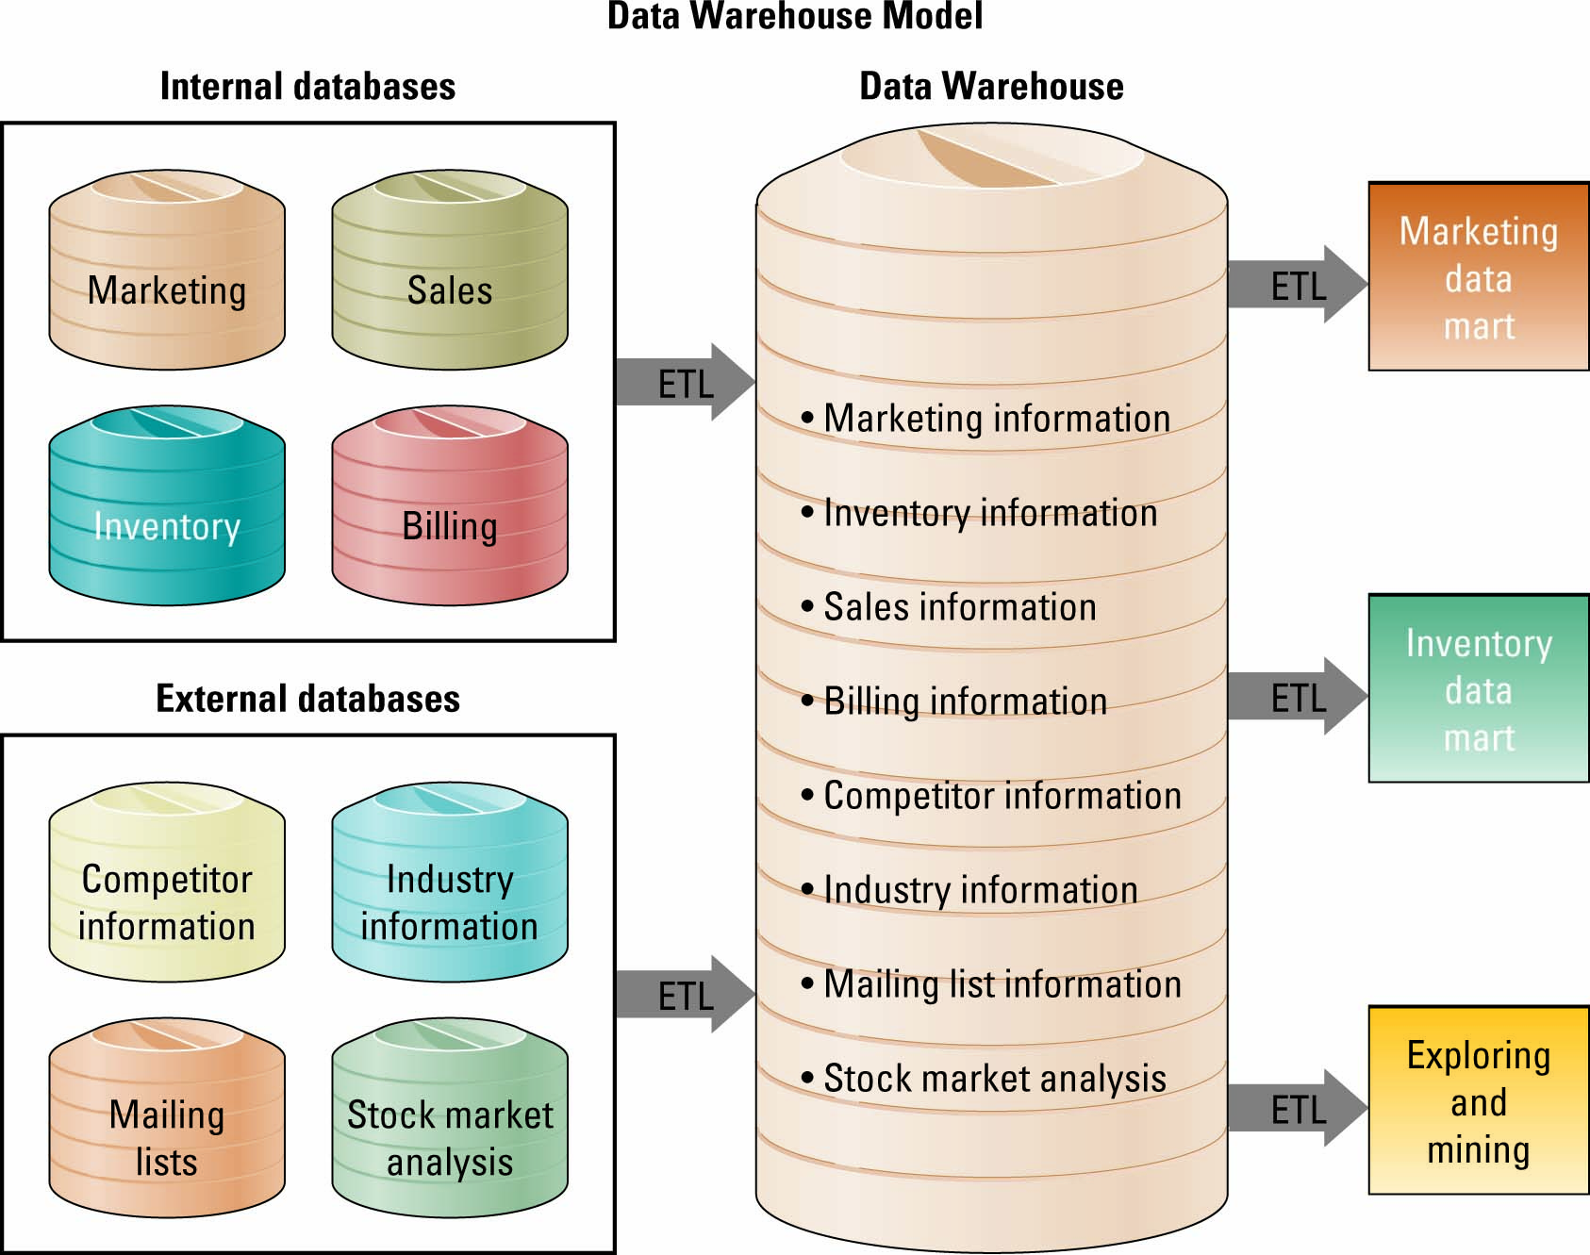
Data Warehouse

