Slide 1
Predictive Data Mining
Chapter 9

Slide 2
Introduction (Slide 1 of 2)
An observation, or record, is the set of recorded values of variables associated with a single entity.
Supervised learning: Data mining methods for predicting an outcome based on a set of input variables, or features.
Supervised learning can be used for:
Estimation of a continuous outcome.
Classification of a categorical outcome.
Notes:
Data Sampling: Extract a sample of data that is relevant to the business problem under consideration.
Data Preparation: Manipulate the data to put it in a form suitable for formal modeling.
Data Partitioning: Divide the sample data into three sets for the training, validation, and testing of the data mining algorithm performance.
Model Construction: Apply the appropriate data mining technique (e.g., k-nearest neighbors, regression trees) to the training data set to accomplish the desired data mining task (classification or estimation).
Model Assessment: Evaluate models by comparing performance on the training and validation data sets.

Slide 3
Introduction (Slide 2 of 2)
The data mining process comprises the following steps:
Data sampling.
Data preparation.
Data partitioning.
Model construction.
Model assessment.

Slide 4
Data Sampling, Preparation, and Partitioning

Slide 5
Data Sampling, Preparation, and Partitioning (Slide 1 of 4)
When dealing with large volumes of data, best practice is to extract a representative sample for analysis.
A sample is representative if the analyst can make the same conclusions from it as from the entire population of data.
The sample of data must be large enough to contain significant information, yet small enough to be manipulated quickly.
Data mining algorithms typically are more effective given more data.

Slide 6
Data Sampling, Preparation, and Partitioning (Slide 2 of 4)
When obtaining a representative sample, it is generally best to include as many variables as possible in the sample.
After exploring the data with descriptive statistics and visualization, the analyst can eliminate variables that are not of interest.
Data mining applications deal with an abundance of data that simplifies the process of assessing the accuracy of data-based estimates of variable effects.

Slide 7
Data Sampling, Preparation, and Partitioning (Slide 3 of 4)
Model overfitting occurs when the analyst builds a model that does a great job of explaining the sample of data on which it is based, but fails to accurately predict outside the sample data.
We can use the abundance of data to guard against the potential for overfitting by decomposing the data set into three partitions:
The training set.
The validation set.
The test set.

Slide 8
Data Sampling, Preparation, and Partitioning (Slide 4 of 4)
Training set: Consists of the data used to build the candidate models.
Validation set: The data set to which the promising subset of models is applied to identify which model is the most accurate at predicting observations that were not used to build the model.
Test set: The data set to which the final model should be applied to estimate this model’s effectiveness when applied to data that have not been used to build or select the model.
Notes:
A training set may be used to estimate the slope coefficients in a multiple regression model.
If the validation set is used to identify a “best” model through either comparison with other models or the turning of model parameters, then the estimates of model performance are biased (we tend to overestimate performance).

Slide 9
Performance Measures
Evaluating the Classification of Categorical Outcomes
Evaluating the Estimation of Continuous Outcomes

Slide 10
Performance Measures (Slide 1 of 19)
Evaluating the Classification of Categorical Outcomes:
By counting the classification errors on a sufficiently large validation set and/or test set that is representative of the population, we will generate an accurate measure of the model’s classification performance.
Classification confusion matrix: Displays a model’s correct and incorrect classifications.

Slide 11
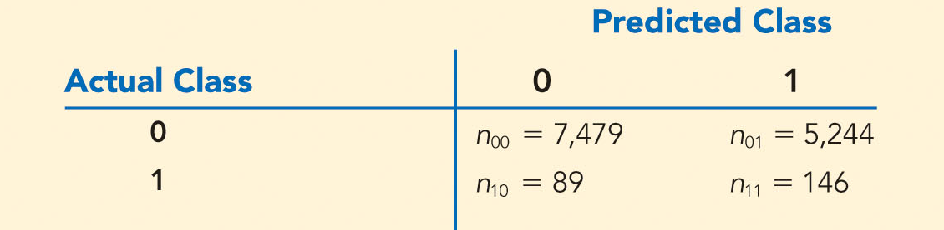
Performance Measures (Slide 2 of 19)
Table 9.1: Confusion Matrix
Many measures of classification performance are based on the confusion matrix.
Overall error rate: Percentage of misclassified observations:
Notes:
Table 9.1 illustrates a classification confusion matrix resulting from an attempt to classify the customer observations in a subset of data from the file Optiva.
In this table, Class 1 = loan default and Class 0 = no default.
The classification confusion matrix is a cross-tabulation of the actual class of each observation and the predicted class of each observation.
From the first row of the matrix in Table 9.1, we see that 7,479 observations corresponding to nondefaults were correctly identified and 5,244 actual nondefaults were incorrectly classified as loan defaults.
From the second row, we observe that 89 actual loan defaults were incorrectly classified as nondefaults, whereas 146 observations corresponding to loan defaults were correctly identified.

Slide 12
Performance Measures (Slide 3 of 19)
Evaluating the Classification of Categorical Outcomes (cont.):
One minus the overall error rate is often referred to as the accuracy of the model.
While overall error rate conveys an aggregate measure of misclassification, it counts as misclassifying an actual Class 0 observation as a Class 1 observation (a false positive) the same as misclassifying an actual Class 1 observation as a Class 0 observation (a false negative).

Slide 13
Performance Measures (Slide 4 of 19)
Evaluating the Classification of Categorical Outcomes (cont.):
To account for the asymmetric costs in misclassification, we define the error rate with respect to the individual classes:
Class 1 error rate =
Class 0 error rate =
Cutoff value: Probability value used to understand the tradeoff between Class 1 error rate and Class 0 error rate.
Notes:
Most classification algorithms first estimate an observation’s probability of Class 1 membership and then classify the observation into Class 1 if this probability meets or exceeds a specified cutoff value (the default cutoff value is 0.5).
The choice of cutoff value affects the type of classification error.
As we decrease the cutoff value, more observations will be classified as Class 1, thereby increasing the likelihood that a Class 1 observation will be correctly classified as Class 1; that is, Class 1 error will decrease.
However, as a side effect, more Class 0 observations will be incorrectly classified as Class 1; that is, Class 0 error will rise.

Slide 14
Performance Measures (Slide 5 of 19)
Table 9.2: Classification Probabilities
Actual Class | Probability of Class 1 | Actual Class | Probability of Class 1
1 | 1.00 | 0 | 0.66
1 | 1.00 | 0 | 0.65
0 | 1.00 | 1 | 0.64
1 | 1.00 | 0 | 0.62
0 | 1.00 | 0 | 0.60
0 | 0.90 | 0 | 0.51
1 | 0.90 | 0 | 0.49
0 | 0.88 | 0 | 0.49
0 | 0.88 | 1 | 0.46
1 | 0.88 | 0 | 0.46
Notes:
To demonstrate how the choice of cutoff value affects classification error, Table 9.2 shows a list of 50 observations (11 of which are actual Class 1 members) and an estimated probability of Class 1 membership produced by the classification algorithm.

Slide 15
Performance Measures (Slide 6 of 19)
Table 9.2: Classification Probabilities (cont.)
Actual Class | Probability of Class 1 | Actual Class | Probability of Class 1
0 | 0.87 | 1 | 0.45
0 | 0.87 | 1 | 0.45
0 | 0.87 | 0 | 0.45
0 | 0.86 | 0 | 0.44
1 | 0.86 | 0 | 0.44
0 | 0.86 | 0 | 0.30
0 | 0.86 | 0 | 0.28
0 | 0.85 | 0 | 0.26
0 | 0.84 | 1 | 0.24
0 | 0.84 | 0 | 0.22
Notes:
To demonstrate how the choice of cutoff value affects classification error, Table 9.2 shows a list of 50 observations (11 of which are actual Class 1 members) and an estimated probability of Class 1 membership produced by the classification algorithm.

Slide 16
Performance Measures (Slide 7 of 19)
Table 9.2: Classification Probabilities (cont.)
Actual Class | Probability of Class 1 | Actual Class | Probability of Class 1
0 | 0.83 | 0 | 0.21
0 | 0.68 | 0 | 0.04
0 | 0.67 | 0 | 0.04
0 | 0.67 | 0 | 0.01
0 | 0.67 | 0 | 0.00
Notes:
To demonstrate how the choice of cutoff value affects classification error, Table 9.2 shows a list of 50 observations (11 of which are actual Class 1 members) and an estimated probability of Class 1 membership produced by the classification algorithm.

Slide 17
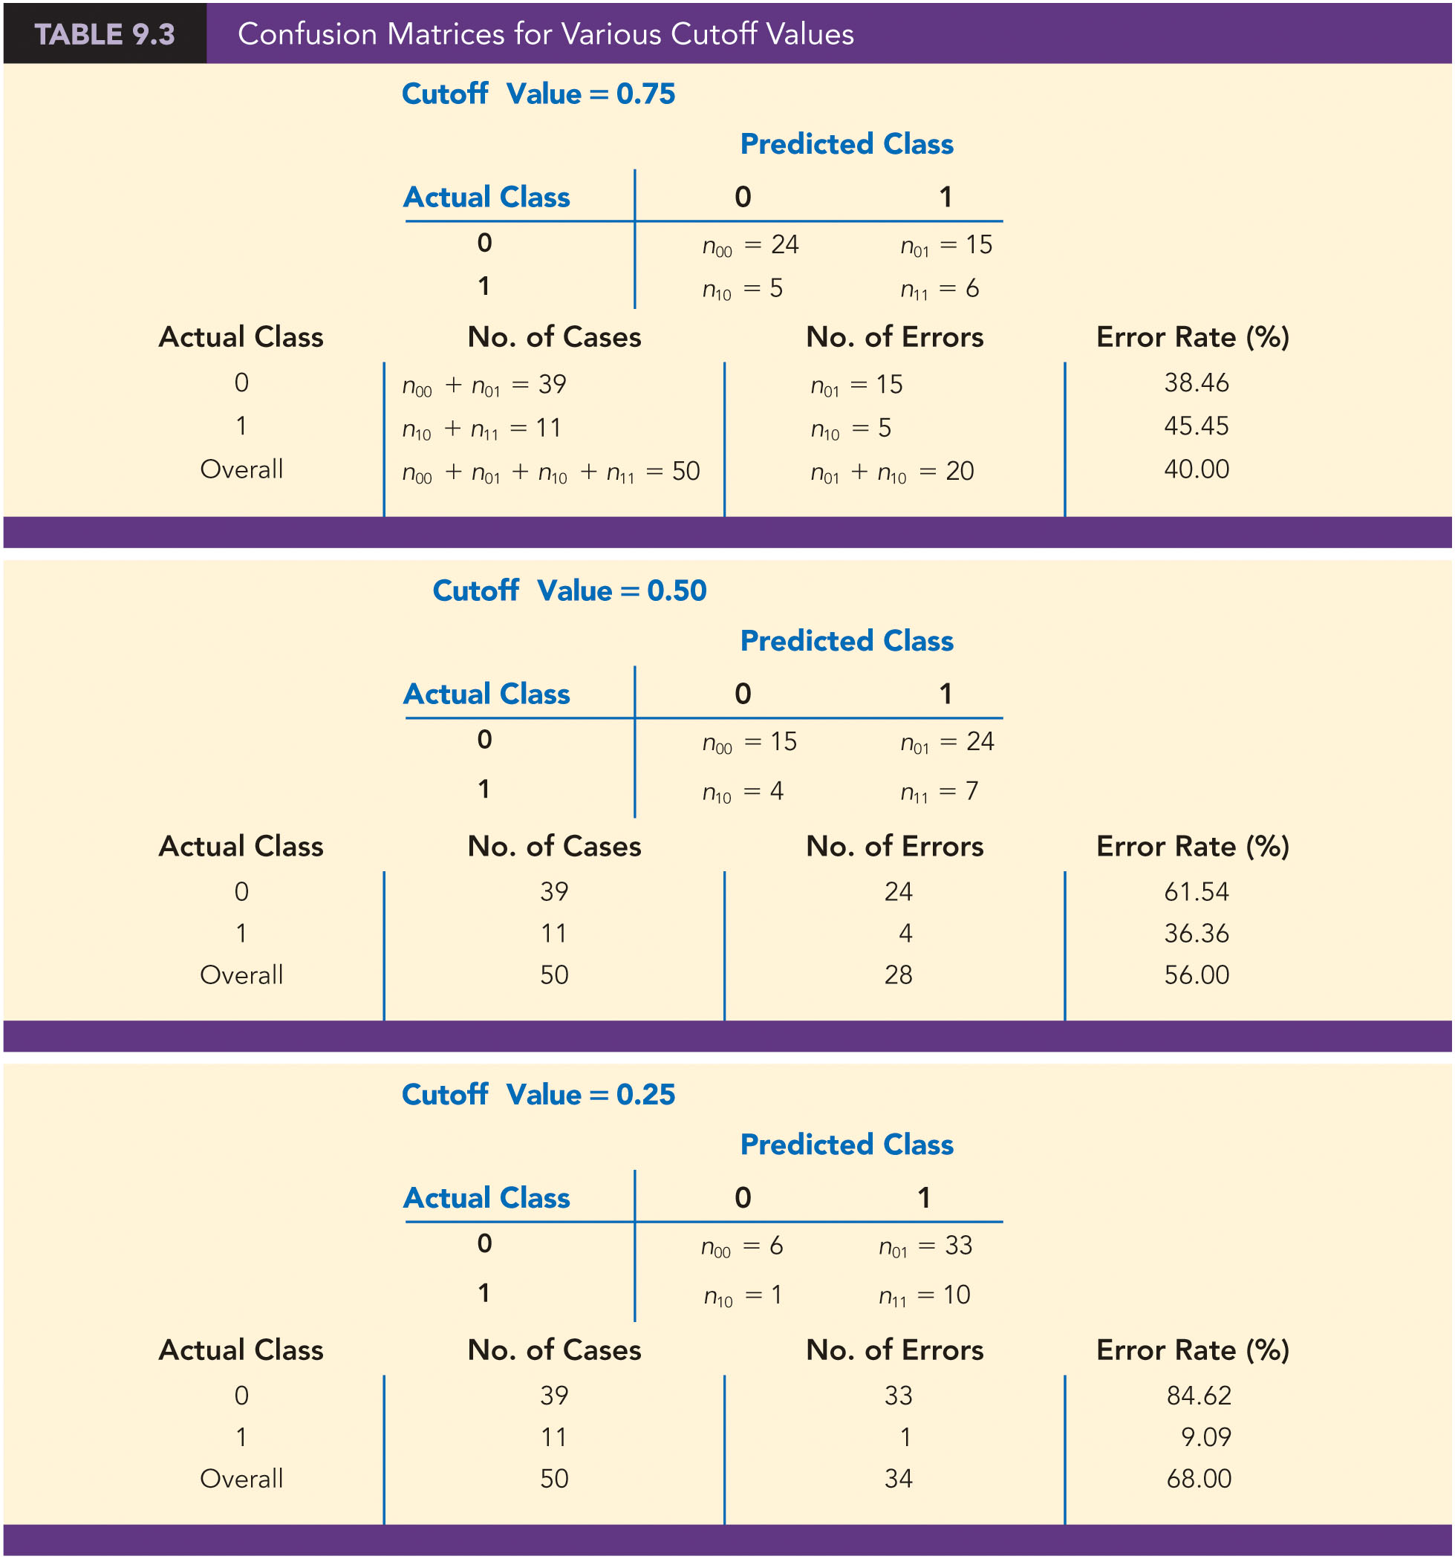
Performance Measures (Slide 8 of 19)
Table 9.3: Confusion Matrices for Various Cutoff Values
Notes:
Table 9.3 shows the confusion matrices and corresponding Class 1 error rates, Class 0 error rates, and overall error rates for cutoff values of 0.75, 0.5, and 0.25, respectively.
As we decrease the cutoff value, more observations will be classified as Class 1, thereby increasing the likelihood that a Class 1 observation will be correctly classified as Class 1; that is, Class 1 error will decrease.
However, as a side effect, more Class 0 observations will be incorrectly classified as Class 1; that is, Class 0 error will rise.

Slide 18
Performance Measures (Slide 9 of 19)
Table 9.3: Classification Confusion Matrices and Error Rates for Various Cutoff Values (cont.)
Notes:
Table 9.3 shows the confusion matrices and corresponding Class 1 error rates, Class 0 error rates, and overall error rates for cutoff values of 0.75, 0.5, and 0.25, respectively.
As we decrease the cutoff value, more observations will be classified as Class 1, thereby increasing the likelihood that a Class 1 observation will be correctly classified as Class 1; that is, Class 1 error will decrease.
However, as a side effect, more Class 0 observations will be incorrectly classified as Class 1; that is, Class 0 error will rise.

Slide 19
Performance Measures (Slide 10 of 19)
Table 9.3: Classification Confusion Matrices and Error Rates for Various Cutoff Values (cont.)
Notes:
Table 9.3 shows the confusion matrices and corresponding Class 1 error rates, Class 0 error rates, and overall error rates for cutoff values of 0.75, 0.5, and 0.25, respectively.
As we decrease the cutoff value, more observations will be classified as Class 1, thereby increasing the likelihood that a Class 1 observation will be correctly classified as Class 1; that is, Class 1 error will decrease.
However, as a side effect, more Class 0 observations will be incorrectly classified as Class 1; that is, Class 0 error will rise.

Slide 20
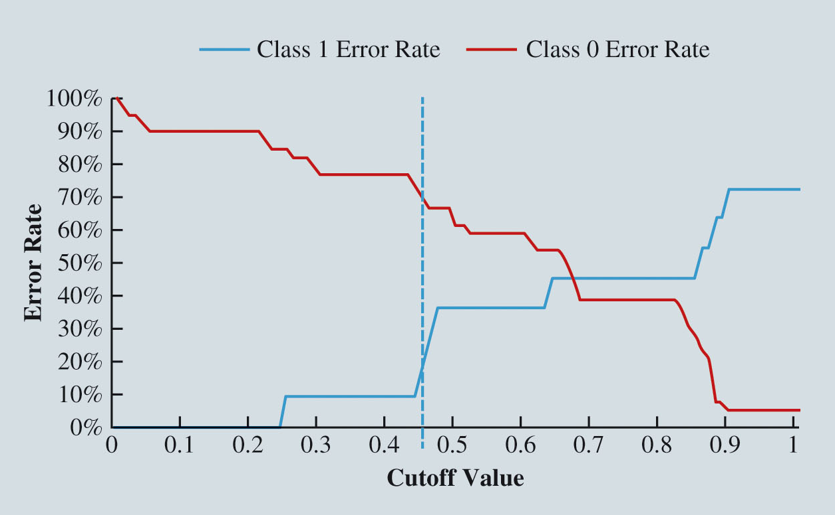
Performance Measures (Slide 11 of 19)
Figure 9.1: Classification Error Rates vs. Cutoff Value
Notes:
Figure 9.1 shows the Class 1 and Class 0 error rates for cutoff values ranging from 0 to 1.

Slide 21
Performance Measures (Slide 12 of 19)
Evaluating the Classification of Categorical Outcomes (cont.):
Cumulative lift chart: Compares the number of actual Class 1 observations identified if considered in decreasing order of their estimated probability of being in Class 1 and compares this to the number of actual Class 1 observations identified if randomly selected.
Decile-wise lift chart: Another way to view how much better a classifier is at identifying Class 1 observations than random classification.
Observations are ordered in decreasing probability of Class 1 membership and then considered in 10 equal-sized groups.

Slide 22
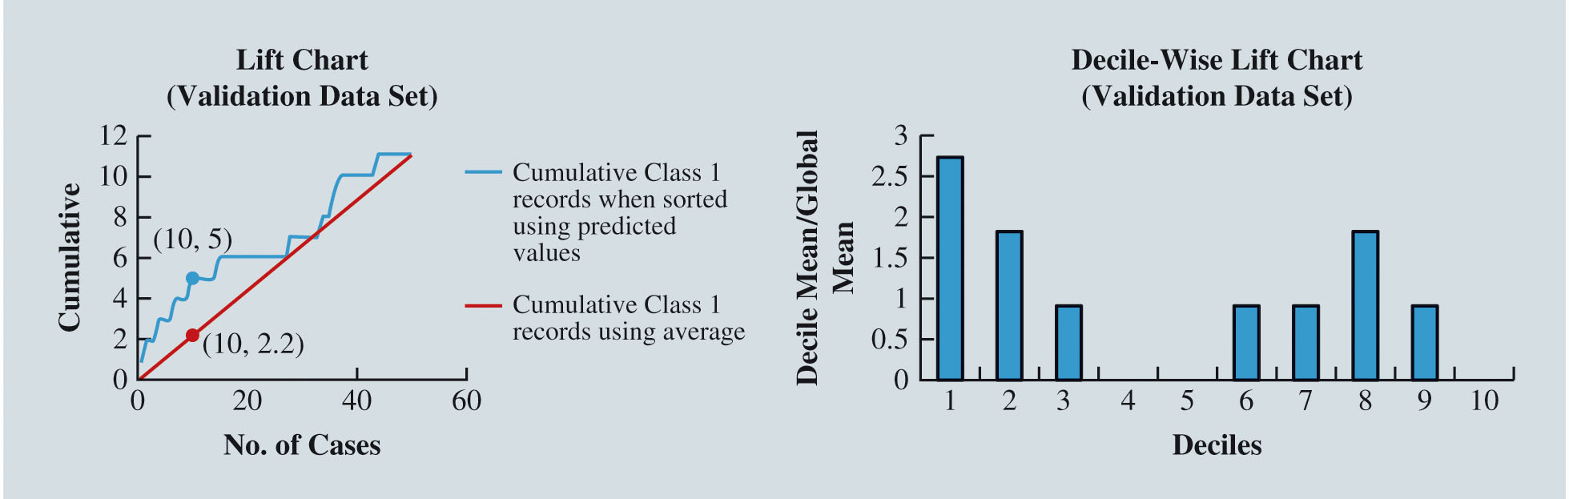
Performance Measures (Slide 13 of 19)
Figure 9.2: Cumulative and Decile-Wise Lift Charts
Notes:
Cumulative lift chart
The left panel of Figure 9.2 illustrates a cumulative lift chart.
The point (10, 5) on the blue curve means that if the 10 observations with the largest estimated probabilities of being in Class 1 were selected from Table 9.2, 5 of these observations correspond to actual Class 1 members.
In contrast, the point (10, 2.2) on the red curve means that if 10 observations were randomly selected, an average of only (11/50) × 10 = 2.2 of these observations would be Class 1 members.
Decile-wise lift chart.
For the data in Table 9.2, the first decile group corresponds to the 0.1 × 50 = 5 observations most likely to be in Class 1, the second decile group corresponds to the sixth through the tenth observations most likely to be in Class 1, and so on.
For each of these decile groups, the decile-wise lift chart compares the number of actual Class 1 observations to the number of Class 1 responders in a randomly selected group of 0.1 × 50 = 5 observations.
In the first decile group (top 10% of observations most likely to be in Class 1) are three Class 1 observations.
A random sample of 5 observations would be expected to have 5 × (11/50) = 1.1 observations in Class 1.
Thus the first-decile lift of this classification is 3/1.1 5 2.73, which corresponds to the height of the first bar in the chart in the right panel of Figure 9.2.
Visually, the taller the bar in a decile-wise lift chart, the better the classifier is at identifying responders in the respective decile group.

Slide 23
Performance Measures (Slide 14 of 19)
Evaluating the Classification of Categorical Outcomes (cont.):
The ability to correctly predict Class 1 (positive) observations is commonly expressed as sensitivity, or recall, and is calculated as:
The ability to correctly predict Class 0 (negative) observations is commonly expressed as specificity and is calculated as:

Slide 24
Performance Measures (Slide 15 of 19)
Evaluating the Classification of Categorical Outcomes (cont.):
Precision is a measure that corresponds to the proportion of observations predicted to be Class 1 by a classifier that are actually in Class 1:
The F1 Score combines precision and sensitivity into a single measure and is defined as:

Slide 25
Performance Measures (Slide 16 of 19)
Evaluating the Classification of Categorical Outcomes (cont.):
The receiver operating characteristic (ROC) curve is an alternative graphical approach for displaying the tradeoff between a classifier’s ability to correctly identify Class 1 observations and its Class 0 error rate.
In general, we can evaluate the quality of a classifier by computing the area under the ROC curve, often referred to as the AUC.
The greater the area under the ROC curve (i.e., the larger the AUC), the better the classifier performs.

Slide 26
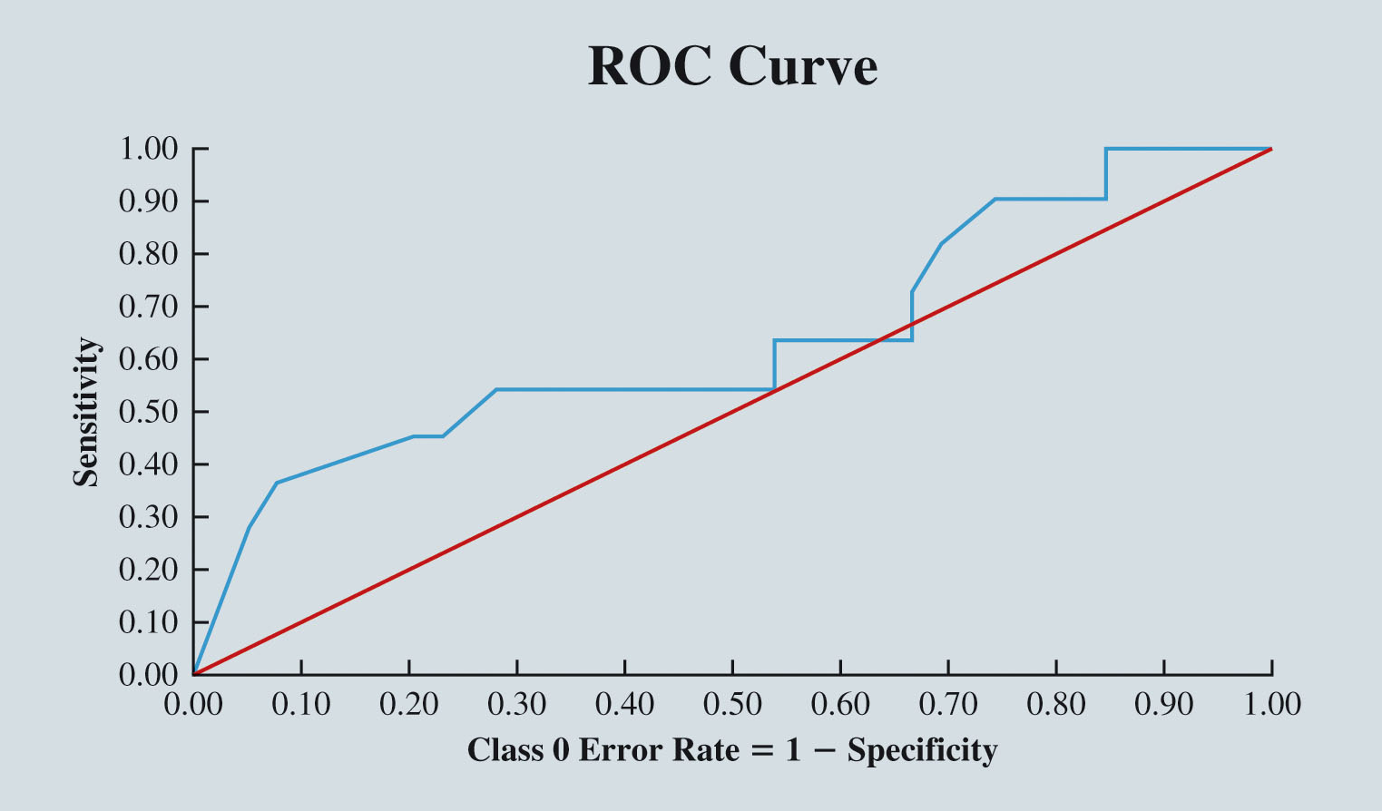
Performance Measures (Slide 17 of 19)
Figure 9.3: Receiver Operating Characteristic (ROC) Curve
Notes:
In Figure 9.3, note that the area under the red diagonal line representing random classification results is 0.5.
In Figure 9.3, we observe that the classifier is providing value over a random classification, as its AUC is greater than 0.5.

Slide 27
Performance Measures (Slide 18 of 19)
Evaluating the Estimation of Continuous Outcomes:
The measures of accuracy are some function of the error in estimating an outcome for an observation i.
Two common measures are:
Average error =
Root mean squared error (RMSE) =
(
= error in estimating an outcome for observation i).
The average error estimates the bias in a model’s predictions:
If the average error is negative, then the model tends to overestimate the value of the outcome variable.
If the average error is positive, the model tends to underestimate.

Slide 28
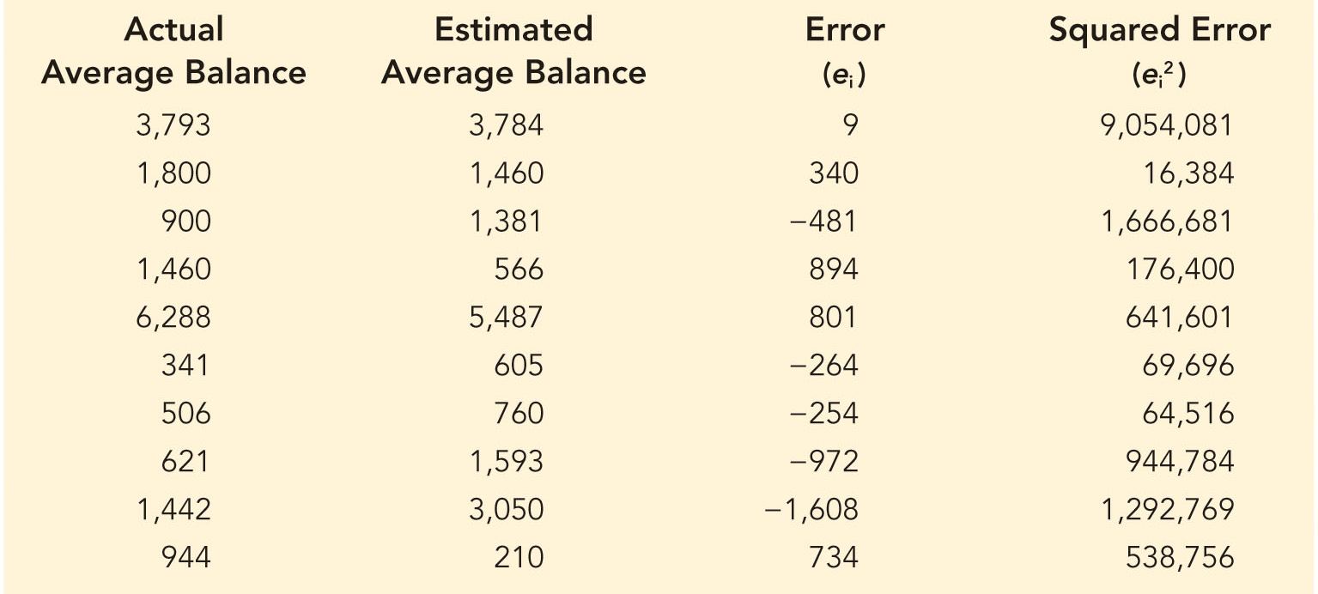
Performance Measures (Slide 19 of 19)
Table 9.4: Computer Error in Estimates of Average Balance for 10 Customers
Notes:
Table 9.4 shows the error and squared error resulting from the predictions of the average balance for 10 observations.
Using Table 9.4, we compute average error = -80.1 and the RSME = 774.
Because the average error is negative, we observe that the model overestimates the actual balance of these 10 customers.
Furthermore, if the performance of the model on these 10 observations is indicative of the performance on a larger set of observations, we should investigate improvements to the estimation model, as the RMSE of 774 is 43% of the average actual balance.

Slide 29
Logistic Regression

Slide 30
Logistic Regression (Slide 1 of 8)
Logistic regression attempts to classify a binary categorical outcome (y = 0 or 1) as a linear function of explanatory variables.
A linear regression model fails to appropriately explain a categorical outcome variable.

Slide 31
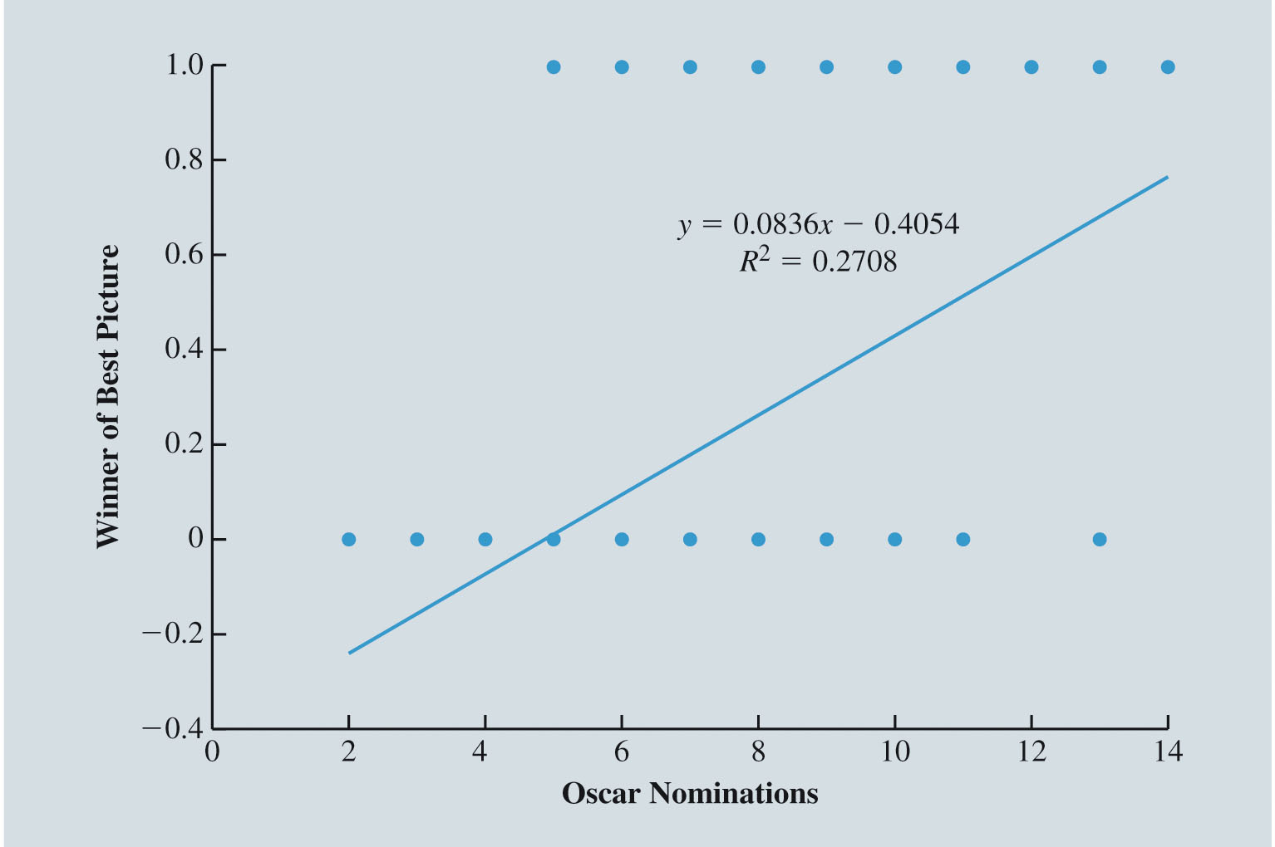
Logistic Regression (Slide 2 of 8)
Figure 9.4: Scatter Chart and Simple Linear Regression Fit for Oscars Example

Slide 32
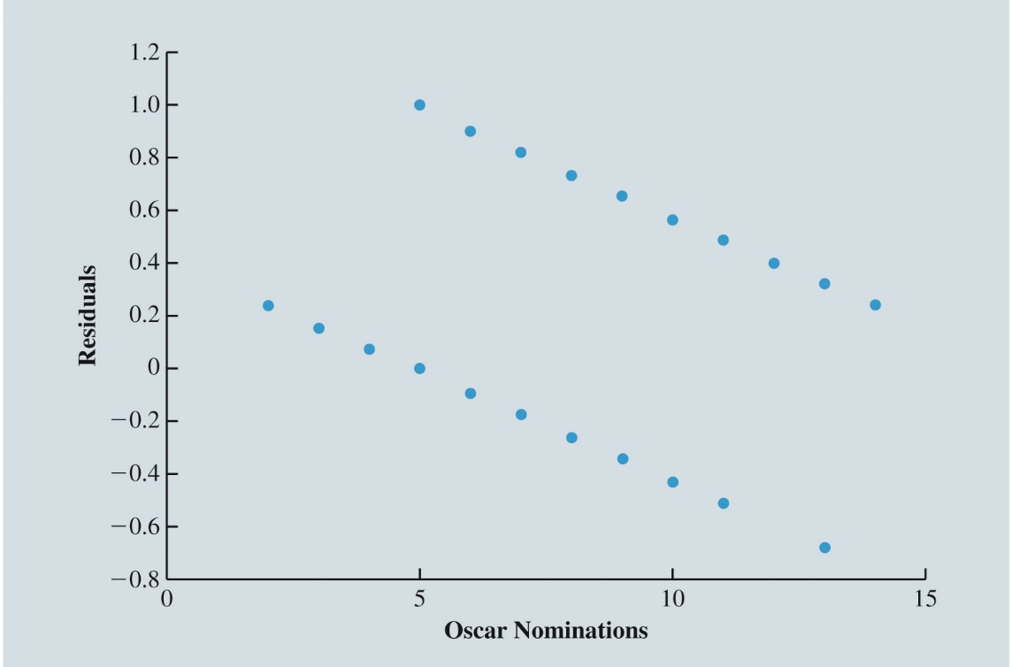
Logistic Regression (Slide 3 of 8)
Figure 9.5: Residuals for Simple Linear Regression on Oscars Data
An unmistakable pattern of systematic misprediction suggests that the simple linear regression model is not appropriate.

Slide 33
Logistic Regression (Slide 4 of 8)
Odds is a measure related to probability.
If an estimate of the probability of an event is
then the equivalent odds measure is
The odds metric ranges between zero and positive infinity.
We eliminate the fit problem by using logit,
Estimating the logit with a linear function results in the estimated logistic regression model.

Slide 34
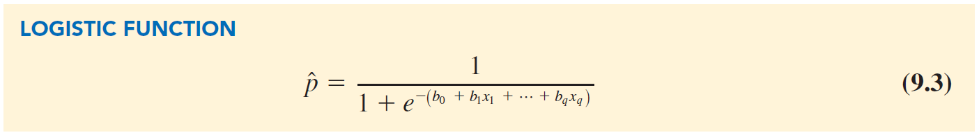
Logistic Regression (Slide 5 of 8)
Logistic regression model:
(9.1)
Given a set of explanatory variables, a logistic regression algorithm determines values of
that best estimate the log odds.
Notes:
Applying a logistic regression algorithm to the data in the file OscarsDemo results in estimates of b₀ = –6.214 and b₁ = 0.596; that is, the log odds of a movie winning the best picture award is given by
ln$\left(\frac{\hat{p}}{1 − \hat{p}}\right)$ = –6.214 + 0.596 × total number of Oscar nominations
b₁ = 0.596, meaning that for every additional Oscar nomination that a movie receives, its log odds of winning the best picture award increase by 0.596.
Logistic function for the OscarsDemo data
$\hat{p}$ = $\frac{1}{1+ e^{−(–6.214 + 0.596 × Total Number of Oscar Nominations) }}$
Plotting the above equation we obtain the S-shaped curve in Figure 9.6.

Slide 35
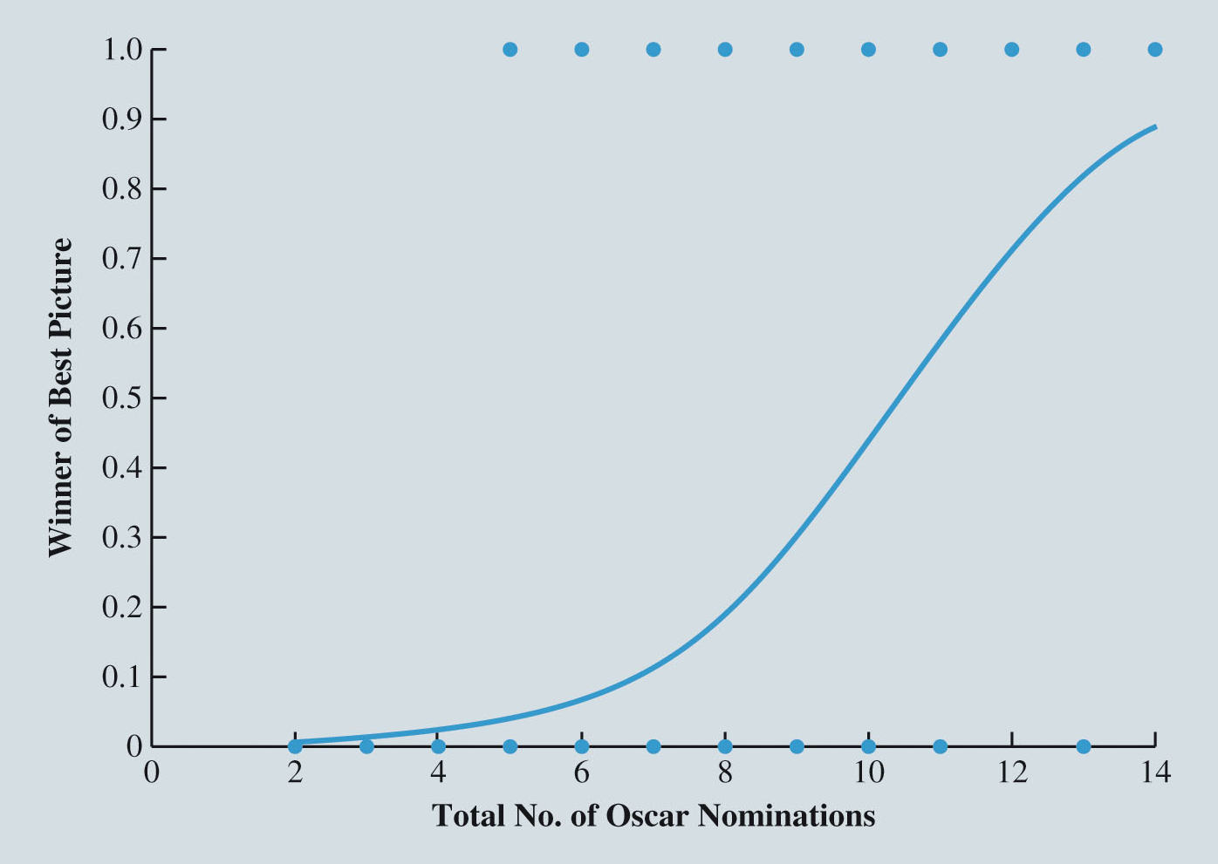
Logistic Regression (Slide 6 of 8)
Figure 9.6: Logistic S-Curve for Oscars Example
Notes:
Consider the task of predicting whether a movie wins the Oscar Award for best picture using information on the total number of Oscar nominations that a movie receives.
Figure 9.6 shows an S-shaped curve that appears to better explain the relationship between the probability p of winning best picture and the total number of Oscar nominations.
Instead of extending off to positive and negative infinity, the S-shaped curve flattens and never goes above one or below zero.
We can achieve this S-shaped curve by estimating an appropriate function of the probability p of winning best picture with a linear function rather than directly estimating p with a linear function.

Slide 36
Logistic Regression (Slide 7 of 8)
Logistic regression classifies an observation by using the logistic function to compute the probability of an observation belonging to Class 1 and then comparing this probability to a cutoff value.
If the probability exceeds the cutoff value, the observation is classified as Class 1 and otherwise it is classified as Class 0.
While a logistic regression model used for prediction should ultimately be judged based on its classification accuracy on validation and test sets, Mallow’s
statistic is a measure commonly computed by statistical software that can be used to identify models with promising sets of variables.

Slide 37
Logistic Regression (Slide 8 of 8)
Table 9.5: Predicted Probabilities by Logistic Regression for Oscars Example
Total No. of Oscar Nominations | Predicted Probability of Winning | Predicted Class | Actual Class
14 | 0.89 | Winner | Winner
11 | 0.58 | Winner | Loser
10 | 0.44 | Loser | Loser
6 | 0.07 | Loser | Winner

Slide 38
k-Nearest Neighbors
Classifying Categorical Outcomes with k-Nearest Neighbors
Estimating Continuous Outcomes with k-Nearest Neighbors

Slide 39
k-Nearest Neighbors (Slide 1 of 7)
k-Nearest Neighbors (k-NN): This method can be used either to classify a categorical outcome or predict a continuous outcome.
k-NN uses the k most similar observations from the training set, where similarity is typically measured with Euclidean distance.

Slide 40
k-Nearest Neighbors (Slide 2 of 7)
Classifying Categorical Outcomes with k-Nearest Neighbors:
A nearest-neighbor is a “lazy learner” that directly uses the entire training set to classify observations in the validation and test sets.
The value of k can plausibly range from 1 to n, the number of observations in the training set.
If k = 1, then the classification of a new observation is set to be equal to the class of the single most similar observation from the training set.
If k = n, then the new observation’s class is naïvely assigned to the most common class in the training set.
Notes:
When k-NN is used as a classification method, a new observation is classified as Class 1 if the percentage of its k-nearest neighbors in Class 1 is greater than or equal to a specified cutoff value (the default value is 0.5).
When k-NN is used as a prediction method, a new observation’s outcome value is predicted to be the average of the outcome values of its k-nearest neighbors.
The value of k can plausibly range from 1 to n, the number of observations in the training set.

Slide 41
k-Nearest Neighbors (Slide 3 of 7)
Table 9.6: Training Set Observations for k-NN Classifier
Observation | Average Balance | Age | Loan Default
1 | 49 | 38 | 1
2 | 671 | 26 | 1
3 | 772 | 47 | 1
4 | 136 | 48 | 1
5 | 123 | 40 | 1
6 | 36 | 29 | 0
7 | 192 | 31 | 0
8 | 6,574 | 35 | 0
9 | 2,200 | 58 | 0
10 | 2,100 | 30 | 0
Average: | 1,285 | 38.2
Standard Deviation: | 2,029 | 10.2

Slide 42
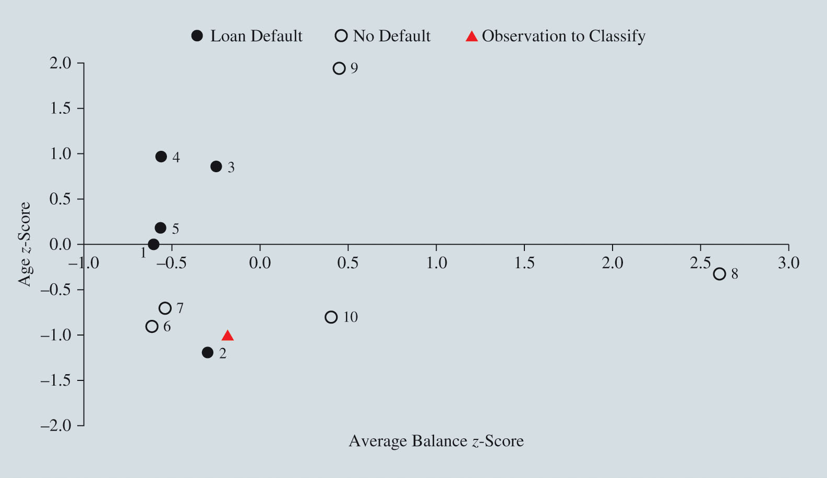
k-Nearest Neighbors (Slide 4 of 7)
Figure 9.7: Scatter Chart for k-NN Classification

Slide 43
k-Nearest Neighbors (Slide 5 of 7)
Table 9.7: Classification of Observation with Average Balance = 900 and Age = 28 for Different Values of k
k | % of Class 1 Neighbors | Classification
1 | 1.00 | 1
2 | 0.50 | 1
3 | 0.33 | 0
4 | 0.25 | 0
5 | 0.40 | 0
6 | 0.50 | 1
7 | 0.57 | 1
8 | 0.63 | 1
9 | 0.56 | 1
10 | 0.50 | 1

Slide 44
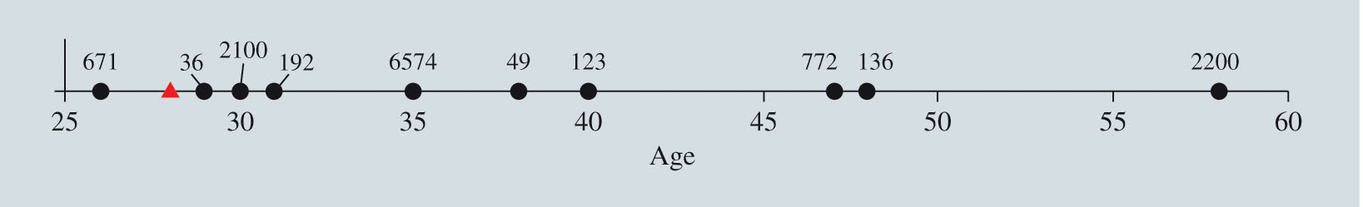
k-Nearest Neighbors (Slide 6 of 7)
Estimating Continuous Outcomes with k-Nearest Neighbors:
When k-NN is used to estimate a continuous outcome, a new observation’s outcome value is predicted to be the average of the outcome values of it k-nearest neighbors in the training set.
The value of k can plausibly range from 1 to n, the number of observations in the training set.
Figure 9.8: Scatter Chart for k-NN Estimation

Slide 45
k-Nearest Neighbors (Slide 7 of 7)
Table 9.8: Estimation Average Balance for Observation with Age = 28 for Different Values of k
k | Average Balance Estimate
1 | $36
2 | $936
3 | $936
4 | $750
5 | $1,915
6 | $1,604
7 | $1,392
8 | $1,315
9 | $1,184
10 | $1,285

Slide 46
Classification and Regression Trees
Classifying Categorical Outcomes with a Classification Tree
Estimating Continuous Outcomes with a Regression Tree
Ensemble Methods

Slide 47
Classification and Regression Trees (Slide 1 of 20)
Classification and regression trees (CART) successively partition a data set of observations into increasingly smaller and more homogeneous subsets.
At each iteration of the CART method, a subset of observations is split into two new subsets based on the values of a single variable.
CART method can be thought of as a series of questions that successively narrow down observations into smaller and smaller groups of decreasing impurity.

Slide 48
Classification and Regression Trees (Slide 2 of 20)
Classifying Categorical Outcomes with a Classification Tree:
Classification trees: The impurity of a group of observations is based on the proportion of observations belonging to the same class.
After a final tree is constructed, the classification of a new observation is then based on the final partition into which the new observation belongs.
Notes:
To demonstrate the classification tree method, we consider an example involving Hawaiian Ham Inc. (HHI), a company that specializes in the development of software that filters out unwanted e-mail messages (often referred to as spam).
HHI has collected data on 4,601 e-mail messages.
For 4,601 e-mail messages, HHI has collected whether or not the message was “spam” (Class 1) or “not spam” (Class 0), as well as the frequency of the “!” character and the “$” character (expressed as a percentage of characters in the message).

Slide 49
Classification and Regression Trees (Slide 3 of 20)
Classifying a Categorical Outcome with a Classification Tree (cont.):
To explain how a classification tree categorizes observations:
We use a small sample of data from DemoHHI consisting of 46 observations.
Only two variables from HHI—percentage of the $ character and percentage of the ! Character.
Notes:
The results of a classification tree analysis can be graphically displayed in a tree that explains the process of classifying a new observation.
The tree outlines the values of the variables that result in an observation falling into a particular partition.

Slide 50
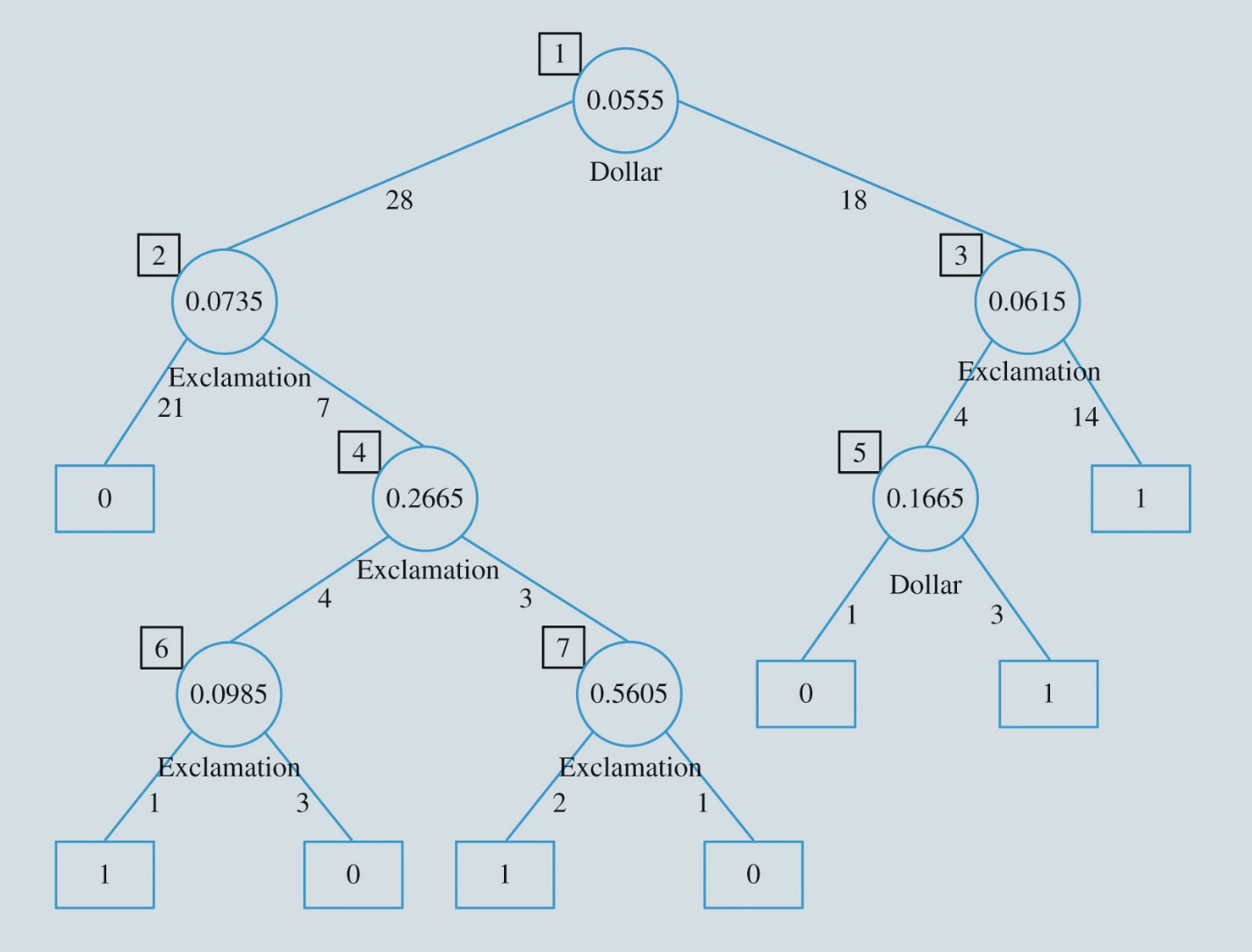
Classification and Regression Trees (Slide 4 of 20)
Figure 9.9: Construction Sequence of Branches in a Classification Tree
Notes:
At each step, the CART method identifies the split of the variable that results in the least impurity in the two resulting categories.
In Figure 9.9, the number within the circle (or node) represents the value on which the variable (whose name is listed below the node) is split.

Slide 51
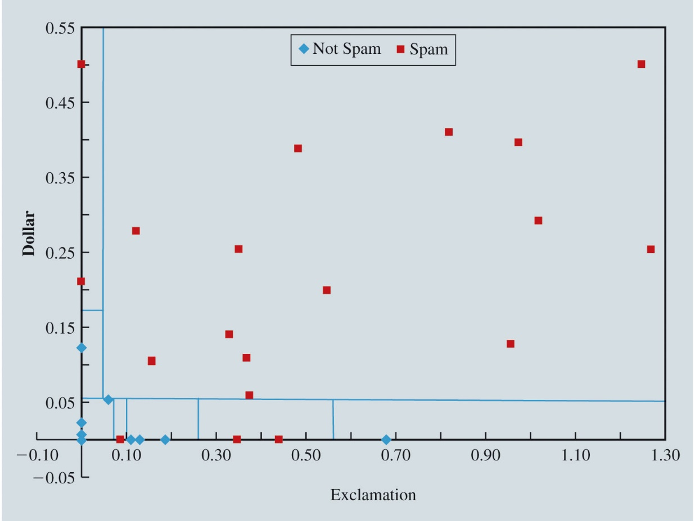
Classification and Regression Trees (Slide 5 of 20)
Figure 9.10: Geometric Illustration of Classification Tree Partitions
The final partitioning resulting from the sequence of variable splits.
Notes:
Figure 9.10 suggests that with enough variable splitting, it is possible to obtain partitions on the training set such that each partition either contains Class 1 observations or Class 0 observations, but not both.
Applying the same partitioning rules to the data in a validation set will typically result in a relatively large classification error. Thus, there is a need to prune the classification tree by removing the branches corresponding to weaker rules.
Specifically, a series of pruned trees is obtained by removing partitions in the reverse order in which they were added.
For example, sequentially pruning the full tree in Figure 9.9 would result in trees with one to six variable splits (decision nodes).

Slide 52
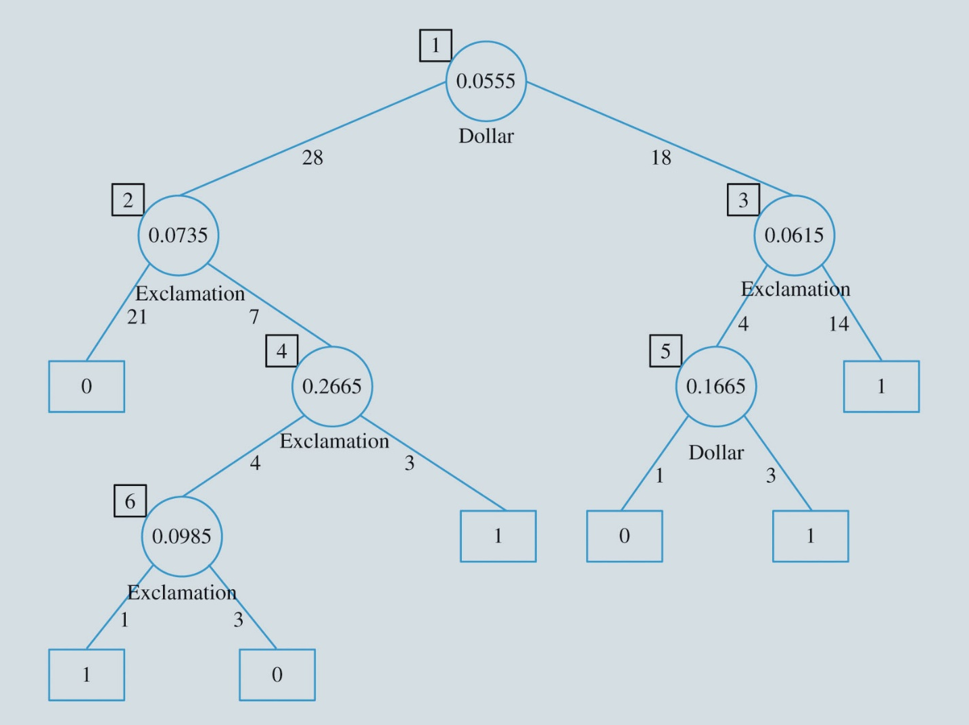
Classification and Regression Trees (Slide 6 of 20)
Figure 9.11: Classification Tree with One Pruned Branch
Notes:
Figure 9.11 illustrates the tree resulting from pruning the last variable splitting rule (Exclamation $≤$ 0.5605 or Exclamation > 0.5605) from Figure 9.9.
By pruning this rule, we obtain a partition defined by Dollar $≤$ 0.0555, Exclamation > 0.0735, and Exclamation > 0.2665 that contains three observations.
Two of these observations are Class 1 (spam) and one is Class 0 (nonspam).
As Figure 9.11 shows, this pruned tree classifies observations in the partition defined as Class 1 observations since the proportion of Class 1 observations in this partition—which we know is (2/3) from Figure 9.9—exceeds the default cutoff value of 0.5.
Therefore, the classification error of this pruned tree on the training set is no longer zero (it is 1/46 = 0.022).
However, this pruned tree is less likely to be overfit to the training set and may classify the validation set more accurately than the full tree that perfectly classifies the training set.

Slide 53
Classification and Regression Trees (Slide 7 of 20)
Table 9.9: Classification Error Rates on Sequence of Pruned Trees
No. of Decision Nodes | % Classification Error on Training Set | % Classification Error on Validation Set
0 | 43.5 | 39.4
1 | 8.7 | 20.9
2 | 8.7 | 20.9
3 | 8.7 | 20.9
4 | 6.5 | 20.9
5 | 4.3 | 21.3
6 | 2.2 | 21.3
7 | 0 | 21.6
Notes:
Table 9.9 shows that the classification error on the training set decreases as more decision nodes splitting the observations into smaller partitions are added.
However, while adding decision nodes at first decreases the classification error on the validation set, too many decision nodes overfits the classification tree to the training data and results in increased error on the validation set.
Table 9.9 suggests that a classification tree partitioning observations into two subsets with a single decision note (Dollar $≤$ 0.0555 or Dollar > 0.0555) is just as reliable at classifying the validation data as any other tree.
As Figure 9.12 shows, if the “$” character accounts for no more than 5.55% of the characters, this best-pruned tree classifies an e-mail as nonspam, otherwise this best-pruned tree classifies an e-mail as spam.
This best-pruned classification tree results in a classification error of 20.9% on the validation set.

Slide 54
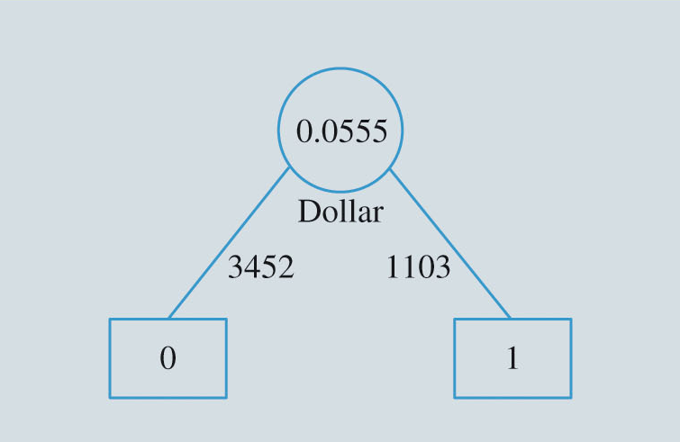
Classification and Regression Trees (Slide 8 of 20)
Figure 9.12: Best-Pruned Classification Tree
Notes:
As Figure 9.12 shows, if the “$” character accounts for no more than 5.55% of the characters, this best-pruned tree classifies an e-mail as nonspam, otherwise this best-pruned tree classifies an e-mail as spam.
This best-pruned classification tree results in a classification error of 20.9% on the validation set.

Slide 55
Classification and Regression Trees (Slide 9 of 20)
Estimating Continuous Outcomes with a Regression Tree:
A regression tree successively partitions observations of the training set into smaller and smaller groups in a similar fashion as a classification tree.
The differences are:
A regression tree bases the impurity of a partition based on the variance of the outcome value for the observations in the group.
After a final tree is constructed, the estimated outcome value of an observation is based on the mean outcome value of the partition in which the new observation belongs.

Slide 56
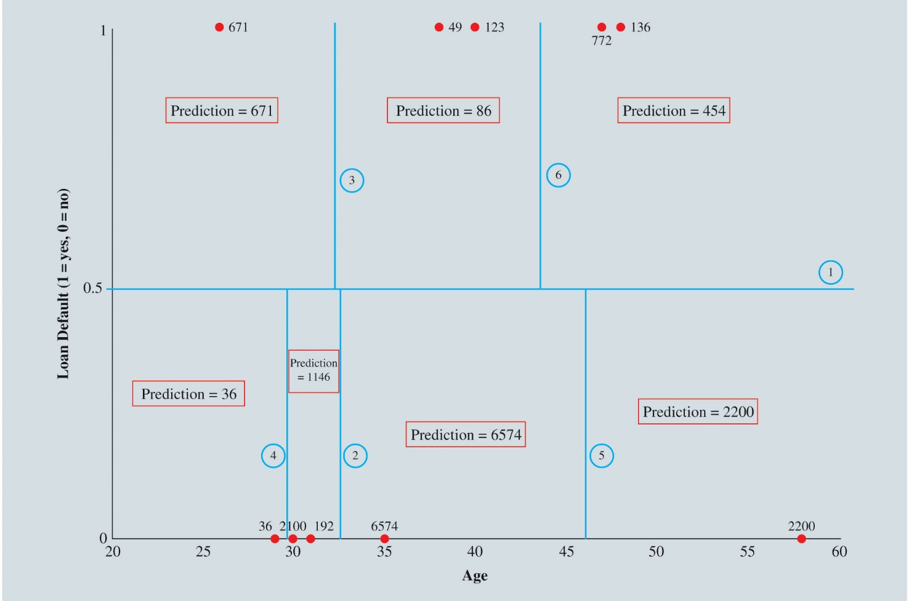
Classification and Regression Trees (Slide 10 of 20)
Figure 9.13: Geometric Illustration of First Six Rules of a Regression Tree

Slide 57
Classification and Regression Trees (Slide 11 of 20)
Ensemble Methods:
In an ensemble method, predictions are made based on the combination of a collection of models.
Two necessary conditions for an ensemble to perform better than a single model:
Individual base models are constructed independently of each other.
Individual models perform better than just randomly guessing.

Slide 58
Classification and Regression Trees (Slide 12 of 20)
Ensemble Methods (cont.):
Two primary steps to an ensemble approach:
The development of a committee of individual base models.
The combination of the individual base models’ predictions to form a composite prediction.
A classification or estimation method is unstable if relatively small changes in the training set cause its predictions to fluctuate.
Three different ways to construct an ensemble of classification or regression trees:
Bagging.
Boosting.
Random forests.

Slide 59
Classification and Regression Trees (Slide 13 of 20)
Ensemble Methods (cont.):
In the bagging approach, the committee of individual base models is generated by first constructing multiple training sets by repeated random sampling of the n observations in the original data with replacement.
Table 9.10: Original 10-Observation Training Data
Age | 29 | 31 | 35 | 38 | 47 | 48 | 53 | 54 | 58 | 70
Loan default | 0 | 0 | 0 | 1 | 1 | 1 | 1 | 0 | 0 | 0

Slide 60
Classification and Regression Trees (Slide 14 of 20)
Ensemble Methods (cont.):
The boosting method generates is committee of individual base models by sampling multiple training sets.
Boosting iteratively adapts how it samples the original data when constructing a new training set based on the prediction error of the models constructed on the previous training sets.
Random forests can be viewed as a variation of bagging specifically tailored for use with classification or regression trees.

Slide 61
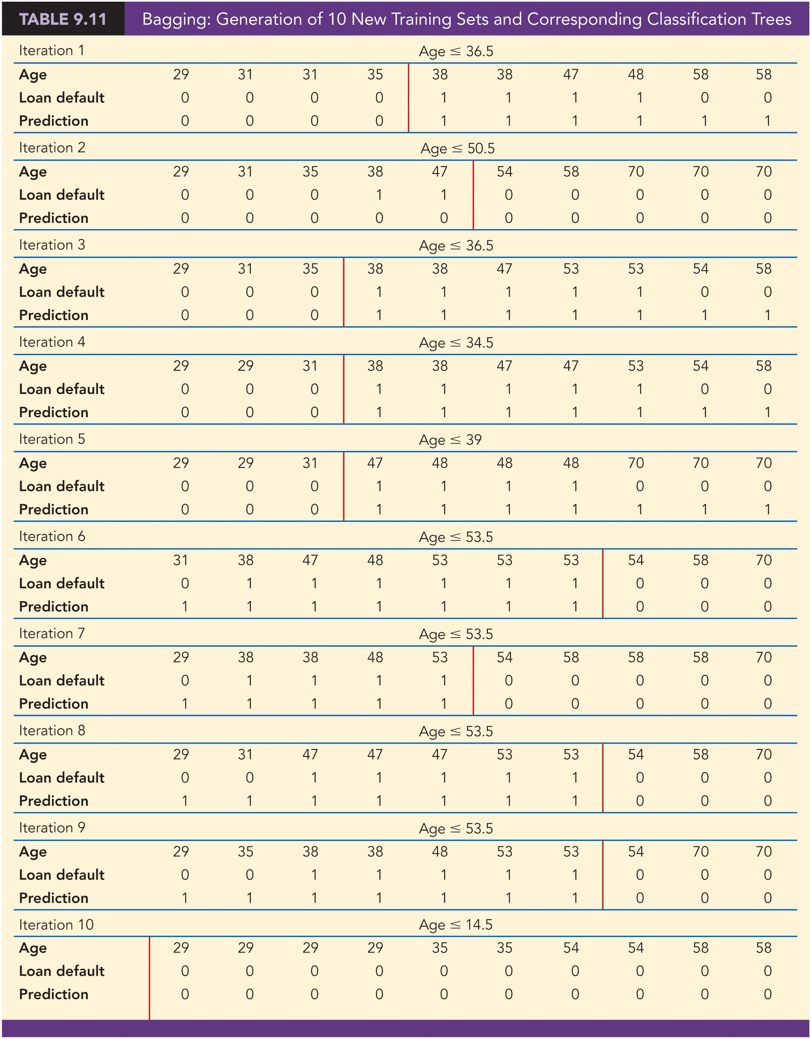
Classification and Regression Trees (Slide 15 of 20)
Table 9.11: Bagging: Generation of 10 New Training Sets and Corresponding Classification Trees

Slide 62
Classification and Regression Trees (Slide 16 of 20)
Table 9.11: Bagging: Generation of 10 New Training Sets and Corresponding Classification Trees (cont.)

Slide 63
Classification and Regression Trees (Slide 17 of 20)
Table 9.11: Bagging: Generation of 10 New Training Sets and Corresponding Classification Trees (cont.)

Slide 64
Classification and Regression Trees (Slide 18 of 20)
Table 9.12: Classification of 10 Observations from Validation Set with Bagging Ensemble
Age | 26 | 29 | 30 | 32 | 34 | 37 | 42 | 47 | 48 | 54 | Overall Error Rate
Loan default | 1 | 0 | 0 | 0 | 0 | 1 | 0 | 1 | 1 | 0
Tree 1 | 0 | 0 | 0 | 0 | 0 | 1 | 1 | 1 | 1 | 1 | 30%
Tree 2 | 0 | 0 | 0 | 0 | 0 | 0 | 0 | 0 | 0 | 0 | 40%
Tree 3 | 0 | 0 | 0 | 0 | 0 | 1 | 1 | 1 | 1 | 1 | 30%
Tree 4 | 0 | 0 | 0 | 0 | 0 | 1 | 1 | 1 | 1 | 1 | 30%
Tree 5 | 0 | 0 | 0 | 0 | 0 | 0 | 1 | 1 | 1 | 1 | 40%
Tree 6 | 1 | 1 | 1 | 1 | 1 | 1 | 1 | 1 | 1 | 0 | 50%
Tree 7 | 1 | 1 | 1 | 1 | 1 | 1 | 1 | 1 | 1 | 0 | 50%

Slide 65
Classification and Regression Trees (Slide 19 of 20)
Table 9.12: Classification of 10 Observations from Validation Set with Bagging Ensemble (cont.)
Age | 26 | 29 | 30 | 32 | 34 | 37 | 42 | 47 | 48 | 54 | Overall Error Rate
Loan default | 1 | 0 | 0 | 0 | 0 | 1 | 0 | 1 | 1 | 0
Tree 8 | 1 | 1 | 1 | 1 | 1 | 1 | 1 | 1 | 1 | 0 | 50%
Tree 9 | 1 | 1 | 1 | 1 | 1 | 1 | 1 | 1 | 1 | 0 | 50%
Tree 10 | 0 | 0 | 0 | 0 | 0 | 0 | 0 | 0 | 0 | 0 | 40%
Average Vote | 0.4 | 0.4 | 0.4 | 0.4 | 0.4 | 0.7 | 0.8 | 0.8 | 0.8 | 0.4
Bagging Ensemble | 0 | 0 | 0 | 0 | 0 | 1 | 1 | 1 | 1 | 0 | 20%

Slide 66
Classification and Regression Trees (Slide 20 of 20)
Ensemble Methods (cont.):
For most problems, the predictive accuracy of boosting ensembles exceeds the predictive accuracy of bagging ensembles.
Boosting achieves its performance advantage because:
It evolves its committee of models by focusing on observations that are mispredicted.
The member models’ votes are weighted by their accuracy.
Boosting is more computationally expensive than bagging.
There is no adaptive feedback in a bagging approach, so all m training sets are corresponding models can be implemented simultaneously.
Random forests approach has performance similar to boosting, but maintains the computational simplicity of bagging.

