Slide 1
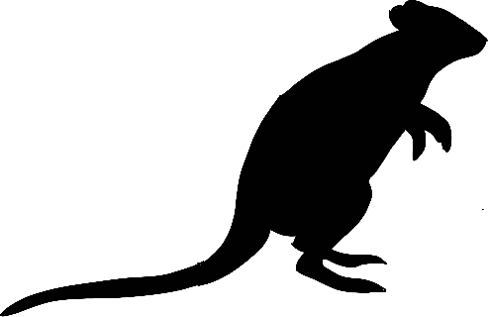
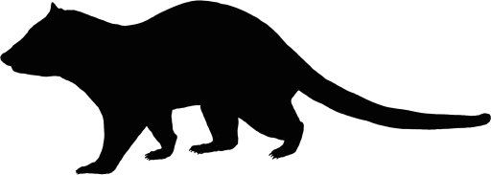
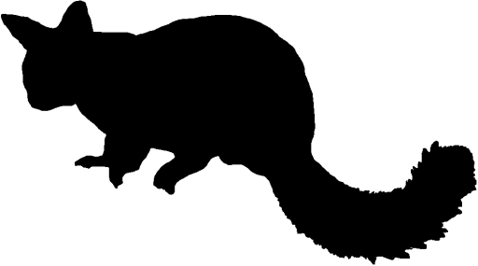
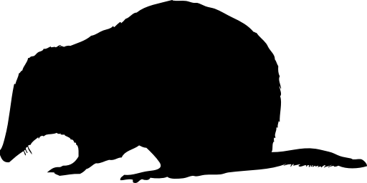
Proportion Valley Habitat
Fox Baiting
Proportion Valley Habitat
Fox Baiting
Woylie
Distance to Pasture
Woylie
Distance to Pasture
Long-term Mean NDVI
Koomal
Quenda
Long-term Mean NDVI
Koomal
Quenda
Annual NDVI Anomaly
Chuditch
Landscape-scale Pasture Cover (1km)
Annual NDVI Anomaly
Chuditch
Landscape-scale Pasture Cover (1km)
Long-term Mean Rainfall
Annual Rainfall Anomaly
Long-term Mean Rainfall
Annual Rainfall Anomaly
Fire Age Diversity
Proportion Recently Harvested (20 yrs)
Fire Age Diversity
Proportion Recently Harvested (20 yrs)
Proportion burnt twice in 10 years
Distance to Burn Assets
Proportion burnt twice in 10 years
Distance to Burn Assets
Proportion Burnt Severely
Road Density
Proportion Burnt Severely
Road Density
Proportion Burnt Moderately
Proportion Burnt Moderately
Proportion Valley Habitat
Fox Baiting
Proportion Valley Habitat
Fox Baiting
Woylie
Distance to Pasture
Woylie
Distance to Pasture
Long-term Mean NDVI
Koomal
Quenda
Long-term Mean NDVI
Koomal
Quenda
Annual NDVI Anomaly
Chuditch
Landscape-scale Pasture Cover (1km)
Annual NDVI Anomaly
Chuditch
Landscape-scale Pasture Cover (1km)
Long-term Mean Rainfall
Annual Rainfall Anomaly
Long-term Mean Rainfall
Annual Rainfall Anomaly
Fire Age Diversity
Proportion Recently Harvested (20 yrs)
Fire Age Diversity
Proportion Recently Harvested (20 yrs)
Proportion burnt twice in 10 years
Distance to Burn Assets
Proportion burnt twice in 10 years
Distance to Burn Assets
Proportion Burnt Severely
Road Density
Proportion Burnt Severely
Road Density
Proportion Burnt Moderately
Proportion Burnt Moderately
Negative association
Positive association

