Slide 1
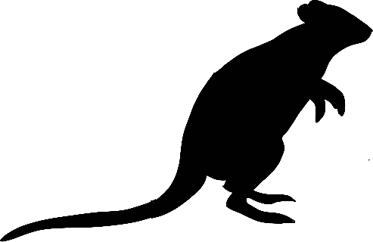
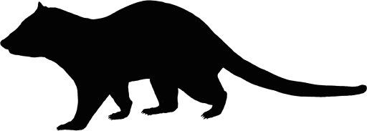
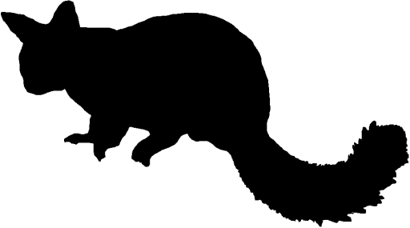
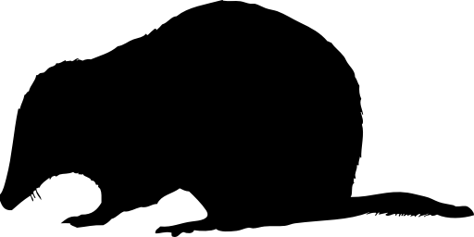
Proportion Valley Habitat
Fox Baiting
Proportion Valley Habitat
Fox Baiting
Woylie
Distance to Pasture
Woylie
Distance to Pasture
Long-term Mean NDVI
Koomal
Quenda
Long-term Mean NDVI
Koomal
Quenda
Annual NDVI Anomaly
Chuditch
Landscape-scale Pasture Cover (1km)
Annual NDVI Anomaly
Chuditch
Landscape-scale Pasture Cover (1km)
Long-term Mean Rainfall
Annual Rainfall Anomaly
Harvest Age Diversity
Long-term Mean Rainfall
Annual Rainfall Anomaly
Harvest Age Diversity
Fire Age Diversity
Fire Age Diversity
Distance to Burn Assets
Distance to Burn Assets
Proportion burnt twice in 10 years
Proportion burnt twice in 10 years
Proportion Burnt Severely
Road Density
Road Density
Proportion Burnt Severely
Proportion Burnt Moderately
Proportion Recently Harvested (20 yrs)
Proportion Burnt Moderately
Proportion Recently Harvested (20 yrs)
Proportion Valley Habitat
Fox Baiting
Proportion Valley Habitat
Fox Baiting
Woylie
Distance to Pasture
Woylie
Distance to Pasture
Long-term Mean NDVI
Koomal
Quenda
Long-term Mean NDVI
Koomal
Quenda
Annual NDVI Anomaly
Chuditch
Landscape-scale Pasture Cover (1km)
Annual NDVI Anomaly
Chuditch
Landscape-scale Pasture Cover (1km)
Long-term Mean Rainfall
Annual Rainfall Anomaly
Harvest Age Diversity
Long-term Mean Rainfall
Annual Rainfall Anomaly
Harvest Age Diversity
Fire Age Diversity
Fire Age Diversity
Distance to Burn Assets
Distance to Burn Assets
Proportion burnt twice in 10 years
Proportion burnt twice in 10 years
Proportion Burnt Severely
Road Density
Road Density
Proportion Burnt Severely
Proportion Burnt Moderately
Proportion Recently Harvested (20 yrs)
Proportion Burnt Moderately
Proportion Recently Harvested (20 yrs)

