Slide 1





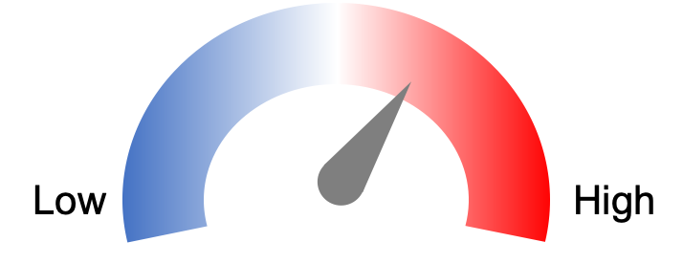



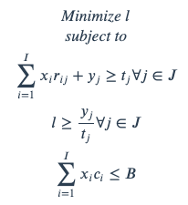
1. Species survey data
2. Estimate abundance relationships
Fox Baiting
Abundance
No
Fox Baiting
Time since fire
3. Generate management scenarios
4. Predict species’ abundances to scenarios
Random draw from coefficient distributions x1000
5. Decide on objective and targets
6. Run prioritizations
7. Compare solutions

