Slide 1


Slide 2
HACK HAPPINESS

Slide 3

Why?

Slide 4
Today
Introduction and Task
Team Formation
Planning and Datasets
Pizza

Slide 5
Tuesday Wednesday Thursday
Rooms 9am-5.30pm
Code
Code
More code

Slide 6
Friday
Present your work!
Prizes(Amazon Echos, £30/£20 Amazon Vouchers)
Judging
Pizza

Slide 7
Rules
Every team must present to the judges to be considered
Any framework/tool goes
No Kaggle cheating or code stealing :)
All team members must write some code (with help if needed)

Slide 8
Datasets and Getting Started
Choose your own problem (NLP, Vision, Video, Time Series)
Find relevant data (examples will be sent via our Github)
Must be relevant to happiness in some non-ridiculous way
(Don't forget about a Test Set)

Slide 9
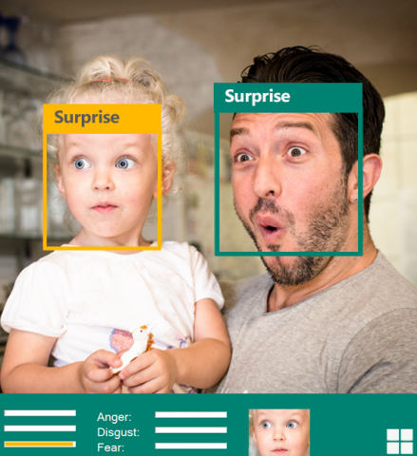
Smile Detection

Slide 10
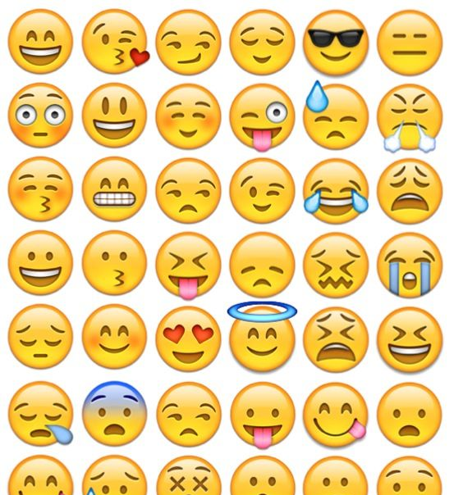
Emoji Prediction

Slide 11

Joke
Generation

Slide 12
More Ideas
Humorous Chat Bot
UN World Happiness Dataset
Where's Waldo?
Video sentiment analysis

Slide 13
The Presentation
Not just an accuracy race
Max 10 minutes
Points for quality of the idea
Show some of your code
Get into the details

Slide 14
Github + Contacts
Github: edintelligence
Stefanie: s1686631@sms.ed.ac.uk
Lauren: s1722201@sms.ed.ac.uk

