Slide 1


brought to you by

Slide 2
The Problem
increasing demand for food production
wastage of resources
water conservation

Slide 3
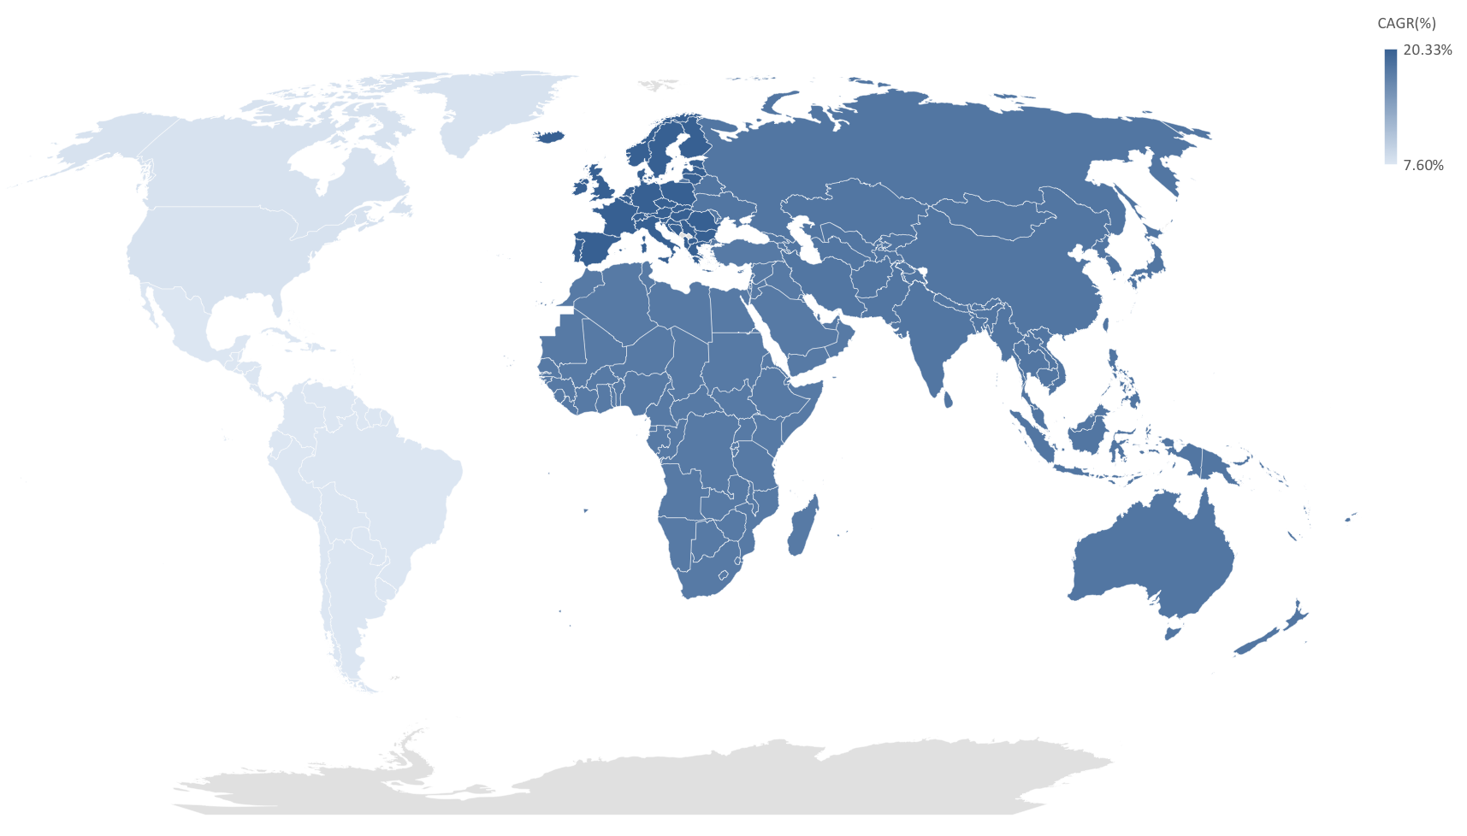
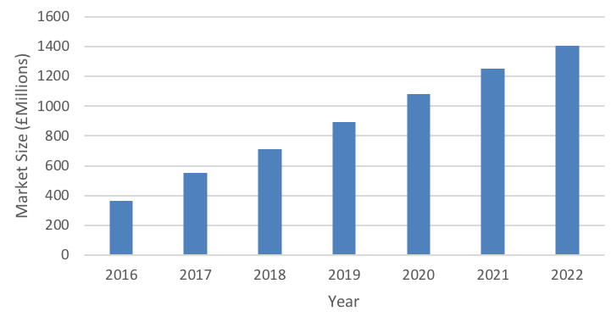
The Market

Slide 4
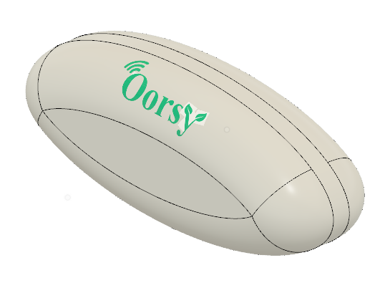
’s Solution
Smart & Open-source

Slide 5
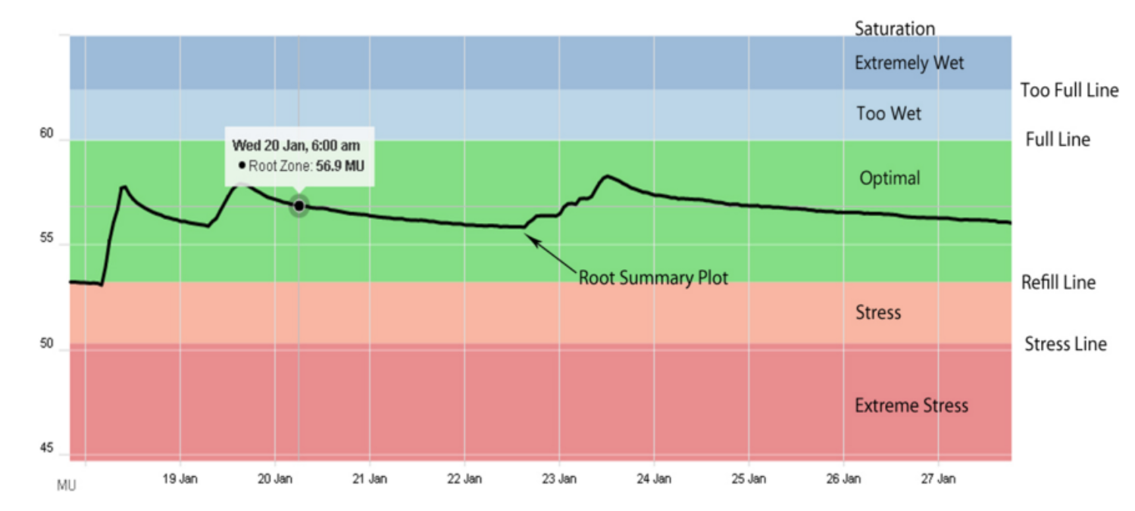
Control System

