Slide 1


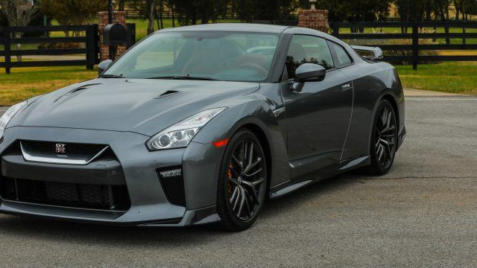
2018 Nissan GT-R
Billy Kwong
Bqkwong
March 12, 2018

Slide 2
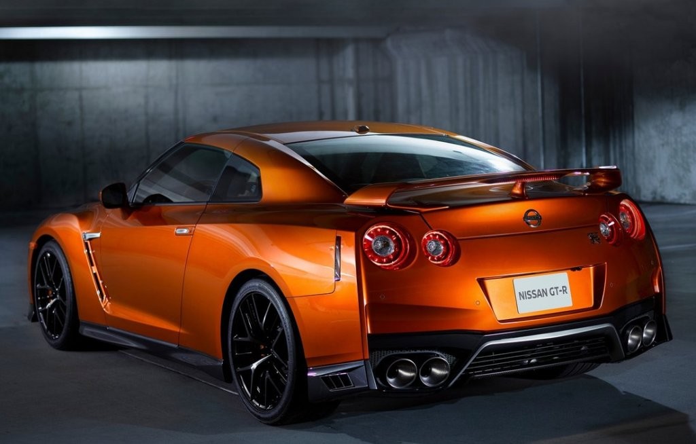
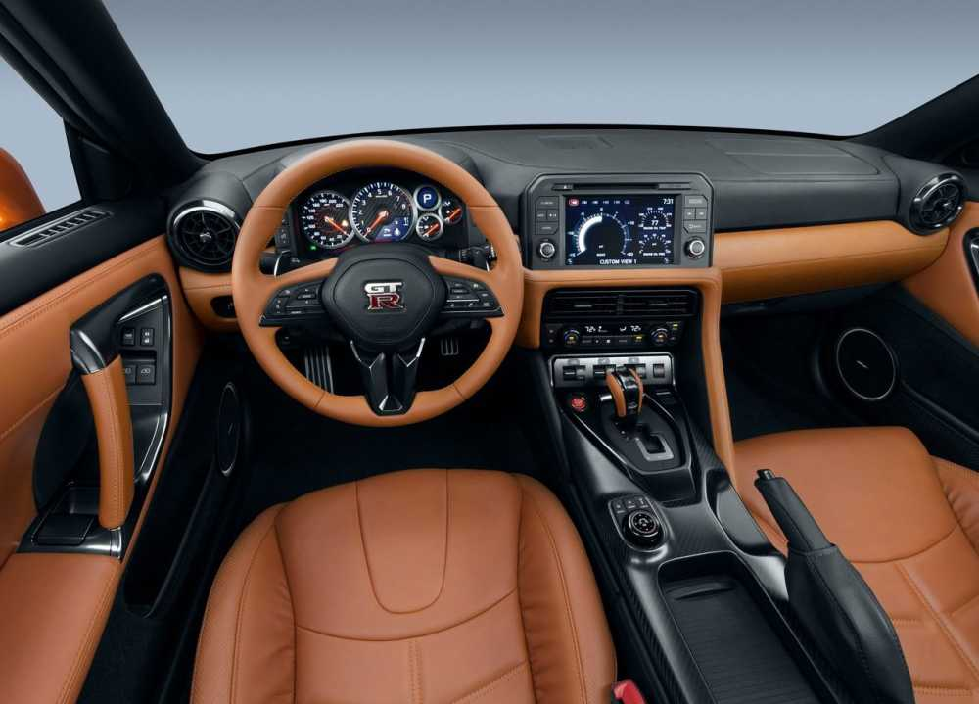
The 2018 Nissan GT-R is by far one of the best GT-R to be created. With a complete revamp of the interior, features include leather dashboard, Recaro leather seats, display commander, 11 buttons, Apple CarPlay, and more, making the car feel more modern.

Slide 3
With many cars in the market, what makes the 2018 Nissan GT-R stand out more than its competitors? Here is a chart comparison to show how well the 2018 Nissan GT-R competes with its competitors. You’ll be the judge to decide how well it fairs off.
Name | 2018 Nissan GT-R | 2018 Audi R8 5.2 V10 | 2018 Porsche 911 Turbo | 2018 Chevrolet Corvette Z06
Price | $99,990 | $164,900 | $161,800 | $79,495
Horsepower | 565 | 540 | 540 | 650
Fuel Economy(City/Hwy) | 16/22 MPG | 14/22 MPG | 19/24 MPG | 15/22 MPG
Integrated Navigation System | With voice activation | With voice activation | With voice activation | Optional

Slide 4
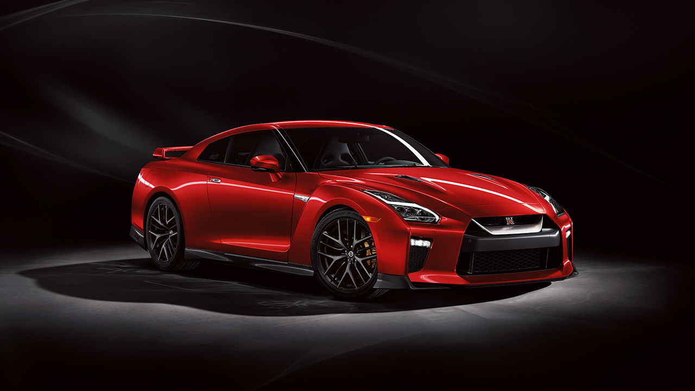
Why the 2018 Nissan gt-r?
Perfomance
3.8-liter twin-turbocharged V6 engine
Dual-clutch 6-speed transmission
565 horsepower
0-60 mph in under 3.0 seconds
Aerodynamic
Design
Carbon-fiber interior accents
Hand-stitched leather-appointed interior trims
Display Commander media controller
Apple CarPlay
Nissan Navigation System
With a starting price of $99,990 , this car competes with many supercars more than triple its price. This car comes in four packages: Pure, Premium, Track Edition, and NISMO.

Slide 5
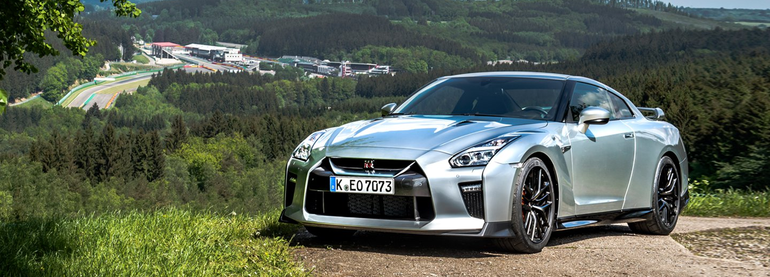
THANK YOU
THE 2018 NISSAN GT-R
FOR MORE INFORMATION, PLEASE VISIT: https://www.nissanusa.com/sportscars/gt-r

