Slide 1
The Battle of Neighborhoods Analysis and Clustering of Athens Regions
Coursera Capstone Project
Vasileios Kalyvas

Slide 2
Contents
Introduction/Business Problem
Data
Methodology
Results
Discussion
Conclusion

Slide 3
1. Introduction/Business Problem (1/2)
Background
Athens: the capital and largest city of Greece, is one of the world’s oldest cities. It was the center for arts, learning, philosophy and the birthplace of democracy, having a great cultural and political impact on the European continent.
Athens is home to two UNESCO World Heritage Sites, the Acropolis of Athens and the Daphni Monastery. Because of its ancient monuments, works of art, landmarks and museums, Athens remains nowadays one of the most famous and attractive places for visitors from all over the world.

Slide 4
1. Introduction/Business Problem (2/2)
Background
Explore the variety of venues around Athens and gain insights on the city’s most popular places.
Beneficial for:
Business Owners:
understand the different regions and select the appropriate place to open or relocate their business
Tourists – Travel officers:
better plan their trips and provide more personalized offers

Slide 5
2. Data
Wikipedia
Foursquare
Regions of Athens
Venues Data
Python

Slide 6
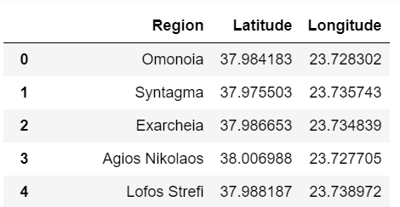
3. Methodology (1/5)
Regions from Wikipedia
“geopy” library in Python
Coordinates
(for almost all regions)
“geopy” does not have coordinates for all regions of Athens, so we will keep only the regions for which we have data to work with. We address this issue with “try-except” and we finally have 52 regions remaining (out of the initial 77). Still, they are sufficient for our analysis.
We then construct a Pandas Dataframe with the Regions, Latitudes and Longitudes.

Slide 7
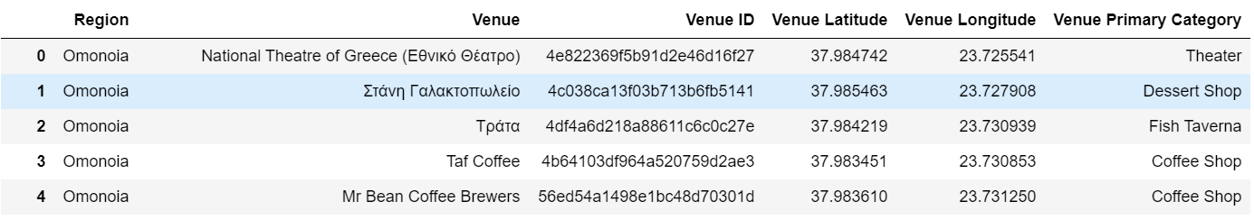
3. Methodology (2/5)
Multiple venues per region
Foursquare
(Developer account)
For simplicity reasons, we decide on a few steps:
We will select the 20 most popular types of venues, so as to perform a representative analysis.
We are not interested in Gyms (not a tourist attraction).
we will combine "cafe" and "coffee shops" into one category.
We will combine “Meze Restaurant" and "Greek Restaurant" into one category (as "meze" refers to traditional Greek food).
As a result, there are 17 venue types remaining.
One hot encoding in order to transform the venue category of every row into features of 0s and 1s (necessary part when having categorical features)

Slide 8
3. Methodology (3/5)
Clustering:
Group the data to have one row per region and compare their venues to find how similar they are.
Scale the data, because clustering is based on distances (very popular venues might "dominate" the less popular ones).
Unsupervised Learning Algorithm, i.e. not based on labeled data and we also do not know the appropriate number of clusters that would give the best performance.

Slide 9
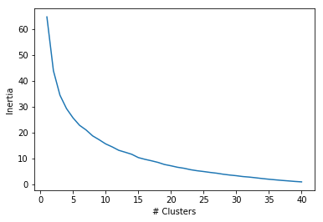
3. Methodology (4/5)
Clustering:
Solution to finding number of clusters: Elbow Method
We can set the appropriate number of clusters between 4 and 10 because, as the number of clusters increases, there is no significant decrease of inertia (i.e. increase of performance), so there is no point working with more clusters.
For simplicity reasons, we set the number of clusters to 4.
“elbow”

Slide 10
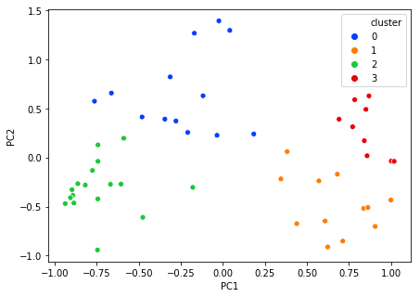
3. Methodology (5/5)
Principal Component Analysis (PCA):
Unsupervised Leaning Algorithm, which decreases the number of features in such a way that new features are constructed in order to keep as much explainability as possible.
The dataset has many features (i.e. every region has multiple venues) and it is not easy to plot the data. So, PCA with 2 components.
In total, the two new features explain about 61% of the initial variance in the data. It is fair enough, taking into consideration that we have 17 venues for every region.
Silhouette Score = 27%

Slide 11
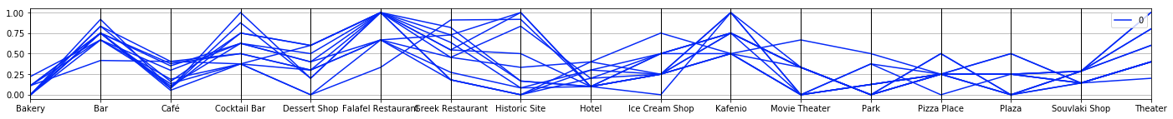
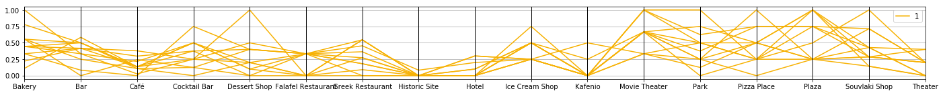
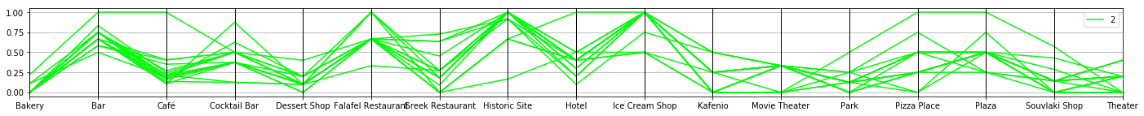
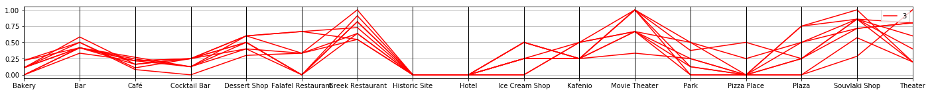
4. Results (Parallel Plots)

Slide 12
5. Discussion (1/2) (Parallel Plots)
Cluster 0 (blue) consists mainly of Bars, Falafel Restaurants, Kafenios (traditional Greek cafeterias), Historic places and some Theaters. This seems like regions in the center of Athens, with their historic places and monuments.
Cluster 1 (orange) seems balanced overall, having a bit of everything but no Historic sites or Hotels. It seems to refer to more suburban areas rather than the city center.
Cluster 2 (green) seems similar to cluster 0 (blue) but with more Historic sites, Ice Cream shops, Plazas, Pizza and Souvlaki shops but, on the contrary, fewer Kafenios, Theaters and Movie Theaters. This also seems like being at the center of Athens.
Cluster 3 (red) mainly consists of Restaurants, Food places and Theaters, probably outside the center. It seems like cluster 1 (orange) but with less options.

Slide 13
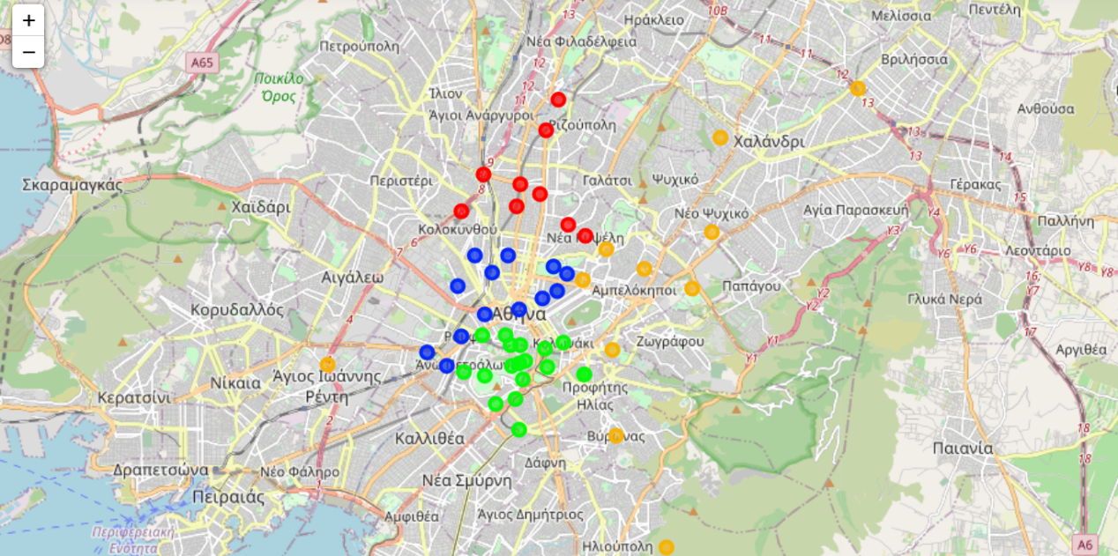
5. Discussion (2/2) (“Folium” Map)
As we can also see in the following map, Clusters 0 (blue) and 2 (green) are indeed located in the center of Athens, as indicated by their Parallel Plots:

Slide 14
6. Conclusion
In this report:
We analyzed the regions of Athens and their similarities in terms of their most popular venues, according to Foursquare.
We grouped them into clusters, viewed them on a map and gained meaningful insights.
These insights could be helpful in personalizing tourist offers or deciding on the correct business at the most appropriate place.
Next steps:
Try different clustering algorithms, with various number of clusters.
Predict the ratings for a new venue based on similar places.

Slide 15
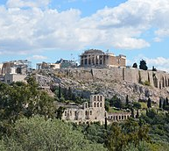
Thank you!

