Slide 1
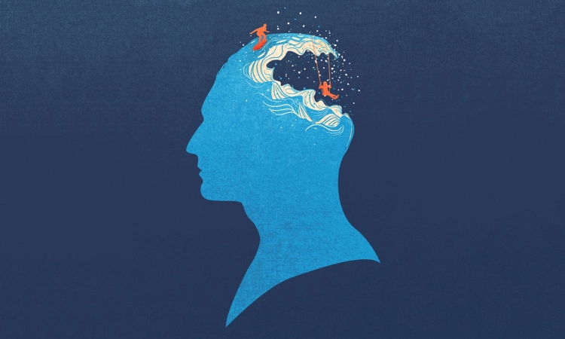

Personality Prediction
FUN PART OF MACHINE LEARNING

Slide 2




Table of Content
Define the Cluster
OCEAN Model
Define the Algorithm
Test the Model
Visualize the Cluster
Evaluate the Results
Define the dataset
Clean the dataset
Visualize the dataset
Train the Model
Improve the Model
Visualize the Model

Slide 3
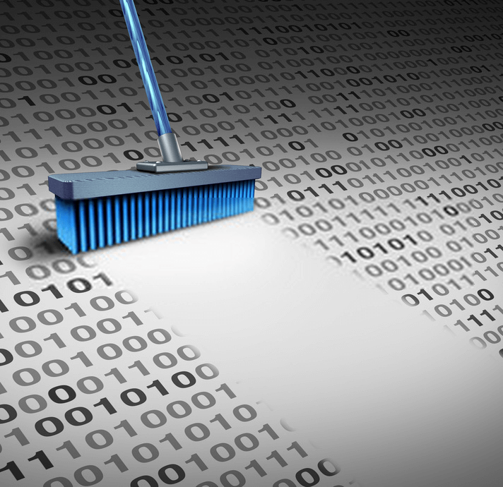
Defining the dataset
Choose a dataset
Import Libraries
Apply functions
Analyze the dataset
Find the empty columns
Visualize the outliers

Slide 4
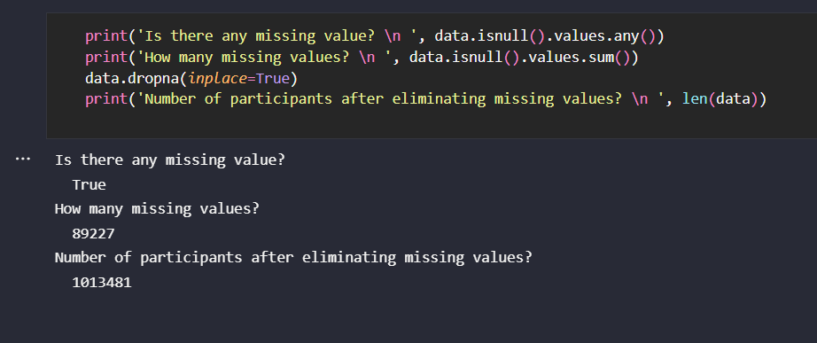
Clean the dataset

Slide 5
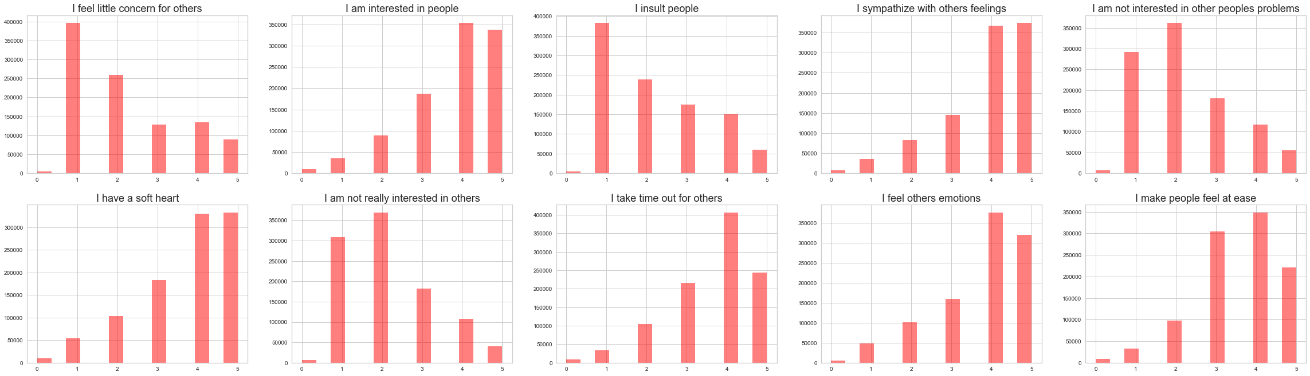
Analyze the dataset
Visualize the rows and columns into graphs & finding the trend

Slide 6
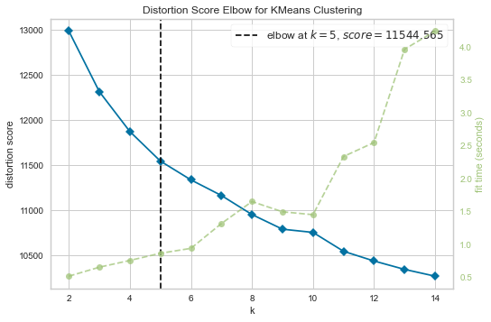
from sklearn.cluster import KMeans from yellowbrick.cluster import KElbowVisualizer kmeans = KMeans() visualizer = KElbowVisualizer(kmeans, k=(2,15)) visualizer.fit(df_sample) visualizer.poof()
Defining the cluster

Slide 7
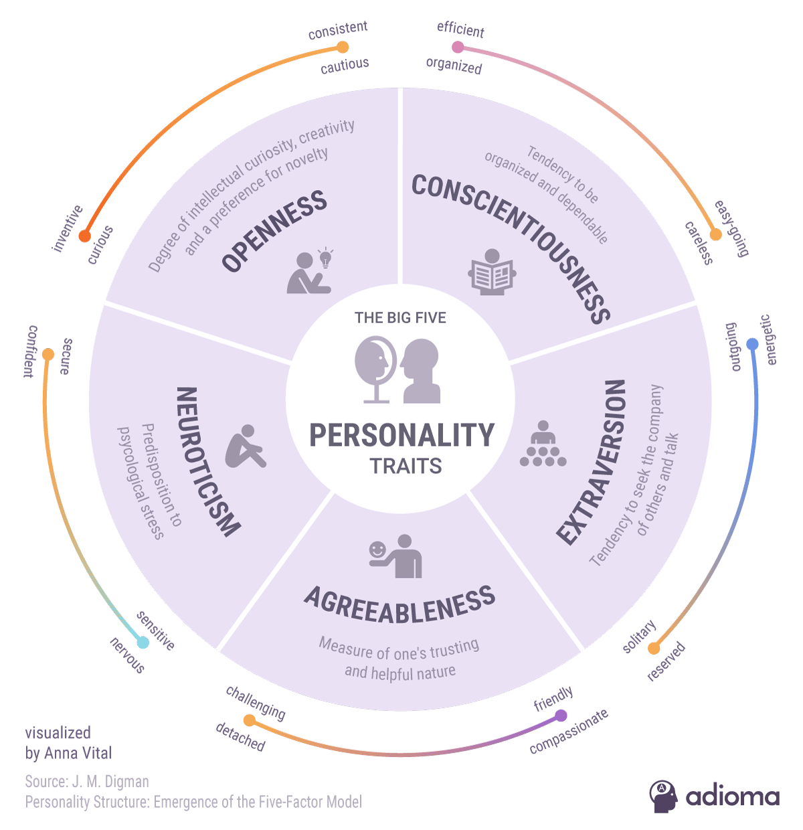
OCEAN Model
It is a psychological model used to identify different broad behaviors within a workplace.
It is the most accepted personality model in academic research and psychology.

Slide 8
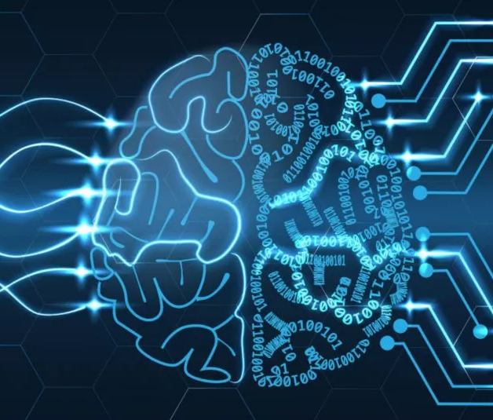
Train the Model
from sklearn.cluster import KMeans
kmeans = KMeans(n_clusters=5)
k_fit = kmeans.fit(df_model)

Slide 9
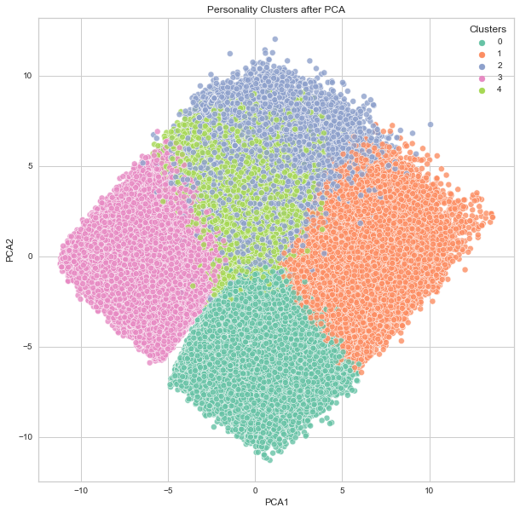
Improve the Model
Visualize the Predictions
Improve the Model
PCA Model

Slide 10
Test the Model
data = pd.read_excel('../dataset/test_data.xlsx')
personality = k_fit.predict(data)

Slide 11

Results and Findings
my_sums['extroversion'] = my_data[ext].sum(axis=1)/10
my_sums['neurotic'] = my_data[est].sum(axis=1)/10
my_sums['agreeable'] = my_data[agr].sum(axis=1)/10
my_sums['conscientious'] = my_data[csn].sum(axis=1)/10
my_sums['open'] = my_data[opn].sum(axis=1)/10
my_sums['cluster'] = my_personality

Slide 12
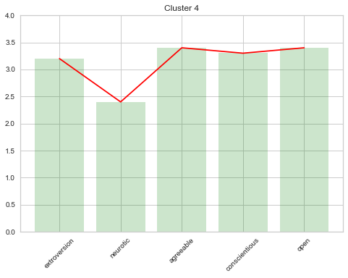
Visualize the cluster
Group the results
Sum up each attribute
Plot the features
Draw the curve

Slide 13
Wait !!! We have GUI as well
Frontend created in Node (JS)
Backend created in Flask (python) with integration of model

Slide 14
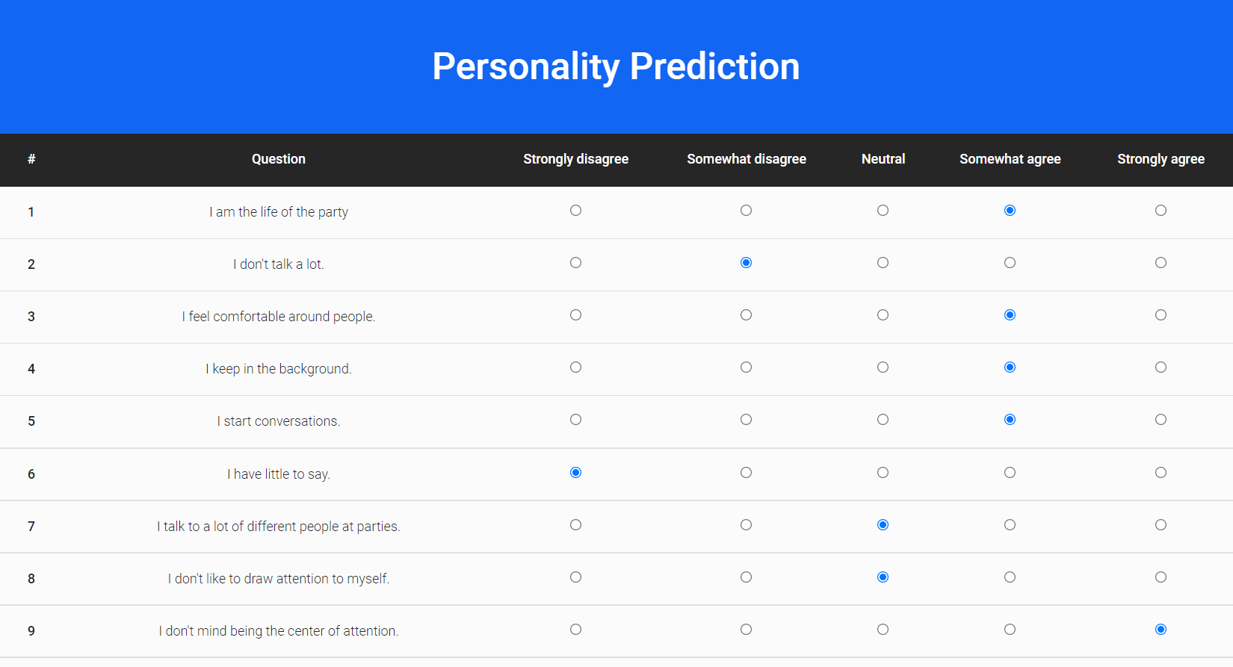

Slide 15
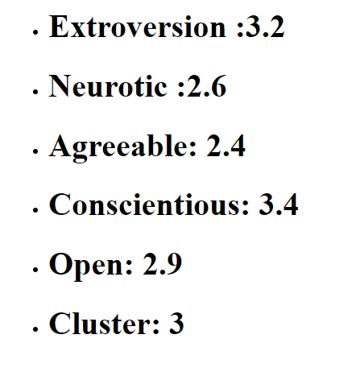

Slide 16

Clap for us and thanks for learning carefully
Any Question ?

