Slide 1
EEE 440 Computer Architecture
Lecture 02- Instruction Set Architecture

Slide 2
Computer Program
Instructions & Data
Binary Numbers
Assembly Language
Low Level close to hardware
One line instruction
Assembler
High Level Language
Compiler

Slide 3
Benefits of HLL
Closer to Natural Languages
C++
FORTRAN scientific computation
COBOL business data processing
Increased Programmer productivity
Small and concise code
Easy and Quick Programming
Independent of Hardware Platform
Compiler converts HLL code to target code

Slide 4
Assembly Language
Basic job of a CPU: execute lots of instructions.
Instructions are the primitive operations that the CPU may execute.
Different CPUs implement different sets of instructions. The set of instructions a particular CPU implements is an Instruction Set Architecture (ISA).
Examples: Intel 80x86 (Pentium 4), IBM/Motorola PowerPC (Macintosh), MIPS, Intel IA64, ...

Slide 5
Instruction Set Architectures
Early trend was to add more and more instructions to new CPUs to do elaborate operations
VAX architecture had an instruction to multiply polynomials!
RISC philosophy (Cocke IBM, Patterson, Hennessy, 1980s) – Reduced Instruction Set Computing
Keep the instruction set small and simple, makes it easier to build fast hardware.
Let software do complicated operations by composing simpler ones.

Slide 6


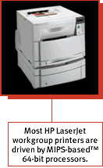
MIPS Architecture
MIPS – semiconductor company that built one of the first commercial RISC architectures
We will study the MIPS architecture in detail in this class
Why MIPS instead of Intel 80x86?
MIPS is simple, elegant. Don’t want to get bogged down in gritty details.
MIPS widely used in embedded apps, x86 little used in embedded, and more embedded computers than PCs
NEC, Silicon Graphics, Nintendo, Sony etc.

Slide 7
RISC - Reduced Instruction Set Computer
RISC philosophy
fixed instruction lengths
load-store instruction sets
limited addressing modes
limited operations
MIPS, Sun SPARC, HP PA-RISC, IBM PowerPC, Intel (Compaq) Alpha, …
Instruction sets are measured by how well compilers use them as opposed to how well assembly language programmers use them
Notes:
As opposed to CISC – Complicated Instruction Set Architecture (ala the x86)

Slide 8
Assembly Variables: Registers
Unlike HLL like C or Java, assembly cannot use variables
Why not? Keep Hardware Simple
Assembly Operands are registers
limited number of special locations built directly into the hardware
operations can only be performed on these!
Benefit: Since registers are directly in hardware, they are very fast (faster than 1 billionth of a second)

Slide 9
Assembly Variables: Registers
Drawback: Since registers are in hardware, there are a predetermined number of them
Solution: MIPS code must be very carefully put together to efficiently use registers
32 registers in MIPS
Why 32? Smaller is faster
Each MIPS register is 32 bits wide
Groups of 32 bits called a word in MIPS

Slide 10
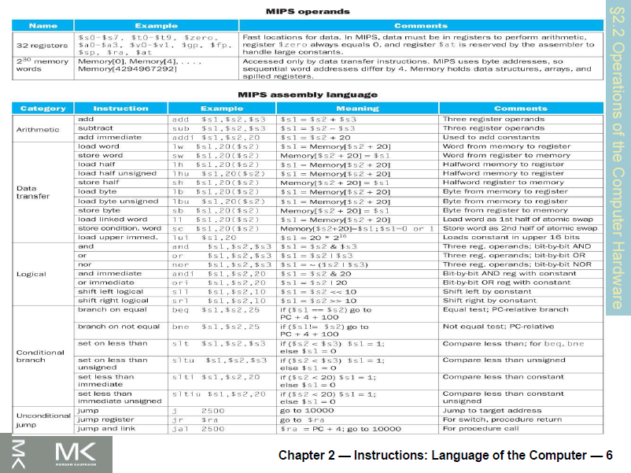

Slide 11
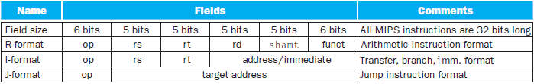
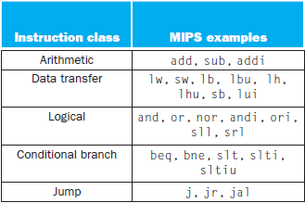

Slide 12
MIPS Registers
Name | Reg. No. | Usage | Preserved on Call?
$zero | 0 | const. value | n.a.
$v0 - $v1 | 2-3 | values | No
$a0 - $a3 | 4-7 | arguments | Yes
$t0 - $t7 | 8-15 | temporaries | No
$s0 - $s7 | 16-23 | saved | Yes
$t8 - $t9 | 24-25 | temporaries | No
$gp | 28 | Global pointer | Yes
$sp | 29 | Stack pointer | Yes
$fp | 30 | Frame Pointer | Yes
$ra | 31 | Return address | Yes

Slide 13
Category | Instr | Op Code | Example | Meaning
Arithmetic (R & I format) | add | 0 and 32 | add $s1, $s2, $s3 | $s1 = $s2 + $s3
 | subtract | 0 and 34 | sub $s1, $s2, $s3 | $s1 = $s2 - $s3
 | add immediate | 8 | addi $s1, $s2, 6 | $s1 = $s2 + 6
 | or immediate | 13 | ori $s1, $s2, 6 | $s1 = $s2 v 6
Data Transfer (I format) | load word | 35 | lw $s1, 24($s2) | $s1 = Memory($s2+24)
 | store word | 43 | sw $s1, 24($s2) | Memory($s2+24) = $s1
 | load byte | 32 | lb $s1, 25($s2) | $s1 = Memory($s2+25)
 | store byte | 40 | sb $s1, 25($s2) | Memory($s2+25) = $s1
 | load upper imm | 15 | lui $s1, 6 | $s1 = 6 * 2¹⁶
Cond. Branch (I & R format) | br on equal | 4 | beq $s1, $s2, L | if ($s1==$s2) go to L
 | br on not equal | 5 | bne $s1, $s2, L | if ($s1 !=$s2) go to L
 | set on less than | 0 and 42 | slt $s1, $s2, $s3 | if ($s2<$s3) $s1=1 else $s1=0
 | set on less than immediate | 10 | slti $s1, $s2, 6 | if ($s2<6) $s1=1 else $s1=0
Uncond. Jump (J & R format) | jump | 2 | j 2500 | go to 10000
 | jump register | 0 and 8 | jr $t1 | go to $t1
 | jump and link | 3 | jal 2500 | go to 10000; $ra=PC+4
Notes:
similarity of the binary representation of related instructions simplifies the hardware design

Slide 14
Assembly Variables: Registers
Registers are numbered from 0 to 31
Each register can be referred to by number or name
Number references:
$0, $1, $2, … $30, $31

Slide 15
Assembly Variables: Registers
By convention, each register also has a name to make it easier to code
For now:
$16 - $23 ➔ $s0 - $s7
(correspond to C variables)
$8 - $15 ➔ $t0 - $t7
(correspond to temporary variables)
Later will explain other 16 register names
In general, use names to make your code more readable

Slide 16
C, Java variables vs. registers
In C (and most High Level Languages) variables declared first and given a type
Example: int fahr, celsius; char a, b, c, d, e;
Each variable can ONLY represent a value of the type it was declared as (cannot mix and match int and char variables).
In Assembly Language, the registers have no type; operation determines how register contents are treated

Slide 17
Comments in Assembly
Another way to make your code more readable: comments!
Hash (#) is used for MIPS comments
anything from hash mark to end of line is a comment and will be ignored
This is just like the C //
Note: Different from C.
C comments have format /* comment */ so they can span many lines

Slide 18
Assembly Instructions
In assembly language, each statement (called an Instruction), executes exactly one of a short list of simple commands
Unlike in C (and most other High Level Languages), each line of assembly code contains at most 1 instruction
Instructions are related to operations (=, +, -, *, /) in C or Java

Slide 19
MIPS Addition and Subtraction
Syntax of Instructions:
1 2,3,4
where:
1) operation by name
2) operand getting result (“destination”)
3) 1st operand for operation (“source1”)
4) 2nd operand for operation (“source2”)
Syntax is rigid:
1 operator, 3 operands
Why? Keep Hardware simple via regularity

Slide 20
Addition and Subtraction of Integers
Addition in Assembly
Example: add $s0,$s1,$s2 (in MIPS)
Equivalent to: a = b + c (in C)
where MIPS registers $s0,$s1,$s2 are associated with C variables a, b, c
Subtraction in Assembly
Example: sub $s3,$s4,$s5 (in MIPS)
Equivalent to: d = e - f (in C)
where MIPS registers $s3,$s4,$s5 are associated with C variables d, e, f

Slide 21
Add Instruction
Instructions, like registers and words of data, are 32 bits long
Arithmetic Instruction Format (R format):
add $t0, $s1, $s2
op rs rt rd shamt funct
op 6-bits opcode that specifies the operation
rs 5-bits register file address of the first source operand
rt 5-bits register file address of the second source operand
rd 5-bits register file address of the result’s destination
shamt 5-bits shift amount (for shift instructions)
funct 6-bits function code augmenting the opcode

Slide 22
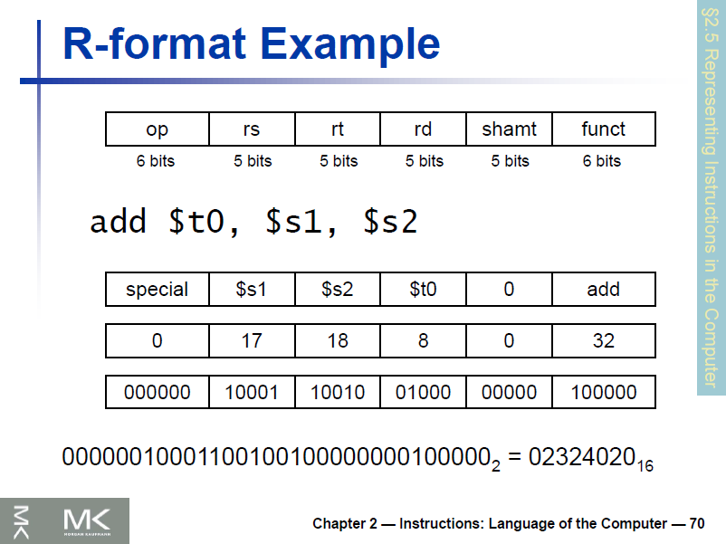

Slide 23
Addition and Subtraction of Integers
How do the following C statement?
a = b + c + d - e;
Break into multiple instructions
add $t0, $s1, $s2 # temp = b + c
add $t0, $t0, $s3 # temp = temp + d
sub $s0, $t0, $s4 # a = temp - e
Notice: A single line of C may break up into several lines of MIPS.
Notice: Everything after the hash mark on each line is ignored (comments)

Slide 24
Addition and Subtraction of Integers
How do we do this?
f = (g + h) - (i + j);
Use intermediate temporary register
add $t0,$s1,$s2 # temp = g + h
add $t1,$s3,$s4 # temp = i + j
sub $s0,$t0,$t1 # f=(g+h)-(i+j)

Slide 25
Register Zero
One particular immediate, the number zero (0), appears very often in code.
So we define register zero ($0 or $zero) to always have the value 0; eg
add $s0,$s1,$zero (in MIPS)
f = g (in C)
where MIPS registers $s0,$s1 are associated with C variables f, g
defined in hardware, so an instruction
add $zero,$zero,$s0
will not do anything!

Slide 26
Immediates
Immediates are numerical constants.
They appear often in code, so there are special instructions for them.
Add Immediate:
addi $s0,$s1,10 (in MIPS)
f = g + 10 (in C)
where MIPS registers $s0,$s1 are associated with C variables f, g
Syntax similar to add instruction, except that last argument is a number instead of a register.

