Slide 1
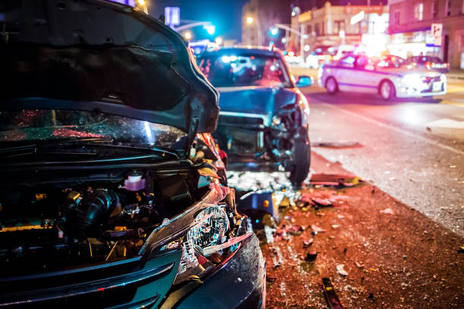
Crash Analysis
By Group 7
Crash
Analysis

Slide 2
Business Understanding
This project analyses road traffic crash data to help public safety agencies and policymakers enhance road safety by addressing three objectives. These insights will support targeted interventions, efficient resource allocation and data-driven policies to reduce crash frequency and severity.
Business Questions
Which factors are most associated with severe or fatal injuries?
When and where do serious crashes most frequently occur and how do injury patterns vary?
How do safety measures impact crash frequency and injury severity?

Slide 3
Objectives
Identify and analyse key risk factors contributing to crash severity.
Examine temporal and situational patterns in crash and injury severity.
Evaluate the impact of preventive measures on crash outcomes.
Modelling Objective: Build and evaluate predictive models to classify or predict injury severity based on available features

Slide 4
Data Understanding
Datasets:
cpd-traffic-crashes Crash data shows information about each traffic crash on city streets within the City of Chicago limits and under the jurisdiction of Chicago Police Department (CPD).
cpd-traffic-crashes-people This data contains information about people involved in a crash and if any injuries were sustained.
cpd-traffic-crashes-vehicles This dataset contains information about vehicles (or units as they are identified in crash reports) involved in a traffic crash.
The three datasets were utilized to gain a comprehensive understanding of cash data involving both individuals and vehicles.

Slide 5
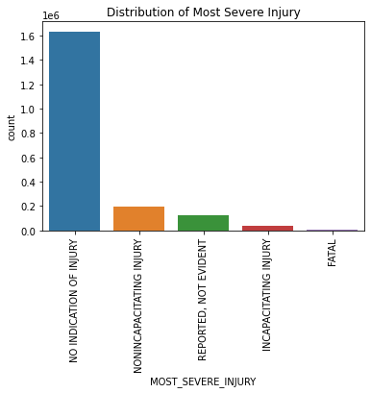
Findings
The above chart highlights the frequency of each injury type, showing which outcomes are most common. The taller bars like "NO INDICATION OF INJURY" suggest that most crashes lead to minor injury while shorter bars for "INCAPACITATING INJURY" or "FATAL" indicate that there are rarer, severe cases on most occasion of a crash.

Slide 6
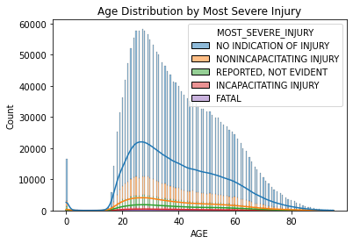
Most crash-involved individuals fall within the young to middle-age range of around 20-40 years. Less severe injuries dominate across all ages while severe outcomes appear more frequently at younger and older age extremes.

Slide 7
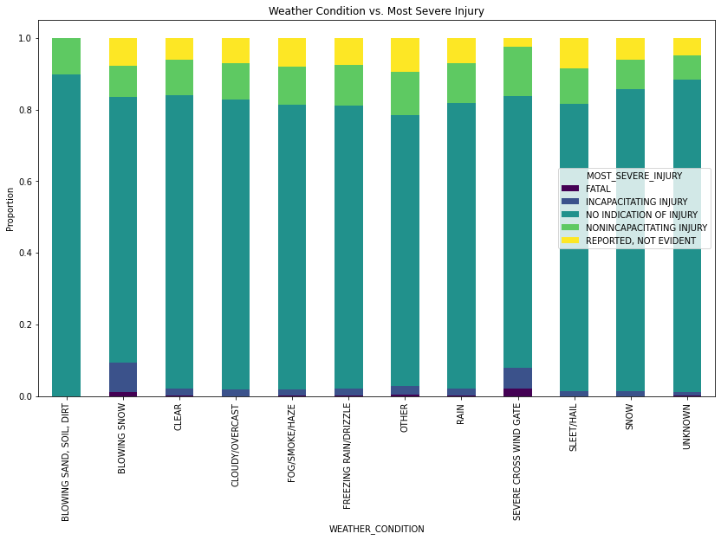

Slide 8
Most crashes across all weather conditions result in minor or no injuries. Severe injuries appear slightly more common in adverse conditions including snow and windy conditions. This suggests weather may influence injury severity.

Slide 9
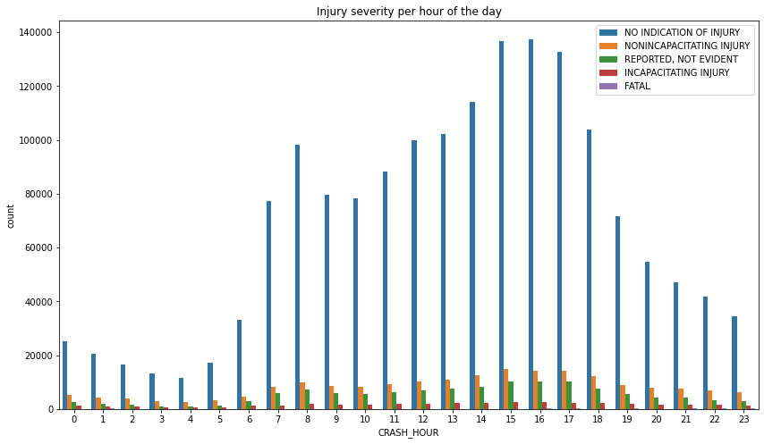

Slide 10
Crash frequency peaks during the morning rush hours and in the afternoon rush hours which are typically commute hours. Most injuries are minor, but severe injuries occur steadily throughout the day suggesting risk exists beyond peak traffic times.
The line plot shows the total number of crashes that occured during each hour of the day.

Slide 11
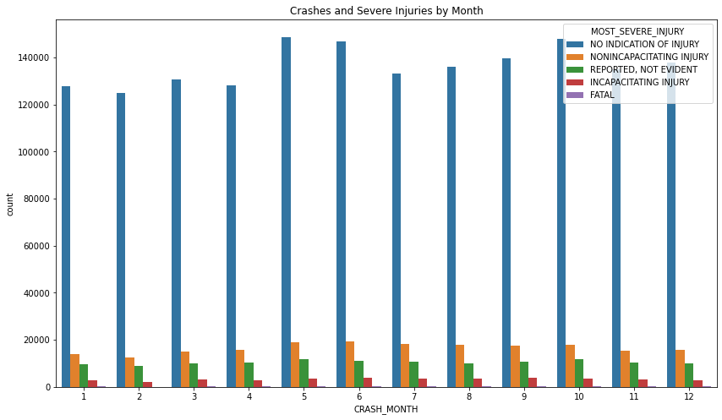

Slide 12
Crash frequency remains fairly consistent throughout the year with slight peaks in warmer months like May and July. Severe injuries are relatively stable across months suggesting seasonality has limited influence on injury severity.

Slide 13
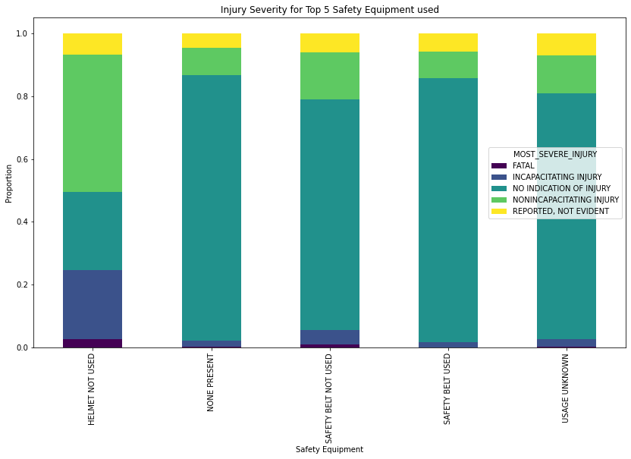
The stacked bar chart compares injury severity proportions for the five most frequently used types of safety equipment. Most individuals using safety belts experience minor or no injuries, while less common equipment types show higher proportions of severe injuries. This highlights the effectiveness of safety belts in reducing injury severity during crashes.

Slide 14
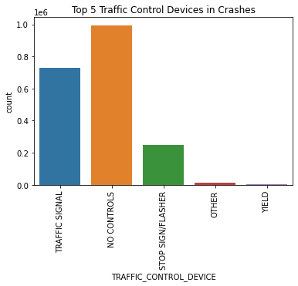
The bar chart displays the five most common traffic control devices present at crash scenes, with "NO CONTROLS" and "TRAFFIC SIGNAL" being the most frequent. This highlights intersections and uncontrolled areas as key locations for crash occurrences.

Slide 15
Our Modelling Approach
We decided to make use of several models, namely logistic regression, decision tree, random forest, AdaBoost and XGBoost models.
Each model was trained using a robust pipeline with hyperparameter tuning using GridSearchCV for optimal model performance.
After intense deliberation, it seemed that the best model was the tuned decision tree, as it had relatively decent accuracy, and was best at classifying minority classes, making it the best model in terms of generalization and fairness.

Slide 16
Conclusions
Most road traffic crashes in Chicago lead to minor or no injuries, with serious injuries—such as fatalities or incapacitating harm—remaining relatively uncommon.
The use of safety equipment, particularly seat belts, shows a strong correlation with lower injury severity, emphasizing its vital role in improving crash outcomes.
Factors like speed limits, weather, and time of day significantly impact crash rates and injury severity, with elevated risks during peak traffic hours and unfavorable weather conditions.

Slide 17
Recommendations
Continue to promote and strictly enforce seat belt use and other proven safety measures to help further reduce the severity of injuries in traffic incidents.
Deploy targeted safety interventions during high-risk times—such as rush hours and poor weather—and in areas with higher speed limits to curb crash rates and their severity.
Mitigate class imbalance in predictive models by employing techniques like SMOTE or other resampling strategies to enhance the model’s ability to identify severe injury cases.

Slide 18
Next Steps
Incorporate supplementary datasets (e.g., traffic flow data, law enforcement activity) to enrich the analysis and improve model precision.
Investigate more sophisticated modeling techniques (e.g., ensemble learning, deep neural networks) and apply advanced feature engineering to boost prediction performance, particularly for underrepresented injury classes.
Design and implement interactive dashboards for dynamic visualization and tracking of crash patterns, risk indicators, and model predictions to aid data-driven decision-making by relevant authorities.

Slide 19


