Slide 1

PROJECT TITLE: DATA DRIVEN INSIGHTS TO LAUNCH A SUCCESSFUL MOVIE STUDIO PROJECT PRESENTATION
Contributors:
Billy Sambasi, Judy Chepkemoi, Purity Wambui, Sharon Thiga, Samson Nguthi.

Slide 2
Business Understanding
The company recognizes the increasing demand for data-driven decision-making in the entertainment industry and aims to establish a competitive movie studio. To achieve this, the company seeks to leverage data analytics to gain a comprehensive understanding of the factors influencing box office success. This includes identifying high-performing genres, analyzing audience preferences across demographics and regions, and evaluating seasonal and regional trends. By uncovering actionable insights, the company aims to optimize its content strategy, maximize revenue, and create impactful movies that resonate with audiences globally.

Slide 3
Project Overview
The project entails how we carried out Exploratory Data Analysis on several datasets to uncover patterns and insights that gave us informed decisions based on our findings.
Objectives
1. Identify Top-Performing Movie Genres Analyze which genres (e.g., Action, Comedy, Drama) consistently generate the highest box office revenue to guide future content strategy.
2. Evaluate seasonal and regional trends
3. Identify movie ratings and audience preferences for various genres
4. Analyze the relationship between production budget and worldwide revenue

Slide 4
Loading and Understanding the Data
Importing the Data with the necessary libraries, recognizing the rows and columns of the dataset, inspecting for duplicates and identifying missing values.
The dataframes loaded included:
- box_office_mojo (CSV)
- the_movies_db (CSV)
- movie_numbers (CSV)
- movie_ratings (SQL)
- movie_basics (SQL)
Cleaning and Normalizing the Data
Dropping of unnecessary columns for driven analysis.
Replacing and filling missing values.
Changing column data types to proper and easily manageable data types.

Slide 5
Data Analysis
1. Hypothesis Testing
Null Hypothesis (H₀)
"There is no significant relationship between a movie's average audience rating and its worldwide gross revenue."
This suggests that variations in audience ratings do not have any meaningful effect on a movie's revenue.
Alternative Hypothesis (H₁)
"There is a significant relationship between a movie's average audience rating and its worldwide gross revenue."
This implies that audience ratings and worldwide revenue are statistically associated, indicating that higher ratings might correlate with higher revenue or vice versa.

Slide 6
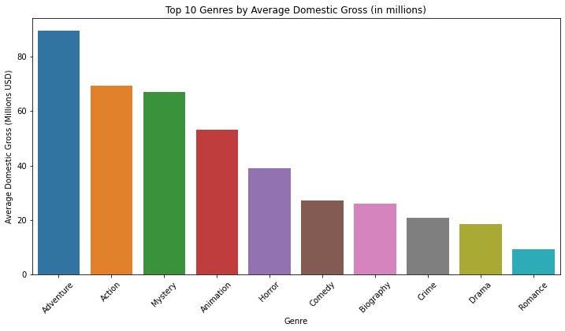
2. Data Visualization
Objective 1: Top-Performing Movie Genres
Analyzes which genres (e.g., Action, Comedy, Drama) consistently generate the highest box office revenue to guide future content strategy.

Slide 7
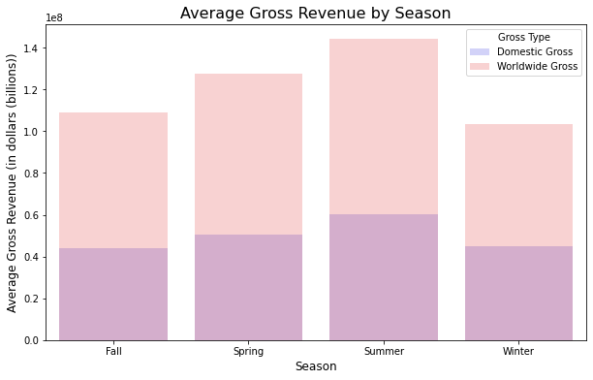
2. Data Visualization
Objective 2: Evaluate seasonal and regional trends
Gross Revenue by Season

Slide 8
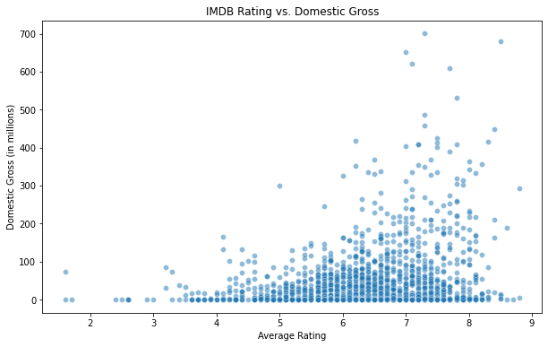
2. Data Visualization
Objective 3: Identify movie ratings and audience preferences for various genres

Slide 9
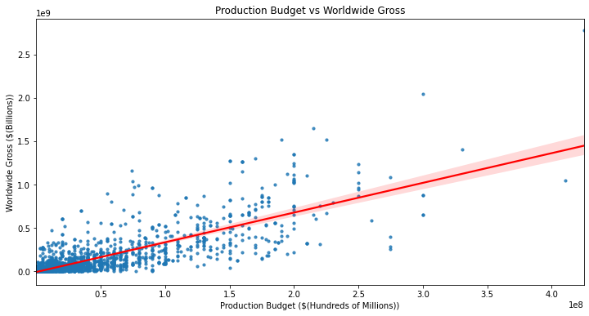
2. Data Visualization
Objective 4: Analyze the relationship between production budget and worldwide revenue

Slide 10
Conclusions
Focus on high performing genres which include adventure, action and mystery which had the 3 highest average domestic gross.
Average gross revenue by season shows that Summer has the highest average worldwide and domestic gross, followed by Spring. Winter and Fall have comparatively lower average gross revenues.
The movies with rating more than 8 had the most average domestic gross.
Production budgets between $50m and $150m has a higher worldwide gross.
Recommendations
Launch with mid-budget Blockbusters which are action and adventure between May and July.
Launch movies around summer season for more gross revenues.
Focus on genres of movies with higher average ratings so as to have more domestic gross.
When making movies, focus on the genres of movies with higher ratings for more domestic gross. Averagely rated movies make the most money domestically.
Focus on mid sized production budgets between $50m and $150m to optimize return on investment and avoid high risk.

Slide 11
Next Steps
1. Refine Genre and Seasonal Strategy: perform deeper analyses on sub-genres within Adventure, Action, and Mystery to identify niche markets or investigate specific summer months (e.g., June vs. July) to pinpoint the most profitable movie release windows.
2. Assess Budget Allocation: conduct sensitivity analyses to further validate the recommended budget range of $50M–$150M and explore cost-reduction opportunities in production workflows while maintaining quality.
3. Test the Recommendations: utilize A/B testing on smaller-scale movie launches to validate insights (e.g., releasing movies with different budgets or genres in summer vs. winter) and compare gross revenue outcomes to ensure alignment with expected patterns.

