Slide 1

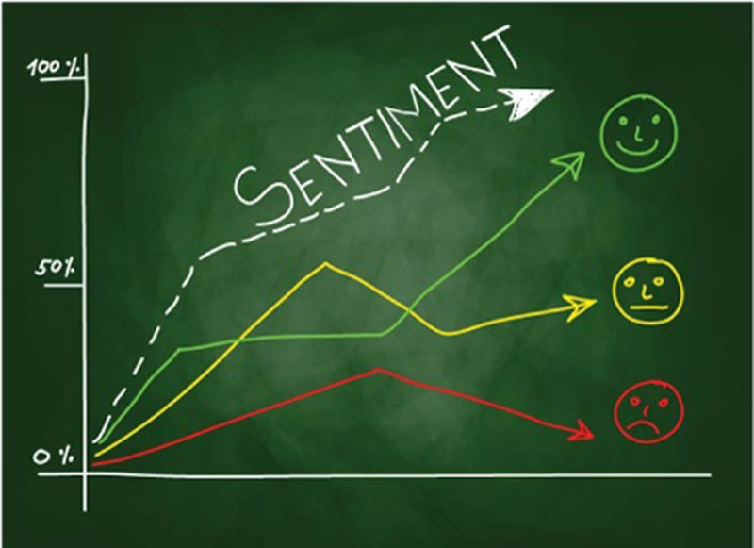

Slide 2

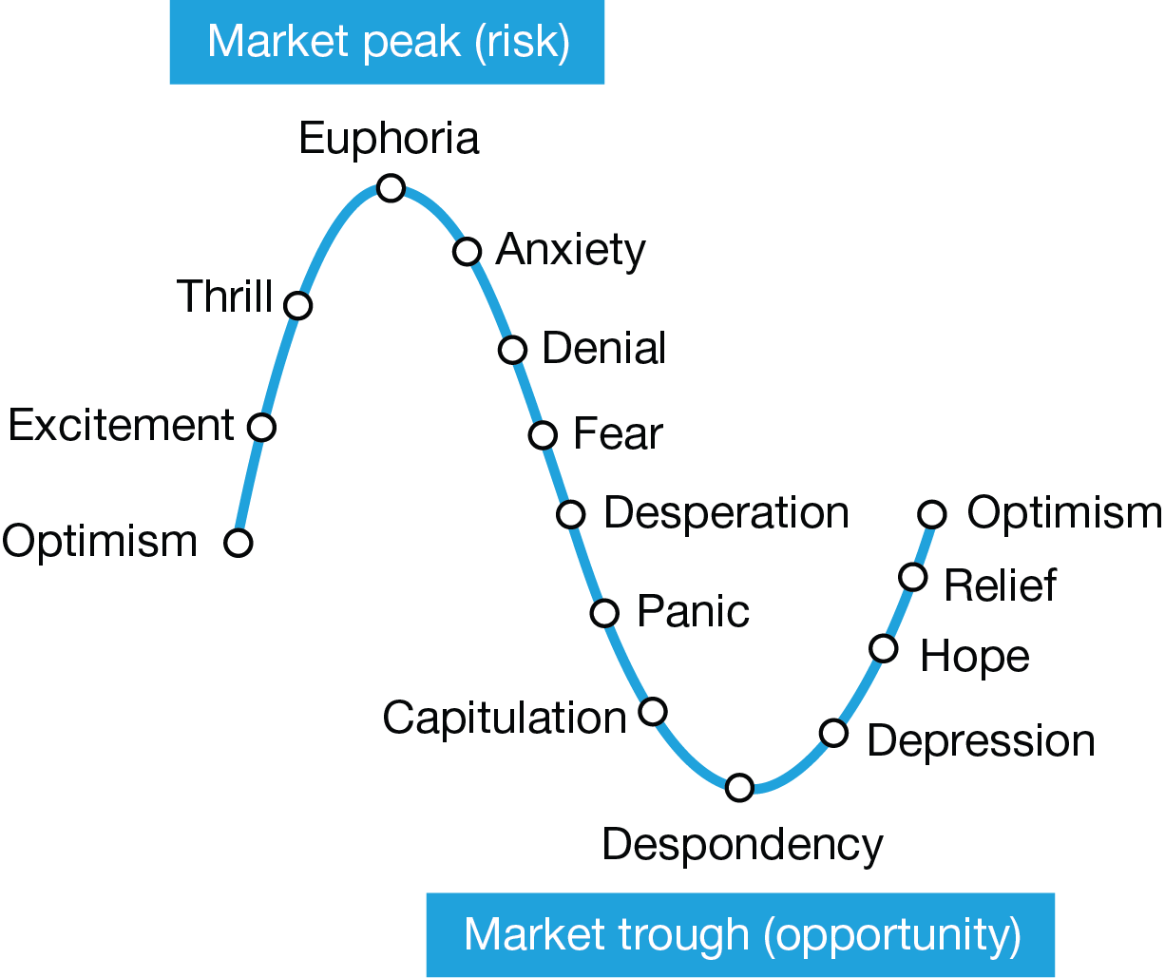
Use case
Notes:
Use Case – (1) To leverage sentiments to analyze and predict stock trend
(2)

Slide 3
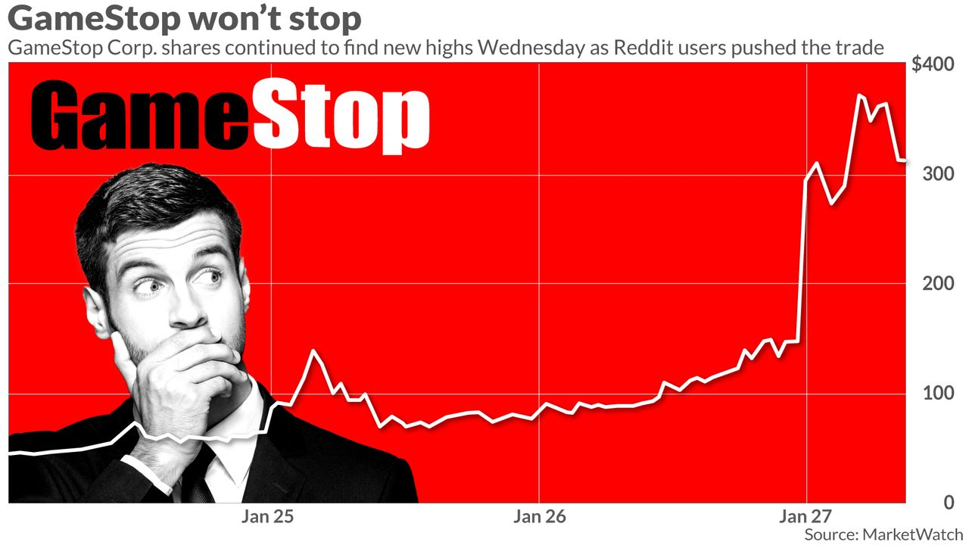

Motivation
Notes:
Motivation (1) You guys

Slide 4
Technologies
Machine learning models
Flask
Javascript
Python
Html
VS Studio
Jupyter lab
Notes:
Methods

Slide 5

Challenges
Volume of data > 2000 rows
Cleaning tedious , special characters, spaces
Separating redundant data
Loading Issue due to Volume
Challenging to organize stocks or group them
Model challenges

Slide 6
Overall market sentiment

Slide 7
Industry wise Market Sentiment

Slide 8
Correlations between sentiments

Slide 9
Polarity vs Positive vs Negative vs Neutral

Slide 10
Stocks trend

Slide 11
Demo

