Slide 1
A Look at How We Tip: NYC Taxi Data
Emily Lin
Billy Shaw Susanto
Thomas Liu

Slide 2
Agenda
Data Collection
Preprocessing
Visualization
Analysis
Conclusion

Slide 3
Data Collection
Obtained through the NY Freedom of information law (FOIL)
Chris Whong requested it from the NYC limousine and taxi commission
~ 170 million rows
Roughly 50 GB of raw data
Notes:
Chris Whong FOIL –ed it
We downloaded
Mention the size of it (15 million entries time 12)

Slide 4
Understanding the Data
Trip_data_1.csv [0:6]
Notes:
Link each trip’s

Slide 5
Understanding the Data
Fare_data_1.csv [500:506]

Slide 6
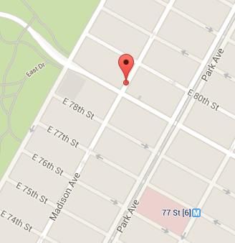
Data Pre-processing
Reverse geocoding
Latitude/longitude to NYC neighborhoods (East Village, etc..)

Slide 7
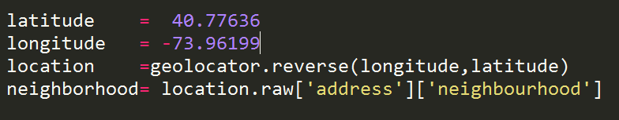
Data Pre-processing [GeoPy]
GeoPy
Package in Python
Reverse geolocator

Slide 8
Data Pre-processing [GeoPy]
Geocoded 31 MB of data in 18 hours
Out of 30 GB of trip data
Not viable
Extremely Slow
Various web server time out errors

Slide 9
Data Pre-processing [Offline]
Create our own geo-coding data
Sample average longitude and latitude from 31MB of geocoded data
233 unique neighborhoods

Slide 10
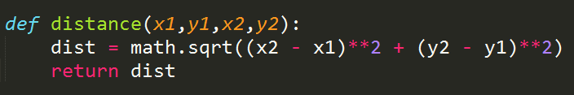
Data Pre-processing [Offline]
Compare each longitude and latitude to our geocode data
Find closest neighborhood
Created 15 GB of geocoded data in 12 hours
Our data:
~75M rows, 22 GB raw
5GB after cleanup

Slide 11
General Visualization
Neighborhood data

Slide 12
Our Questions
Which neighborhoods are most popular for pick up / drop off?
At which time do New Yorkers take cab rides the most / least?
Which times have the highest / lowest average speed?
General tip percentages?
Credit card vs. cash per neighborhood?

Slide 13
Top neighborhoods
Pickup
Dropoff
Notes:
Tableau density

Slide 14
Visualization
Average speed per pickup hour
Average pickups per hour

Slide 15
Tip percentages
20.2%: Average tip
Credit card data only
3.02%: Non-tippers
2.2M rides
8.75%: People who tip exactly $1
6.4M rides

Slide 16
Regression Analysis: What affects tip?
Neighborhood?
Distance?

Slide 17
Neighborhood and Tip
Tableau

Slide 18
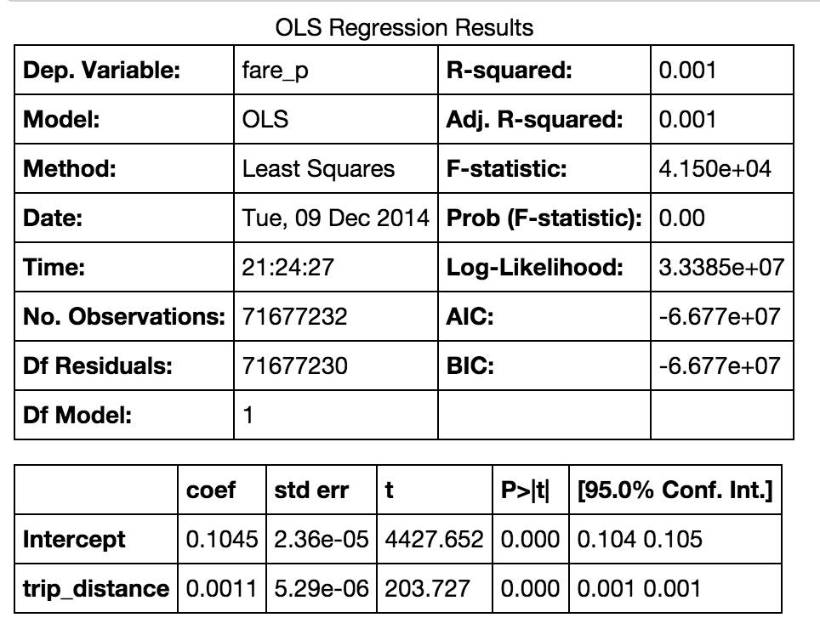
Distance and Tip

Slide 19
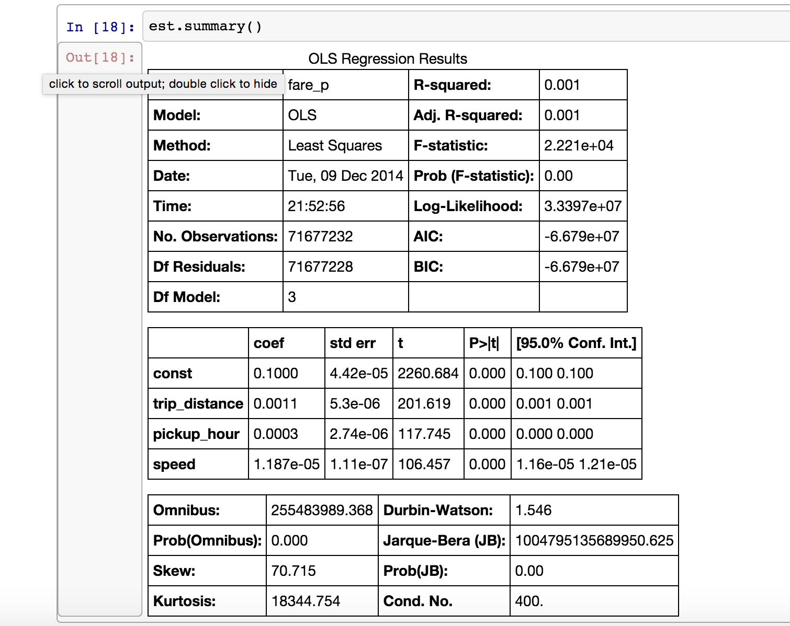
Pickup Hour + Speed and Tip

Slide 20
Payment Type by Neighborhood
54% of taxi rides use credit card

Slide 21
Conclusions
Average tip: ~20%
Taxi UI/UX matters
Richer neighborhoods
Tip marginally more
Except UES
Use more credit cards

Slide 22
Questions?

