Slide 1

Association of Computing Machinery

Slide 2
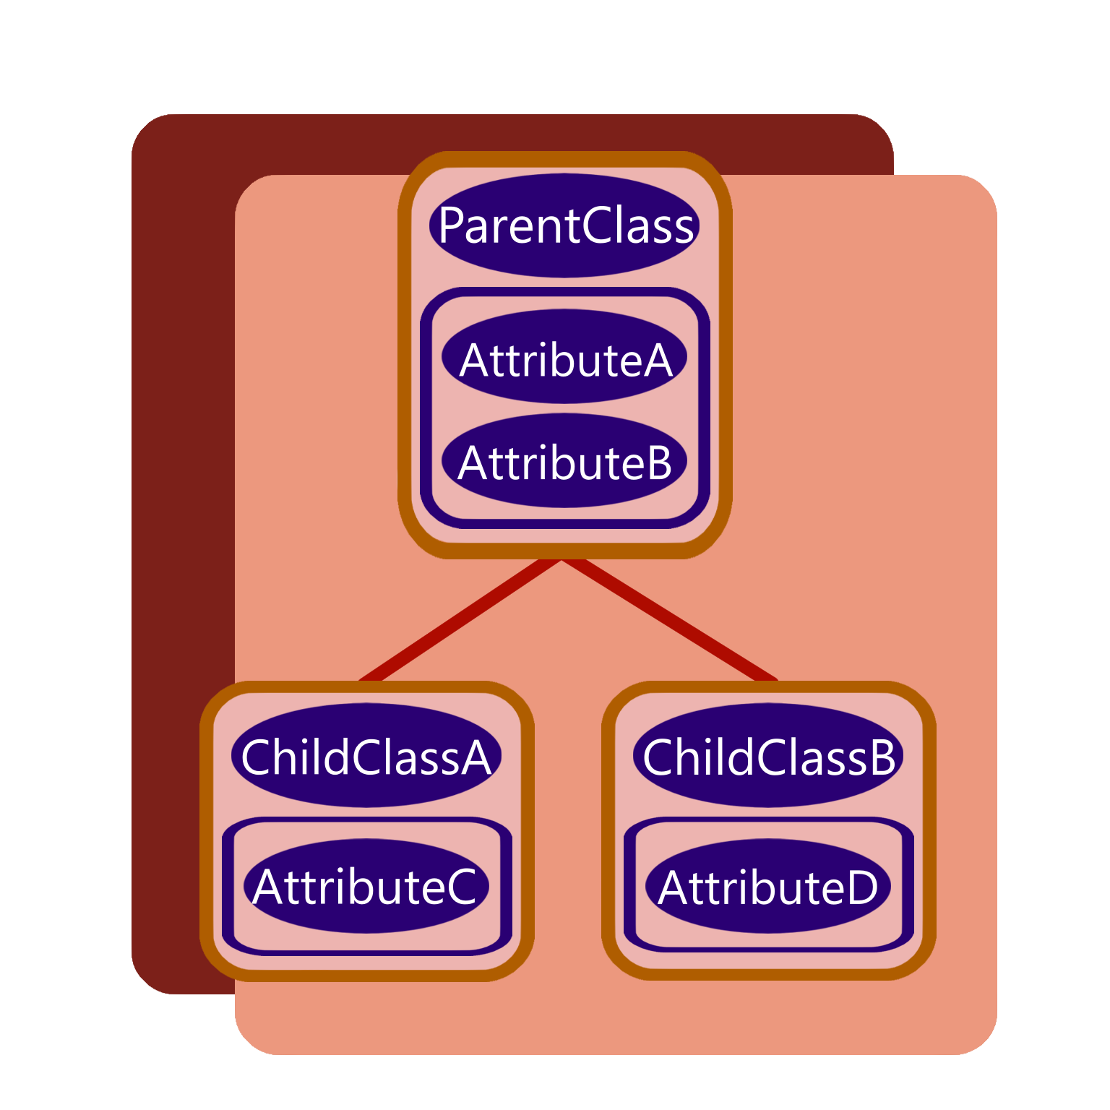
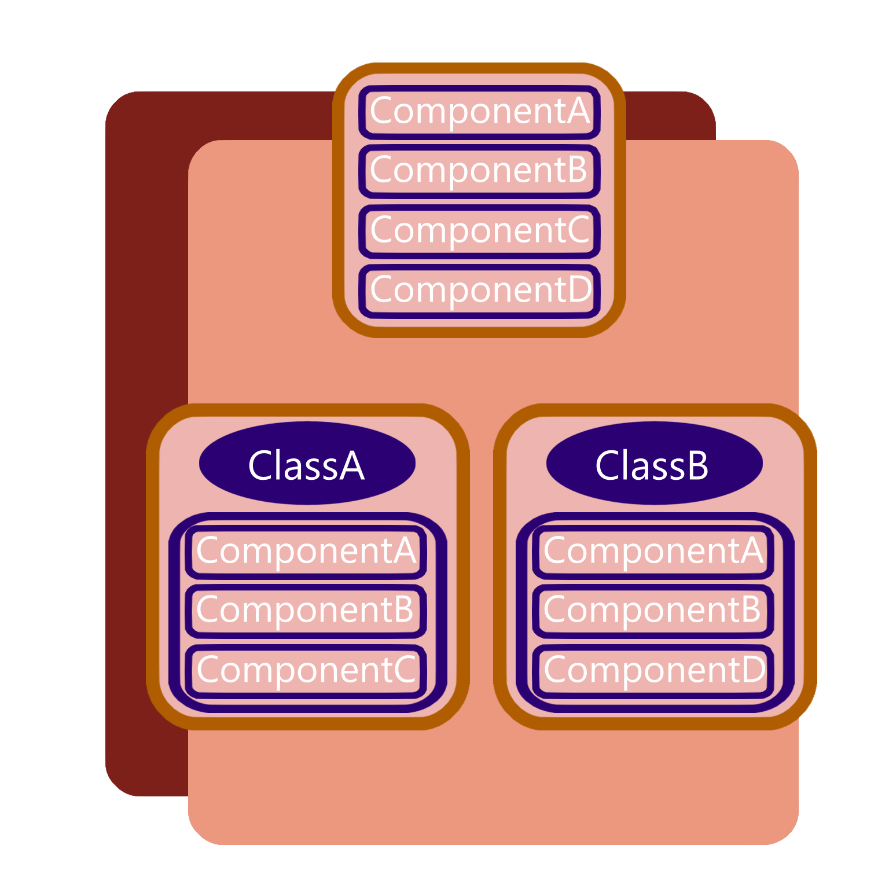
Inheritance Composition

Slide 3
Inheritance
Assume we want to implement two Classes. A Player and an Enemy.
The Player has health, can attack, and listens to input.
The Enemy has health, can attack, has pathfinding, and drops loot when killed.
We can Generalize the Health and Attack attributes to an EntityBase Class.
Player
Health
Attack
Input
Enemy
Health
Attack
Pathfinding
Loot

Slide 4
EntityBase
Health
Attack
Player
Input
Enemy
Pathfinding
Loot

Slide 5
EntityBase
Health
Attack
Player
Input
Enemy
Pathfinding
Loot

Slide 6
EntityBase
Health
Attack
Player
Input
Enemy
Pathfinding
Loot
NPC
Pathfinding
Loot
- no Attack

Slide 7
EntityBase
Health
HostileBase
Attack
Player
Input
Enemy
Pathfinding
Loot
NPC
Pathfinding
Loot
Crate
Loot

Slide 8
Composition
HealthComponent
AttackComponent
InputComponent
PathfindingComponent
LootComponent
Player
HealthComponent
AttackComponent
InputComponent
NPC
HealthComponent
PathfindingComponent
Loot
Enemy
HealthComponent
AttackComponent
PathfindingComponent
Loot
Crate
HealthComponent
LootComponent

