Slide 1
The Effects of Cognitive Behavior Therapy on Chronic Fatigue Syndrome and its Potential Moderators:
A meta-analysis
Group member: 孟威廉
林郁秀
吳希彥
林怡安
2013.01.11

Slide 2
Outline of proposal
Introduction of CFS and its diagnosis
Measurement of CFS
CFS treatment
  CBT for CFS
Previous studies
Research questions
Moderators
Method
Result
Discussion

Slide 3
我真的很累，不是裝的！(康健雜誌，2007.03)
已經好幾個月覺得無法解釋的疲倦，早上不想起床，整天提不起勁來，不想見人，不想跟人說話，肌肉與關節在痛，頭痛……
過勞死是台灣勞工心中永遠的痛！美國有線電視新聞網CNN，日前針對台灣勞工超時工作製作專題，引起軒然大波。健康管理專家表示，「過勞死」的發生其實是一連續的過程，而其中重要階段即是「慢性疲勞」。雖然「慢性疲勞」不一定會導致「過勞死」，但是一旦得了慢性疲勞症候群，「過勞死」的風險與發生機率就會大大增加… (文/張世傑)
過去慢性疲勞症候群被稱為「雅痞感冒」（yuppieflu），還有人說它是「一群歇斯底里、上流階層白種女人的抱怨」。因為它雖讓人陷入無法解釋的疲倦感、頭痛、肌肉痛、失眠……等，但旁人卻視為無病呻吟。

Slide 4
Why CFS study is important?
It’s pathological etiology remain unknown.
There is a debate about if CFS is a mental disorder
  High co-morbidity(共病) with depression (50%).
  Patients usually refute the explanation of mental problem, even physiological check shows everything is normal.
The review show that CFS is a kind of somatoform disorder.
(Castell, Kazantzis, & Moss-Morris, 2011; Euba, Chalder, Deale, & Wessely, 1996;
Surawy, Hackmann, Hawton, & Sharpe, 1995)

Slide 5
CFS Definition & Diagnosis
Chronic Fatigue Syndrome (CFS)
  Severe fatigue lasting longer than 6 months and leading to disability.
Diagnose Criteria
Centers for Disease Control (CDC) criteria
The Oxford criteria
Notes:
有持續六個月以上無法因休息而緩解的疲勞感或身體不適

Slide 6
Centers for Disease Control (CDC) criteria
(Fukuda et al., 1994)
A patient must report four out of eight additional symptoms :
  unrefreshing sleep (睡眠仍無法改善疲勞)
  Post-exertional malaise (勞動後，極度疲憊)
  Headache
  muscle pain
  multi-joint pain (非發炎性之多發關節痛)
  sore throat
  tender lymph nodes (頸部或腋下淋巴結腫痛)
  complaints about concentration and memory.

Slide 7
The Oxford criteria
(Sharpe et al., 1991)
以疲勞為主要症狀的症候群。
該症候群有明顯的起源時間。
疲勞的症狀嚴重，甚至使人失能(disabling)，並影響身體狀態和心理功能的運作。
疲勞的症狀持續至少六個月，其中有一半時間以上感到疲勞。
其他症狀像是肌痛、情緒和睡眠障礙可能共同出現。
必須排除以下病患：
  患者具有可能造成身體疲勞的疾病症狀(例如：貧血)。所有患者必須經由醫師進行病史和生理檢查。
  患者目前有被診斷為精神分裂症、躁鬱症、物質濫用、飲食障礙及腦傷。其他疾患(例如：憂鬱症、焦慮症、及過度換氣症候群的患者)則不須被排除。

Slide 8
More about CFS
Prevalence: ranging from 0.2% to 0.7% in the United States and United Kingdom (Browne, 2009).
一項針對台灣1000位基層門診病患的研究中，發現有8.5%的病患有持續超過六個月的虛弱疲勞感，但其中只有15%符合慢性疲勞症候群的診斷標準（林英哲，2009）。

Slide 9
Measurement
CFS measurement
Fatigue
Functional disability
Adjustment
Chalder Fatigue Questionnaire Scale (CFQs)
Checklist Individual Strength subscale fatigue severity (CIS-F)
Fatigue Severity Scale (FSS)
Short Form Health Survey (SF-36) [physical disability]
10-item Physical Functioning (PF-10) [physical disability]
Symptom Check-List 90 (SCL-90)
Work and Social adjustment scale (WASA)
Social Adjustment Scale (SAS)
Notes:
問題1:最常用的CFS測量工具有3個理論上都可用，但大家還沒有一個標準，不知道研究三個問卷之間有沒有明顯分別。

Slide 10
Measurement
The heterogeneity of the outcome measurement systems across the trials (Cho et al. 2005).
Past meta-analysis use a mean ES of all the measurements outcomes (Castell et al., 2011; Malouff et al., 2008).
Notes:
The major limitation of the review was the heterogeneity of
the outcome measurement systems across the trials. Different
scales and instruments were used to define and measure the
endpoint, clinical improvement. Because of this concern, we
categorized the trials according to the strictness of response
criteria and investigated its contribution to the heterogeneity.
The meta-regression showed a marginal effect for strictness of
response criteria (p .08), with studies with very strict
criteria having lower placebo response rates

Slide 11
Adult & Child
Should be discussed separately.
Due to…
  CFS in children and adolescents is associated with serious impairment.
  Different kind of treatment is involved. eg. Family-based.
  Past studies are also discussed separately (i.e. Chalder et al., 2010a; Chalder et al., 2010b; Lloyd et al., 2012 ).

Slide 12
CFS Treatments
Pharmacological
Immunological
Nutritional
Graded exercise therapy (GET)
Cognitive Behavior Therapy (CBT)
  CBT has been showed to have a significant effect on the recovery of CFS patient

Slide 13
CBT for CFS
Recent developments in CBT include ’third wave’ approaches, including
Mindfulness-based therapy (Kabat-Zinn 1991; Segal 2002),
Group based CBT
Phone based CBT
CBT has the efficacy of improving health of CFS patients and depressive mood.
Notes:
CBT的療效主要針對哪一方面? 是疲勞效果或身體症狀?
Predictors of poor
response to CBT include poor social and occupational functioning
before the onset of illness, a poor sense of control of symptoms,
low activity levels, and focusing on physical symptoms (Browne)

Slide 14
Previous studies
  CBT
    Has been showed to have a significant effect on the recovery of CFS patients.
      g = 0.33 (Castell et al., 2011); d=0.48(Malouff, 2007)
    Study quality does not moderate its effect size.
      Follow up duration, sample size, diagnostic standard, inclusion criteria.
    CBT type is not a moderator
      Individual or group, phone-based or face-to-face.
(Castell, Kazantzis, & Moss-Morris, 2011; Malouff, Thorsteinsson, Rooke, Bhullar, & Schutte, 2008)

Slide 15
Previous studies
Low placebo effect
  Little of the effect of CBT for CFS is due to placebo
    Does it means between group study is as good as test-retest study?
(Cho, Hotopf, & Wessely, 2005)

Slide 16
Till now…
We know…
We don’t know…
CBT has certain treatment effect
Low placebo effect
Study quality is not a moderator
CBT type study is not a moderator
Do different measurements have different ES?
Are between group studies as good as test-retest studies?
Does patients’ demographic variables have a moderator effect?
Is treatment duration (whole treatment) a moderator variable?
Is publication year a moderator variable?

Slide 17
Research questions
Does CFS treatment outcomes differ according to different types of measurements (SF-36, CIS-F, CFS)?
Replicate previous findings on the efficacy of CBT for CFS.
Does Intra-group comparison (test-retest) of CBT treatment on CFS patient show a significant difference from that of inter-group comparison studies (experiment-control)
Are patients’ demographic features moderator variables?
Gender, age, illness duration (treatment duration and publication year)
Notes:
問題1:最常用的CFS測量工具有3個理論上都可用，但大家還沒有一個標準，不知道研究三個問卷之間有沒有明顯分別。

Slide 18
Moderator
Gender
      Women : Men= 2~3:1
      Gender as a factor that influence treatment effect?
Age
      The prognosis is worse if patients seizure after 38. (林英哲等人，2009)
      Younger age is associated with higher levels of perceived control (Strang, 2002).

Slide 19
Moderator
Illness duration
      6 months of fatigue or not (Castell, 2011)
      A shorter duration of CFS is related with higher levels of perceived control (Strang, 2002).
Treatment duration
  Does not have an effect on treatment outcomes. (Castell, 2011)
Publication year
        Does the understanding of CBT intervention on CFS patients contribute to the treatments effects?

Slide 20
Method
Search: 9 database
  Web of Science, Medline, PsyArticles, PUBMED, PsycINFO, Academic Search Complete, Science direct, ProQuest & CEPS電子期刊
Publication year: 2002-2012
Keywords
  Chronic Fatigue Syndrome, Treatment, & outcome.
  慢性疲勞症候群、治療、療效
    Why do we choose “treatment” but not “CBT” as keyword?

Slide 21
Exclusion criteria
The study was conducted with adolescents or children
Other language different that English & Chinese.
Qualitative research
CFS patients have comorbidity with other DSM- IV-TR diagnoses
Not focus on the evaluation of treatment effect.
Not CBT treatment.

Slide 22
Keywords: “Chronic Fatigue Syndrome”, “treatment”, “outcome”
558 papers from 9 data base (PUBMED, PsycINFO, Academic Search Complete, Web of Science, Medline, PsycARTICLES, Science direct, CEPS電子期刊, ProQuest)
471 papers excluded (e.g. repetitions of papers, did not pass exclusion criteria)
75 papers excluded (e.g. dont use CBT as treatment)
87 papers reviewed
Manual Search: + 10 papers
22papers included in data base
(including 1 unpublished)

Slide 23
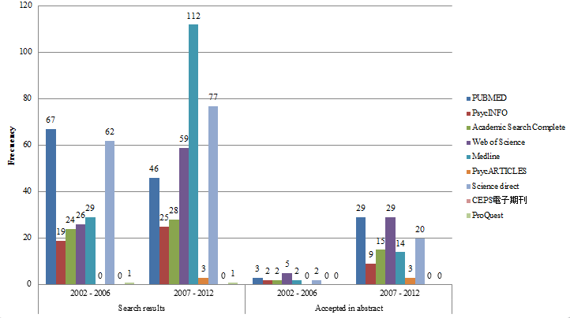

Slide 24
Coding & Analysis
Coding variables
  Study: ”Methodology”, “Pub year”, “Methodology”, ”Diagnose criteria”
  Sample characteristics: “sample size”, “gender proportion”, “age”
  Treatment: “Treatment type”, “instrument”, “duration of the treatment”, “score of instrument”
Inter-rater reliability
  Kappa=.8849, Min=.58, Max=1.00
SPSS analysis

Slide 25


Weight ES calculation
We did two types of analysis, the first one was the within group comparison (test-retest), the second was the intergroup comparison (Post-scores CBT - Waitlist)
Accordingly, we use two different formulas to calculate the Inverse Variance Weight (Weight)
Mean gain – unstandardized
Mean difference – unstandardized

Slide 26
Results- Descriptive analysis
Patients’ demographic background
  Total sample size (3176), CBT patients (2364),
  Control patients (812).
 | Mean | S.D | Min | Max
Average age | 40.14 | 5.06 | 31.50 | 51.20
n size | 71.86 | 60.59 | 10.00 | 240.00
Perc of women | 75.79 | 12.31 | 51.00 | 100.00
illness duration in years | 5.58 | 2.85 | 2.33 | 13.40
Duration of the studies in years | .8085 | .85072 | .15 | 4.00

Slide 27
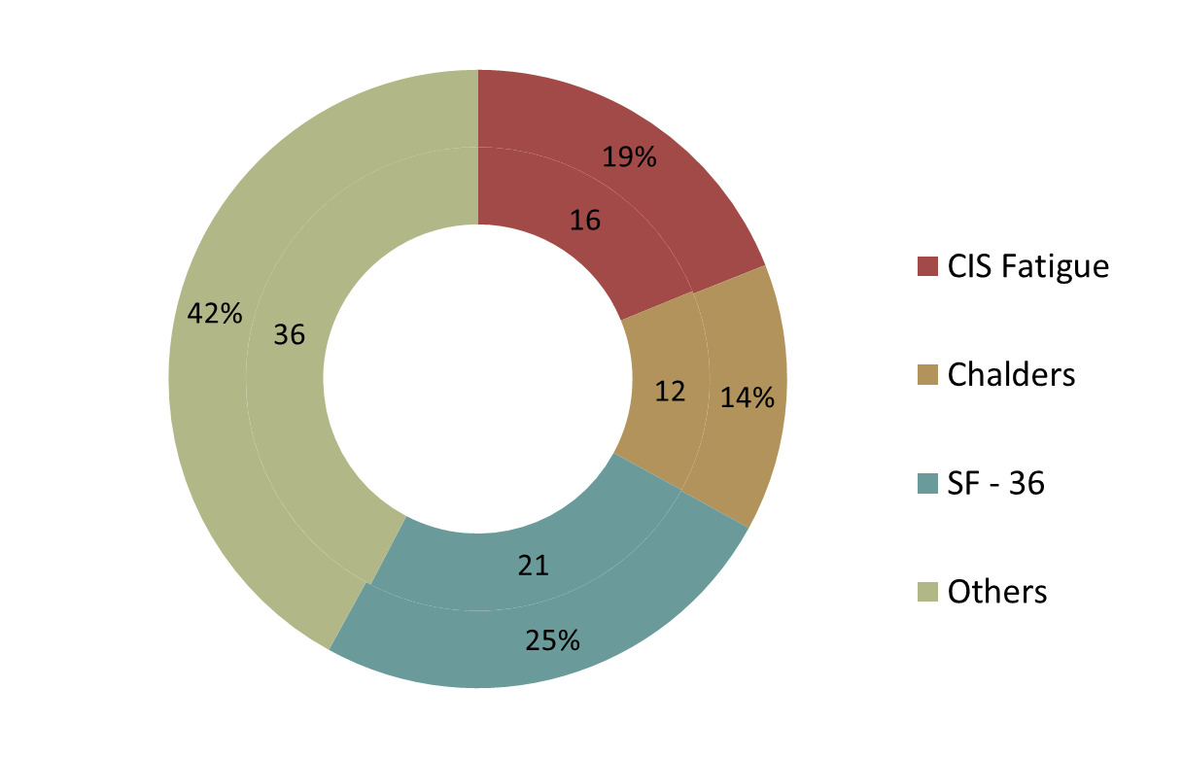
Instrument used
CFQs

Slide 28
Descriptive analysis pre and post scores for
the most frequently reported instruments
 | Instrument
 | CIS Fatigue |  | Chalder Questionnaire |  | SF – 36 * larger score represent healther
 | pretest | posttest | pretest | posttest | pretest | posttest
CBT | 50.3 (.95) | 35.6 (7.4) | 21.6 (7.1) | 15.9 (5.6) | 48.1 (9.8) | 58 (19.5)
wait list | 50.3 (1.6) | 44.7 (4.4) | 25.3 (2.1) | 21.5 (4.4) | 42.2 (17.8) | 48.6 (17.2)

Slide 29
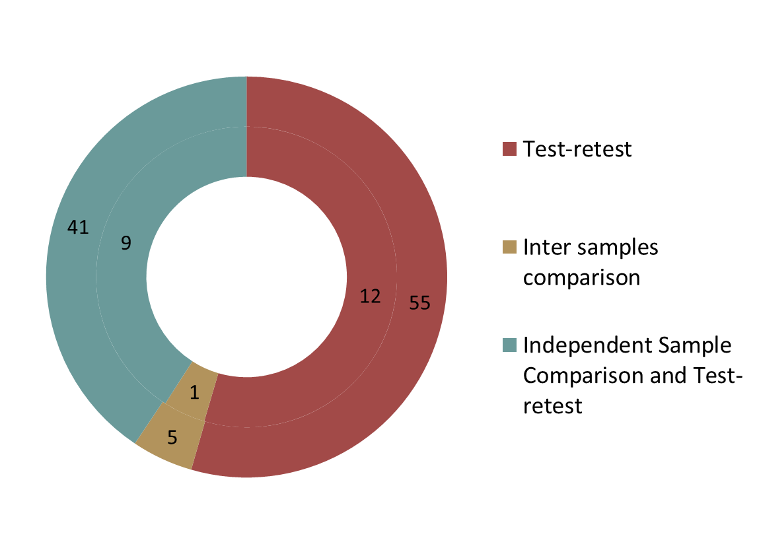
Methodology

Slide 30
Treatment type (of CBT)
Treatment type | Frequency | Percent
CBT | 17 | 77.2
CBT+GET | 1 | 4.5
Mindfulness-based cognitive therapy | 1 | 4.5
CBT based on Energy Envelop Theory | 1 | 4.5
CBT - Phone based | 1 | 4.5
CBT with group therapy | 1 | 4.5
Total | 22 | 100

Slide 31
META-ANALYSIS RESULTS

Slide 32
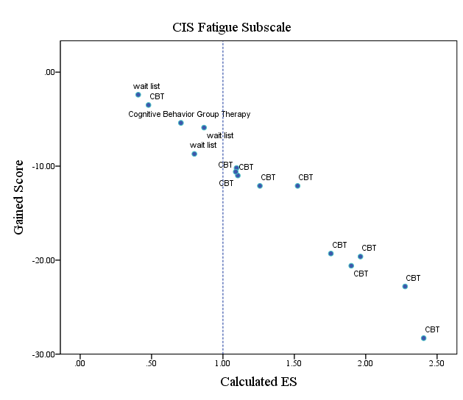
Effect sizes for CIS Fatigue Subscales, all samples across studies

Slide 33
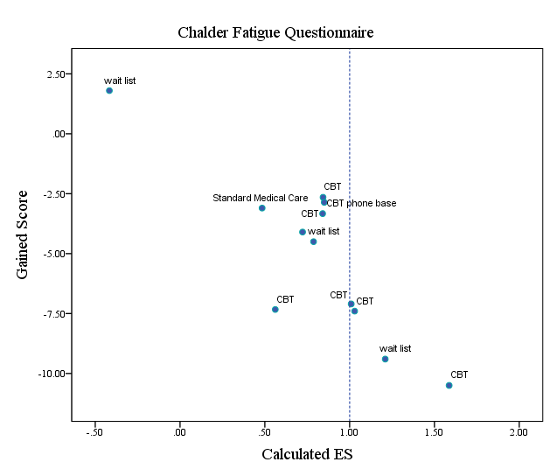
Effect sizes for Chalder Fatigue Questionnaire, all samples across studies

Slide 34
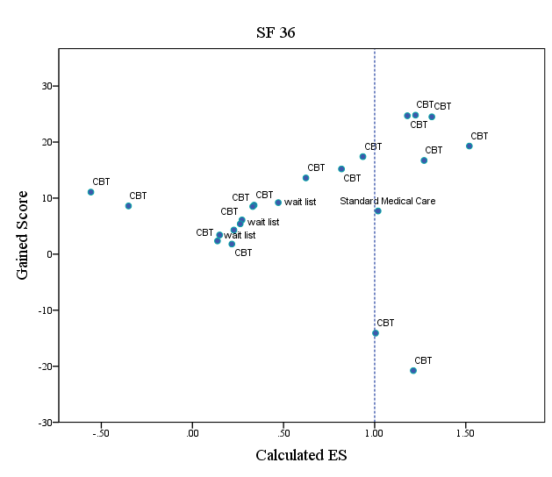
Effect sizes for SF - 36, all samples across studies

Slide 35
H1&2: 3 different instruments
(SF-36, CIS-F, CFS)
Homogeneity Analysis | Q=7.5925 | Df = 36 | P = 1.000
Instrument | Mean ES | Z | P
Total | .9527 | 7.5054 | <.001
Fatigue
CIS | 1.3736 | 3.3506 | <.001
CFQs | 0.9364 | 6.2998 | <.001
Physical health
SF-36 | 0.79 | 2.6021 | <.01

Slide 36
H3: Between group – within group difference (SF 36)
Homogeneity Analysis |  |  | Q=1.6597 | df = 20 | p = 1.000
Instrument | Mean ES | SE | -95% CI - 95% CI | Z | P
Total | .6779 | .3331 | .0249 – 1.3308 | 2.0347 | .0419
Within group | .7246 | .3465 | .0455 – 1.4037 | 2.0914 | .0365
Between group | .1052 | 1.2127 | -2.2717 – 2.4820 | .0867 | .9309

Slide 37
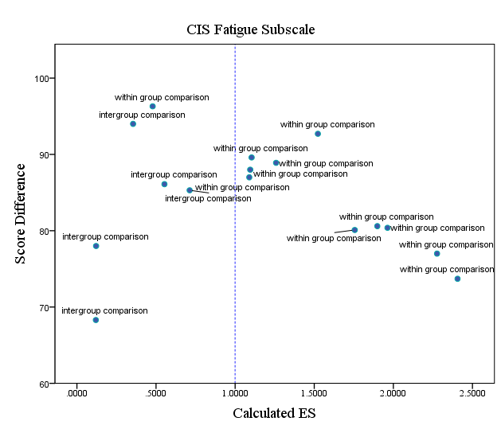
Effect size per test type
Within group comparison = Test – retest CBT
Intergroup comparison = Post test scores (CBT vs. Waitlist)

Slide 38
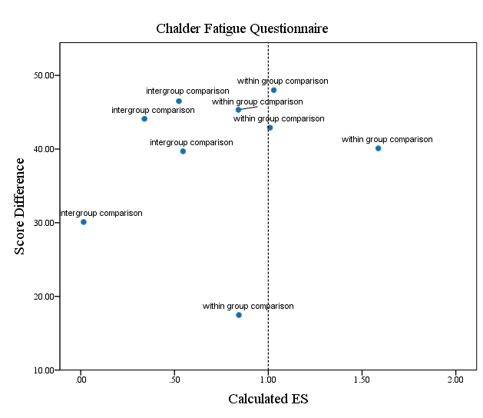
Effect size per test type
Within group comparison = Test – retest CBT
Intergroup comparison = Post test scores (CBT vs. Waitlist)

Slide 39
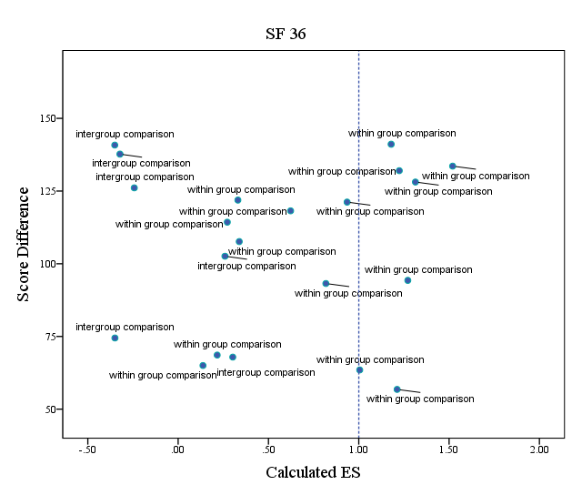
Effect size per test type
Within group comparison = Test – retest CBT
Intergroup comparison = Post test scores (CBT vs. Waitlist)

Slide 40
H4: Does patients’ demographic background moderate ES? (SF 36)
Homogeneity Analysis | Q=.3604 |  | df = 5 |  | p = .9964
Item | B | Standard Error | -95% CI - 95% CI | Z | p
Publication year | .0075 | 2.6486 | -5.1988 – 5.1988 | .0028 | .9977
Age | -.0554 | .7062 | -1.4396 – 1.3288 | -.0784 | .9375
Treatment duration | .4199 | 2.5338 | -4.5463 – 5.3861 | .1657 | .8684
Female perception | -.004 | .6337 | -1.2460 – 1.2380 | -.0063 | .9949
Illness duration | .0217 | 2.5 | -4.8783 – 4.9218 | .0087 | .9931

Slide 41
2002-2007 VS 2008-2012
Homogeneity Analysis |  |  | Q=1.5443 | df = 16 | p = 1.000
Instrument | Mean ES | SE | -95% CI – 95% CI | Z | P
Total | .79 | .3036 | .1949 – 1.3850 | 2.6021 | <.01
2002-2007 (n=5) | .7047 | .4241 | -.1265 – 1.5359 | 1.6617 | .0966
2008-2012 (n=12) | .8796 | .4348 | .0274 – 1.7318 | 2.0230 | <.05

Slide 42
Discussion
There is a significant diff. between the 3 instruments.
  Should be analyzed separately.
A high CBT efficacy for CFS was found
(SF36, d= 0.79; CIS-F, d=1.3736; CFQs, d=0.9364 ).
  Comorbidity of depression & anxiety : g = 0.33 (Castell et al., 2011)
  Including adolescent sample: d=0.48 (Malouff, 2007)
  Combinations of questionnaires
    ES calculation : Fatigue + functional impairment + depression +anxiety (Castell et al., 2011)
    ES calculation : Mental + physical + and mixed mental and physical (Malouff, 2007)
Notes:
A high CBT efficacy for CFS ().
g = 0.33 (Castell et al., 2011); d=0.48(Malouff, 2007)
比起之前的研究我們使用較多篇文獻?
Conclusions that can be drawn from the moderator analyses are limited because the analyses included a relatively
low number of studies, which created low power for identifying significant differences. Hence, the finding of no
significant differences between two levels of a possible moderator might be due to low power rather than the absence of
a difference.
治療時間 (過去CBT通常要長達一年)
CBT usually lasts for approximately 15 fortnightly sessions,
with follow-up sessions for up to 1 year after discharge to monitor
progress and deal with any residual problems.
但是我們的平均治療時間是九個多月
就有好的效果量 而且treatment duration並非調節變項
=>意味著未來可以朝向短期的CBT治療嗎?

Slide 43
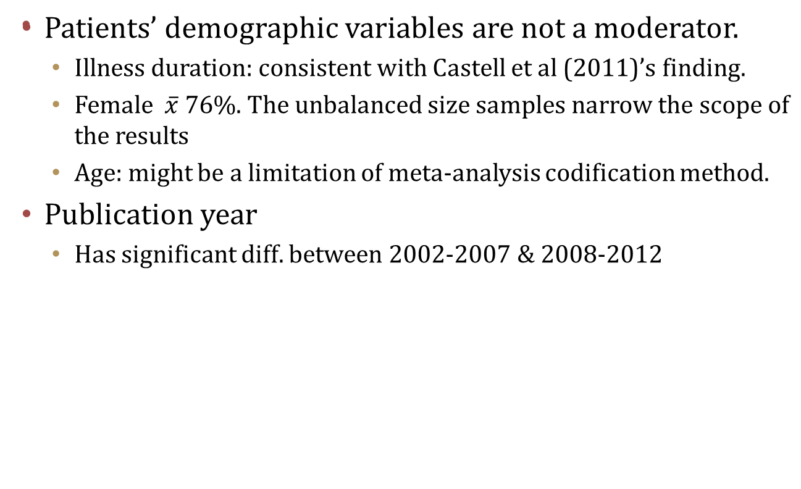
Discussion

Slide 44
Discussion
Treatment duration
  Treatment duration mean time = 9 months. A moderator effect was not found.
  Treatment quality is more important.
Within vs. Between
  Placebo effect
  Social support

Slide 45
Limitation & future direction
Absent of information on CFS Asian population.
Further study topic of CBT treatment for CFS in Taiwan.
A further investigation on the differences between measurements of CFS is needed.

Slide 46
Q & A
Thanks for your attention ☺

Slide 47
APPENDIX

Slide 48
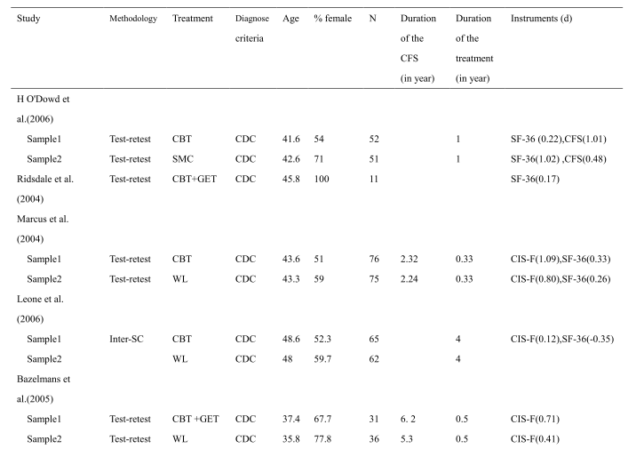

Slide 49
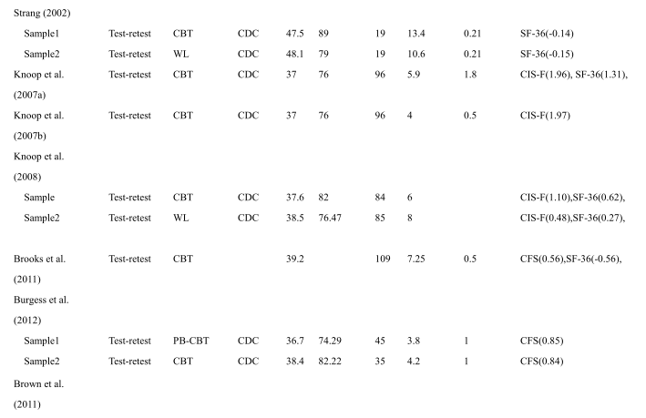

Slide 50
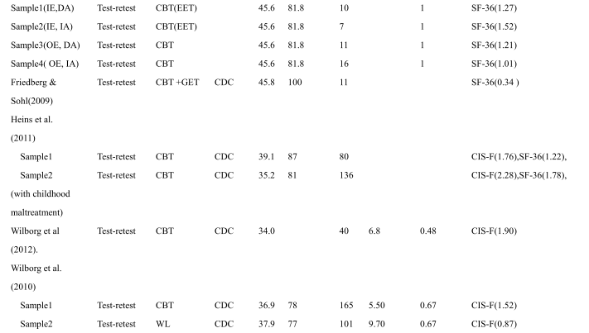

Slide 51
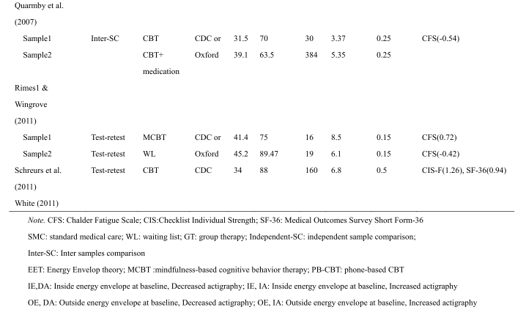

Slide 52
PREVIOUS META-ANALYSIS

Slide 53
The Placebo Response in the Treatment of Chronic Fatigue Syndrome:
A Systematic Review and Meta-Analysis (Cho et al, 2005)
Objective: Exploring the placebo response in treatment of CFS
Hypothesis: Physical causality were hypothesized to have a high placebo effect than those based on the psychological assumption.
Sample: 28 articles
Results: The pooled placebo response was 19.6%, lower than predicted and lower than in some other medical conditions. The meta-regression revealed that intervention type significantly contributed to the heterogeneity of placebo response (p=.03).
Conclusion: Psychological-psychiatric interventions were shown to have a lower placebo response, perhaps linked to patient expectations.
Notes:
Reference:
Cho, H. J., Hotopf, M., & Wessely, S. (2005). The placebo response in the treatment of chronic fatigue syndrome: A systematic review and metaanalysis.
Psychosomatic Medicine, 67, 301−313.
Disadvantages:
Focus on placebo response not treatment effects

Slide 54
Efficacy of cognitive behavioral therapy for chronic fatigue syndrome: A meta-analysis (Malouff, 2007)
Objective: To determine the efficacy of cognitive behavioral treatment for CFS and to search for moderators of effect size.
Moderator: The specific type of CBT provided, the diagnosis criteria, the amount of treatment, the types of outcome variables, and the length of follow-up.
Sample: 13 studies
Results: d=0.48, between CBT and control groups
Conclusion:
CBT has produced promising results when applied to chronic fatigue syndrome
The moderator search produced only some non-significant trends.
Notes:
Reference: Malouff, J. M., Thorsteinsson, E. B., Rooke, S. E., Bhullar, N., & Schutte, N. S. (2008). Efficacy of cognitive behavioral therapy for chronic fatigue syndrome: A meta-analysis.
Disadvantages:
Sample size is small , 1371 participants
Only including publication before 2006
Only between groups comparison
Moderators did not include duration of illness
A comparison in the present meta-analysis of treatments with and without cognitive elements provided no significant evidence that including cognitive components led to a greater effect?? (Including CBT without cognitive components?!)
Did not include unpublished studies
Moderator:
For instance, there was a nonsignificant trend towards studies that used the Oxford diagnostic criteria having a larger effect size than studies that used the CDC 1994 diagnostic
criteria.
clients with themedical-problem criteria required only for the CDC standards are harder to treat??
The type of control group used in a treatment study was not significantly associated with effect size.
There was a nonsignificant trend for studies that included only individuals diagnosed with CFS to have larger effect sizes than studies that set a slightly lower standard for inclusion
hours of treatment ranged from 0.2 to 16. There was a substantial but nonsignificant association (r=0.47) between number of treatment hours and effect size.

Slide 55
Cognitive Behavioral Therapy and Graded Exercise for
Chronic Fatigue Syndrome: A Meta-Analysis (Castell et al, 2011)
Objective: Comparing the efficacy of CBT and GET while addressing the limitations of Malouff et al. (2008) and extends the analysis in several important ways
Hypothesis: CBT would produce a larger mean ES across all outcome measures than GET
Moderators: treatment setting, type of control group, diagnostic criteria used, length and intensity of treatment, and pretreatment duration of illness.
Sample: 20 studies (GET trials (N = 170) and 16 were CBT trials (N = 1,457))
Results: Overall effect sizes suggested that GET (g = 0.28) and CBT (g = 0.33)
Notes:
Reference: Castell, B. D., Kazantzis, N., & Moss-Morris, R. E. (2011). Cognitive Behavioral Therapy and Graded Exercise for Chronic Fatigue Syndrome: A Meta-Analysis.
Clinical Psychology: Science and Practice . 18, 67, 301−313.
Disadvantages:
Sample size is small (5 GET; 16 CBT) GET trials (N = 170) and 16 were CBT trials (N = 1,457).
Only between groups comparisons
Moderators:
Diagnostic criteria did not significantly moderate effect size (Qb = 1.64, p > .05), although lower effect sizes tended to be found for trials using the Australian criteria. Trials using the Oxford criteria tended to return the highest effect sizes.
Type of control group utilized did not appear to exert a significant moderating influence on effect size (Qb = 3.38, p > .05). However, trials using wait-list controls tended to return the highest effect sizes, while controls previously demonstrated to have greater effects than placebo, such as nondirective counseling and pacing, tended to return the lowest effect sizes.
Treatment format (group vs. individual delivery) did not moderate effect size, with both delivery formats returning similar effect sizes.
Regression analysis
The number of treatment hours, however, was a significant predictor of effect size
CBT resulted in significant improvements in anxiety, this effect size was small (g = 0.15) and almost nonexistent for GET (g = 0.01).

Slide 56
Possible Etiology about CFS (Kumar & Kumar, 2006)
Infection
Immune Dysfunction
Stress and Emotional Disorder
Psychological and Behavior Factor
Inactivity
Dysfunction of Central Nervous System
Sleep Disorder
Notes:
Reference:
Kumar R, Kumar R. Chronic fatigue syndrome. Apollo MedicineAnnu. 2006; 3: 290-297.
(a) Infection
Patient frequently give a history suggestive of acute infection at the outset. Fatigue states lasting several months can follow infection such a Epstein barr virus and Q fever. Infection may therefore trigger chronic fatigue syndrome, but available evidence does not support the hypothesis that infection is the cause of CFS [6,7].
(b) Immune dysfunction
Minor immune abnormalities have been detected ina proportion of patients. Cytokines can cause fatigue. However, no consistent immune abnormality or casual link of these symptoms has been established in the patient with CFS. The role of immune factor remains of interest but is unclear [8].
(c) Stress and emotional disorder
More then half the patient seen in the hospital clinics who meet criteria for CFS also meet the criteria for anxiety and depressive disorders. Therefore, it has been suggested that at least some cases of CFS are due to emotional disorder that is expressed somatically. This is undoubtedly true in some cases, but in many others either absent or in adequate explanation of illness.
(d) Psychological and behavioral factors
There is an evidence that Psychological and behavioral factors play an important role in perpetuating CFS. They include misconception about the nature of illness, excessive avoidance of physical activity so that the person become inactive, repeated seeking of medical care and failure to respond to continuing psychological and social problem [9].
(e) Inactivity活動力過低
Some patients of CFS are profoundly inactive. This may lead to muscle wasting, changes in cardiovascular response to excretion and postural hypertension. The consequent intolerance of activity may perpetuate the illness.
( f ) Dysfunction of central nervous system
Although abnormalities in test of cognitive function and abnormalities in neuroendocrine test and functional neuroimaging have been found but specificity and clinical utility of such test remains unestablished [10].
(g) Sleep disorder
Various sleep abnormalities have been found in patients with CFS. They include both pacific disorders like sleep apnoea syndrome and non specific abnormality such as fragmentation of sleep. They may contribute to day time fatigue in at least some cases
[11].

Slide 57
Deconditioning model
Lack of use of the body’s cardiovascular, neuromuscular, biomechanical, and musculoskeletal systems → Avoidance of exercise →Tiredness and exhaustion → Deconditioning is a physiological process → Functional capacity ↓ and the body’s efficiency ↓ which can lead to physical deconditioning.
Deconditioning reduces the body’s capacity for physical exertion and increases the perception of the effort that is required to complete a certain activity.
It can lead to an increase in fatigue symptoms at lower levels of exercise, which in turn can affect sleep patterns and exercise tolerance.
Graded exercise therapy
Notes:
Reference:
Browne, T., Chadler, T. (2009) Somatoform disorders and medically unexplained symptoms. Psychiatry. 8;5, 153-157.

Slide 58
Graded exercise therapy
GET involves a controlled activity management programme that aims for a steady increase in aerobic activity.
It focuses on building up the patient’s fitness by gradually increasing activity levels in a step-by-step or ‘graded’ manner.
The clinician and patient work together to set achievable goals and devise plans, incorporating rest periods at specific times.
Randomized controlled trials (RCTs) evaluating GET have found that it has a positive effect on fatigue and capacity for practical work.
However, drop-out rates appear to be higher than for CBT.
Notes:
Reference:
Browne, T., Chadler, T. (2009) Somatoform disorders and medically unexplained symptoms. Psychiatry. 8;5, 153-157.

Slide 59
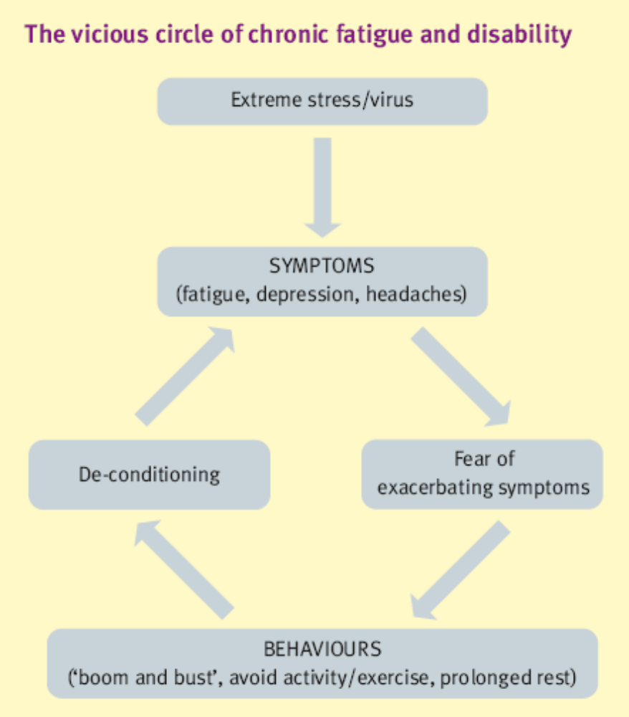
The circle of Chronic Fatigue and Disability
Notes:
Reference:
Browne, T., Chadler, T. (2009) Somatoform disorders and medically unexplained symptoms. Psychiatry. 8;5, 153-157.
People who base their self-esteem on their abilities to live up to high standards and are highly achievement-oriented are thought to be vulnerable. When these people encounter precipitating factors, such as a combination of extreme stress or an acute biological illness or injury, they often attempt to carry on with their lives and cope as before. They then attribute the resulting ongoing symptoms of fatigue to physical factors, and rest in an attempt to recover. However, reduced activity levels conflicts with their achievement orientation, resulting in sporadic bursts of activity in an attempt to meet their own high expectations. This ‘boom and bust’ pattern worsens the symptoms, further reinforcing their belief that they have a serious illness, and creates a vicious circle (Figure 3).
Eventually, patients abandon their efforts to meet their preceding high standards and become increasingly preoccupied with their symptoms and illness, intensifying the experience and
frequency of symptoms. Unhelpful beliefs (e.g. that any activity increasing fatigue is damaging or that CFS is untreatable or irreversible) and fear about symptoms further influence disability. For some, the belief that they have an ongoing incurable illness
results in chronic disability.

Slide 60
Cognitive Behavior Therapy (CBT)
First developed in the 1970s, and later manualised as cognitive therapy (CT) (Beck 1979)
CBT incorporates elements of both behavioural therapy (BT) and cognitive therapy approaches.
CBT facilitates the identification of unhelpful, anxiety-provoking thoughts, and challenges these negative automatic thoughts and dysfunctional underlying assumptions
Through collaborative ’hypothesis-testing’, using behavioural tasks of diary-keeping and validity-testing of beliefs between sessions, together with skills training within sessions.
Notes:
Reference: Price, J. R., Mitchell, E., Tidy, E., & Hunot, V. (2008). Cognitive behaviour therapy for chronic fatigue syndrome in adults. Cochrane Database of Systematic Reviews, 3,
CD001027. doi:10.100214651858.CD001027.pub2

Slide 61
Measurement
Medical Outcomes Survey Short Form-36,
SF-36(Ware & Sherbourne, 1992 )
  Including 8 concepts: physical functioning, role limitation due to physical problems, Social functioning, bodily pain, general mental health, role limitation due to emotion, vitality, general health.
  Each concept scale range from 1 to 100.
  Reliability>.90 (Ware et al., 1994)
Chalder Fatigue Questionnaire Scale, CFS (Chalder et al., 1993)
  To measure the severity of physical and mental fatigue.
  Asks patients to rate their fatigue symptoms on a Likert scoring system (0–33), with high scores indicating high levels of fatigue.
  Cronbach's alpha reliability= 0.92 (Cella & Chalder, 2010)

Slide 62
Measurement
Checklist Individual Strength subscale fatigue severity, CIS-F (Vercoulen et. al, 1994)
  Measures subjective fatigue and related behavioral aspects
  Consists of 20 statements for which the person has to indicate on a 7-point scale to what extent the particular statement applies to him or her (1 = Yes, that is true; to 7 = No, that is not true).
  Four fatigue aspects: (1) subjective fatigue (e.g., I feel tired), (2) reduced motivation (e.g., I feel no desire to do anything), (3) reduced activity (e.g., I don't do much during the day), and (4) reduced concentration (e.g., My thoughts easily wander).

Slide 63
CBT for CFS
Recent developments in CBT include ’third wave’ approaches, including
Mindfulness-based therapy (Kabat-Zinn 1991; Segal 2002),
Compassion-focused therapy (Gilbert 2005)
Acceptance and commitment therapy (Hayes 2003)
Now being used with a number of other disorders, including CFS,
A gradual increase in activity, negotiated and agreed with the patient, can be used as a behavioural experiment
core beliefs such as about the link between increased activity and worsened physical symptoms, can be tested.
Catastrophic interpretations of transient increases in physical symptoms can be challenged by orthodox cognitive therapy techniques
the original, anxious, unhelpful thought is written alongside new, more realistic, more helpful alternatives.

Slide 64
This is the results of the comparison between the inter sample post test scores and the test-retest CBT treatment only…the results indicates that there is a significant difference within the test-retest scores, which means that for those patients who receive a CBT based intervention there is significantly effective. But in the inter sample comparison there is no a significant difference which means that other variables
According to the Homogeneity Q value (Q = 8.3769 p=1) the distribution of the ES values did not violate the assumption of normal distribution.
Effect Size result by group and total
Group | Mean ES | SE | -95%CI | +95%CI | Z | P
within | 1.0187 | 0.1506 | 0.7235 | 1.3139 | 6.7641 | 0
between | 0.3649 | 0.4735 | -0.5632 | 1.293 | 0.7707 | 0.4409
Total | 0.9586 | 0.1435 | 0.6773 | 1.2399 | 6.6795 | 0

Slide 65
This is the analysis of the comparison between test retest scores of two group (CBT alone and Wait list), as can be see for both groups there is a significant difference between the pre and post, larger for the CBT group. Nevertheless, it can be inferred that experiencing CBT does not make a large difference in the burden of the symptoms in comparison with the wait list, therefore there might exist other variable that explain the prognosis of the disease.
According to the Total Homogeneity Q value (Q = 13.4 p=1) the distribution of the ES values did not violate the assumption of normal distribution.
Group | Mean ES | SE | -95%CI | +95%CI | Z | P
CBT | 1.0187 | 0.1506 | 0.7235 | 1.3139 | 6.7641 | 0
Waitlist | 0.6624 | 0.1936 | 0.2829 | 1.0418 | 3.4214 | 0.0006
Total | 0.8844 | 0.1189 | 0.6514 | 1.1173 | 7.4397 | 0

