Slide 1
Full Stack Development
Lecture 10: Object Oriented Programming

Slide 2
What is OOP?
Object Oriented Programming
  One of the most popular programming paradigms
  Relies on the use of Classes and Objects
  Allows for greater reusability and encapsulation
  Easier debugging
  Modular

Slide 3
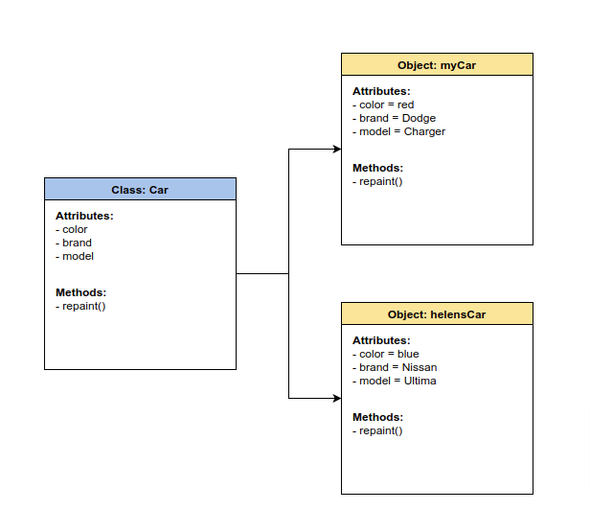
Classes

Slide 4
Classes
Self contained
Blueprint for more specific instances (think of a recipe)
Describes attributes of something without defining them
Defines methods or functions that can be used by any object of the class
Is a – my motorcycle ‘is a’ vehicle, my dog ‘is an’ animal; vehicle and animal would be the classes

Slide 5
Class Structure
Name
  All classes must have a unique name
  Cannot be duplicated or you will get an error
  Name-spacing
Attributes
  Also called class level variables
  Can be private, protected, or public
Methods
  These are the functions that can be used by the objects of the class
  These methods utilize the class variables/attributes with the $this keyword
  Most common and easy ones are set/get methods

Slide 6
Class Structure
Class Dog extends Animal {
  private string $name;
  private string $color;
  private int $age;
  private int $weight;
  private getName(){
  return $this→name;
  }
}

Slide 7
Objects
Individual instance of a class
Defines the attributes of the class
Can utilize the functions defined by its class
Is a – my motorcycle ‘is a’ vehicle, my dog ‘is an’ animal; my motorcycle and my dog would be the objects of the classes

Slide 8
Defining Objects
Objects are stored in variables like any other data
Sets the individual attributes to its unique needs
Use the “new” keyword to instantiate objects
$myDog = new Dog(‘tank’, ‘black’, 1, 25);
$myDog→getName(); // returns ‘tank’

Slide 9
For more information
https://www.educative.io/blog/object-oriented-programming
https://www.w3schools.com/php/php_oop_what_is.asp
https://www.php.net/manual/en/language.oop5.php

