Slide 1
Meeting the needs of development with fixed instances and Agile
Justin A�onuevo
Lead ServiceNow Developer
University of California, Berkeley

Slide 2
Agenda
About Me and the University of California, Berkeley
About this presentation
What you need to know first
Method 1: Export
Method 2: Hide
Method 3: Branching Instances
Method 4: Inline Instances
How we patch
Exploratory Development

Slide 3

Speaker Introduction
NAME: Justin A�onuevo
TITLE: Lead Developer
FUNCTION: ServiceNow Development
COMPANY: University of California, Berkeley
Experience: 9 years in web development, 4 years working with ServiceNow
Expertise: Web Development, Javascript, SQL, ServiceNow, Data Analytics
Achievements: HR Case management rollout, Cross tool integrations.
Current Projects: HR Case Management, Surveys, Testing Automation.

Slide 4

University of California, Berkeley
NAME: University of California, Berkeley
INDUSTRY: Education, Research
About UC Berkeley: From a group of academic pioneers in 1868 to the Free Speech Movement in 1964, Berkeley is a place where the brightest minds from across the globe come together to explore, ask questions and improve the world.
Initiatives: Improving interunit intra-ticket communication, Improve the speed at which customer requests turn into user stories, Improve data quality for HR requests and processing.
Notes:
About UC Berkeley from berkeley.edu

Slide 5
Objectives and What You Will Learn
Objectives
Show you how we manage short term, long term and experimental development
Show you the process we went through, including problems we encountered
What you will learn
The four ways have have or will manage our environments
Why we chose those methods
Problems and benefits of each method
The issues we ran into as we grew and how that motivated our decisions:
Formalizing our development process (How we handle patching, upgrading, mixed timelines)
Splintering timelines (Mixing long term and short term projects)
Notes:
Note: Highlight why the audience should care to sit through your session.

Slide 6
Why did we do this?
In mid 2014 we signed on a new client within the University: Human Resources
We started work with the existing Human Resources Service Management application, in Dublin release
HRSM was new, replaces HR Management
No scoped apps at the time. This came with Fuji, 2 releases later
Our customer wanted less frequent large releases instead of constant small improvements
Our customer also wanted the agility of agile, since they were still discovering their requirements
At the same time as working with another customer, the Campus Shared Services IT
Had a more traditional, sprint based, release cycle
Notes:
This is why we took on this journey
We needed to be agile, but with limited releases for only 1 customer

Slide 7
What you should know about our environment
We do not use Scoped Apps
Was not available at the time we started our long term effort
Conversion takes a long time
Efforts we are balancing:
Long Term Development
Human Resources Service Management feature building
Short Term Development
HR Service Management Fixes, Incident, Change, ESS, Reporting

Slide 8
What are we trying to fix?
Development Needs:
Short Term Development
Long Term Development
Upgrades and Patches
Product Owner Needs
Flexibility (Pivot with the needs of the customer)
Minimizing Downtime
Product Discovery (What can we do in our instances)
Notes:
Short Term Development:
Any feature, bug or improvement that can be done within one 2 week sprint. These are delivered as they are completed.
Example: Adding a business rule to prevent the “Rows removed to security” message
Long Term Development:
These are large feature sets that are completed over several sprints, often taking 3-6 months or more to complete. No part is revealed to customers until the entire feature is complete
Example: Adding a new module, including table, workflow, ACLs, roles, business rules, etc
Upgrades and Patches:
Normal ServiceNow Patching and Upgrading timeline
Flexibility:
Ability to change direction as things arise from the customer.
Example: Fixing a high priority production bug that was discovered mid sprint.
Minimizing Downtime
Minimizing the amount of time that developers cannot develop
Minimizing the amount of time that the production instance is under maintenance
Example: Shortening the amount of time needed for patching
Product Discovery
Exploring new features or ideas
Example: Exploring the Wish List feature that was part of Istanbul

Slide 9
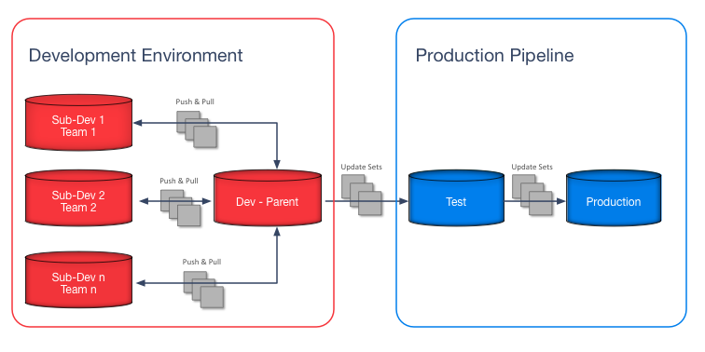
How does ServiceNow recommend we fix this
Requires a lot of instances
Does not go into specifics on how to patch or upgrade
Does not address upgrading/patching while doing Long Term Development

Slide 10
What are our alternatives?
Method 1: Export
Method 2: Hide
Method 3: Branching Instances
Method 4: Inline Instances

Slide 11
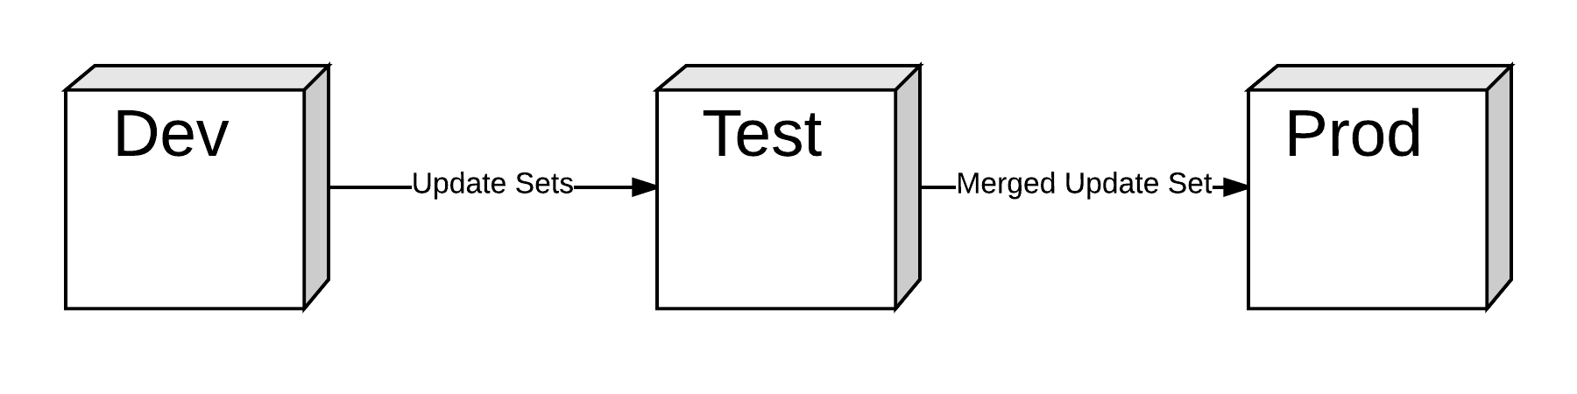
Method 1: Export
Basic Setup
Don’t push Long Term Development out of Dev until ready for deployment
During Patching and Upgrading, merge then export.

Slide 12
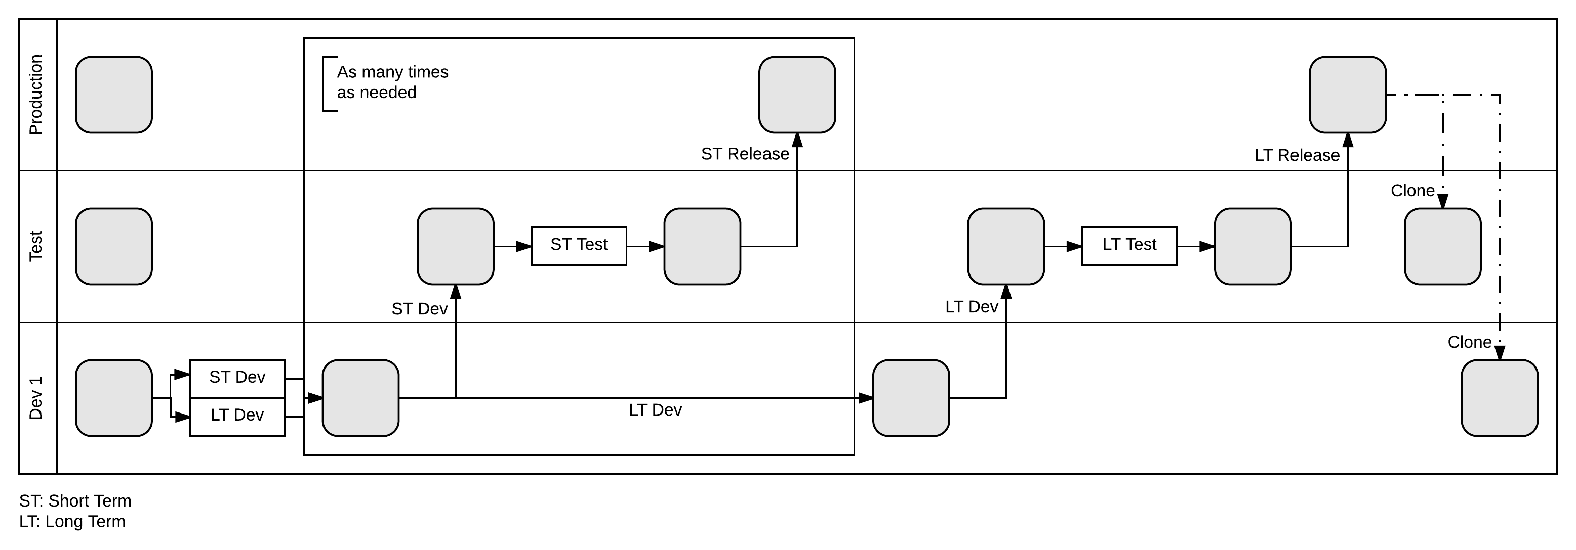
Method 1: Export – Detailed Development Cycle
All development in dev instance
Short term pushed to test during every sprint (box)
Long term held in dev until release
Short term tested in test (box)
Short term release in production at the end of every sprint (box)
Long term pushed to test and tested only when ready for final release.
Long term pulled into production on release.
After long term release, clone over test and dev
Notes:
Summary: Leave in dev instance. Release only once.
Long Term and Short Term in the same instance
Saved as update sets
Short term pushed to Test
Long term remains
Short term is tested and released as needed
Long term pushed to test only when ready for release
Long term tested
Then Long term released
Then clone over

Slide 13
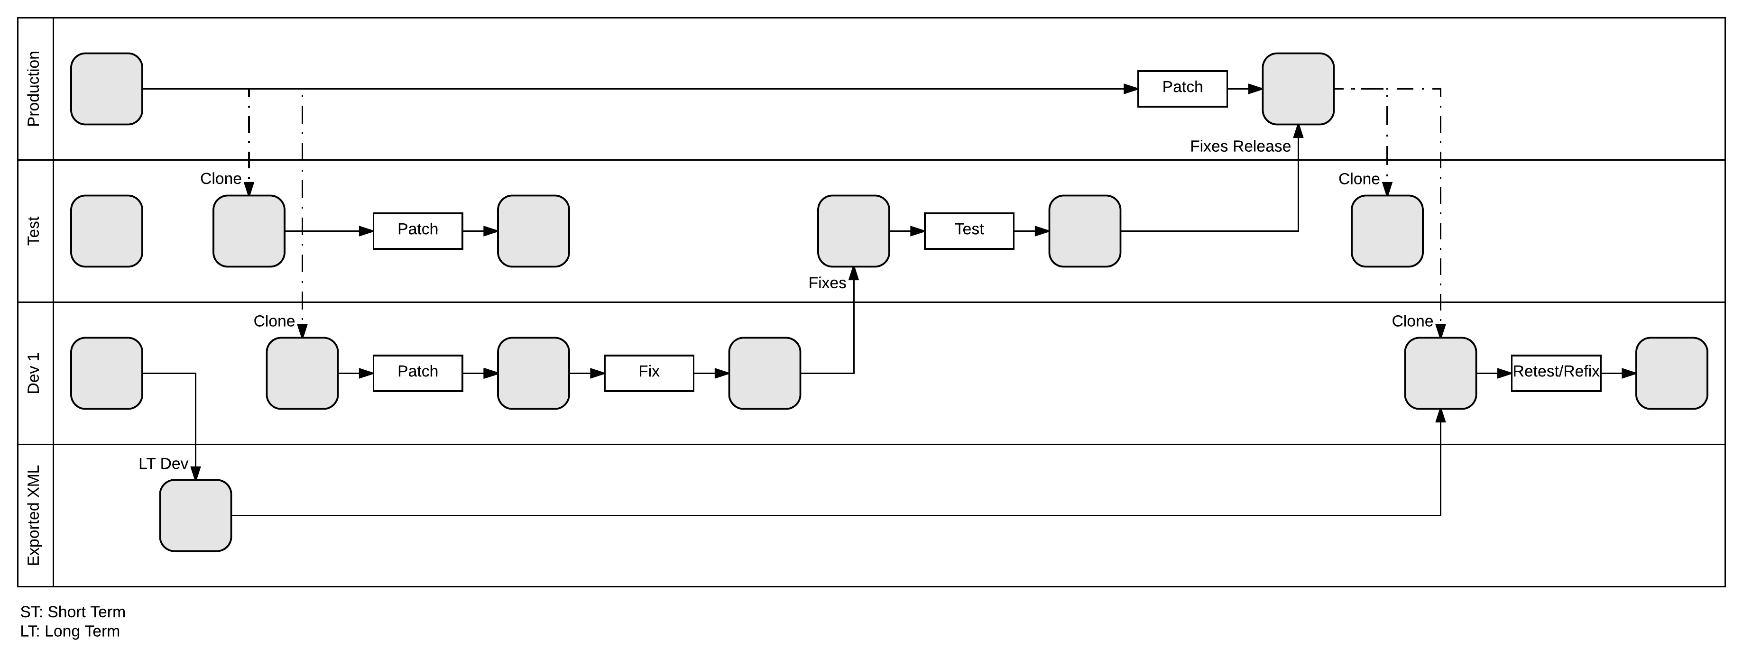
Method 1: Export – Patching/Upgrading Cycle
Short term work has all been release before a patch/upgrade
All long term work exported into an external update set
Clone from production to test and dev
Patch both test and dev
Review the skiplist and need to check list in dev.
Fix what needs to be fixed in dev
Full regression testing in test
Test fixes in test
Release into production
Clone production over test and dev
Apply the exported update set to dev
Review new skiplist and need to check list in dev.
Fix new fixes in dev
Regression testing for the long term dev
Test new fixes in dev
Notes:
Summary: Export out of dev as XML, upgrade/patch, import, apply, retest
Export work from Dev
Clone over all instances
Patch Dev and Test
Fix Dev
Move via Update sets to Test
Test
Release
Clone
Apply exported work
Re-test for long term work
Re-fix for Long term work

Slide 14
Method 1: Export – Results
Notes:
Update sets applied different number of updates every time it was applied
Including when applied to 2 instances cloned from the same backup
This reduces out confidence in the deployment
Pros
Kept long term out of production, no risk of exposure
Relatively simple process
Did not lose an work
Cons
Potential conflict of effort between Short term and Long term
Still considered unpredictable
Required constant revalidation

Slide 15
Next Step: What we can do better
Fix the issue with inconsistent update counts on apply
This was a big issue for us. It removed confidence we had in the deployment.
Stop applying update sets out of order
We were afraid out of order update sets might override changes we wanted. Required effort to make sure nothing was updated in and out of the exported update sets.

Slide 16

Method 2: Hide
Basic Setup
Push long term development with each release, but use a script to hide it
Patch and Upgrade as if you did not have long term development

Slide 17
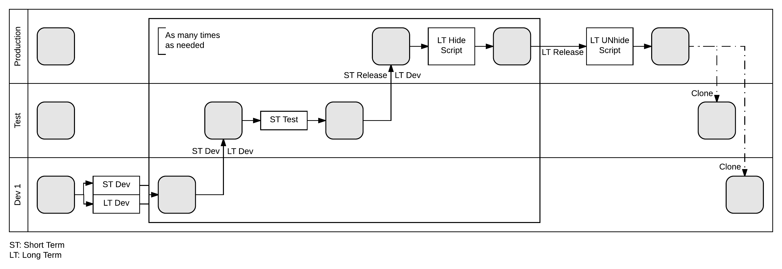
Method 2: Hide – Detailed Development Cycle
All development in dev instance
Short term and long term pushed to test during every sprint (box)
Short term and long term tested in test (box)
Short term and long term release in production at the end of every sprint (box)
Long term hidden in production via a script
On release, long term unhidden via same script
After long term release, clone over test and dev
Notes:
Summary: Leave in dev instance, release with each sprint, hide until ready for final release
Long Term and Short Term in the same instance
Saved as update sets
Short term and long term pushed to Test
Short term is tested and released as needed
Long term released with short term but hidden by a script
When ready for long term release
In test, long term unhidden
Long term tested
Then Long term released
Then clone over

Slide 18
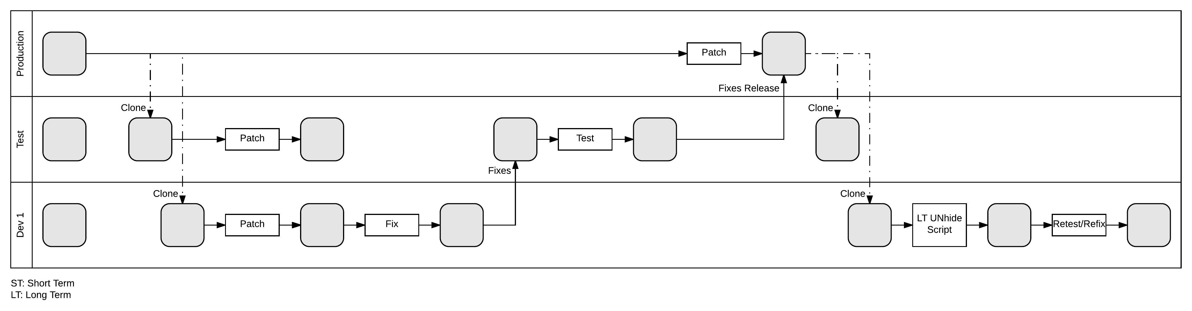
Method 2: Hide – Patching/Upgrading Cycle
Short term work has all been release before a patch/upgrade
Clone from production to test and dev
Patch both test and dev
Review the skiplist and need to check list in dev.
Fix what needs to be fixed in dev
Full regression testing in test
Test fixes in test
Release into production
Clone production over test and dev
Unhide long term via script
Review new skiplist and need to check list in dev.
Fix new fixes in dev
Regression testing for the long term dev
Test new fixes in dev
Notes:
Summary: Patch as normal, then unhide in dev, full retest.
Clone over all instances
Patch Dev and Test
Fix Dev
Move via Update sets to Test
Test
Release
Clone
Unhide using script
Re-test for long term work
Re-fix for Long term work

Slide 19
Method 2: Hide – Results
Notes:
Script had to be meticulously maintained
Required constant development effort to evolve into what we ended with
Pros
Easy to apply
Predictable Results
Script was scalable
Cons
Potential conflict of effort between Short term and Long term
Cannot hide everything
Lots of testing

Slide 20
Next Step: What we can do better
Script works best when entire module hidden
That is no longer the case
Going forward new work might overwrite current functionality we might not want live yet
There were some things we could not hide
Example: business rule modifications
Now that part of the functionality was live, the risk of exposing something you didn’t want exposed was higher.
How do we require less testing
How do we remove the test on every release that everything was hidden

Slide 21
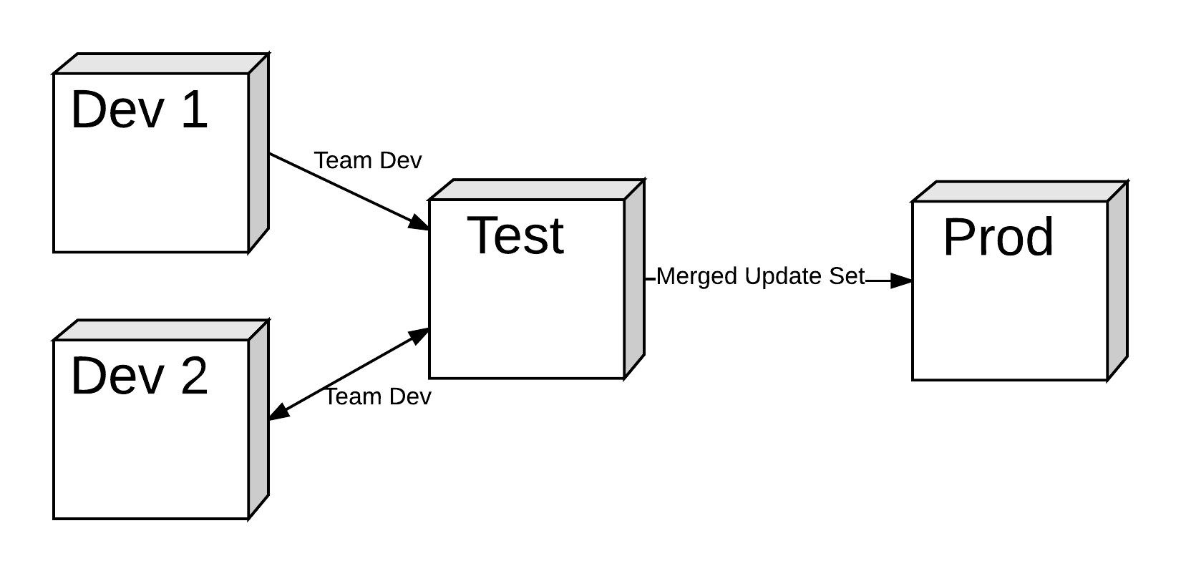
Method 3: Branching Instances (Our current process)
Closer to what ServiceNow recommends
Long term development stays in Dev 2 until release
Patch and Upgrade uses a complicated process, Dev 2 never gets cloned over

Slide 22
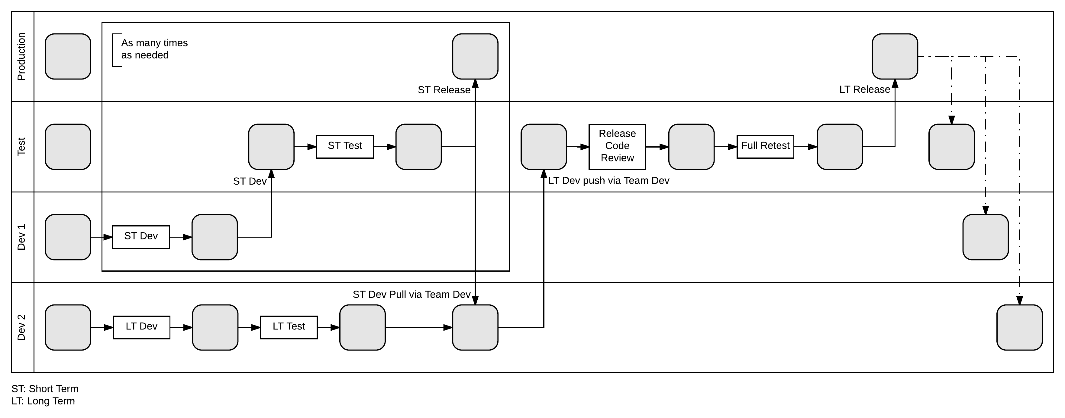
Method 3: Branching Instances – Detailed Development Cycle
Short term in dev1. Long term in dev2
Short term pushed to test during each sprint (box)
Short term tested in test (box)
Short term released into production at the end of each sprint (box)
Short term pulled into dev2 at the end of each sprint
Long term tested in dev2
Long term pushed to test when ready for release
Long term fully retested in test
Long term released to production
Production cloned over test, dev1, and dev2
Notes:
Summary: Leave long term in dev2 instance, release as normal pulling the new short term work into dev2 from test. Release long term work via test when ready
Long Term and Short Term in different instances
Saved as update sets, pushed via Team Development
Short term pushed to Test
Short term is tested and released as needed
Short term is pulled into Dev2 once a week from test
When ready for long term release
Push all to test
Do a code review
Account all changes
Full retest of all functionality
Release
Clone

Slide 23
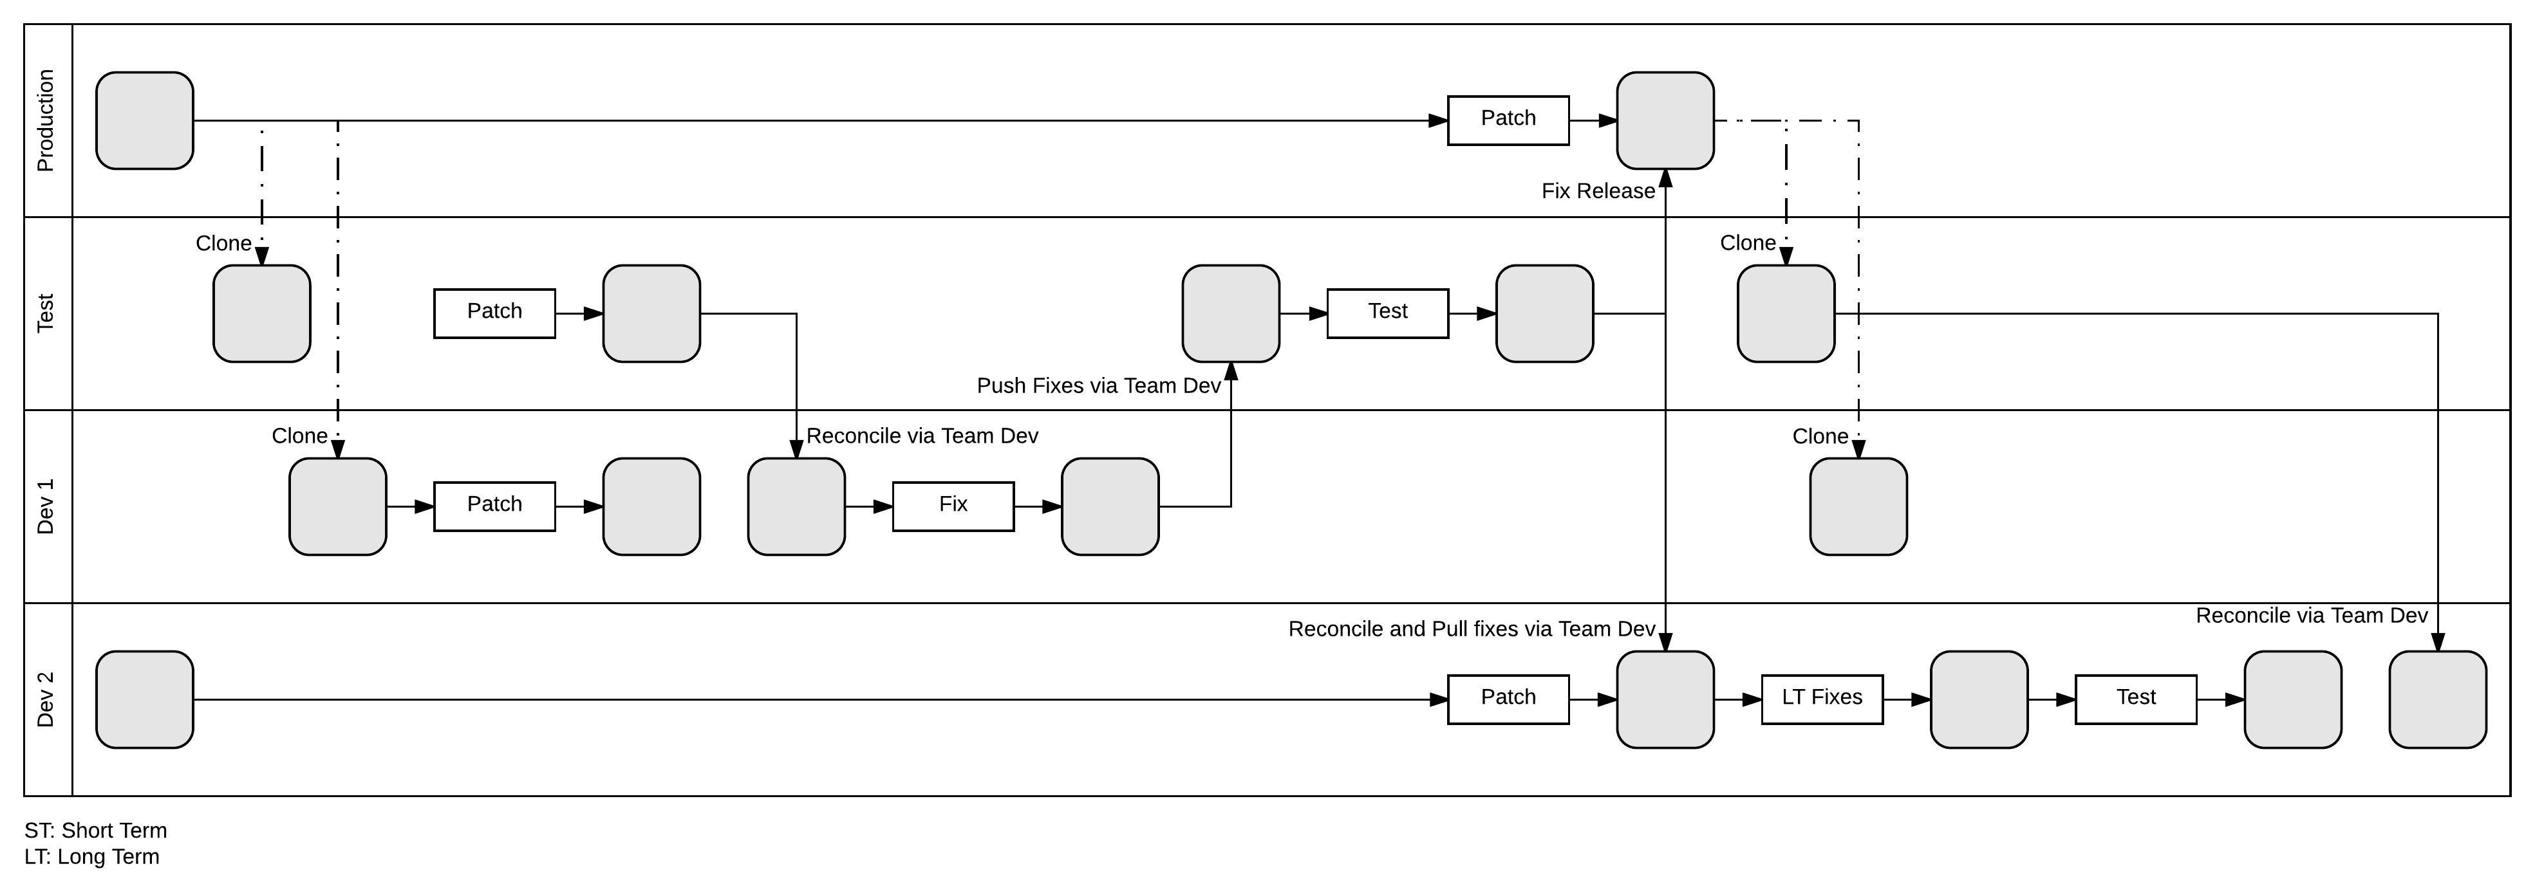
Method 3: Branching Instances – Patching/Upgrading Cycle
Short term work has all been release before a patch/upgrade
Clone from production to test and dev1
Patch both test and dev1
Use Team Develop to Reconcile dev1 and test
Review the skiplist and need to check list in dev1.
Fix what needs to be fixed in dev1
Full regression testing in test
Test fixes in test
Release into production
Patch dev2
Pull fixes from test to dev2
Clone production over test and dev
Review new skiplist and need to check list in dev2.
Fix new fixes in dev2
Regression testing for the long term dev2
Test new fixes in dev2
Use Team Develop to reconcile test and dev2
Notes:
Summary: Leave long term in dev2 instance, upgrade as normal all except dev2. then once that is done patch dev2, pull in the fixes from test and retest.
Clone over test and dev
Patch Dev and Test
Reconcile via Team Dev between test and dev
Fix Dev
Move via Team Dev to Test
Test
Release
Pull fixes down from test to Dev 2
Clone Dev and Test
Re-fix for Long term work
Re-test for long term work
Reconcile Test and Dev2

Slide 24
Method 3: Branching Instances – Results
Notes:
Requires another instance.
Works when some parts are live.
Pros
Manages conflicts of Long term and Short term
Easy release of short term efforts
Cons
Push too large to validate
Difficult to patch
Required full retest
Dev and test are in the same instance

Slide 25
Next Step: What we can do better
Minimize our pushes
More frequent pushes allow better use of the built in tools for code review
Separate testing instance from development instance
Allows testing to be more accurate with what it will look like on release
Changes that are not part of the update set won’t affect testing
Minimize retesting when ready to deploy

Slide 26
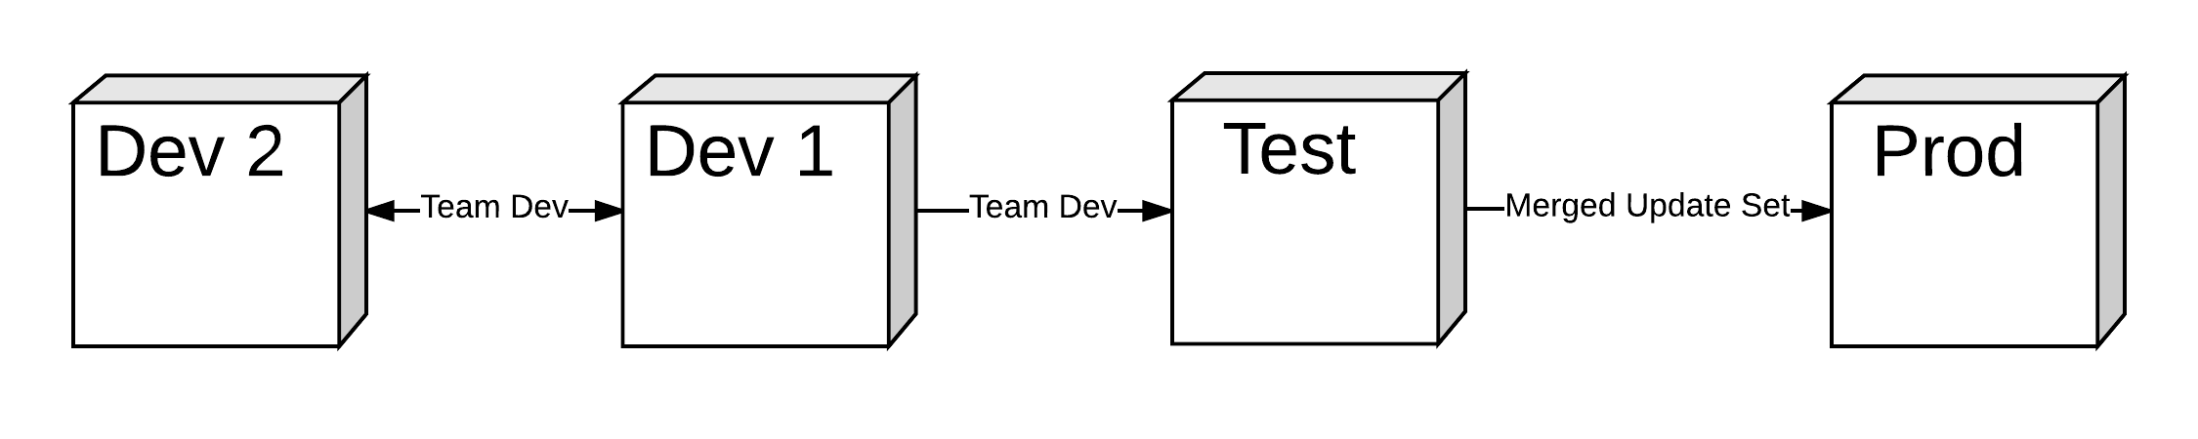
Method 4: Inline Instances (Process still in development)
Important: Separates Development and Testing for Long term efforts
Long term development pushed from Dev 2 to Dev 1 then held until release
Patch and Upgrade uses a complicated process

Slide 27
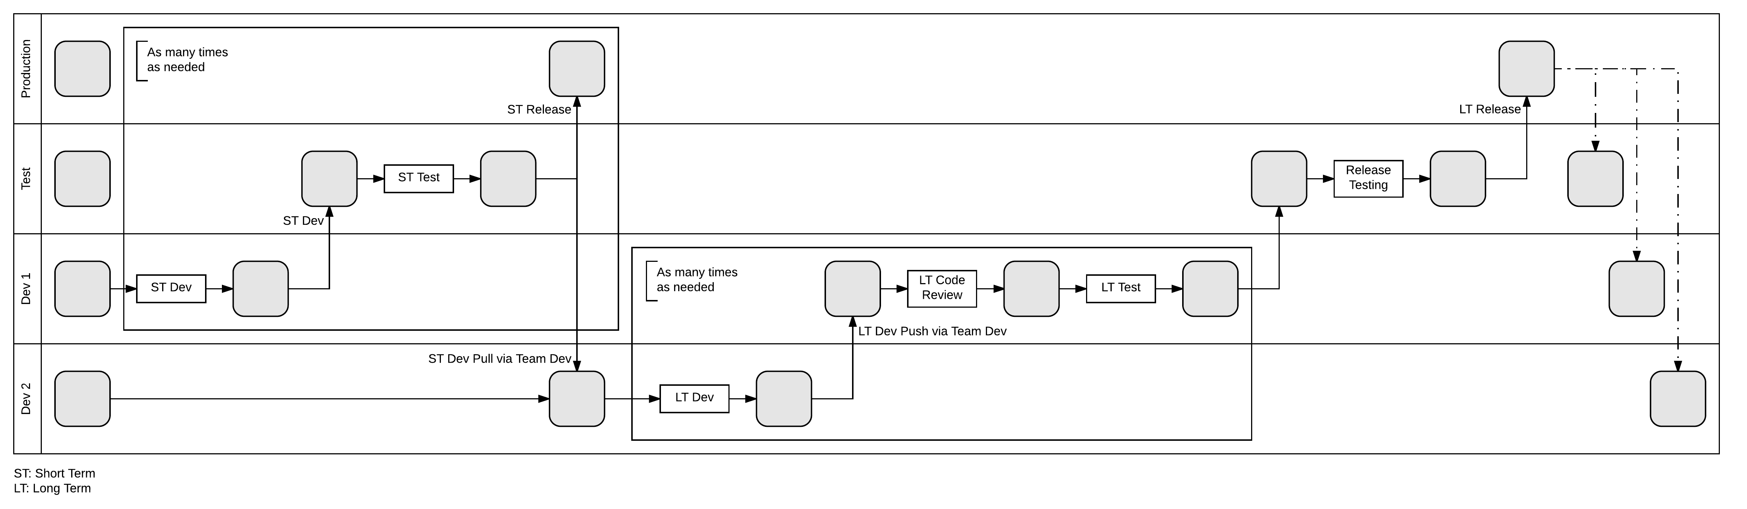
Method 4: Inline Instances – Detailed Development Cycle
Short term in dev1. Long term in dev2
Short term pushed to test during each sprint (box1)
Short term tested in test (box1)
Short term released into production at the end of each sprint (box1)
Short term pulled into dev2 at the end of each sprint
Long term pushed to dev1 during each sprint
Long term pushed to test from dev1 when ready for release
Long term smoke tested in test
Long term released to production
Production cloned over test, dev1, and dev2
Notes:
Summary: Leave long term in dev2 instance, release as normal pulling the new short term work into dev2 from dev. Release long term work via dev then test when ready
Long Term and Short Term in different instances
Saved as update sets, pushed via Team Development
Short term pushed to Test
Short term is tested and released as needed
Short term is pulled into Dev2 once a week from test
Long term is developed in dev 2
Long term is pushed to dev 1
Long term is tested in dev 1
Long term held in dev 1 until release
Long term gets constant code review
When ready for long term release
Push to test
Release testing which can be abbreviated
Release
Clone

Slide 28
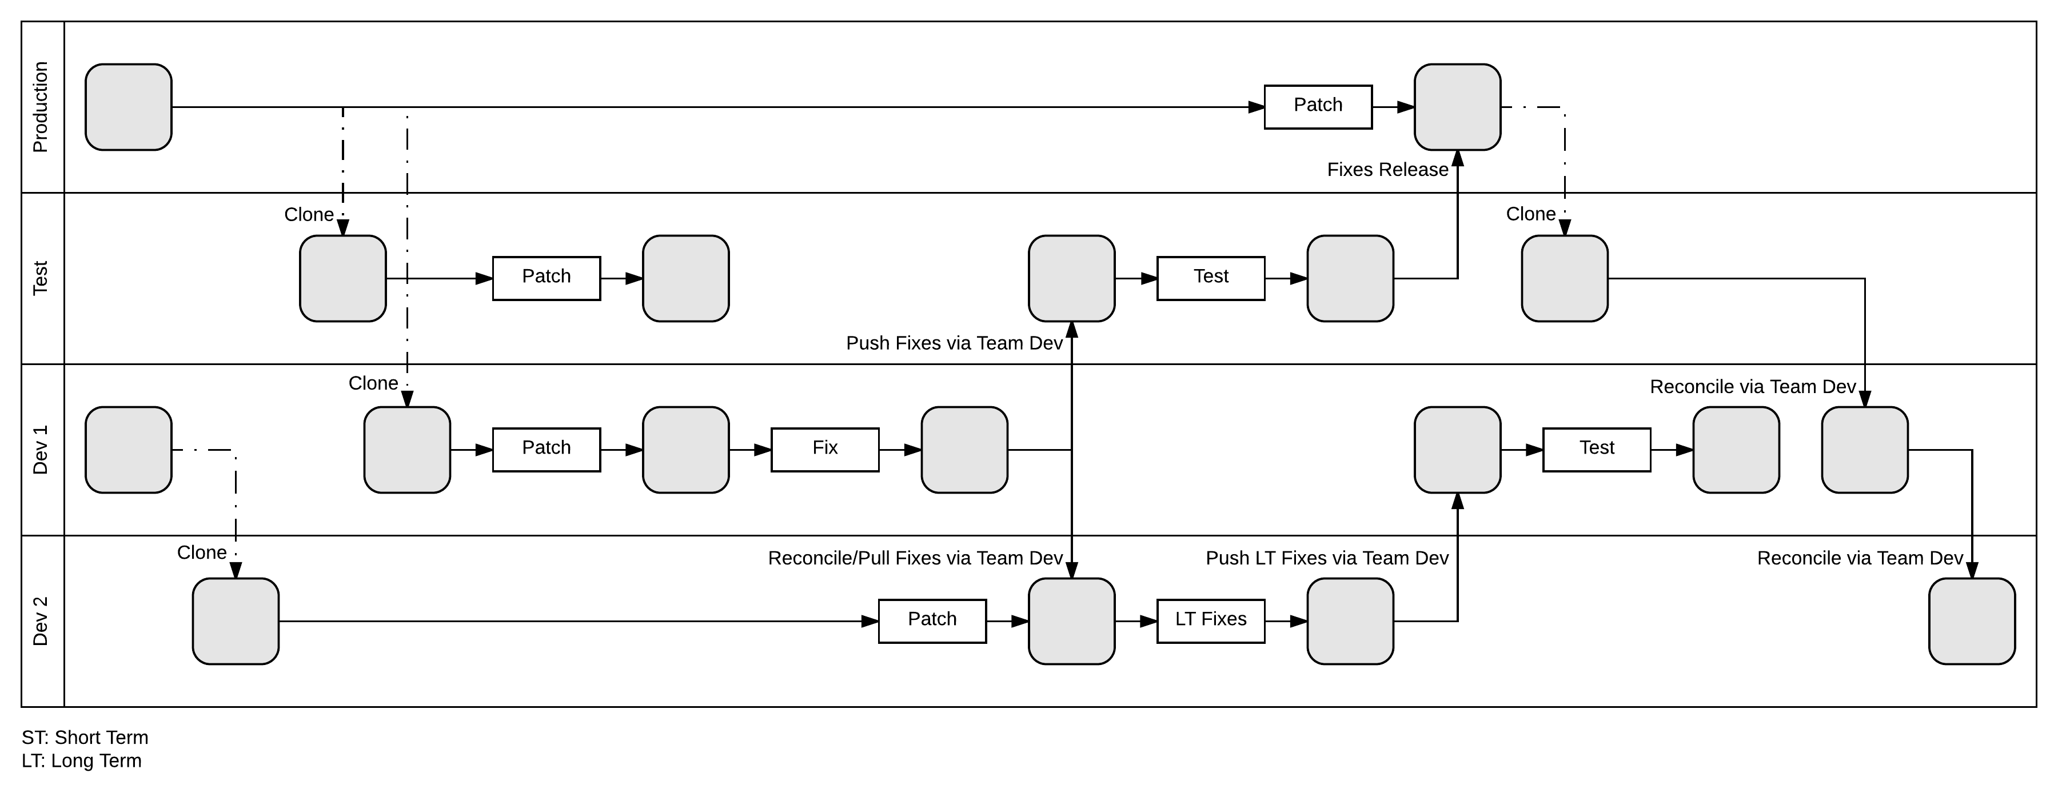
Method 4: Inline Instances – Patching/Upgrading Cycle
Short term work has all been release before a patch/upgrade
Clone from dev1 to dev2
Clone from production to test and dev1
Patch both test and dev1
Use Team Develop to Reconcile dev1 and test
Review the skiplist and need to check list in dev1.
Fix what needs to be fixed in dev1
Patch dev2
Pull fixes from dev1 to dev2
Full regression testing in test
Test fixes in test
Release into production
Clone production over test
Review new skiplist and need to check list in dev2.
Fix new fixes in dev2
Regression testing for the long term dev1
Test new fixes in dev1
Use Team Develop to reconcile test and dev1 and dev1 and dev2
Notes:
Summary: Leave long term in dev2 instance, upgrade as normal all except dev2. then once that is done patch dev2, pull in the fixes from dev. Then push long term work from dev2 to dev1 and test in dev1
Clone dev 1 over dev 2 (it has all dev 2’s work already)
Clone Production over Dev 1 and Test
Patch Dev 1 and Test
Fix on Dev
Push to test
Test on Test
Patch Dev 2
Pull fixes down to dev 2
Fix long term fixes in dev 2
Push to dev 1
Test long term fixes in dev 1
Reconcile dev 1 with test
Reconcile dev 2 with dev 1

Slide 29
Method 4: Inline Instances – Predictions
Notes:
Separates testing and development for long term efforts
More confident in deployments
Pros
Constant formal code reviews
Testing and Development are separate
Cons
Risk of conflict between Short term and Long term
Difficult to patch

Slide 30
How we patch
Apply patch
Export list of all skips
Import into ’Special Sauce’ spread sheet
Filter out skips that we have seen before via matching hashes
Review remaining skips: Keep, Revert, Merge
Revert the reverts
Manually merge the merges
Go over the Development Check List
Fix what needs fixing from the check list
Test

Slide 31
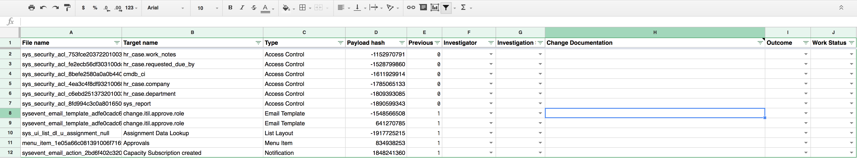
Our Patching Spreadsheet
Columns
File Name (From Skiplist)
Target Name (From Skiplist)
Type (From Skiplist)
Payload Hash (From Skiplist)
Previous (Hash matches)
Investigator
Investigation
Change Documentation
Outcome
Work Status
Notes:
Demo after this

Slide 32
Exploratory Development
No spare instances
Some exploration we can back out, some we can’t, other break when you backout
Personal Development Instances
Be careful of IP conflicts
Cannot clone from your business environment
On Methods 1,2,3 exploratory development can cause issues with testing if done in LT environment

Slide 33

Thank You
Justin Anonuevo
Lead Developer
University of California, Berkeley
Justin.anonuevo@berkeley.edu

