Slide 1
GitHub demo/tutorial
SERVIR Global GIT Exchange
Created By: Billy Ashmall

Slide 2
What are we going to cover today
What is GitHub
Create a Repository
Create a Branch
Make and commit changes
Open a Pull Request
Merge your Pull Request
How to use GitHub Desktop
How to view a site on you GitHub Branch

Slide 3
What is GitHub?
GitHub is a code hosting platform for version control and collaboration.
It lets you and others work together on projects from anywhere.
It makes tracking code changes easier
Makes project documentation easy to access.

Slide 4
What is a Repository?
A repository is a single location that you can organize your projects.
I recommend that you use a single repository for each project.
Repositories can house any kind of digital media like code files, images, data sets or anything else that your project requires.
I recommend including a README file with information about your project.

Slide 5
Create a Repository
Navigate to github.com and login or create new account.
Once logged in, in the upper right corner, next to your avatar, click + then select New repository.
Enter name, description, and check Initialize with README
Click Create Repository

Slide 6
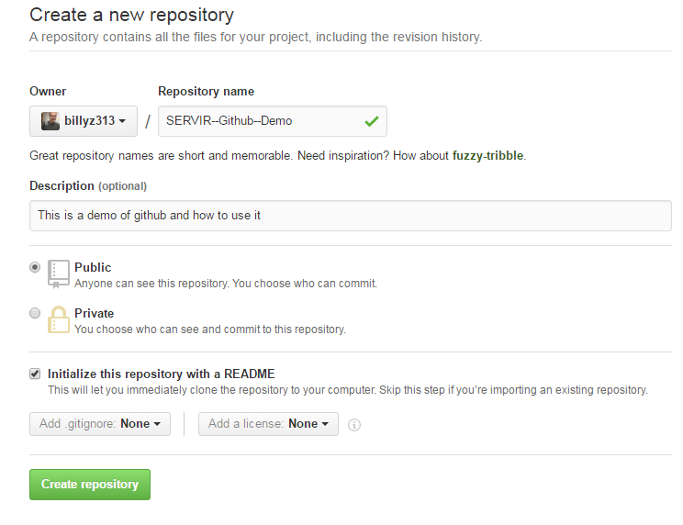

Slide 7
What is a branch
Branching is the way to work on different versions of a repository at one time.
A branch gives you an environment where you can try new things, add new features, test ideas.
Changes in the branch do not affect the master until you are ready to merge.
Every repository starts with the master branch

Slide 8
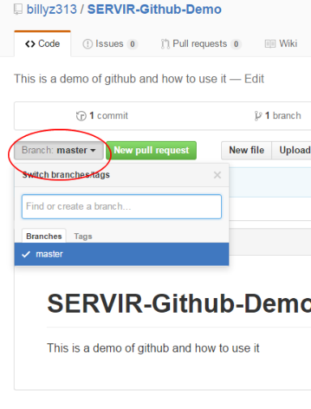
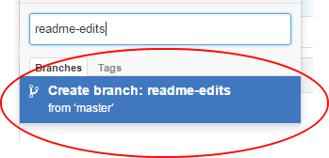
Create a Branch
Now you have two branches, master and readme-edits. They look exactly the same, but not for long! Next we’ll add our changes to the new branch.
Go to your new repository
Click the drop down that says branch: master.
In the textbox, type readme-edits
Click the blue Create branch: readme-edits from ‘master’
You now have a master and a readme-edits branch. They are currently exactly the same, but we’ll add our changes to the new branch soon.

Slide 9
Make and commit changes
Now it’s time to make some edits to our branch.
On GitHub, saved changes are called commits
Each commit has an associated commit message describing why a particular change was made
Commit messages help to capture the history of your changes, so other contributors can understand exactly what you’ve done and why.

Slide 10
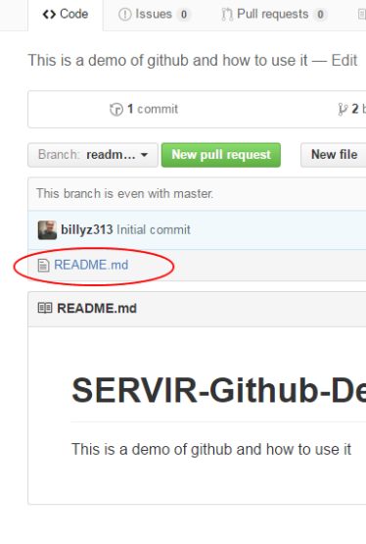
Make and commit changes
Click the blue link README.md
Click the pencil icon in the top right corner
In the editor write what the goal of the project is.
Scroll to the bottom of the page and click Commit Changes button

Slide 11
What is a Pull Request
Pull Requests are made to collaborate your new branch contribution to the master.
Pull requests show diffs, or differences, of the content from both branches.
As soon as you make a commit, you can open a pull request and start a discussion, even before the code is finished.

Slide 12
Open a Pull Request
Click the tab at the top that says Pull Requests
Click the green New pull request button.
Expand the dropdown to the right which says compare:master and select readme-edits.
Look over your changes in the diffs on the Compare page, make sure they’re what you want to submit.
Click the big green Create Pull Request button.
Give a title and description for your changes
Click Create pull request

Slide 13
Merge your Pull Request
A merge brings these changes together by actually merging the two branches .
Click the green Merge pull request button to merge the changes into the master branch
Click Confirm merge.
Notice the Delete branch button? Since you have merged all of the changes we can go ahead and click it to remove the edit branch.
Now we just have the master branch again.

Slide 14
GitHub Desktop
GitHub Desktop is the easiest way to get code on GitHub.com
You won’t need to learn any command-line instructions, SSH keys, or complicated Git terminology
All you’ll need is your Mac or Windows computer and a GitHub.com account.
You can download GitHub Desktop https://desktop.github.com here.
Once you install GitHub Desktop, a short set up wizard will walk you through some basic configuration and will help you connect GitHub Desktop with your GitHub.com account.

Slide 15
Clone your repository
Create a local copy of your repository by clicking the +
Click the clone tab and select the repository you want to clone
Select where you would like the repository to reside on your machine. No need to create the top folder it will be created for you
You now have a local editable copy of your repository

Slide 16
Branch and add code
Click the branch button at the top left
Enter name and click create
Click open this repository in Explorer
Right click and add new text file rename it index.html
Open the file in your favorite editor, add some basic html and save
<html>
<head>
<title>Sample</title>
</head>
<body>
<h1>This is just a sample</h1>
</body>
</html>

Slide 17
Publish and request Pull
Click the publish button.
In the left panel add description
Click Commit to Code-adding-branch
Click the Pull request button
Add description and click Send pull request
Your pull request was created!
Click view it on GitHub and Merge it! (the same way you merged earlier)

Slide 18
Display the index.html page online
Create new branch and name it gh-pages
In browser navigate to {username}.github.io/{repositoryName}
For example http://billyz313.github.io/SERVIR-Github-Demo/

Slide 19
Here’s what we accomplished in this session
Created an open source git repository
Started and managed a new branch
Changed a file and committed those changes
Opened Pull Request
Merged two branches
Deleted merged branch
Used GitHub Desktop
Published a branch webpage

Slide 20
Please direct any questions or comments to Billy Ashmall billy.ashmall@nasa.gov

