Slide 1








Open Source Applications React
Billy Ashmall, SERVIR SCO
November 15, 2018

Slide 2
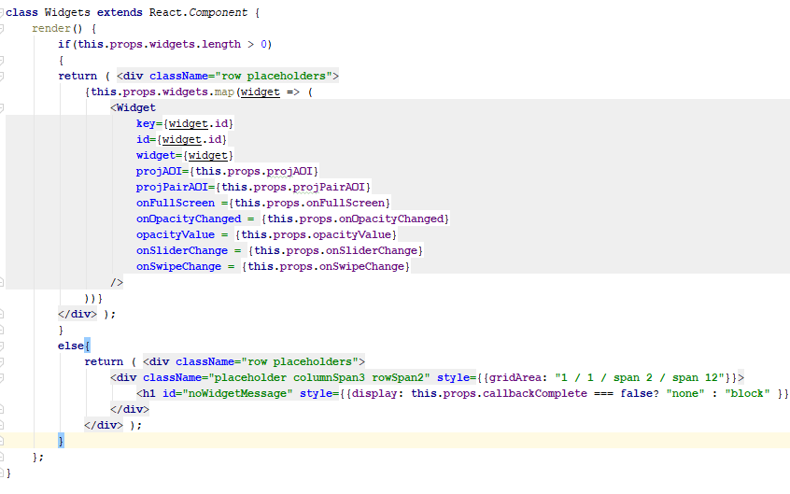
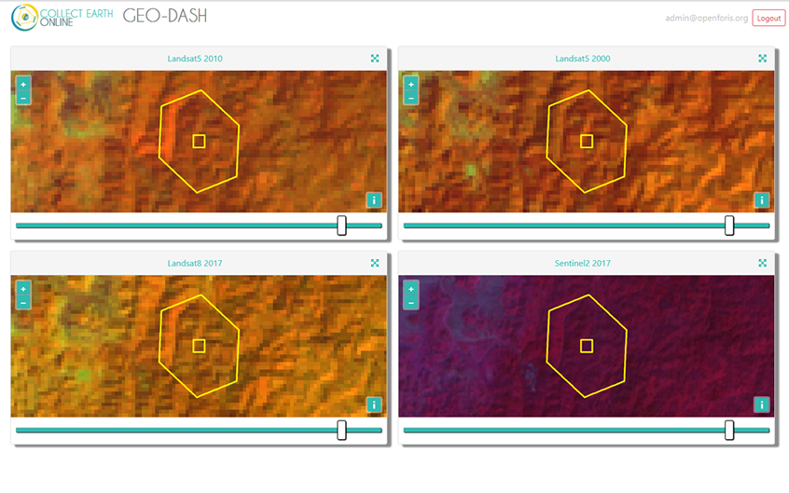
Agenda
React overview
Code demo
Define Components
Start project
Includes
Develop
Test components
Deploy components
Use deployed components
Example component code
Example of components displayed

Slide 3

React overview

Slide 4
React overview
About
Open-source JavaScript library which is used for building user interfaces
Used for handling view layer for web and mobile apps
Component based – Allows us to create reusable UI components
Works with a virtual DOM to allow elements to update without reloading the entire page
Stateful – meaning we change the state and react handles rendering the display as we defined it

Slide 5
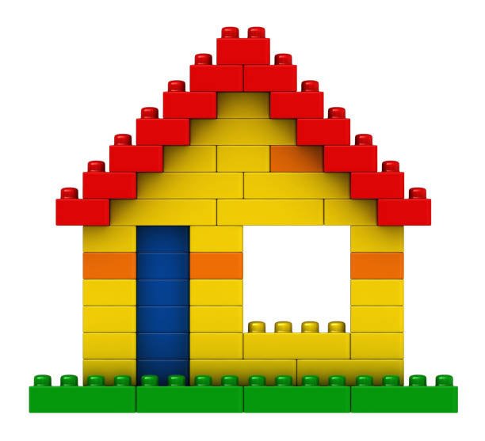
React Lego house example
Reusable components
Instead of having to build each part of the house we start with the top component – House
A house consists of a roof, walls, doors, and windows.
Each sub component can also have deeper components for example a roof consists of shingles, a wall consists of blocks, windows(0 to n), and doors(0 to n)

Slide 6
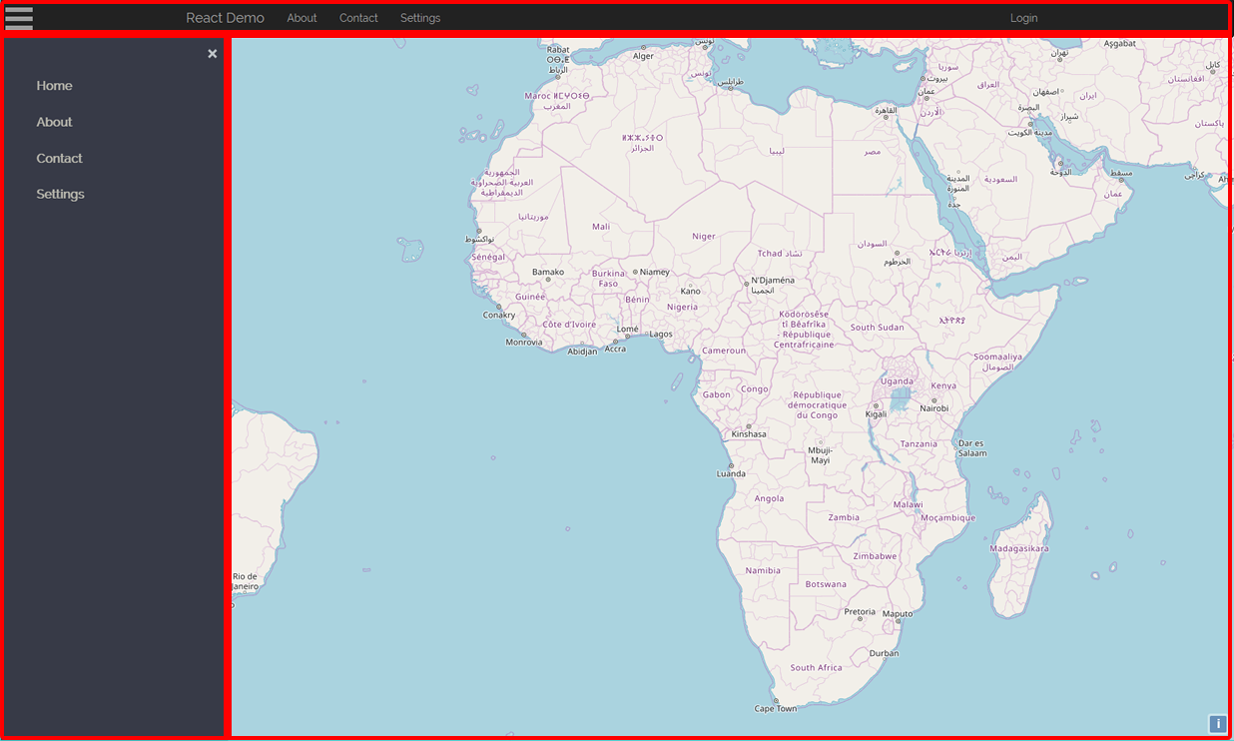
Consider reusable parts of a website

Slide 7
Requirements
Node
https://nodejs.org/en/download/
yarn
https://yarnpkg.com/lang/en/docs/install/
Any text editor
https://code.visualstudio.com/download
The video that was shown during the presentation is located at: https://github.com/billyz313/react_demo/raw/master/Notes/React_Demo.mp4

Slide 8
Project setup
Code demo
https://github.com/billyz313/react_demo/blob/master/Notes/1_env_setup.txt

Slide 9
Component Development
Code demo
https://github.com/billyz313/react_demo/blob/master/Notes/2_component_dev.txt

Slide 10
Component Development
Code demo
https://github.com/billyz313/react_demo/blob/master/Notes/3_side_panel_component.txt

Slide 11
Component Development
Code demo
https://github.com/billyz313/react_demo/blob/master/Notes/4_map_component.txt

Slide 12
Component Development
Code demo
https://github.com/billyz313/react_demo/blob/master/Notes/5_publish_components.txt

Slide 13
Discussion

