Slide 1
Predict Stock Correlations With ARIMA+LSTM
December, 2023
PREPARED BY Jijun Chi(1010253887), Yingying Liu(1008325974), Yuchen Zhang (1005693019), Ke Yao(1004883183)
Option 5:
Apply an ARIMA+LSTM model to predict stock correlations to enhance an
algorithmic trading system based on PCA.

Slide 2
AGENDA
Input and Target
Data pre-processing
Model
  ARIMA
  LSTM
  PCA
Parameters
  Absorption Ratio
  Covalent Matrix
  Absorption Ratio Delta
Result
Improvements
Reference

Slide 3
Abstraction
With the existing algorithm trading system of PCA, we replace one of the data set (variable) called absorption ratio with our results from improved and advance ARIMA+LSTM model. ARIMA, as Autoregressive Integrated Moving Average, is a decent time series prediction model for linear system. And the LSTM, as Long Short-Term Memory, is designed to find the nonlinear parameters in the data set. By combining both model, the linear and nonlinear part of the data trend are conclude and estimate with better precision and performance.
Stock market, as a typical example of chaos theory, is a proper target for our project. With its property of highly unpredictable and volatile, an algorithm trading system have faster responsible time, multi-task process, and actions that absolutely match the certain logic. But the fact is there are too many parameters and indicators that can affect the stock price. Our trading system cannot and will not perform as we expected to predict the stock market. But we do improved some of the xxx to better “predict” the future.

Slide 4
Input Data
20industries_ETF_prc_UNSTACKED
Including daily prices of ETFs of 20 different industries from 2007 to 2019 (IYW,IYJ,IBB,IGV,IXP,IYT,VNQ,PBS,PBJ,KCE,KIE,KBE,XSD,ITB,ITA,IHI,IHF,IHE,IEZ, and FDN)
AGG_VTI_UNSTACKED_adjusted_returns
Test data for different trading strategy performance.
VTI as Equity and AGG as Fixed Income assets

Slide 5
Target
Annual return
This target specifies the percentage of profit through the year
Annual volatility
This target specifies the risk of the investment. Higher volatility means greater the risk is.
Average number of trades per year
This target specifies the frequency of trading. As in stock market, the trading itself would have the brokerage commission. The less trades the better.
Sharpe Ratio
This target compares the return of an investment with its risk. It represents the additional amount of return that an investor receives per unit of increase in risk.

Slide 6
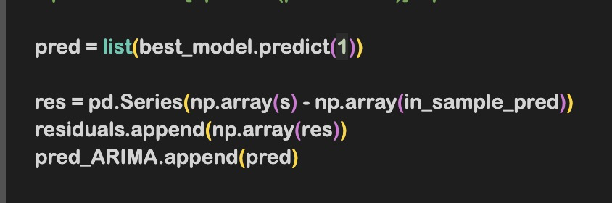
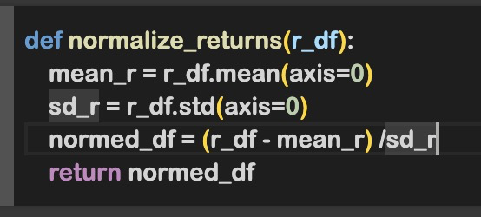
Input Processing
We process time-series stock price data, calculates rolling correlations between pairs of assets, and organizes the results into a DataFrame for further analysis. The rolling correlations are sampled at regular intervals to create a structured data matrix.
Create Residuals For ARIMA
Normalise Daily Returns For absorb Ratio
The function takes a DataFrame of returns data, calculates the mean and standard deviation for each column (asset), and then normalizes the data by subtracting the mean and dividing by the standard deviation. The output is a DataFrame with normalized returns.

Slide 7
Models Intro
ARIMA
LSTM
The Autoregressive Integrated Moving Average model, known as ARIMA, is one of the traditional statistical models for time series prediction
Linear regression model for tracking linear trends in stationary time series data
The autoregressive (AR) part of ARIMA indicates that the evolving variable of interest is regressed on its own lagged values
The Long Short-Term Memory model, known as LSTM, is a model that detecting nonlinear trends in the dataset
Based on Recurrent Neural Networks (RNN) and Backward Propagation Through Time (BPTT) process
A common LSTM unit usually includes 4 parts: a cell, an input gate, an output gate, and a forget gate.

Slide 8
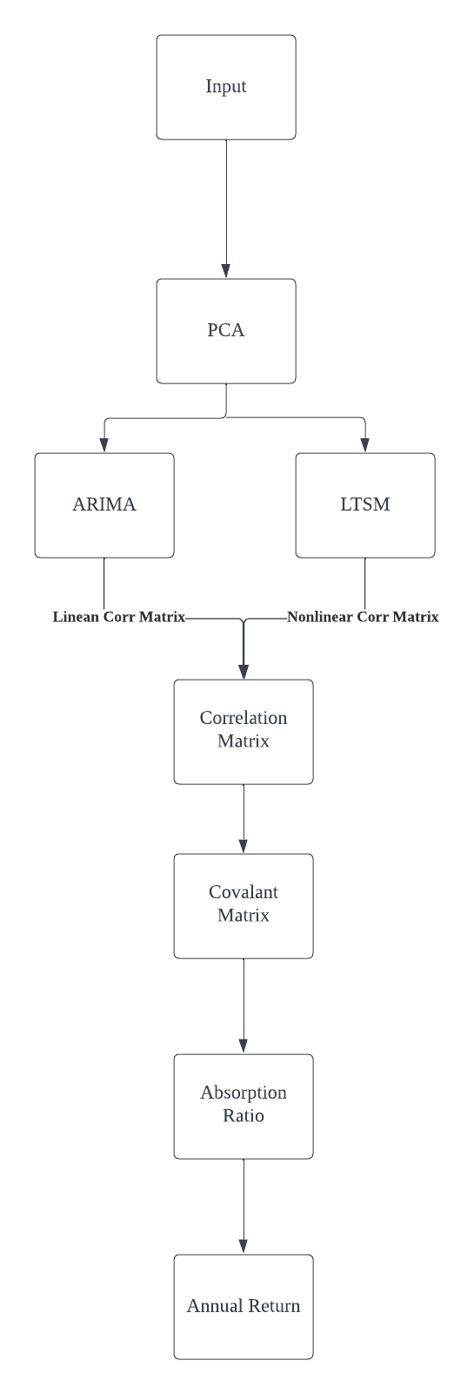
PCA
The Principal component analysis, known as PCA, is specialized for analysing is in large data tables by means of a smaller set of “summary indices” that can be more easily visualized and analyzed. It increase the interpretability of data while preserving the maximum amount of information. Which in our model, stock price is the main focus. The strategy based on absorption ratio is applied to PCA based trading system. And finally, it gives us the annual return of the specific strategy.

Slide 9
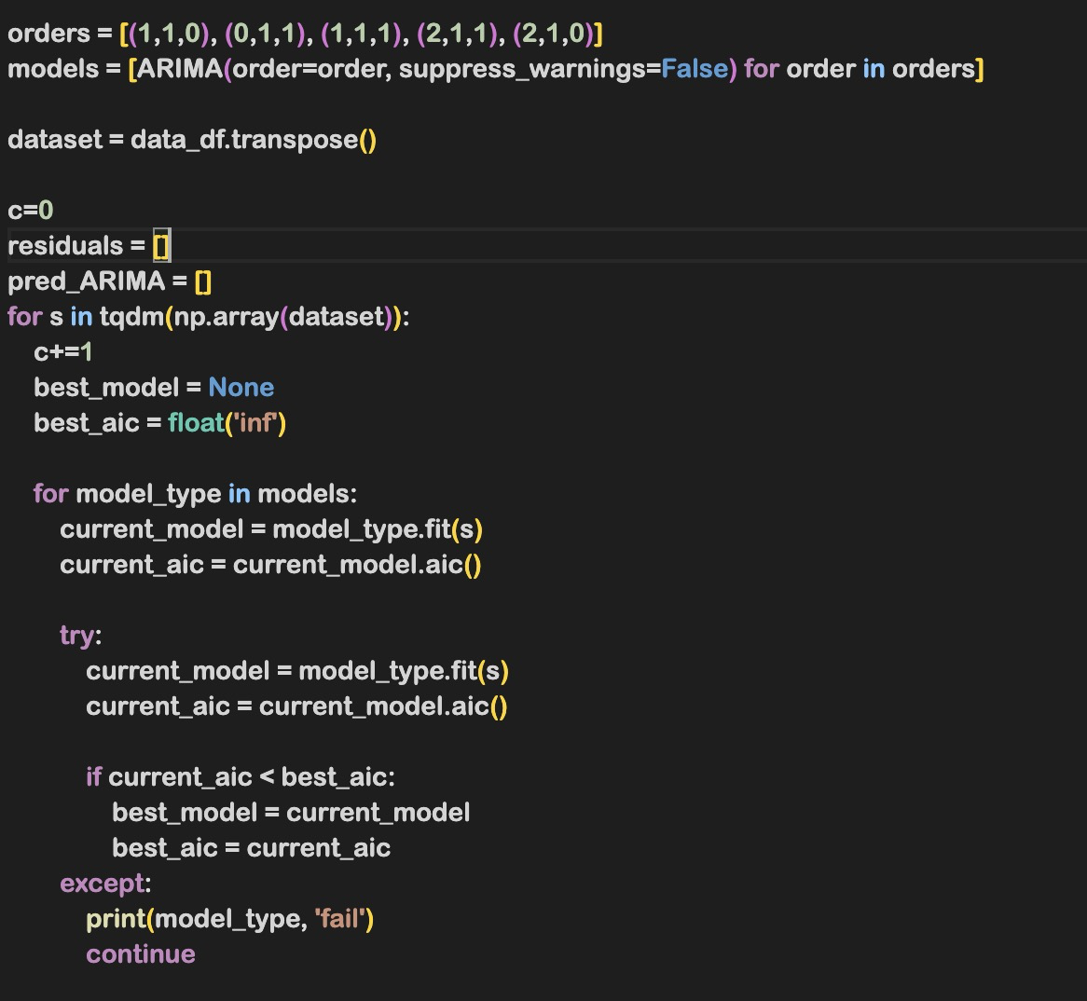
Parameter
ARIMA
The model parameters for the ARIMA models are specified in the “orders” list. Each tuple in the list represents a set of parameters for an ARIMA model. Specifically, each tuple has three values corresponding to the AR order, Integration order, and MA order. The code then iterates over these different sets of parameters to find the best-fitting ARIMA model for each time series.

Slide 10
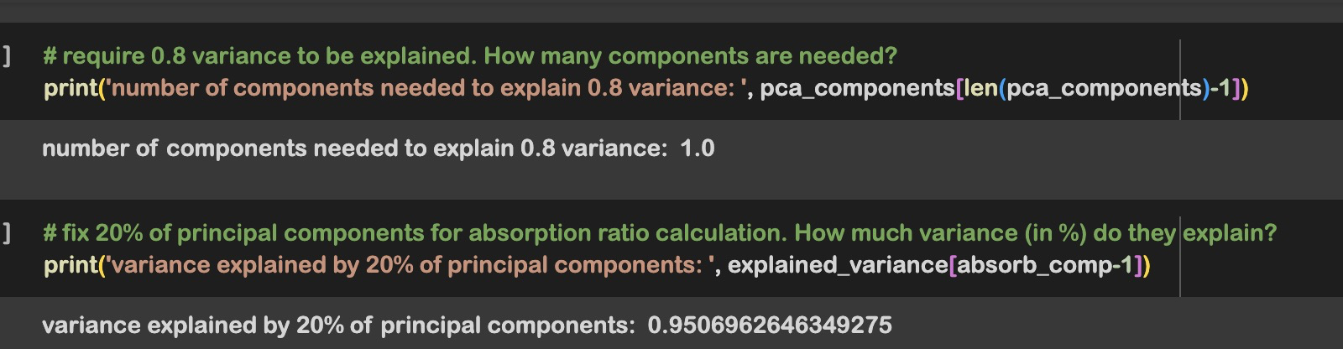
Parameter
LSTM
According to requirements, we use the trained model provided in the essay of
“epoch247.h5”
PCA
If we want to explain 0.8 variance, we find that how many components are needed

Slide 11
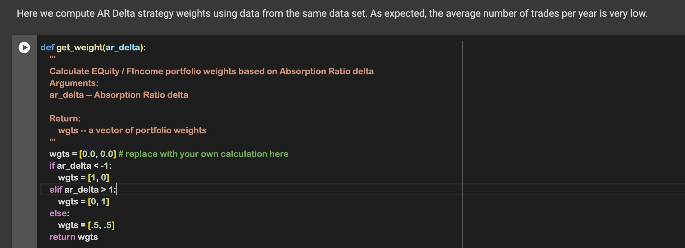
Parameter
AR Trading Strategy Model
The function uses the ar_delta parameter to determine the portfolio weights.

Slide 12
Parameter
AR Trading Strategy Model
Decision Logic:
If ar_delta is less than -1, the function assigns a portfolio weight of [1, 0], indicating 100% weight in Equity and 0% in Fixed Income.If ar_delta is greater than 1, the function assigns a portfolio weight of [0, 1], indicating 0% weight in Equity and 100% in Fixed Income.If ar_delta is between -1 and 1, the function assigns an equal weight of [0.5, 0.5] to both Equity and Fixed Income.

Slide 13
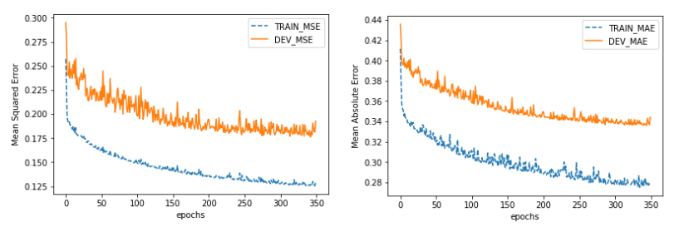
Train vs. Validation Error
Since we didn’t train the model ourselves, the training result from the provided material is shown.

Slide 14
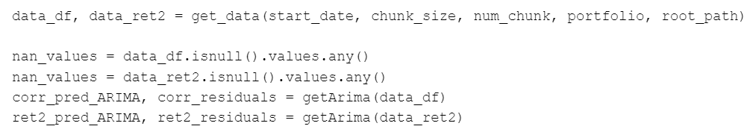
Model - ARIMA
As for the linear part of the datasets, the calculation has been made. From the parameter we received from the input setting, we start to process the data to get two parts of data: the correlation between each pair of EFTs and the return percentage of each EFTs. To produce the correlation predicted matrix and the correlation residuals, we apply the function getArima. Also the prediction of return_percentage^2 of each ETF and the residual of it for the future analysis is generated at the same time.

Slide 15
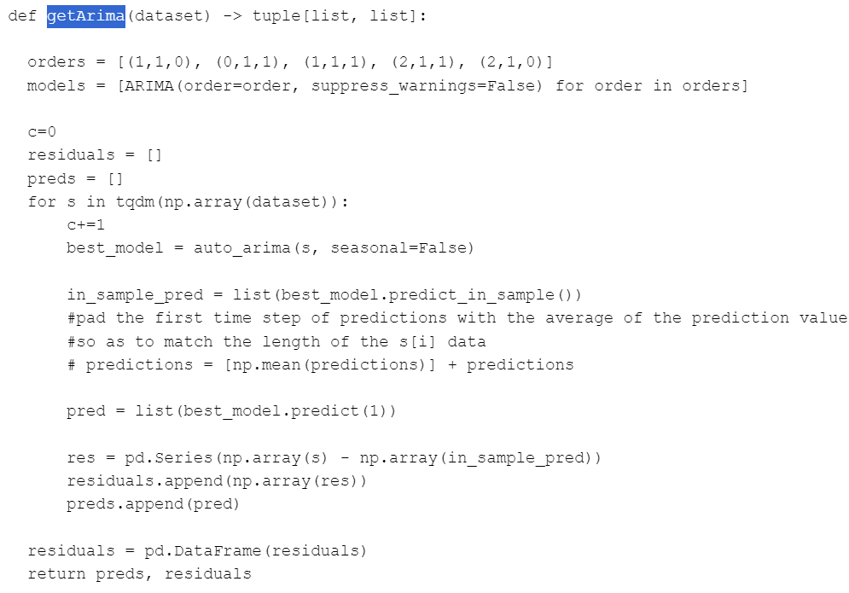
The function getArima is presented here. The basic logic follows the provided material which tried multiple sets of parameters to find out the best match

Slide 16

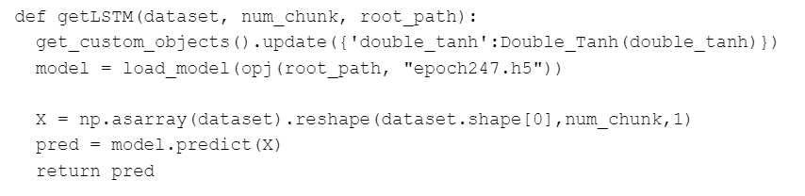
Model - LSTM
The nonlinear prediction correlation matrix are generated by LSTM model, where the parameters are used from both input and the result of the ARIMA model.
Within the function getLSTM, the following script shows the logic of our LSTM model with stated in epoch247.h5.

Slide 17

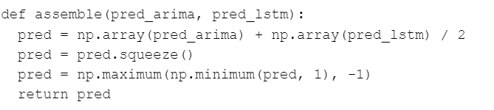
After we receive the linear and the nonlinear part of the correlation matrix, we combine them with the function “assemble” which simply calculated the average value of both predicted matrix.

Slide 18
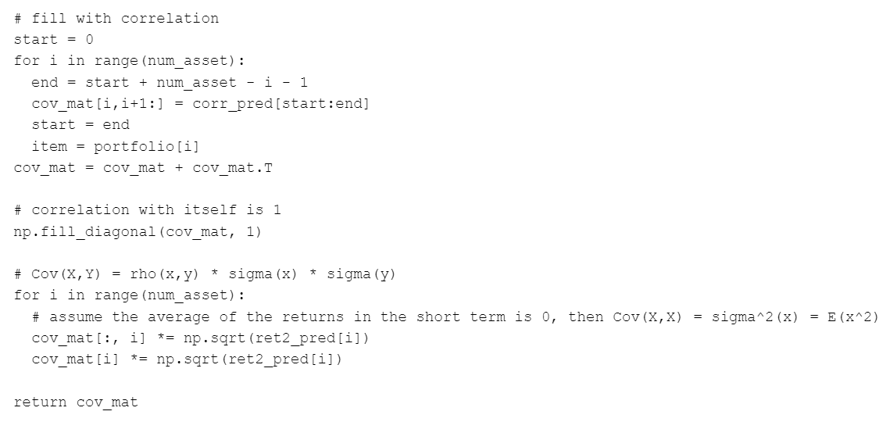
After generating the correlation matrix, the required covalence matrix can be produced by following scripts. And the results which are needed for the absorption ratio calculation are fulfilled.

Slide 19
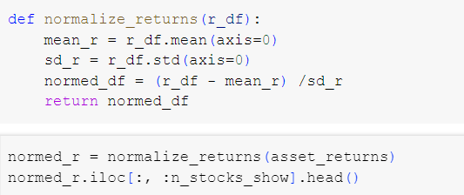
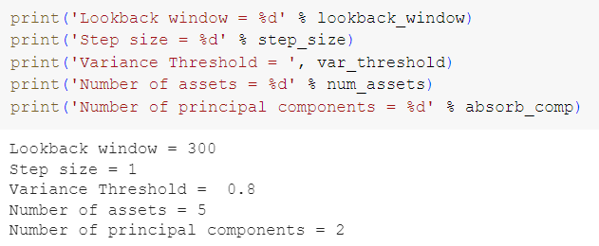
Model - PCA
First, with 20 ETFs daily price enters the system, we would calculated the daily returns of each ETF. Then, we normalized the return to fit the following models as or data pre-processing.
Then, we define the parameter of our ARIMA+LSTM model with window size of 300, step size of 1, variance threshold of 0.8, number of asset of 5, and number of principal components of 2.

Slide 20
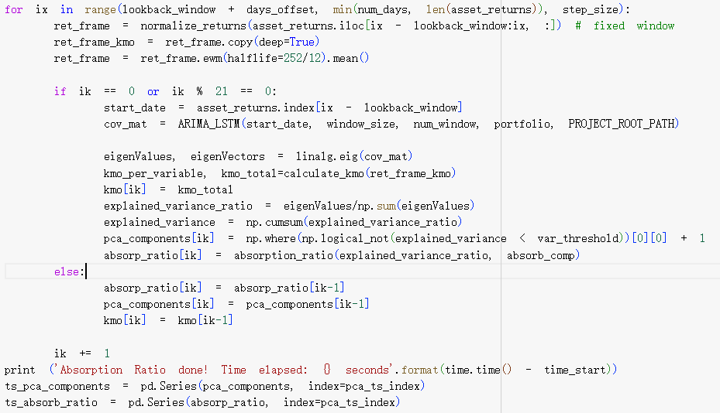
With these parameters and the definition of the absorption ratio, we can loop the calculation by fits PCA to covalent matrix which provide by ARIMA+LSTM model.

Slide 21
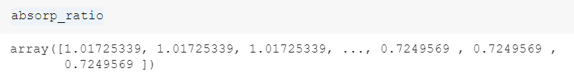
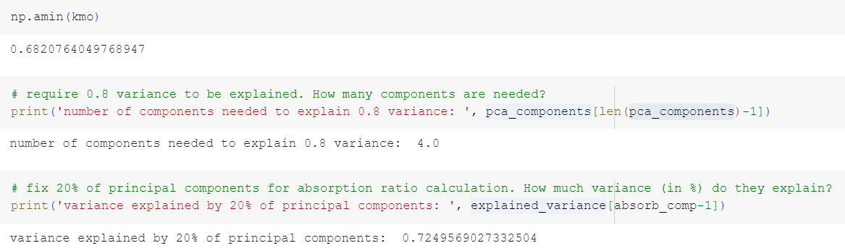
The absorption ratio array shown above is produced by loop. By following functions, we testify the proper indicator value for using the PCA, components needed for results, and the variance of it. The KMO gives the value is still between 0.6 and 1, which means PCA would extract useful information.

Slide 22
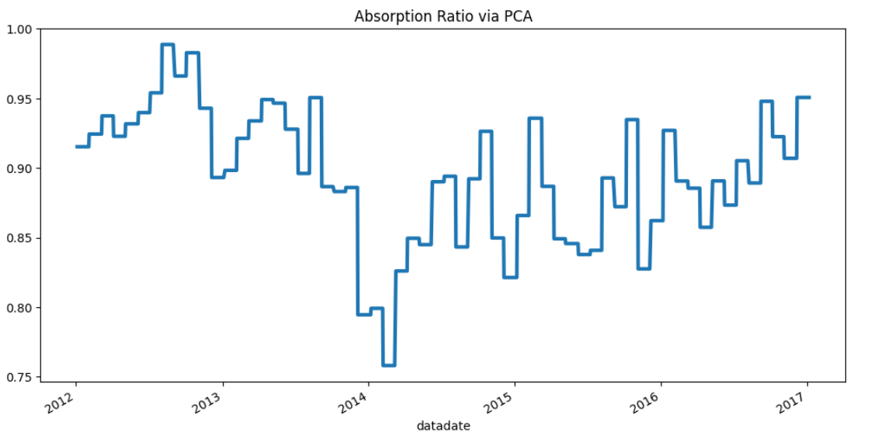
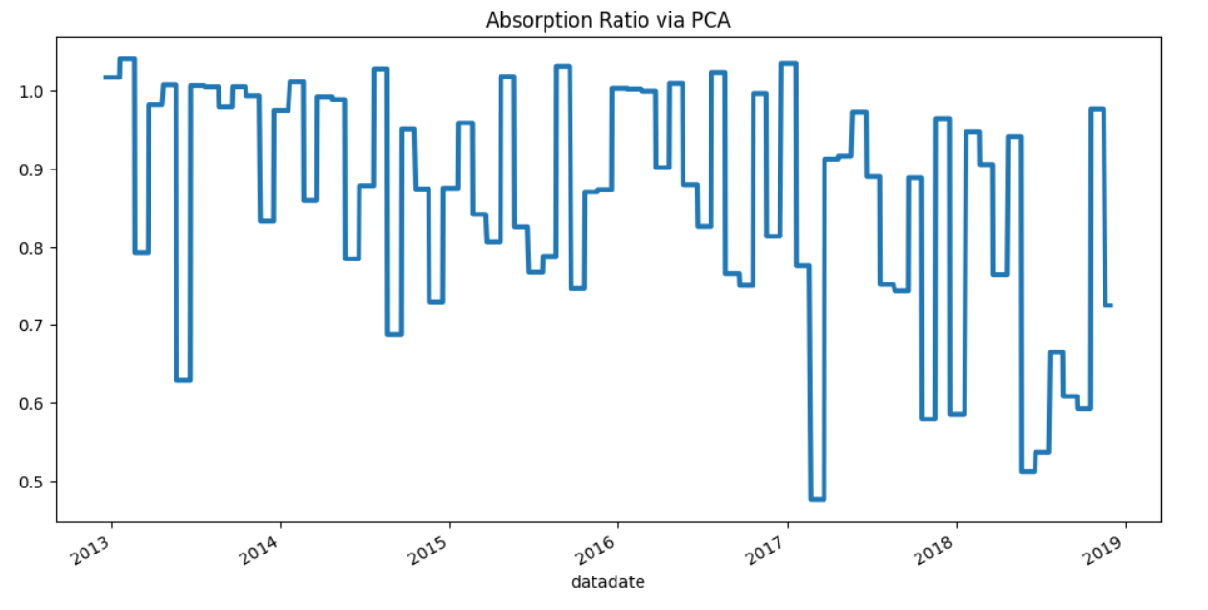
Result
The first figure is the AR vs. PCA without ARIMA+LSTM model. The Absorption ratio is simply calculated by a function without consideration of linear and nonlinear. The minimum AR value shows about 0.75. The average AR shows around 0.88.
With the ARIMA+LSTM model, the AR vs PCA shows lower minimum value around 0.5 with similar average absorption ratio about 0.80. The variance after model is applied is certainly larger than before.
That shows after applied our model, the overall AR have decreased.

Slide 23
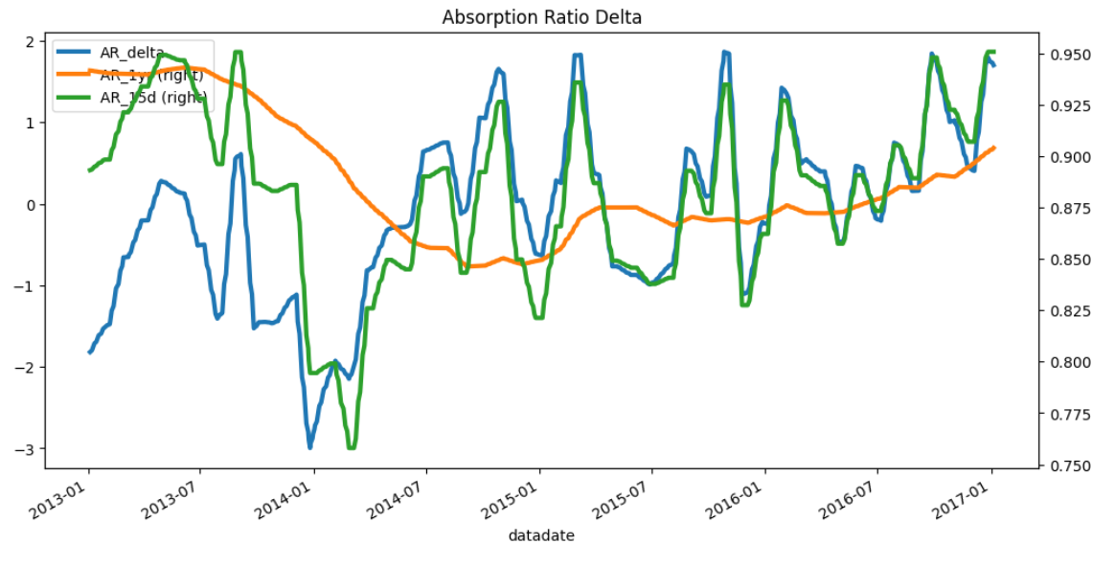

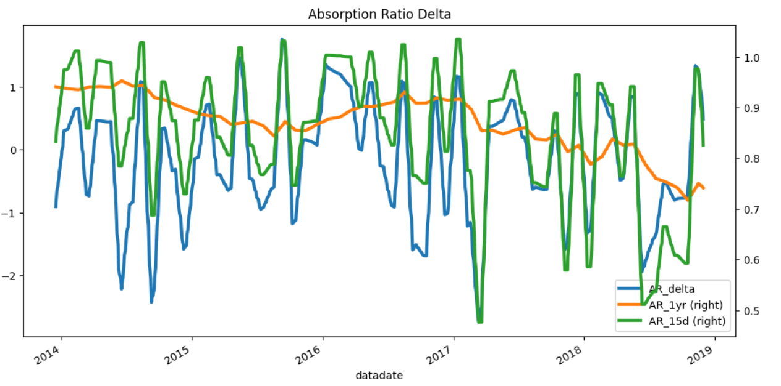
Without ARIMA+LSTM
The absorption ratio delta shows the standardized change of AR over time. The original model shows larger variation and maxmin difference from -3 to 2. Which as our model, the AR delta are limited between -2.3 and 1. With lower standardized change of AR, our trading system shows more stable trading strategy and annual return.
With ARIMA+LSTM

Slide 24
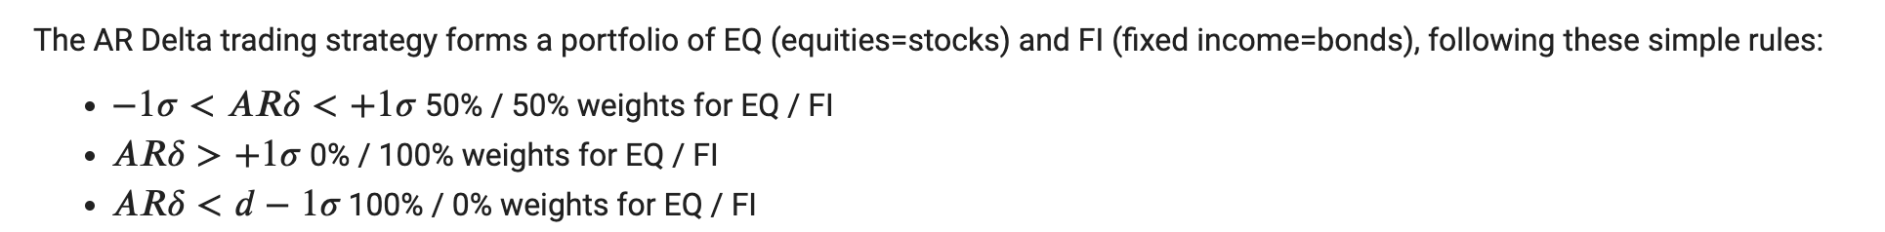
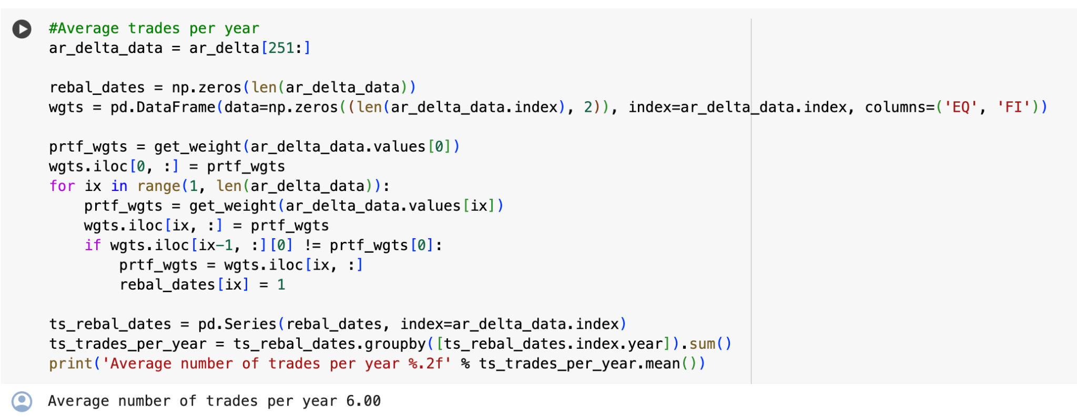
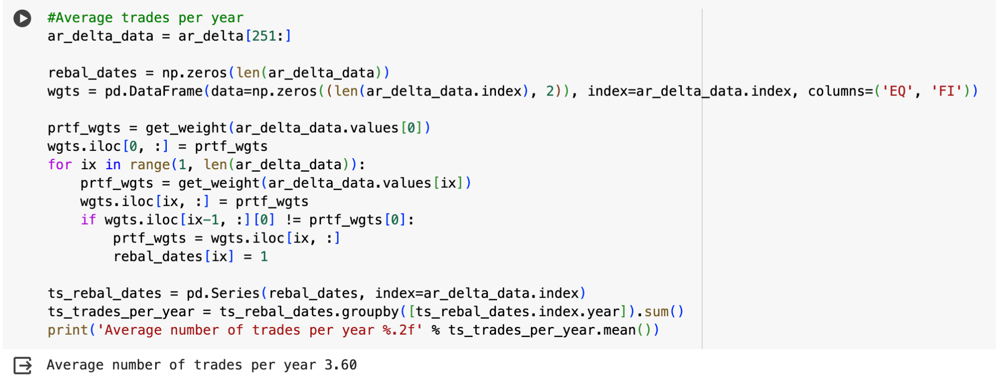
With the same AR Delta Trading Strategy below, we could find the original system gives the average number of trades per year is 3.60, and our ARIMA+LSTM modeling system gives the average number of trades per year is 6.00, which we could observe a increase of trades per year after applied the model.

Slide 25
With the backtested strategy, our absorption ratio portfolio also beats the equally weighted portfolio with higher difference. Especially for the sharpe ratio which represents the with unit of risk what the annual return would be. Compare with the original system, may due to the timeline difference, the overall economy environment is better than our time window, the annual return of the both strategy is higher than our results. But the percentage of improvement shows that our model still perform better behavior than the model without ARIMA-LSTM.
Original System
System with ARIMA+LSTM

Slide 26
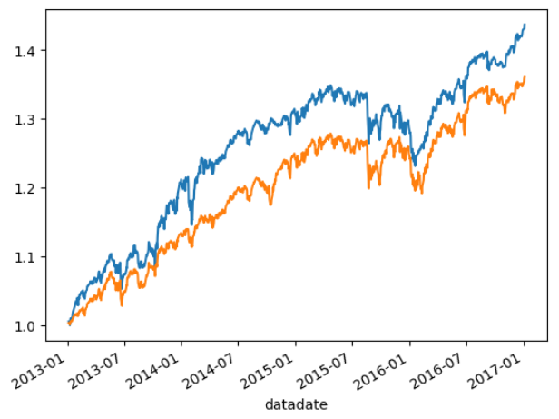
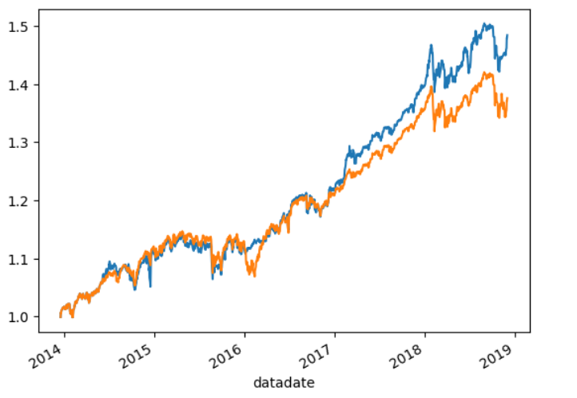
Original System
The total return of the investment is visualized when backtested strategy is applied to the system. With the different strategy and time interval, the result shows rather unchanged. Within four years, the return rate is about the same at around 1.4. With our system, the huge loss doesn’t happen anymore which shows more stability.
System with ARIMA+LSTM

Slide 27
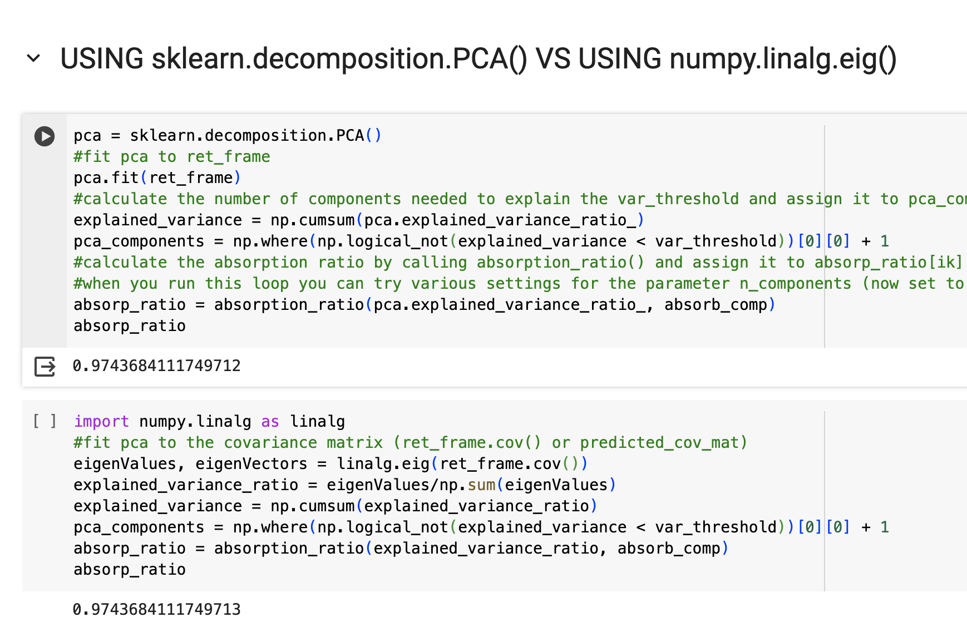
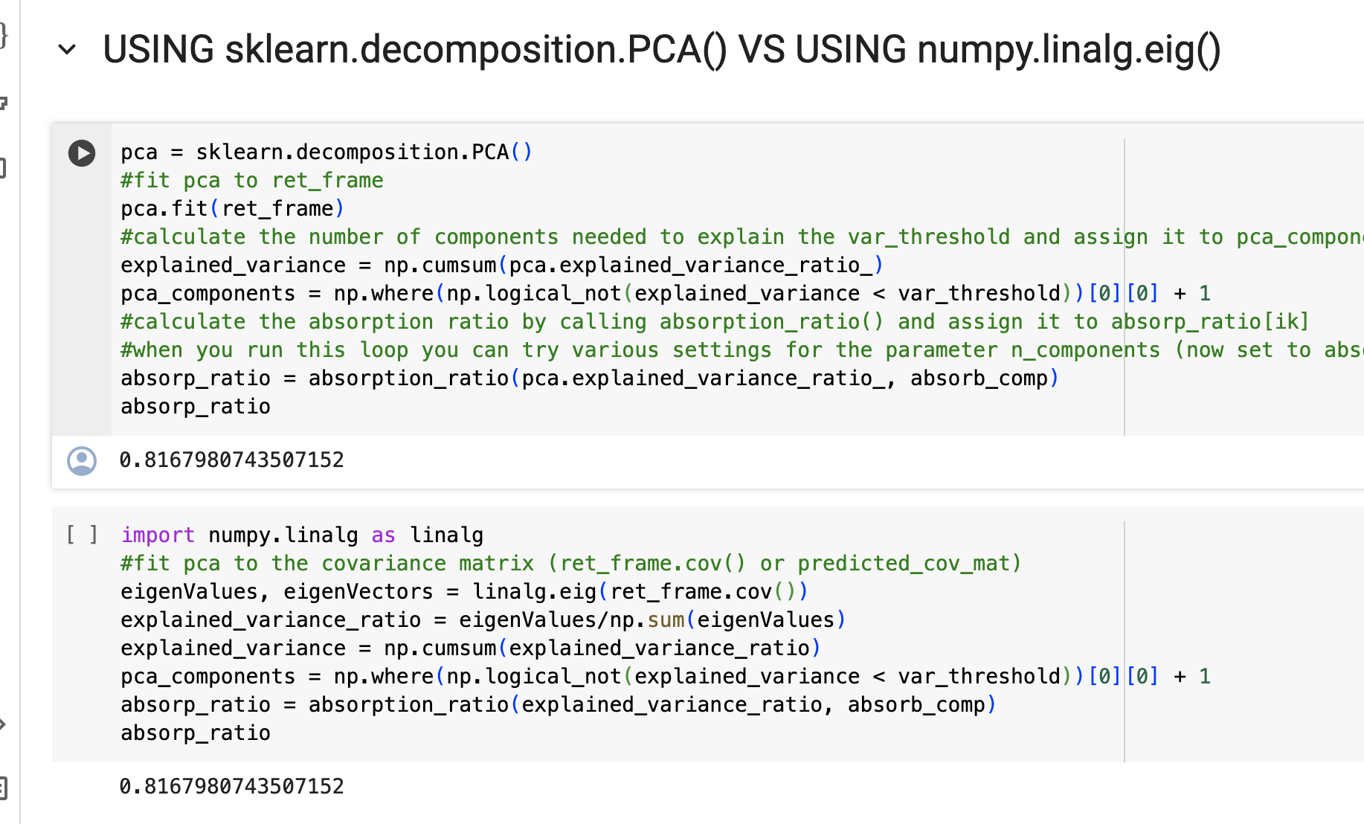
AR Comparison of original vs ARIMA+LSTM
We could notice that the AR of our modeling vs original system have decreased from 0.97 to 0.82. That means our modeling is effective since a high value of absorption ratio corresponds to a high level of systemic risk, and we should not expected high systemic risk necessarily to lead to asset depreciation or financial turbulence. Thus, the decrease of AR is our expected for modeling.

Slide 28
Improvement
With similar annual return, the annual volatility is lower compare with original system. The risk is lower than before.
Also the higher sharpe ratio shows with the same risk our return is higher than original system.
The absorption ratio delta is closer to 0 than original system which represents that the developed system is more stable with same strategy and less trading number during the year with less brokerage cost.
The overall AR of the original system is 0.9743684111749712, and the AR of our applied ARIMA+LSTM model system is 0.8167980743507152, which shows aftering modeling, the AR is lower, and that shows the systemic risk have decreased, which is our desired for modeling.

Slide 29
Team
Jijun Chi：ARIMA+LSTM theoretical modeling, coding, training and evaluation, Align covariance matrix with the trading system.
Yingying Liu: Analyse the research paper, construct and run ARIMA+LSTM models to check the correctness. Compose PowerPoint and set the schedule for all the process.
Yuchen Zhang: Perform the original system to run normally. After the ARIMA+LSTM model is completed, adjust the input and debug to fit the model into the modified system. Compare and analyze AR and strategy between the original system and the system which the model is applied.
Ke Yao: PowerPoint formation, Result analysis, Comparison between Original system and current system with ARIMA+LSTM, Flowchart of system mode

Slide 30
Reference
[1] Hyeong Kyu Choi, “Stock Price Correlation Coefficient Prediction with ARIMA-LSTM Hybrid Model,”arXiv:1808.01560 [cs.CE] https://doi.org/10.48550/arXiv.1808.01560
[2] Kritzman, Mark and Li, Yuanzhen and Page, Sebastien and Rigobon, Roberto, Principal Components as a Measure of Systemic Risk (March 31, 2010). Available at SSRN: https://ssrn.com/abstract=1582687 or http://dx.doi.org/10.2139/ssrn.1582687

