Slide 1
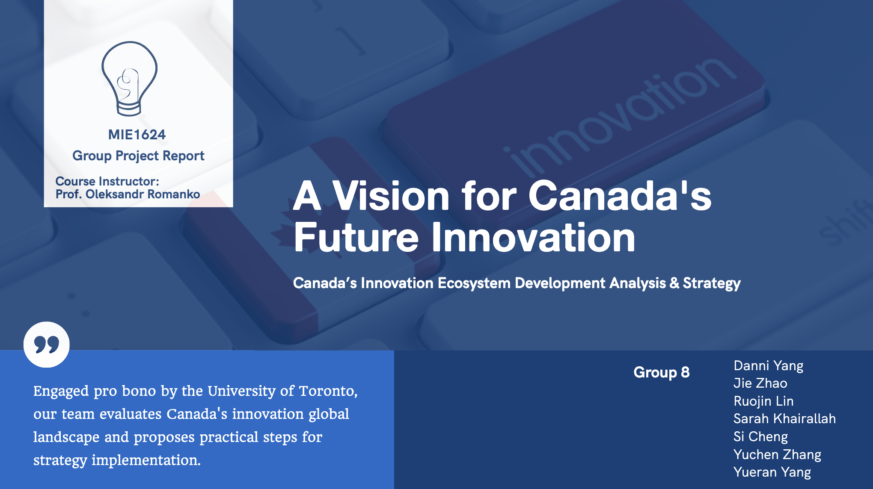
Group 8

Slide 2
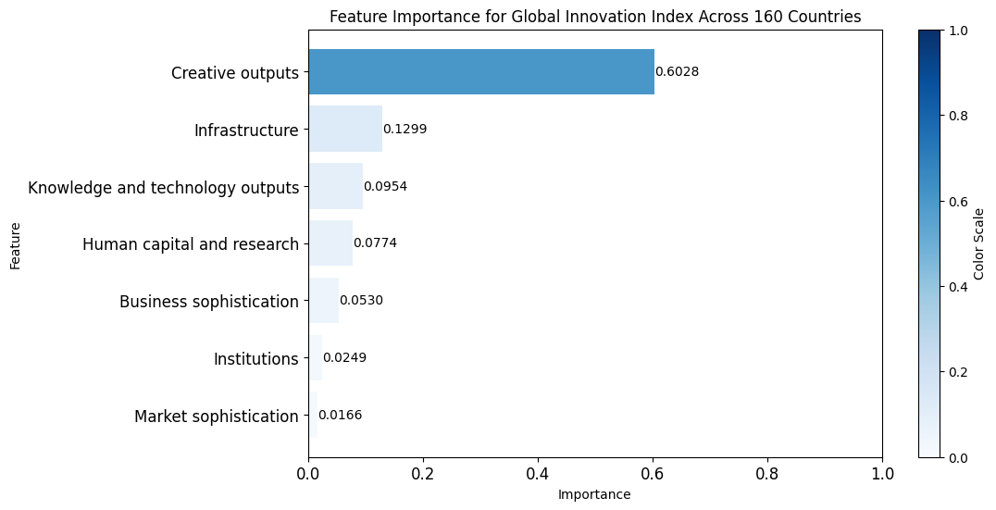
Global Innovation Index (GII): Unveiling Key Features
Essential for understanding the innovation landscape globally. Utilizing Random Forest Regression, revealed Creative Outputs significantly impacts the GII, followed by Infrastructure and Knowledge and Technology Outputs.
Framework for GII:
Institutions
Human Capital & Reasearch
Infrastructure
Market Sophistication
Business Sophistication
Knowledge & Technology Outputs
Creative Outputs
Source: Merged from Mendeley and the World Intellectual Property Organization (WIPO)

Slide 3
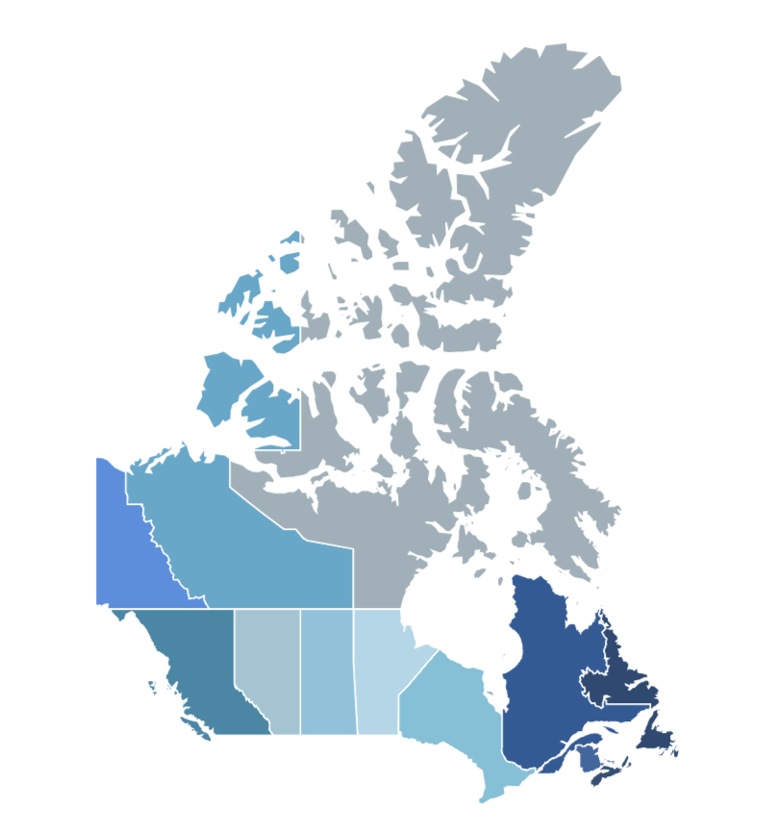


Average GII Rankings over 13 Years
Evaluated the average GII rankings of each country globally across these features over a 13-year timeline, show the strengths and areas for enhancement for Canada’s innovation landscape.
Features
Rank
4th
Market Sophistication
Strengths
Institutions
6th
Canada Innovation
Areas for Improvement
19th
Human Capital & Research
Knowledge & Technology Outputs
21th

Slide 4
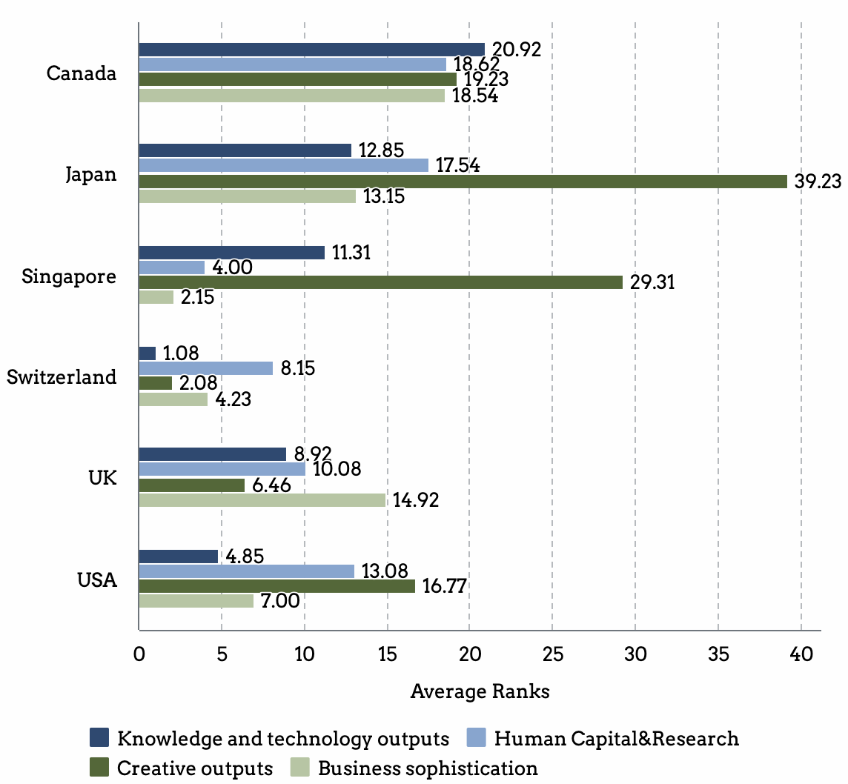
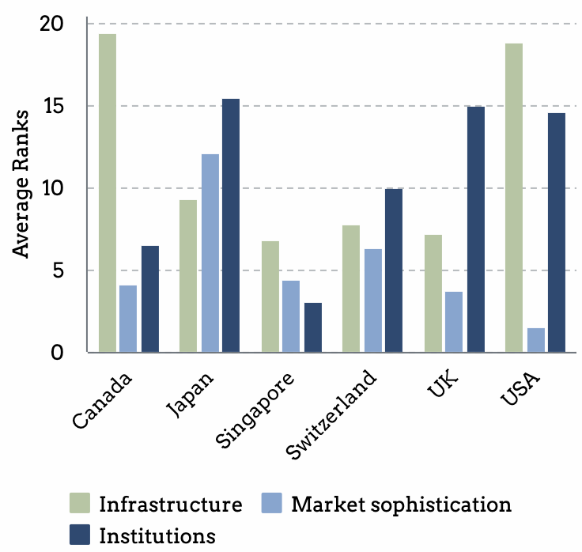
Average GII Rankings over 13 Years
Evaluated the average GII rankings of each country globally across these features over a 13-year timeline, show the strengths and areas for enhancement for Canada’s innovation landscape.
Country | Average Global Innovation Index
Canada | 14.62
Japan | 16.92
Singapore | 6.31
Switzerland | 1.00
UK | 4.23
USA | 4.69
Comparison Analysis: The UK, Singapore, USA, Switzerland, and Japan - we identified countries that Canada can enhance its performance to align with global innovation leaders. Notably, Human Capital and Research and Knowledge and Technology Outputs require attention, as these domains consistently achieve higher average rankings in the other five countries.

Slide 5
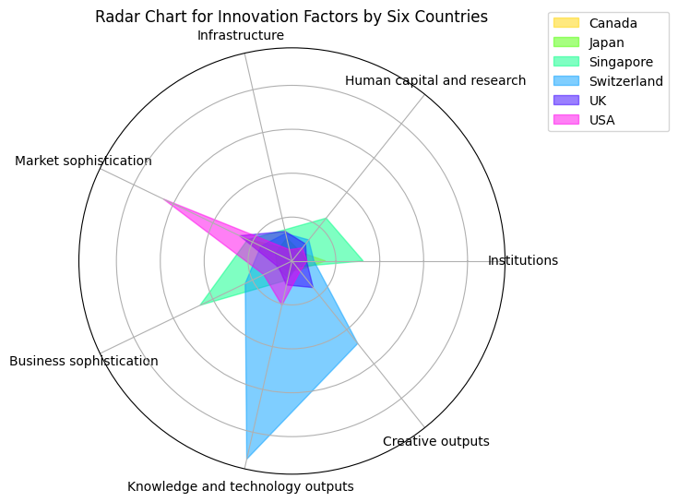
Comparative Analysis of Innovation Strengths
A radar chart to visually represent and compare the key innovation strengths of six countries.
Switzerland consistently ranking first in Knowledge and Technology Outputs.
The USA excelled in ‘Market Sophistication’.
Singapore demonstrated strength in ‘Human Capital and Research’, ‘Business Sophistication’, and ‘Institutions’.

Slide 6

Strategic Insights from OpenAI API
Summarizing National Innovation Strategies from Top 5 Countries from the Innovation Index

Slide 7

The United States: Research and Development
Research and Development (R&D), defined as systematic activities aimed at acquiring new knowledge or improving existing knowledge to develop new products, processes, or services (The National Defense Science & Technology Strategy, 2023)
The core of the U.S.’s R&D strategies are novel discoveries, technical insights, and refinements, especially in critical and emerging technologies (CET).
The standards frequently incorporate patented technologies, with licensing revenues from these patents enabling the industry to recoup R&D expenses and reinvest in future innovations.
The Department of Justice's Antitrust Division, the U.S. Patent and Trademark Office, and NIST to enhance innovation and competitiveness in the marketplace, including withdrawing their policy statement on Standards Essential Patents, which often encompass breakthroughs at the heart of new technologies.

Slide 8

The United Kingdom: IP Education Program
The UK Innovation Strategy also mentions the Intellectual Property Education Program for research education to help researchers leverage their intellectual property for commercialization.
IP Education Program:
Support Small and Medium-sized Enterprises (SMEs) in commercializing their IP and will provide support for research and development, securing and managing new IP rights, and helping with cutting down the costs which businesses face when leveraging their IP assets.
Patent Box tax incentive is another measure that supports the retention of IP in the UK by allowing businesses to pay a reduced rate of tax on profits arising from exploiting patents and other qualifying products.
etc.

Slide 9

Apply Global Insights to Canada
Notes:
In shaping Canada's 2023 innovation strategy, we should leverage global insights, notably from the U.S. and the UK. The U.S. example emphasized sector-specific nuances and the integral role of Research and Development (R&D), linking patented technologies to innovation cycles. Examining the UK's approach highlighted education's pivotal role, with initiatives like the STEM Ambassador program and substantial investments in technical training. As Canada forges ahead, integrating these insights—sector specificity, robust R&D focus, and a strong educational foundation—will propel the nation into a leading position in the global innovation landscape.

Slide 10


Slide 11

Feature Analysis
Knowledge and Technology Outputs
This feature represents the intellectual and technological achievements arising from a nation's innovation ecosystem, including discoveries, patented technologies, and creative outputs, driving economic growth and enhancing global competitiveness by leveraging intellectual capital to generate innovative products, processes, and services for Canada.
Human Capital and Research
This feature emphasizes the crucial role of skilled workers in driving innovation. It aims to encourage impactful research through incentives and collaboration, contributing to economic growth and technological progress. Ongoing measurement ensures strategic improvements and maintains the workforce as a key force in innovation.

Slide 12
Policy Recommendations
01
HEAIP tackles research challenges, fosters collaboration, and supports diverse needs, contributing to a vibrant research landscape in Canada.
Holistic Engagement for Advanced Innovation Programs (HEAIP)
02
The policy aligns Canada's innovation with a strong intellectual property strategy, providing comprehensive support, instilling confidence, and leveraging international agreements for global impact.
Intellectual Property Strategy
03
The InnoHarbor Canada Program (IHCP) acts as a link between private enterprises and national R&D goals, promoting collaboration and encouraging increased R&D spending for enhanced global innovation standing.
InnoHarbor Canada Program (IHCP)
04
It creates specialized hubs to drive collaborative research and technology transfer, fostering interdisciplinary collaboration and accelerating the practical application of knowledge and technologies.
Innovation Hub Model
05
This policy aims to strengthen STEM education, aligning it with industry needs to cultivate a skilled workforce. It focuses on immediate talent demand and envisions long-term benefits, anticipating sustained innovation and economic growth through educational investment.
STEM Education Enhancement

Slide 13

Implementation Approach
Stakeholders will be engaged through consultations and partnerships.
Collaboration with government bodies will secure funding and regulatory support, while public support will be garnered through awareness campaigns.
Addressing potential opposition involves transparent communication and policy flexibility. Fiscal impact will be managed through diversified funding, including public-private partnerships.
The evaluation plan includes continuous monitoring of innovation metrics, periodic reviews with stakeholders, and adaptive policy adjustments based on evolving needs and feedback.

Slide 14


Feature-
Knowledge and Technology Outputs
“Patents”
"Patents"
"Patents"
"Patents"
Feature-Knowledge & Technology
Outputs
"Patents"
Patent
"Patents"
"Patents"
"Patents"

Slide 15
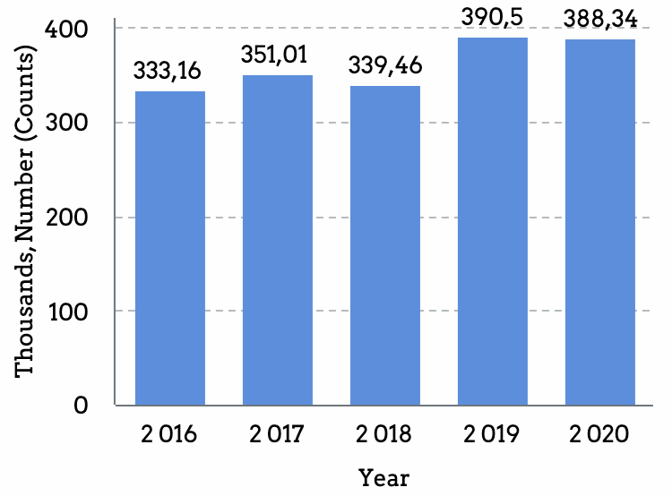
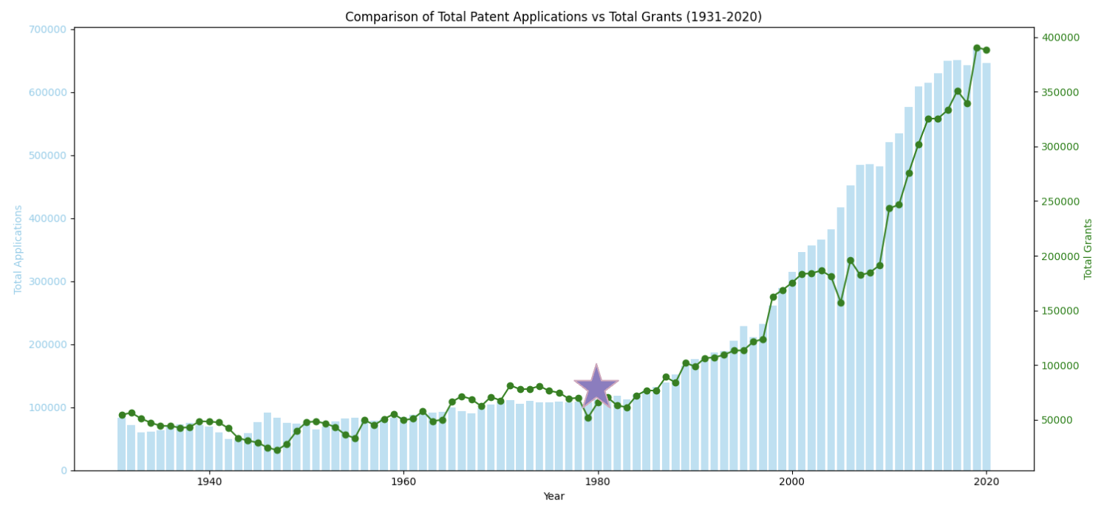
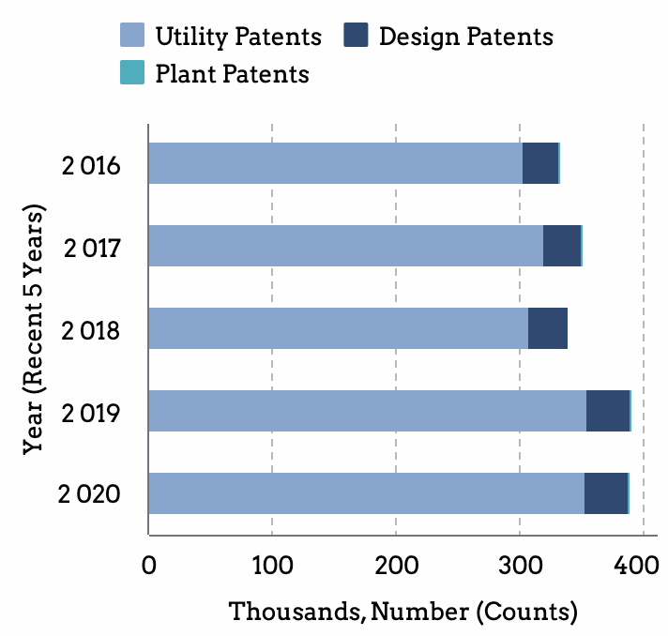
Patent Numbers & Total Grants in The USA, 1931 to 2020
Time Series Analysis of Knowledge and Technology Outputs Data: Analyze the U.S patents data, which represent a key indicator of knowledge and technology output.
Patents of USA, Total&Types
There was a marked increase in both applications and grants after 1980.
Source: United States Patent and Trademark Office. (n.d.). U.S. Patent Statistics Chart. Retrieved from https://www.uspto.gov/web/offices/ac/ido/oeip/taf/us_stat.htm

Slide 16
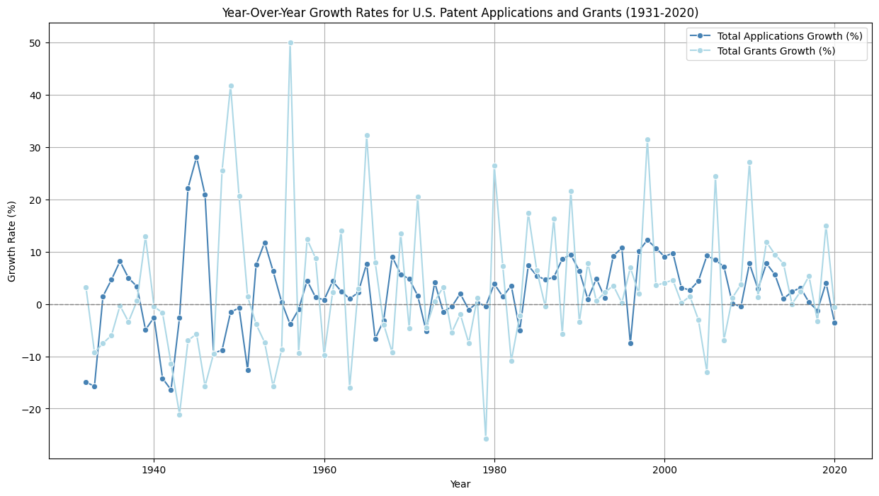

Slide 17

Patent Numbers in The USA, Time Series Model
Analysis the U.S. patent growth rate by various time series models, revealing the nature of the data and further forecasting.
Model | MSE
ARIMA(1,1,1) | 0.0019
Simple Exponential Smoothing | 0.0014
Double Exponential Smoothing, | 0.0217
Additive Holt-Winters | 0.0039

Slide 18
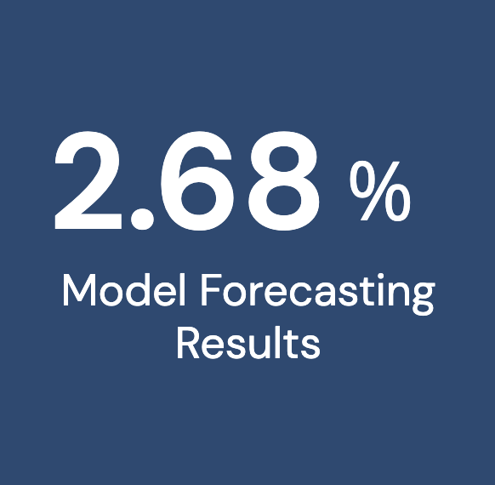


Model Prediction & Further Policies Implement
Our predictive modeling forecasts a growth rate of 2.68% for the next decade in Canada, influenced by analogous U.S. policies that are expected to stimulate patent growth.

Slide 19
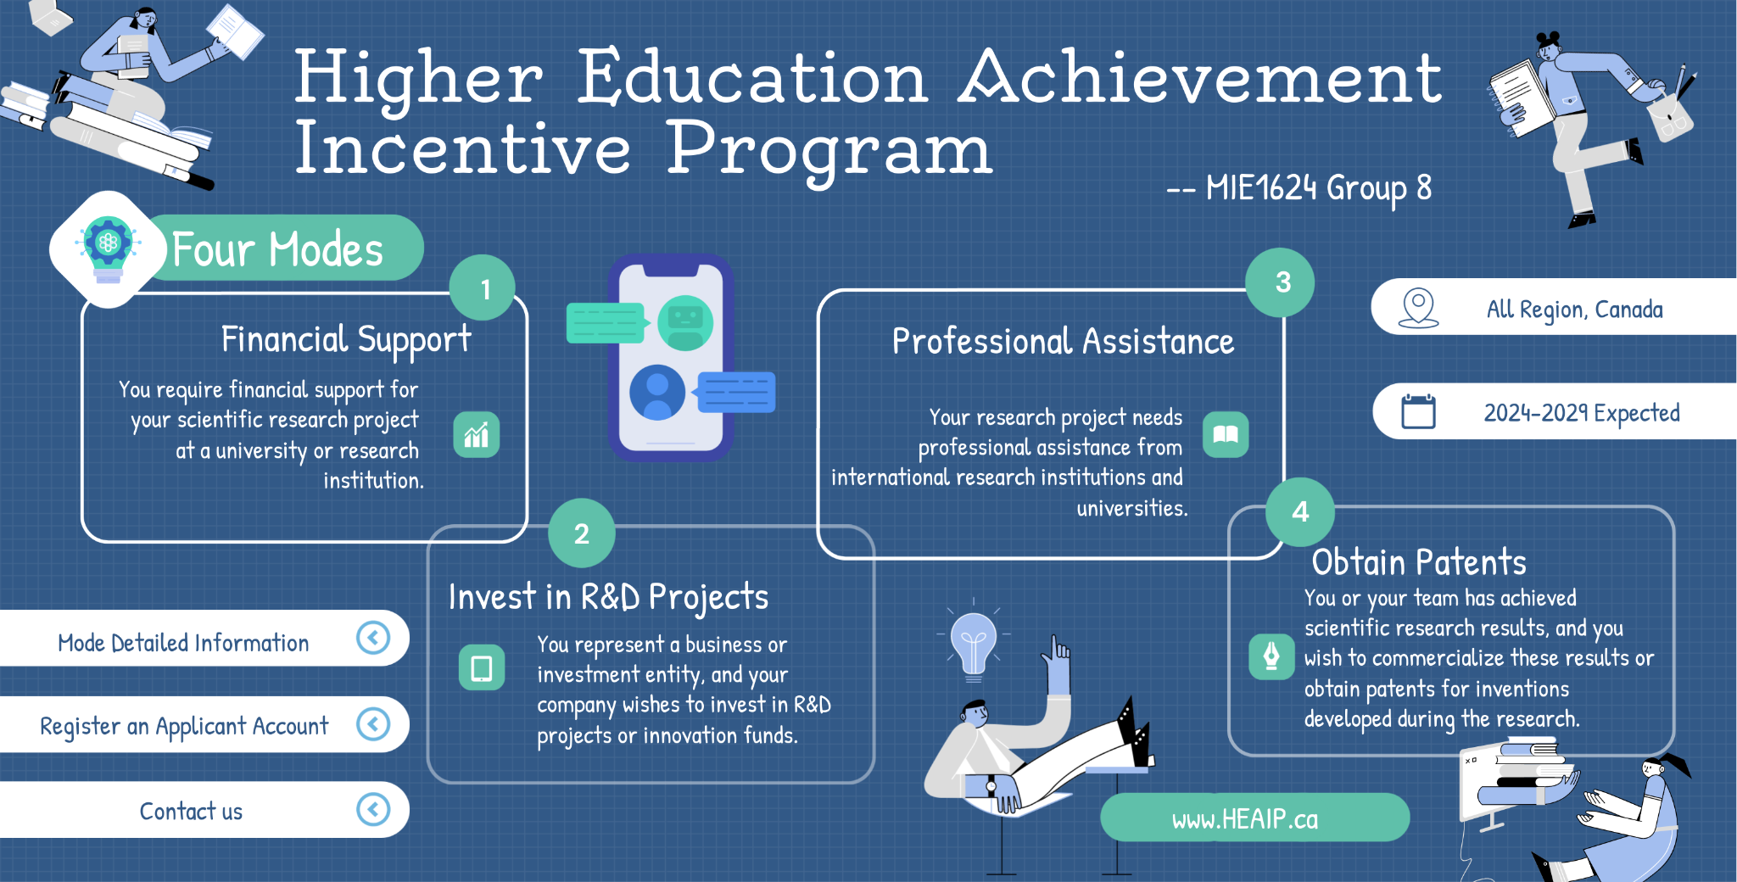

Slide 20

Human Capital & Research
R&D

Slide 21
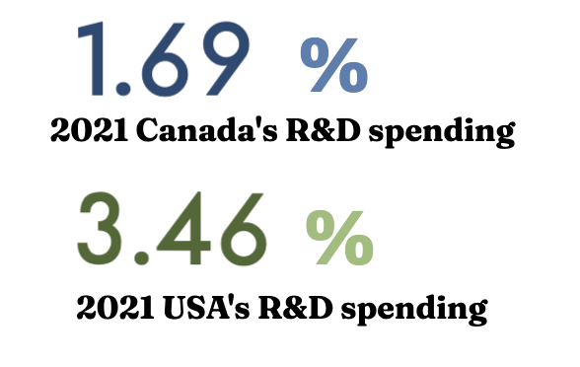
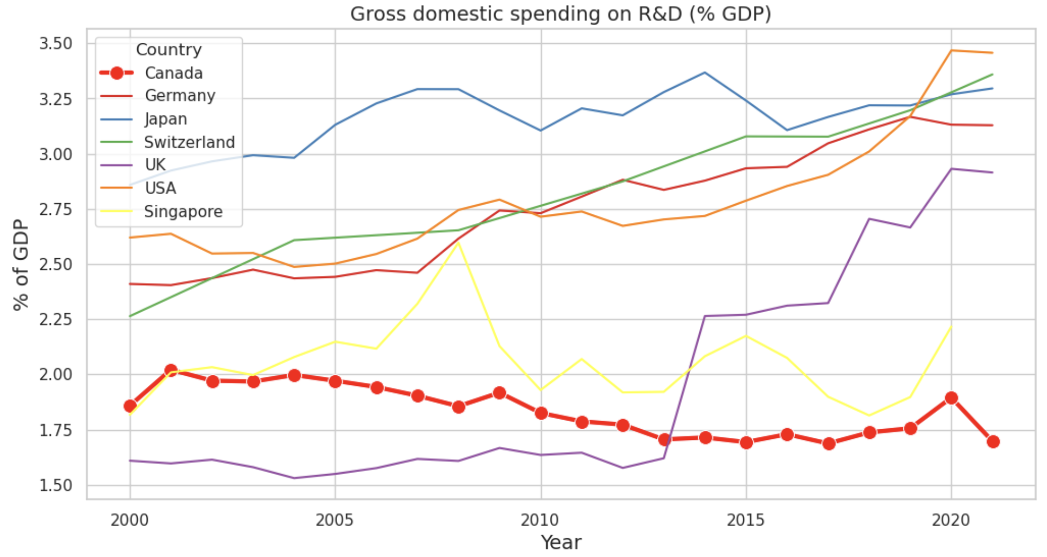
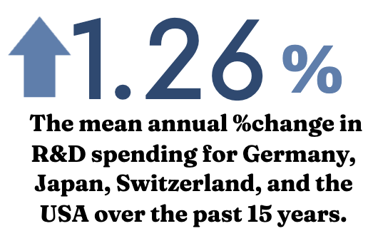
National Gross Domestic Spending on R&D
Canada's Gross Domestic Spending on R&D (% GDP) lags behind that of other nations. To enhance the Canada innovation landscape, it is imperative to boost net national spending in R&D.
Source: OECD, Research and development (R&D) - gross domestic spending on R&D - OECD data 2023
Notes:
Based on this plot, Canada's Gross Domestic Spending on Research and Development (% GDP) lags behind that of other nations. To enhance the Canada Innovation Measure Index, it is imperative to boost net national spending in R&D. To achieve this, we will propose a strategy focusing on increasing R&D funding. Since various R&D funding sources across sectors, therefore we would find the most important sector and propose strategy focus on it.

Slide 22
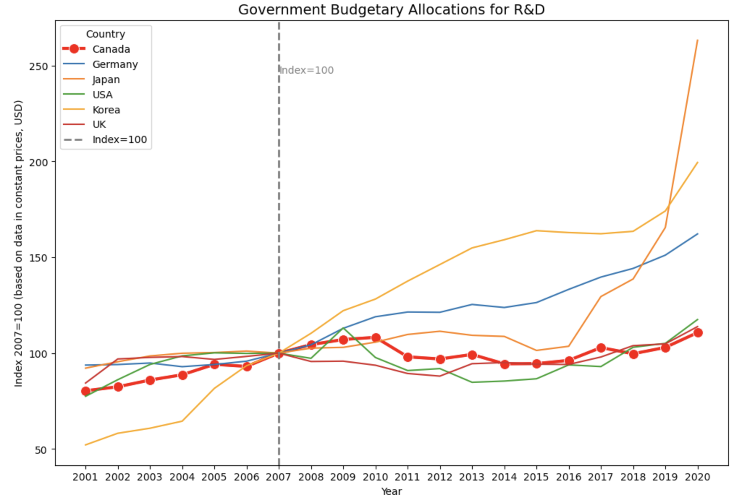
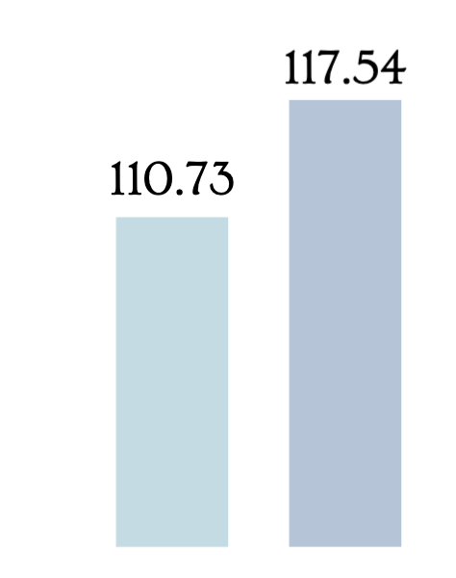
Planned Government Budgetary Allocations on R&D
With reference index (2007=100) using constant prices (USD), Canada's R&D government budget lags behind other countries, with the most significant percentage changes (increasing) observed in Japan, Korea, and Germany.
2021 Planned Government R&D Budgets: relatively small gap between the USA and Canada
CA
USA
Source: OECD, OECD Main Science and Technology Indicators - OECD 2023
Notes:
Potential need for increased investment in Canada's R&D sector. Compare this with the USA and Canada, the difference is not that significant; but from the pervious page (comparison of national spending of the USA and Canada), the difference is significant. Therefore, we want to see their R&D spending structures (& R&D funding) from different sectors in the USA and the CA.

Slide 23
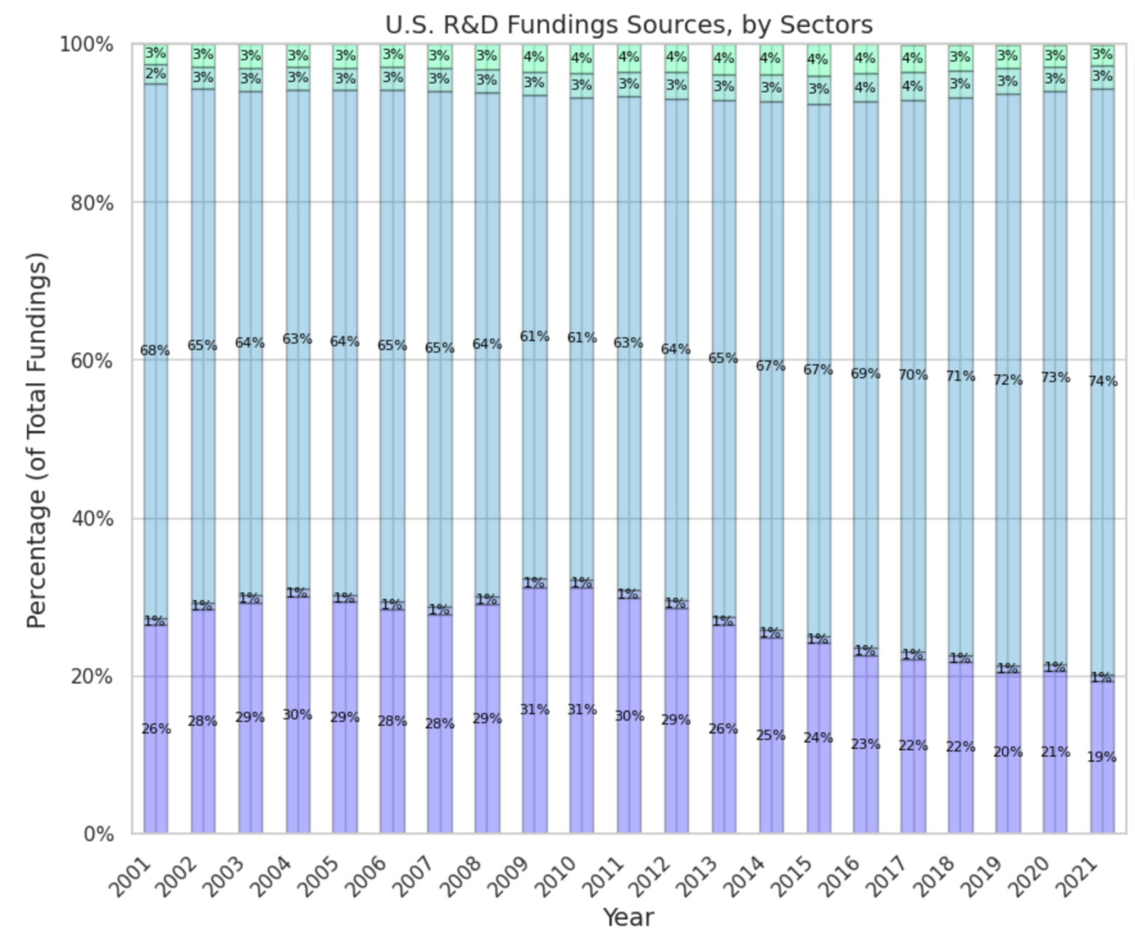
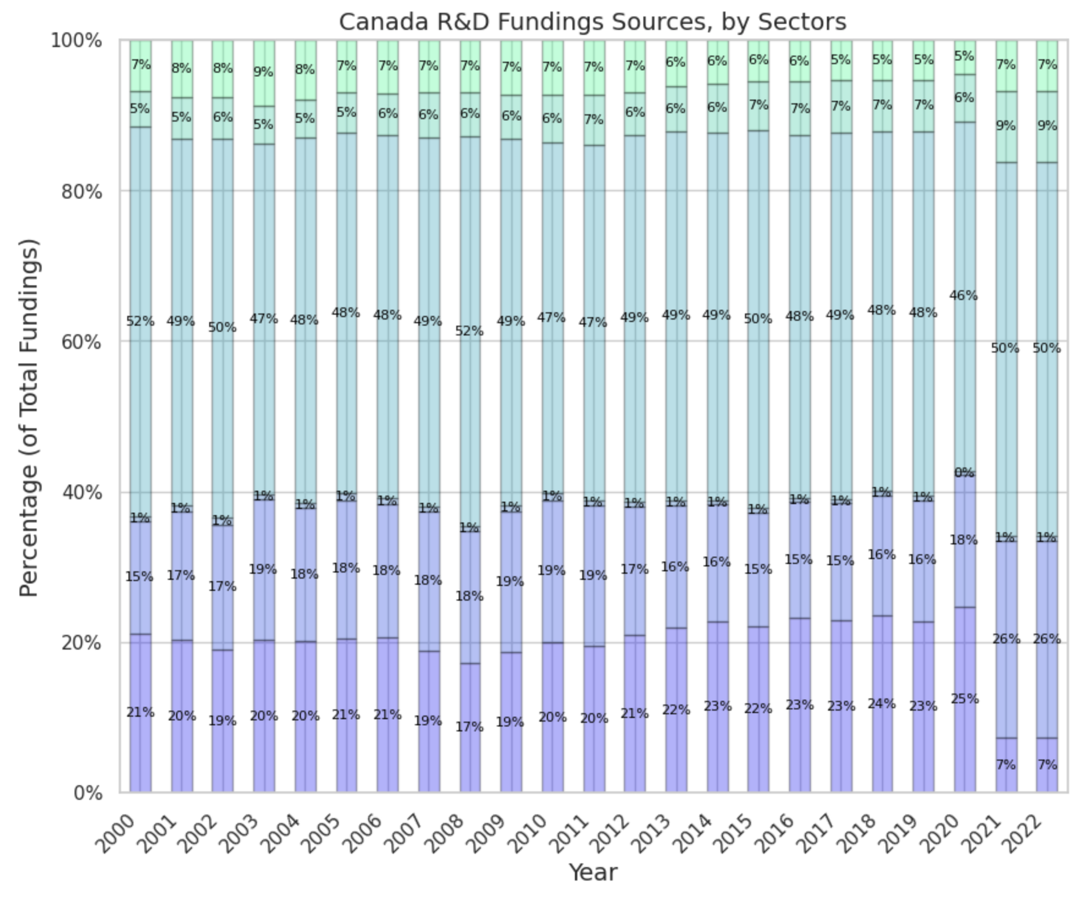
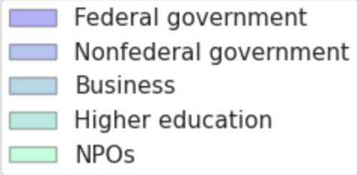
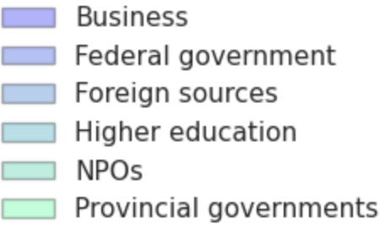
Comparative of R&D Funding by Sectors: USA vs. Canada
R&D Funding Sources Analysis (From 2000 to 2021): USA outpaces Canada in business sector R&D funding; boosting Canadian business R&D investments is a potential strategy for innovation enhancement.
Post covid-19 pandemic
Notes:
By comparing the Percentage of Total R&D funds sources by different sectors of the USA and Canada, we obtain that the Canadian Business enterprise can increase their R&D funding (spending) (which is a significant sector different than the USA's Business enterprise) ---> To boost Canada's innovation. In addition, we obtain dramatical decrease in R&D from business sector in the Canada in post covid-19 pandemic era…

Slide 24
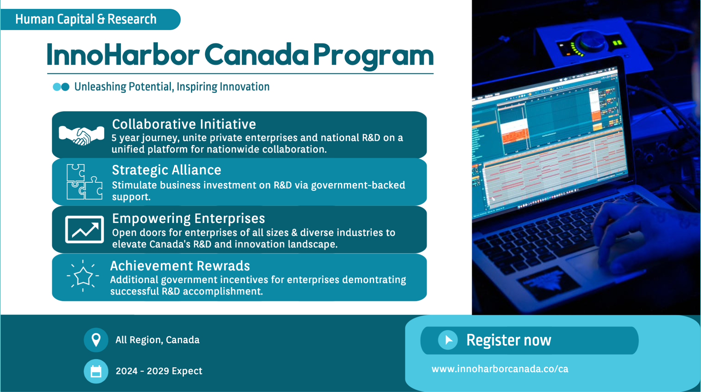

Slide 25
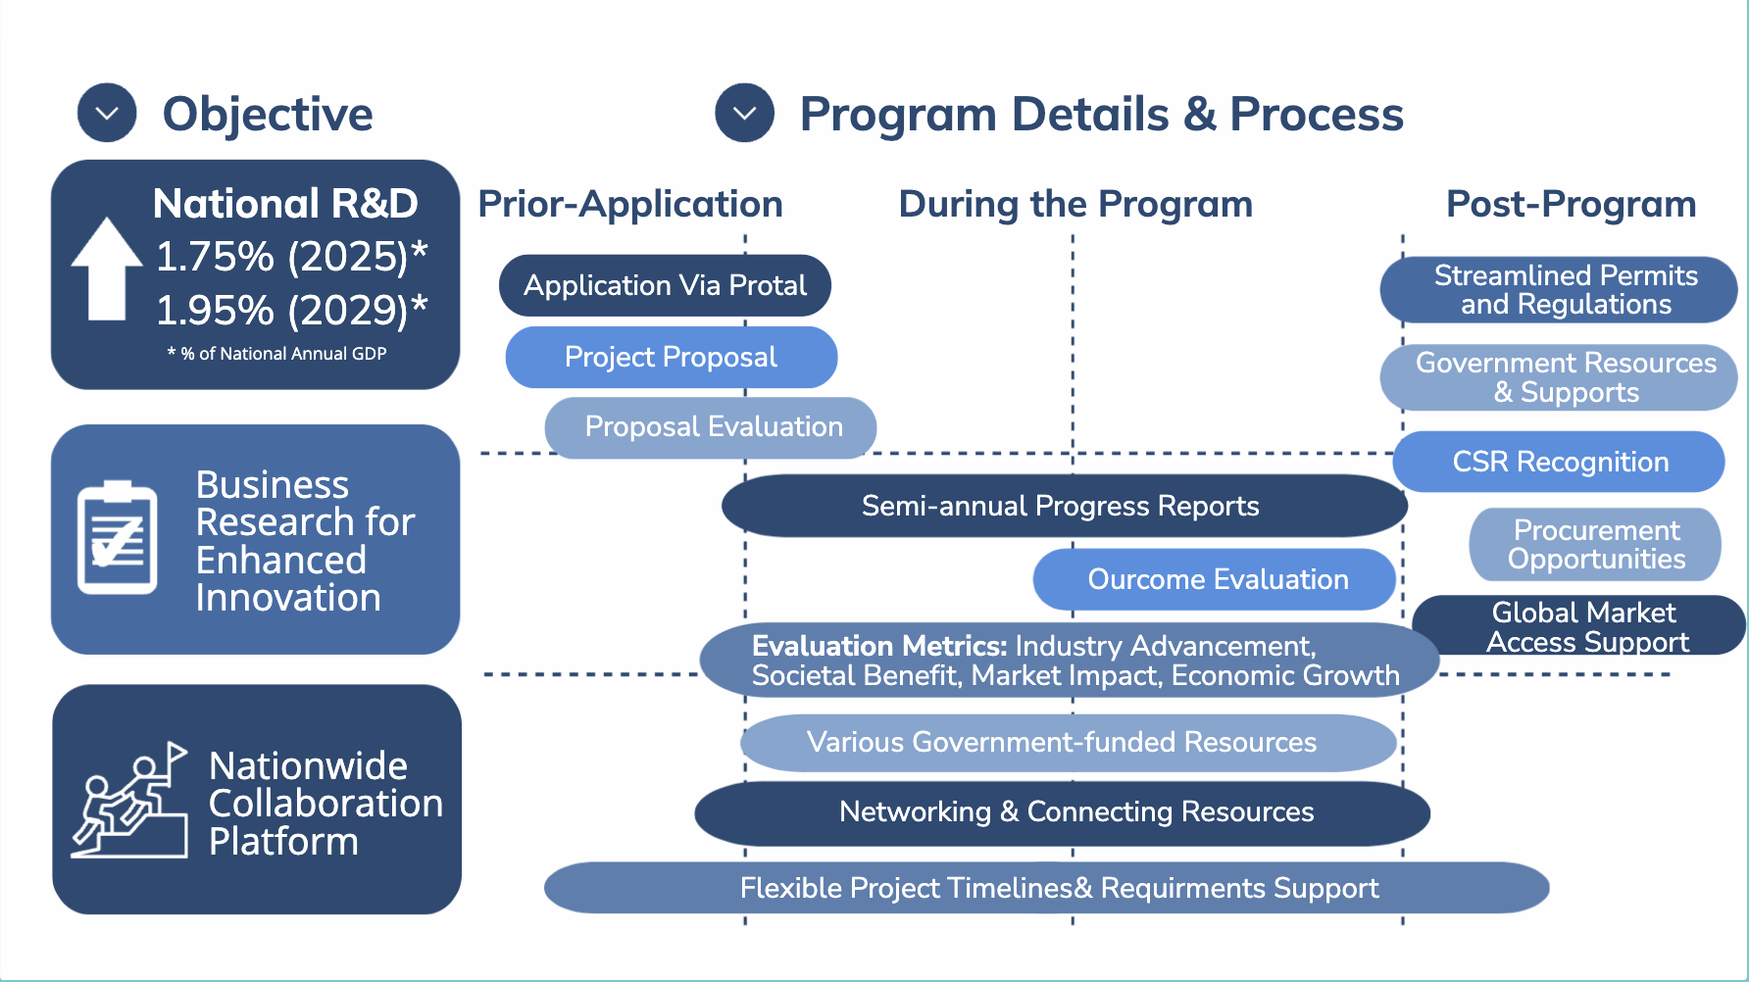

Slide 26
References
[1] Bury, P. (2016). "Innovation in Regulatory Policy: A Fresh Look." Regulatory Policy Institute.
[2] Sector, S. and I. P. (2022a, July 7). Government of Canada. Government of Canada, Innovation, Science and Economic Development Canada, Office of the Deputy Minister, Strategy and Innovation Policy Sector. https://ised-isde.canada.ca/site/canada-fundamental-science-review/en
[3] Smith, A. (2019). "Incentivizing Scientific Research: A Comparative Analysis of Global Programs." Journal of Innovation and Research Policies, 10(3), 215-230.
[4] Johnson, M., & White, L. (2020). "Collaborative Models in Scientific Research: Lessons from HEAIP Implementation in Canada." Research Policy, 45(2), 112-128.
[5] Anderson, J., & Davis, R. (2019). "Shaping Innovation through Intellectual Property: Lessons from the U.S. Post-1980 Model." Journal of Intellectual Property Studies, 12(4), 321-340.
[6] Harris, D., & Nelson, S. (2021). "Motivating R&D Spending: Insights from the InnoHarbor Canada Program." Science and Innovation Policies, 25(3), 201-220.
[7] Baker, C., & Taylor, R. (2018). "The Role of Innovation Hubs in Knowledge Transfer: A Case Study of Canadian Initiatives." Journal of Innovation Management, 14(2), 89-104.

Slide 27
[8] Reed, G., & Foster, A. (2019). "Facilitating Interdisciplinary Collaboration through Innovation Hubs: Lessons from the Canadian Experience." Journal of Interdisciplinary Studies in Innovation, 6(1), 45-62.
[9] Young, E., & Turner, L. (2020). "Aligning STEM Education with Industry Needs: A Case Study of Policy Impacts in Canada." Journal of STEM Education, 15(3), 167-185.
[10] Brás, Gonçalo (2022), “Global Innovation Index: panel data (2011-2022)”, Mendeley Data, V4, doi: 10.17632/cvkdzr8tv3.4
[11] Lock Search Group. (2018, June 18). Canada’s Expertise in Innovation [Image]. Retrieved from https://www.locksearchgroup.com/canadas-expertise-in-innovation/
Sources of funds for expenditures on research and development (R&D) in the higher education sector, in dollars and as a percentage of total funding, Canada and provinces - Dataset from:
https://open.canada.ca/data/dataset/267a1984-3816-4768-b31a-8d0a77a60d22/resource/0ae0cff7-1a3c-40bf-be52-543330012553
[12] OECD. (2023a). OECD Main Science and Technology Indicators - OECD. https://www.oecd.org/sti/msti.htm
[13] OECD. (2023b). Research and development (R&D) - gross domestic spending on R&D - OECD data. https://data.oecd.org/rd/gross-domestic-spending-on-r-d.htm
[14] United States Patent and Trademark Office. (n.d.). U.S. Patent Statistics Chart [Data set]. Retrieved from https://www.uspto.gov/web/offices/ac/ido/oeip/taf/us_stat.htm
[15] Canadian Intellectual Property Office. (2020). Patent Statistics 2019-2020. Innovation, Science and Economic Development Canada. Retrieved from https://ised-isde.canada.ca/site/canadian-intellectual-property-office/en/patent-statistics-2019-2020
[16] WIPO (2023), “Global Innovation Index 2023, 16th Edition Innovation in the face of uncertainty” Dataset retrieve from: https://www.wipo.int/publications/en/details.jsp?id=4679

Slide 28


