Slide 1
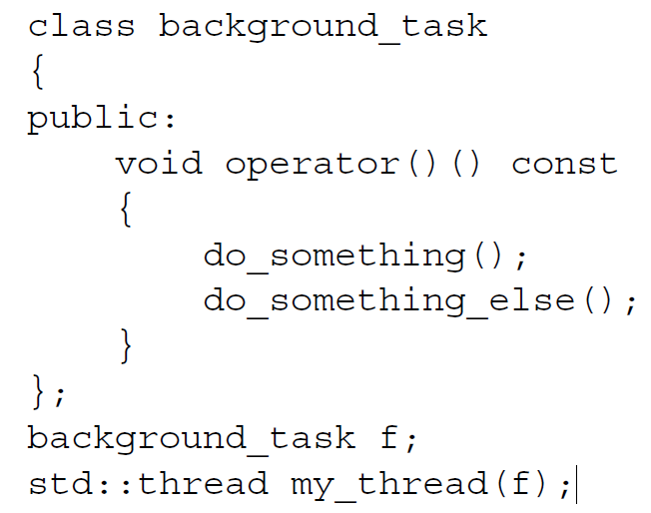
Managing threads
thread() noexcept; | (1) | (since C++11)
thread( thread&& other ) noexcept; | (2) | (since C++11)
template< class Function, class... Args > explicit thread( Function&& f, Args&&... args ); | (3) | (since C++11)
thread(const thread&) = delete; | (4) | (since C++11)
the supplied function object is copied into the storage belonging to the
newly created thread of execution and invoked from there
Once you’ve started your thread, you need to explicitly decide whether to wait for it to or leave it to run on its own。
(the std::thread destructor calls std::terminate())

Slide 2
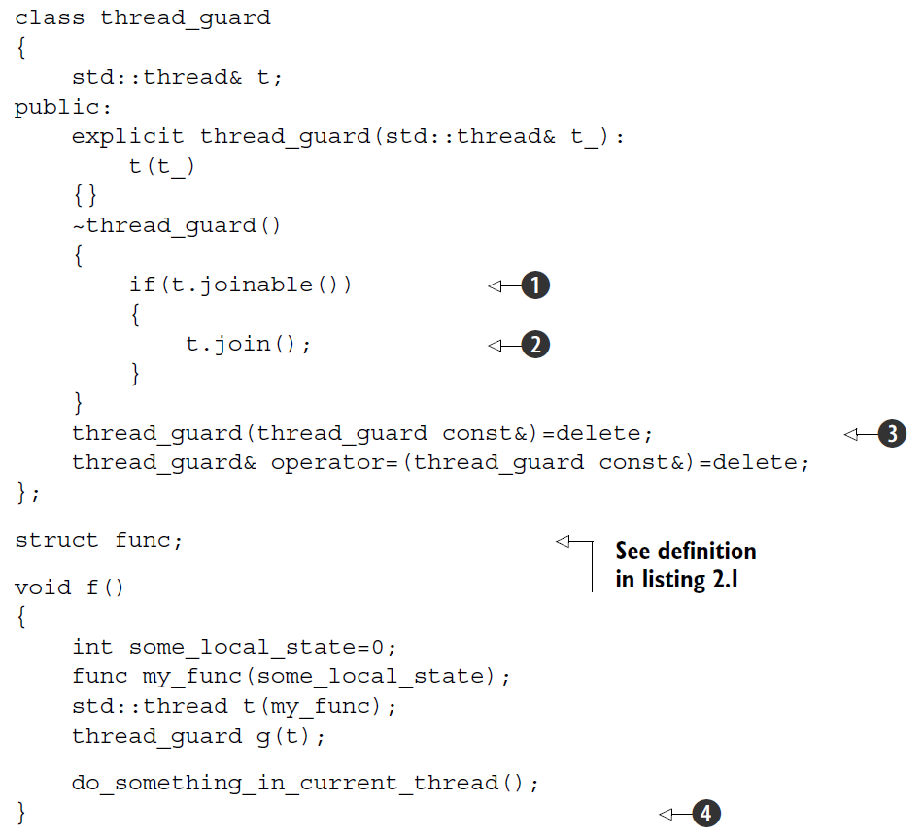
Waiting in exceptional circumstances
The act of calling join() also cleans up any storage associated
with the thread, so the std::thread object is no longer associated with the now-finished thread; it isn’t associated with any thread. This means that you can call join() only once for a given thread; once you’ve called join(), the std::thread object is no longer joinable, and joinable() will return false.
can usually call detach() immediately after the thread has been
started。
call to join() is liable to be skipped if an exception is thrown after
the thread has been started but before the call to join().
see if the std::thread object is joinable() B before calling join()

Slide 3
Running threads in the background
if a thread becomes detached, it isn’t possible to obtain a
std::thread object that references it, so it can no longer be joined. Detached threads
truly run in the background; ownership and control are passed over to the C++ Runtime
Library, which ensures that the resources associated with the thread are correctly
reclaimed when the thread exits.（daemon threads）

Slide 4
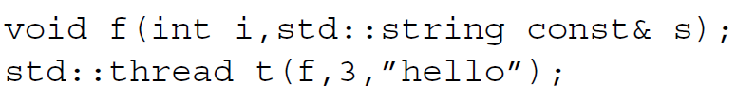
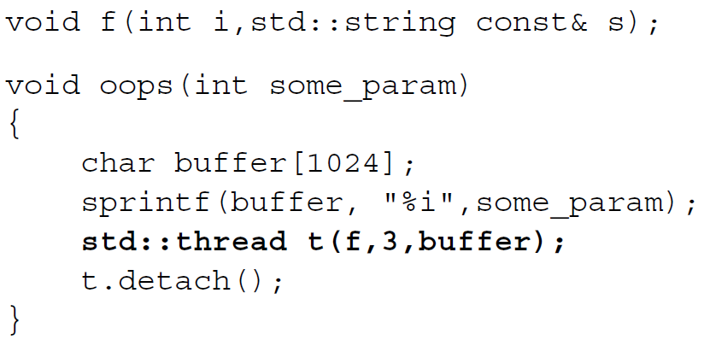
Passing arguments to a thread function
But it’s important to bear in mind that by default the arguments are copied into internal
storage, where they can be accessed by the newly created thread of execution,
even if the corresponding parameter in the function is expecting a reference.
the string literal is passed as a char const* and converted to a std::string only in the context of the new thread.
解决悬空指针
可能导致悬空指针
解决传引用

Slide 5
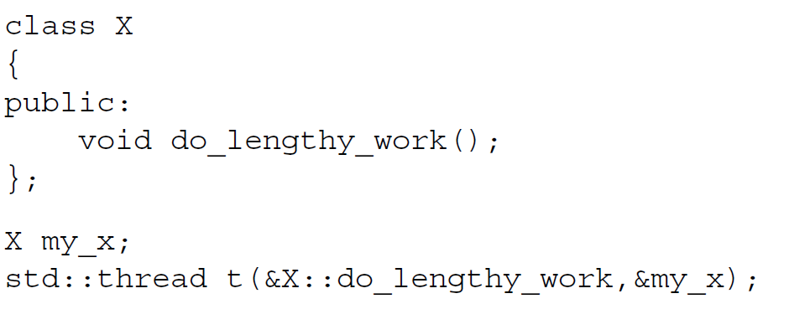
Passing arguments to a thread function
This code will invoke my_x.do_lengthy_work() on the new thread, because the
address of my_x is supplied as the object pointer
For 不能copy对象

Slide 6
Transferring ownership of a thread
只能移动
The move support in std::thread also allows for containers of std::thread
objects, if those containers are move aware (like the updated std::vector<>).
std::thread::hardware_concurrency(). This function returns an indication of the number of threads that cantruly run concurrently for a given execution of a program.
Objects of type std::thread::id can be freely copied and compared。
which provide a total ordering for all distinct values，This allows them
to be used as keys in associative containers。
std::this_thread::get_id()
Thread::get_id()

Slide 7
Protecting shared data with mutexes
the race condition leads to broken invariants that there’s a problem
constexpr mutex() noexcept; | (1) | (since C++11)
mutex( const mutex& ) = delete; | (2) | (since C++11)
注意把被保护的指针或者引用传出, 或者传入其他函数，在其他函数中被保存了，而后的数据访问没有被mutex保护
Don’t pass pointers and references to protected data outside the scope of the lock, whether by
returning them from a function, storing them in externally visible memory, or passing them as
arguments to user-supplied functions.
lock on a std::mutex when you already hold it is undefined behavior

Slide 8
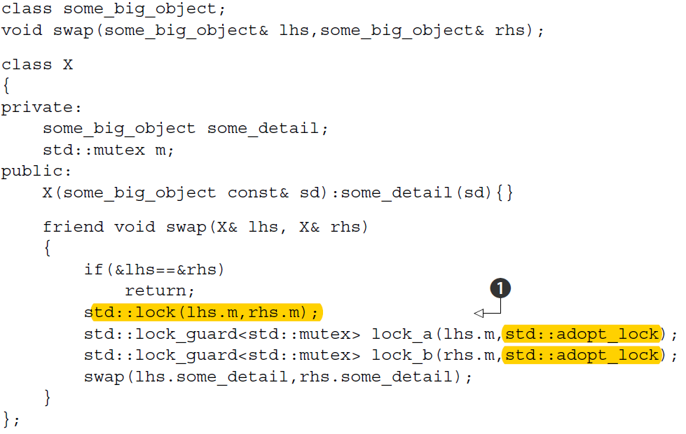
Deadlock:
Deadlock doesn’t just occur with locks。
each thread call join() on the std::thread object for the other（死锁）
don’t wait for another thread if there’s a chance it’s waiting for you

Slide 9
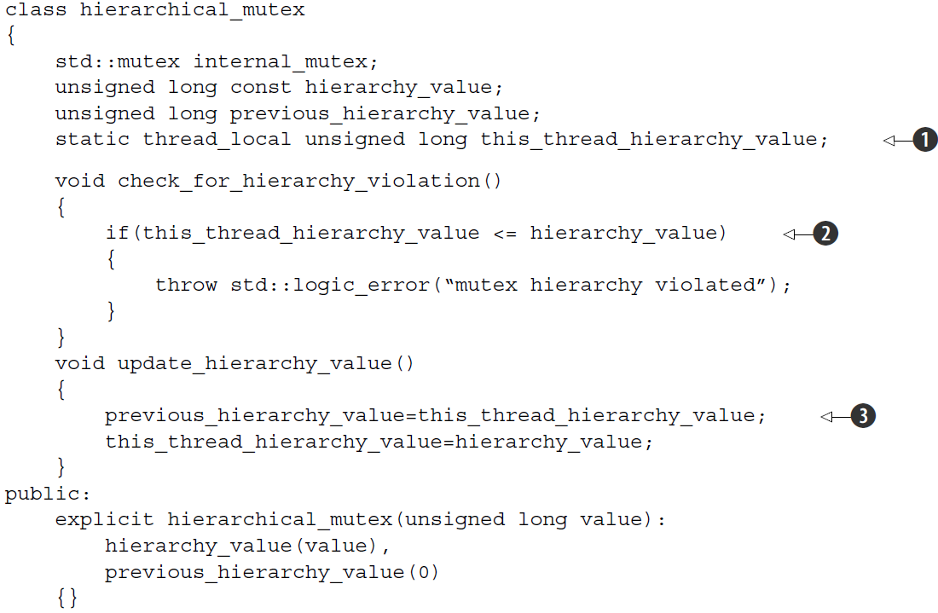
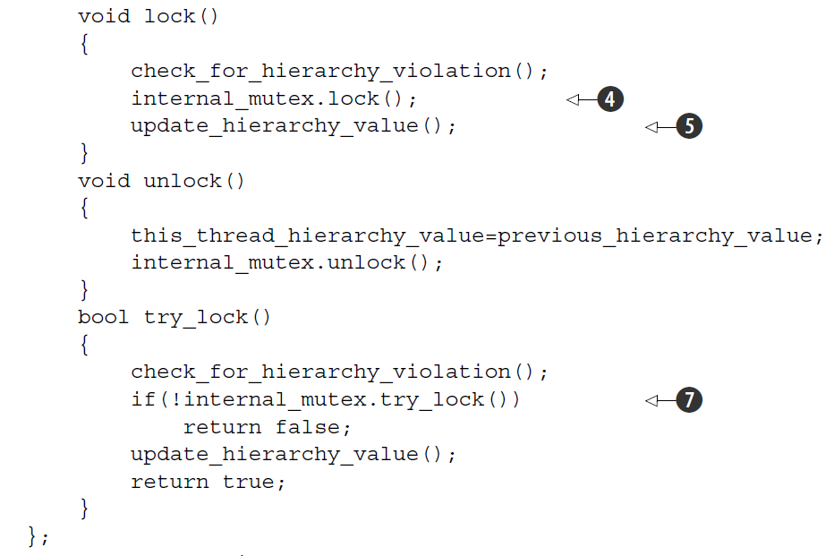
给锁加序

Slide 10
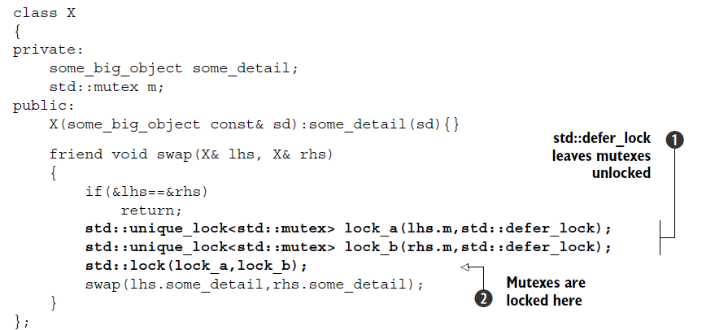
std::unique_lock
std::unique_lock instance doesn’t always own the mutex that it’s
associated with. First off, just as you can pass std::adopt_lock as a second argument
to the constructor to have the lock object manage the lock on a mutex, you can also
pass std::defer_lock as the second argument to indicate that the mutex should
remain unlocked on construction. The lock can then be acquired later by calling
lock() on the std::unique_lock object (not the mutex) or by passing the std::
unique_lock object itself to std::lock(). Lock_guard 不可以移动，在构造时就去获得锁，没有其他成员函数。Unique_lock 有lock,try_lock,unlock等

Slide 11
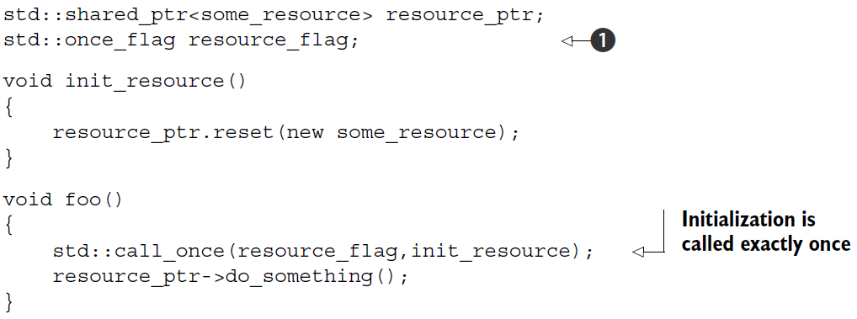
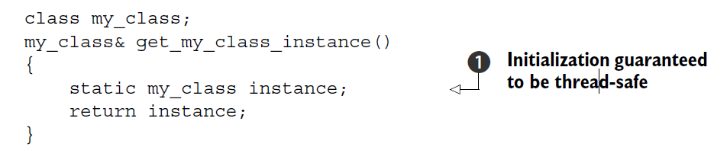
Protecting shared data during initialization
std::mutex, std::once_flag instances can’t be copied or moved

