Slide 1
Deducing Types
function template
Auto
decltype

Slide 2
function template type deduction
template<typename T> void f(ParamType param); f(expr);
• ParamType is a pointer or reference type, but not a universal reference.
• ParamType is a universal reference.
• ParamType is neither a pointer nor a reference.

Slide 3
ParamType is a pointer or reference type, but not a universal reference.
If expr’s type is a reference, ignore the reference part.
Then pattern-match expr’s type against ParamType to determine T.（保留const, volatile）
template<typename T> void f(T& param);
int -> int, int&
const int -> const int, const int&
const int & -> const int, const int&
Const int * & -> const int *, const int * &
template<typename T> void f(const T& param);
int -> int, const int&
const int -> int, const int&
const int & -> int, const int&
Const int * & -> int *, const int * &
当ParamType为 T*, const T*, 类型推导方法一样

Slide 4
ParamType is a Universal Reference
If expr is an lvalue, both T and ParamType are deduced to be lvalue references.
If expr is an rvalue, the “normal” (i.e., Case 1) rules apply
template<typename T>
void f(T&& param);
Int -> int &, int &
Const int -> const int &, const int &
Const int & -> const int &, const int &
当 const T&& param：
Const int & -> int &, const int &
2 -> int, int &&
string() -> string, string &&
New string() -> string *, string *&&
Int && ->int &, int&
Const int & 可以绑定到右值
右值引用本身是左值

Slide 5
ParamType is neither a pointer nor a reference
if expr’s type is a reference, ignore the reference part. expr is const, volatile ignore that, too.
Common Type Arguments. Not array, not function.
Array Arguments.
Function Arguments .
Decay:
const char[10] -> const char *, const char *
Void (int) -> void (*)(int), void (*)(int)
补充 T&情况：
const char[10] -> const (&)char[10] , const char (&) [10]
Void (int) -> void (&) (int), void (&) (int) (vs不是这样的)
补充 T&&情况：如果是左值
const char[10] -> const char (&) [10] , const char (&) [10]
Void (int) -> void (&) (int), void (&) (int) (vs不是这样的)
注意： 不是const char &[10], const & char[10], const *(int)
[],()优先级比较高
template<typename T> void f(T param);
Common Type
Int -> int, int
Const int & -> int, int
const char* const -> const char *, const char *

Slide 6
template<typename T, std::size_t N> constexpr std::size_t arraySize(T (&)[N])
int keyVals[] = { 1, 3, 7, 9, 11, 22, 35 }
T -> int
N -> 7

Slide 7
auto type deduction
When a variable is declared using auto, auto plays the role of T in the template, and the type specifier for the variable acts as ParamType.
template<typename T>
void f(ParamType param);
Auto && z = x; int &
Auto &&zz = 2; int &&
Int h[10]
Auto hh = h; int *
Auto &hhh = h; int (&)[10]
Auto &&hhhh = h; int (&)[10]
auto x = 27; int
Const Auto xx = x; const int
Auto xxx = xx; int
Auto * y = &x; int *
Const auto yy = y; const int *
Auto &yyy = yy; const int * (&)
影响可读性
可能与你期待的不一样
Ide能够提示

Slide 8
Auto Trap
When the initializer for an auto-declared variable is enclosed in braces, the deduced type is a std::initializer_list.
auto x5 = { 1, 2, 3.0 }; // error! can't deduce T for std::initializer_list<T>
auto x1 = 27; auto x2(27); auto x3 = { 27 }; auto x4{ 27 };
auto x1 = 27; // type is int, value is 27
auto x2(27); // ditto
auto x3 = { 27 }; // type is std::initializer_list<int>,// value is { 27 }
// 包含一个单元素27
auto x4{ 27 }; // ditto

Slide 9
The treatment of braced initializers is the only way in which auto type deduction and template type deduction differ
When an auto–declared variable is initialized with a braced initializer, the deduced type is an instantiation of std::initializer_list. But if the corresponding template is passed the same initializer, type deduction fails, and the code is rejected:
why
auto x = { 11, 23, 9 }; // x's type is std::initializer_list<int>
template<typename T>
void f(T param);
f({ 11, 23, 9 }); // error! can't deduce type for T
the rule is the rule

Slide 10
C++14 auto
C++14 permits auto to indicate that a function’s return type should be deduced, and C++14 lambdas may use auto in parameter declarations. However, these uses of auto employ template type deduction, not auto type deduction
std::vector<int> v;
…
auto resetV = [&v](const auto& newValue)
{ v = newValue; }; // C++14
…
resetV({ 1, 2, 3 }); // error! can't deduce type
// for { 1, 2, 3 }
auto createInitList() { return { 1, 2, 3 }; } // error: can’t deduce type

Slide 11
Auto 和 std::vector<bool>
std::vector<bool> fh() {
bool a = true;
return std::vector<bool> (10, a);
}
bool a = fh()[1]; //ok
Auto c = fh()[1]; // bad, 不是引用到临时变量的问题
Not return bool&, it returns an object of type std::vector<bool>::reference(a class nested inside std::vector<bool>)
operator[] for std::vector<T> is supposed to return a T&, but C++ forbids references to bits
operator[] for std::vector<bool> returns an object that acts like a bool&.
For this act to succeed, std::vector<bool>::reference objects must be usable in essentially all contexts where bool&s can be. Among the features in std::vector<bool>::reference that make this work is an implicit conversion to bool. (Not to bool&, to bool).
解决办法：static_cast类型转换

Slide 12
Understand decltype
Given a name or an expression, decltype tells you the name’s or the expression’s type. Typically, what it tells you is exactly what you’d predict, but…
If the argument is an unparenthesized id-expression or an unparenthesized class member access expression, then decltype yields the type of the entity named by this expression. If there is no such entity, or if the argument names a set of overloaded functions, the program is ill-formed.
If the argument is any other expression of type T, and
a) if the value category of expression is xvalue, then decltype yields T&&;
b) if the value category of expression is lvalue, then decltype yields T&;
c) if the value category of expression is prvalue, then decltype yields T.

Slide 13
const int i = 0; // decltype(i) is const int bool f(const Widget& w); // decltype(w) is const Widget& // decltype(f) is bool(const Widget&) struct Point { int x, y; // decltype(Point::x) is int }; // decltype(Point::y) is int Widget w; // decltype(w) is Widget if (f(w)) … // decltype(f(w)) is bool
decltype(2) -> int decltype((2)) -> int
Int &&a = 2;
Decltype(a) -> int &&
Decltype((a)) -> int &
struct A { double x; }
const A* a = new A();
decltype((a->x)) -> const double&
template<typename T> // simplified version of std::vector class vector { public: … T& operator[](std::size_t index); … }; vector<int> v; // decltype(v) is vector<int> … if (v[0] == 0) … // decltype(v[0]) is int&
lvalue，prvalue，xvalue，glvalue和rvalue的参考链接：
http://en.cppreference.com/w/cpp/language/value_category#cite_ref-1

Slide 14
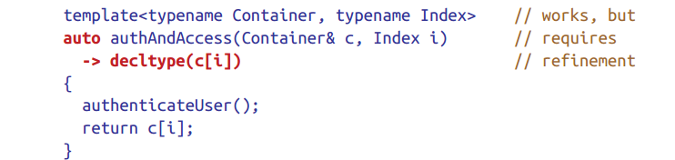
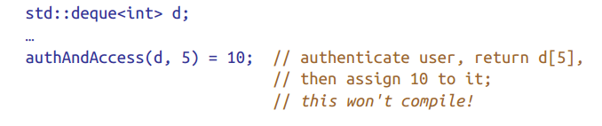
Using: function templates return type
template<typename Container, typename Index> // C++14; auto authAndAccess(Container& c, Index i) // not quite { // correct authenticateUser(); return c[i]; // return type deduced from c[i] }
what’s important here is that the type returned by a container’s operator[] depends on the container.
std::vector<bool>, however, operator[] does not return a bool&
Atrailing return type has the advantage that the function’s parameters can be used in the specification of the return type

Slide 15
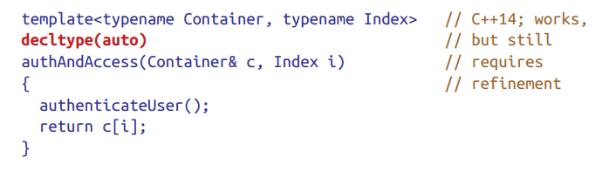
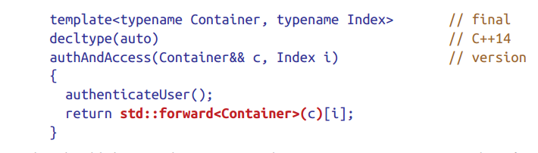
Using: function templates return type
decltype(auto) 不只是可以用于函数返回类型，也可以用于表达式

Slide 16
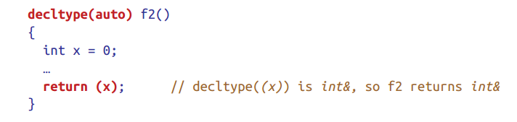
trap
Names are lvalue expressions, but that doesn’t affect decltype’s behavior. For lvalue expressions more complicated than names, however, decltype ensures that the type reported is always an lvalue reference .
That is, if an lvalue expression other than a name has type
T, decltype reports that type as T&
int x = 0; decltype(x) is int
decltype((x)) is therefore int&

Slide 17
Rvalue References, Move Semantics, and Perfect Forwarding
表达式的属性: 返回类型和返回类型的分类
什么是移动语义
C++11的移动相关介绍

Slide 18
With the introduction of move semantics in C++11, value categories were redefined to characterize two independent properties of expressions^{[5]}:
has identity: it's possible to determine whether the expression refers to the same entity as another expression, such as by comparing addresses of the objects or the functions they identify (obtained directly or indirectly);
can be moved from: move constructor, move assignment operator, or another function overload that implements move semantics can bind to the expression.
In C++11, expressions that:
have identity and cannot be moved from are called lvalue expressions;
have identity and can be moved from are called xvalue expressions;
do not have identity and can be moved from are called prvalue ("pure rvalue") expressions;
do not have identity and cannot be moved from are not used^{[6]}.
The expressions that have identity are called "glvalue expressions" (glvalue stands for "generalized lvalue"). Both lvalues and xvalues are glvalue expressions.
The expressions that can be moved from are called "rvalue expressions". Both prvalues and xvalues are rvalue expressions.

Slide 19
Move semantics makes it possible for compilers to replace expensive copying operations with less expensive moves. In the same way that copy constructors and copy assignment operators give you control over what it means to copy objects, move constructors and move assignment operators offer control over the semantics of moving. Move semantics also enables the creation of move-only types, such as std::unique_ptr, std::future, and std::thread.
Perfect forwarding makes it possible to write function templates that take arbi‐trary arguments and forward them to other functions such that the target func‐tions receive exactly the same arguments as were passed to the forwarding functions.
Rvalue references are the glue that ties these two rather disparate features together. They’re the underlying language mechanism that makes both move semantics and perfect forwarding possible.

Slide 20
std::move doesn’t move anything
perfect forward‐ing is imperfect
Move operations aren’t always cheaper than copying and they’re not always called in a context where moving is valid
The construct “type&&” doesn’t always represent an rvalue reference.

Slide 21
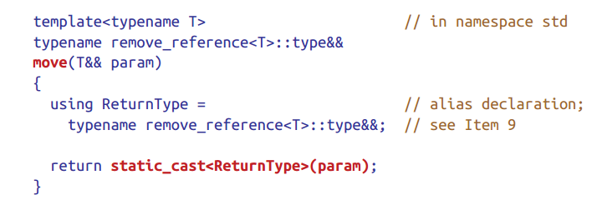
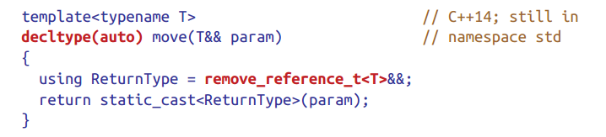
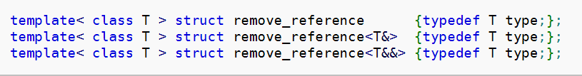
std::move： unconditionally casts

Slide 22
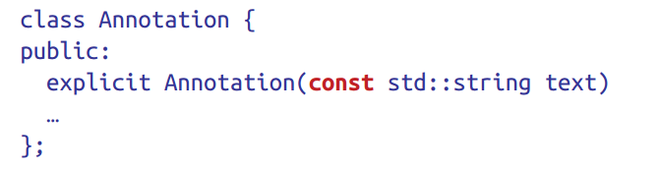
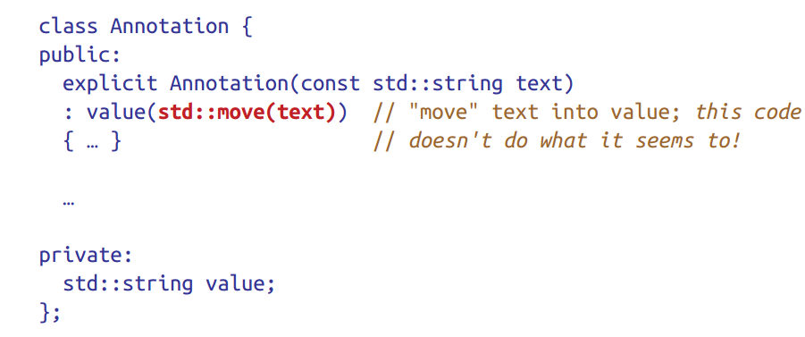
std::move： unconditionally casts
don’t declare objects const if you want to be able to move from them

Slide 23
std::forward: conditional cast 模板参数不能省略
template<typename _Tp> constexpr _Tp&& forward(typename std::remove_reference<_Tp>::type& __t) noexcept { return static_cast<_Tp&&>(__t); }
template<typename _Tp> constexpr _Tp&& forward(typename std::remove_reference<_Tp>::type&& __t) noexcept { static_assert(!std::is_lvalue_reference<_Tp>::value, "template argument" " substituting _Tp is an lvalue reference type"); return static_cast<_Tp&&>(__t); }
SFINAE: Substitution Failure Is Not An Error

Slide 24
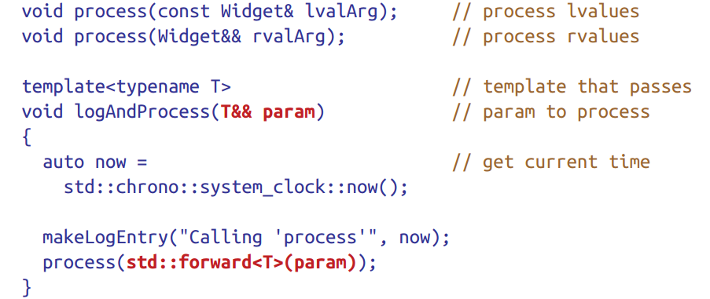
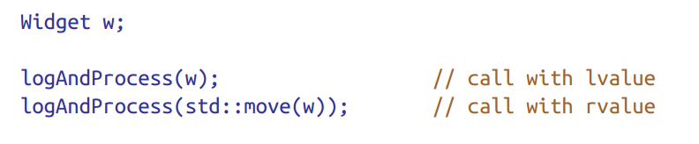

Slide 25
std::move函数移动后,要求移后源是可析构的
任何对象被移动后，仍然可以被正常析构。

Slide 26
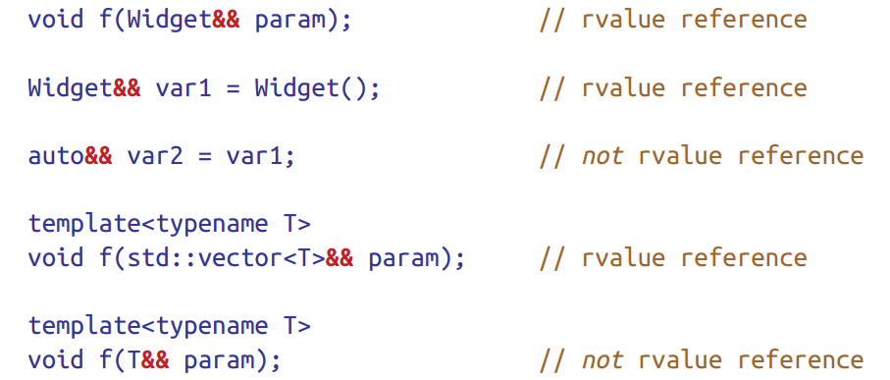

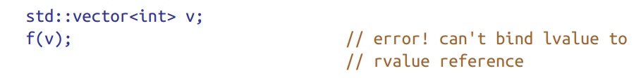
Distinguish universal references from rvalue references.

Slide 27
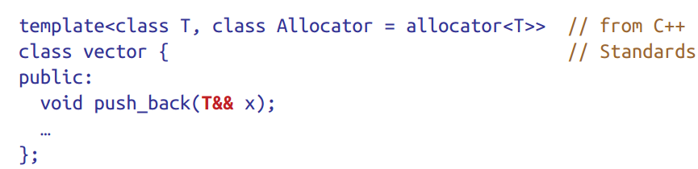
If you’re in a template and you see a function parameter of type “T&&”, you might think you can assume that it’s a universal reference. You can’t. That’s because being in a template doesn’t guarantee the presence of type deduction. Consider this push_back member function in std::vector:
std::vector<Widget> v;
causes the std::vector template to be instantiated as follows: class vector<Widget, allocator<Widget>> { public: void push_back(Widget&& x); // rvalue reference … };
是universal reference的条件：
1，格式唯一
2，一定要有类型推到 auto &&, template T&& T&&…

Slide 28
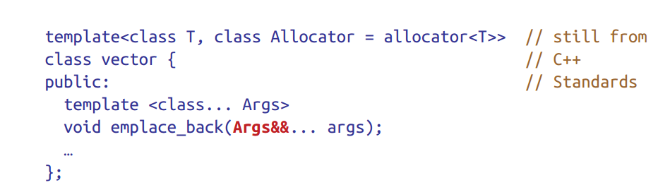
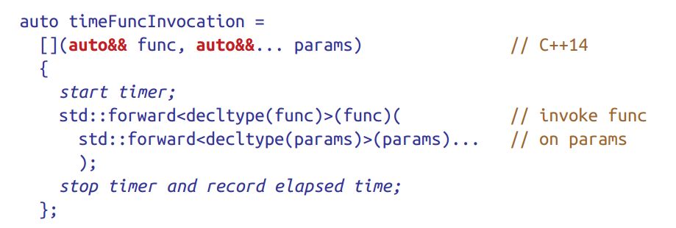
Here, the type parameter Args is independent of vector’s type parameter T, so Args must be deduced each time emplace_back is called.

Slide 29
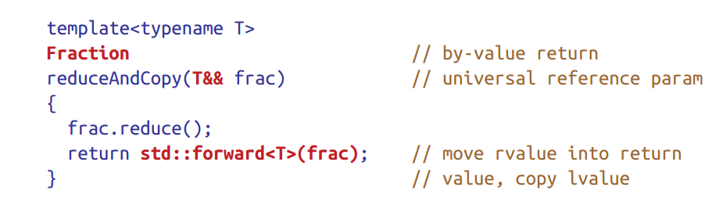
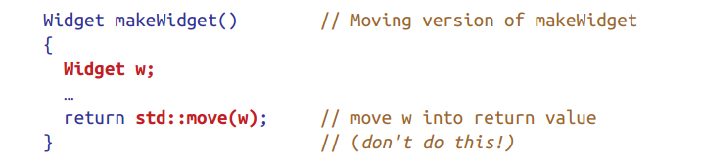
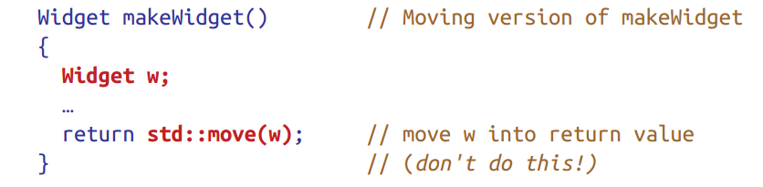
Use std::move on rvalue references, std::forward on universal references
在你确定不需要该引用的时候调用
return value optimization (RVO)

Slide 30
return value optimization (RVO)
两个条件： compilers may elide the copying (or moving) of a local object2 in a function that returns by value if (1) the type of the local object is the same as that returned by the function and (2) the local object is what’s being returned.
Rvo参考资料

Slide 31
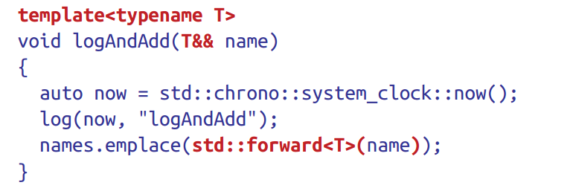
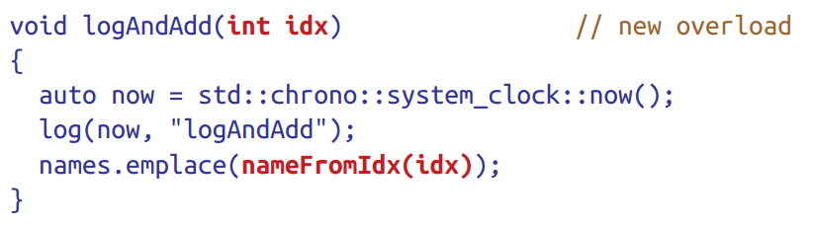
Avoid overloading on universal references

Slide 32
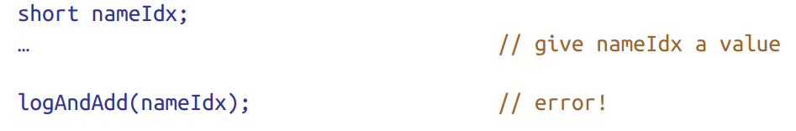
Functions taking universal references are the greediest functions in C++

Slide 33
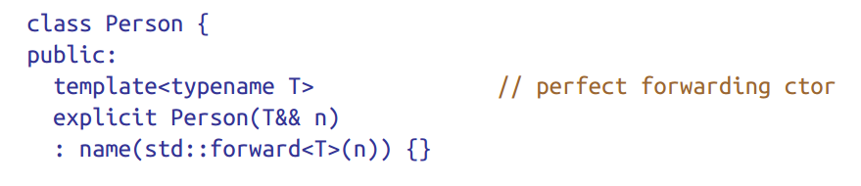
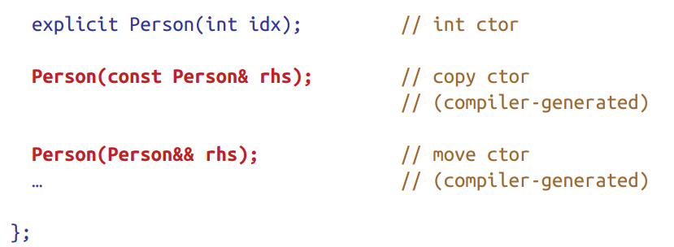
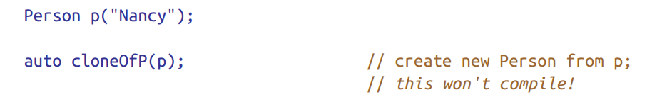
即便有模板，也可以自动生成

Slide 34
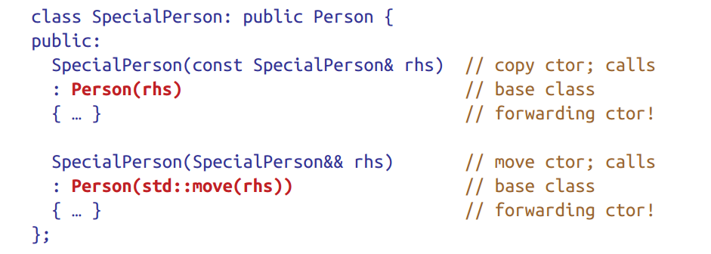
调用模板构造函数
• Overloading on universal references almost always leads to the universal refer‐ ence overload being called more frequently than expected. • Perfect-forwarding constructors are especially problematic, because they’re typically better matches than copy constructors for non-const lvalues, and they can hijack derived class calls to base class copy and move constructors.

Slide 35
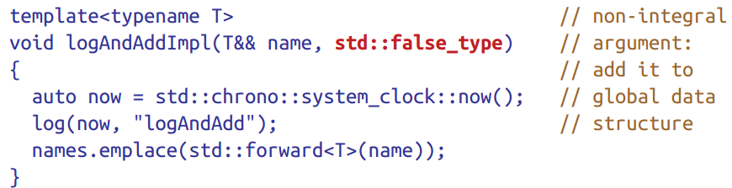
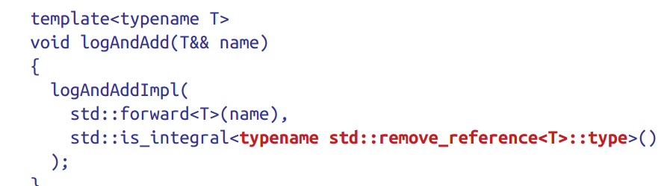
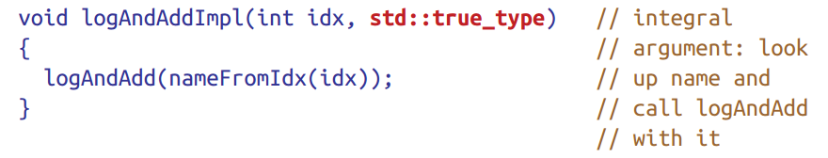
Familiarize yourself with alternatives to overloading on universal references
avoid the drawbacks of overloading on universal references by simply using different names for the would-be overloads (对构造函数不管用)
Use Tag dispatch

Slide 36
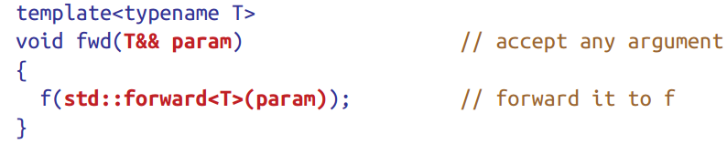
Familiarize yourself with perfect forwarding failure cases
Braced initializers
0 or NULL as null pointers 推到成整数，使用nullprt

