Slide 1
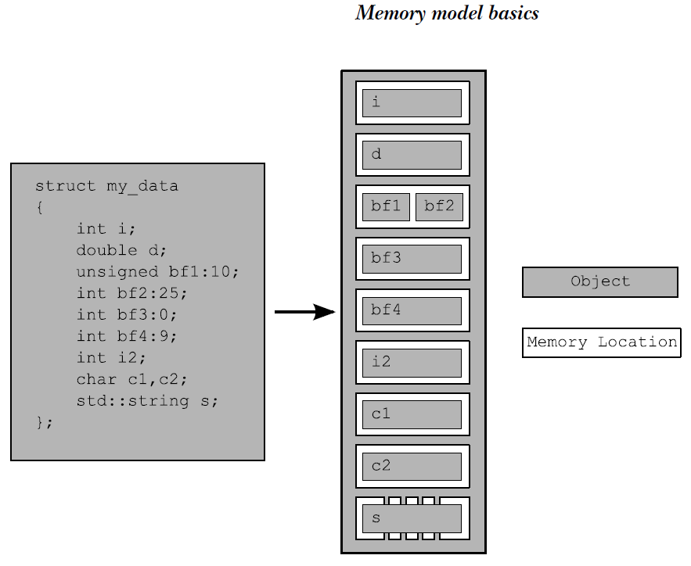
Objects and memory locations
The C++ Standard defines an object as “a region of storage,” although it goes on to assign properties to these objects, such as their type and lifetime.
There are four important things to take away from this:
■ Every variable is an object, including those that are members of other objects.
■ Every object occupies at least one memory location.
■ Variables of fundamental type such as int or char are exactly one memory location, whatever their size, even if they’re adjacent or part of an array.
■ Adjacent bit fields are part of the same memory location.
Each such memory location is either an object (or subobject) of a scalar type such as unsigned short or my_class* or a sequence of adjacent bit fields

Slide 2
If two threads access separate memory locations,
there’s no problem: everything works fine.
If there’s no enforced ordering between two accesses to a single memory location
from separate threads, one or both of those accesses is not atomic, and one or both is
a write, then this is a data race and causes undefined behavior.

Slide 3
The standard atomic types
the standard atomic types themselves might use such emulation:
they (almost) all have an is_lock_free() member function, which allows the
user to determine whether operations on a given type are done directly with atomic
instructions (x.is_lock_free() returns true) or done by using a lock internal to the
compiler and library (x.is_lock_free() returns false).
The only type that doesn’t provide an is_lock_free() member function is
std::atomic_flag. This type is a really simple Boolean flag, and operations on this type
are required to be lock-free; once you have a simple lock-free Boolean flag, you can use
that to implement a simple lock and thus implement all the other atomic types using that
as a basis.
they can then either be queried and set (with the test_and_set() member function) or cleared (with the clear() member function).
std::atomic_flag f=ATOMIC_FLAG_INIT;（必须）
they have no copy constructors or copy assignment operators.

Slide 4
however, support assignment from and implicit conversion to the corresponding
built-in types as well as direct load() and store() member functions, exchange(),
compare_exchange_weak(), and compare_exchange_strong(). They also support the
compound assignment operators where appropriate: +=, -=, *=, |=, and so on, and
the integral types and std::atomic<> specializations for pointers support ++ and --.
These operators also have corresponding named member functions with the same
functionality: fetch_add(), fetch_or(), and so on. The return value from the assignment operators and member functions is either the value stored (in the case of the assignment operators) or the value prior to the operation (in the case of the named functions).
however, support assignment from and implicit conversion to the corresponding
built-in types as well as direct load() and store() member functions, exchange(),
compare_exchange_weak(), and compare_exchange_strong(). They also support the
compound assignment operators where appropriate: +=, -=, *=, |=, and so on, and
the integral types and std::atomic<> specializations for pointers support ++ and --.

Slide 5
Each of the operations on the atomic types has an optional memory-ordering argument
that can be used to specify the required memory-ordering semantics.
■ Store operations, which can have memory_order_relaxed, memory_order_release,
or memory_order_seq_cst ordering
■ Load operations, which can have memory_order_relaxed, memory_order_consume,
memory_order_acquire, or memory_order_seq_cst ordering
■ Read-modify-write operations, which can have memory_order_relaxed, memory_
order_consume, memory_order_acquire, memory_order_release, memory_order_
acq_rel, or memory_order_seq_cst ordering

Slide 6
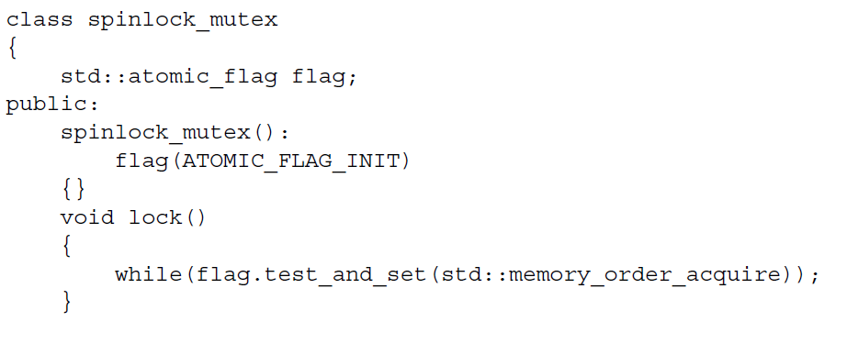
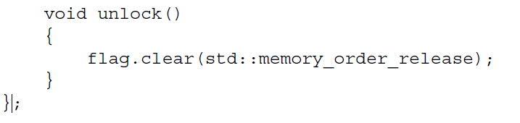
std::atomic_flag
A single operation on two distinct objects can’t be atomic。因此std::atomic_flag没有copy-construct和assign-operator
std::atomic_flag is so limited that it can’t even be used as a general Boolean flag,
because it doesn’t have a simple nonmodifying query operation. For that you’re better
off using std::atomic<bool>

Slide 7
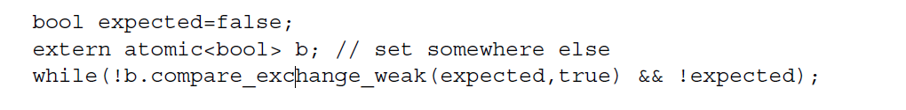
std::atomic<bool>
atomic types: the assignment operators they support return values (of
the corresponding nonatomic type) rather than references. If a reference to the
atomic variable was returned, any code that depended on the result of the assignment
would then have to explicitly load the value, potentially getting the result of a modification
by another thread. By returning the result of the assignment as a nonatomic
value, you can avoid this additional load, and you know that the value obtained is the
actual value stored.
spurious failure
compare_exchange_strong() is guaranteed to return false
only if the actual value wasn’t equal to the expected value.

