Slide 1
基础
By default, Python source files are treated as encoded in UTF-8.
To declare an encoding other than the default one, a special comment line should be added as the first line of the file. The syntax is as follows:
# -*- coding: encoding -*-
>>> 8 / 5 # division always returns a floating point number 1.6
17 // 3 # floor division discards the fractional part 5
2 ** 7 # 2 to the power of 7 128
In interactive mode, the last printed expression is assigned to the variable _
>>> '"Isn\'t," she said.‘
'"Isn\'t," she said.'
>>> ('"Isn\'t," she said.')
"Isn't," she said.

Slide 2
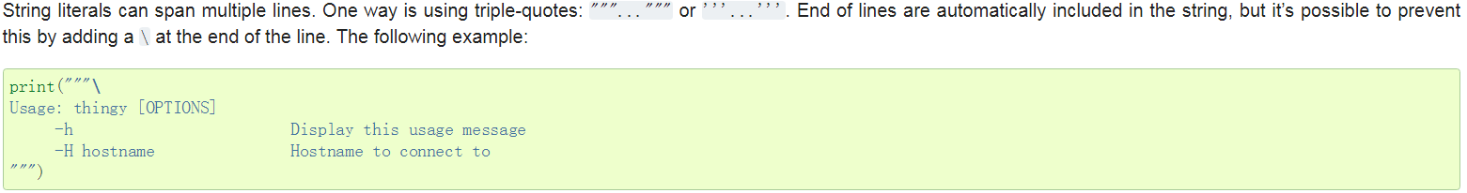
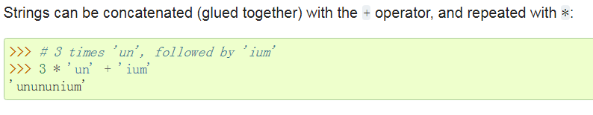
>>> ('C:\some\name') # here \n means newline!
C:\some ame
>>> (r'C:\some\name') # note the r before the quote
C:\some\name

Slide 3
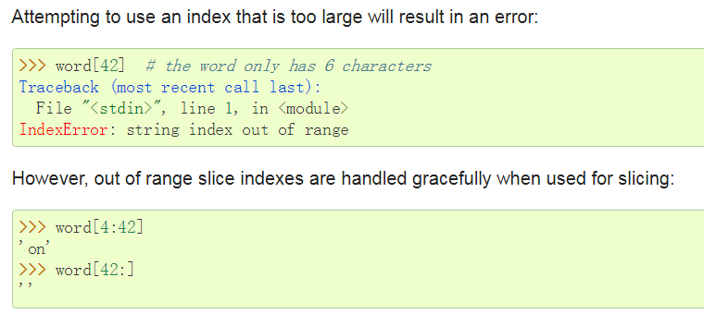
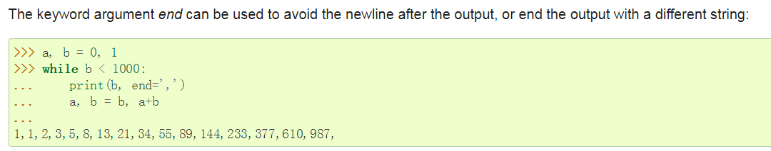

Slide 4
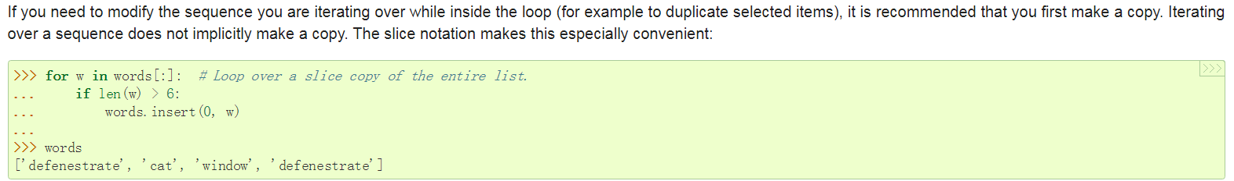
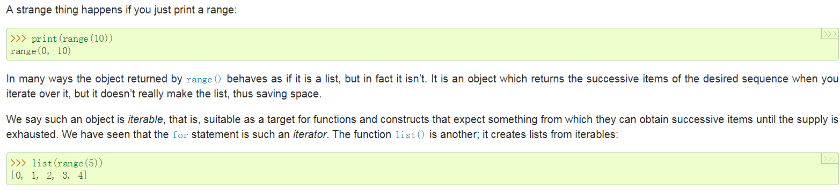

Slide 5
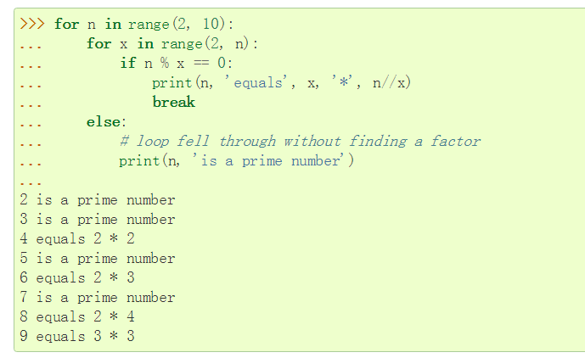
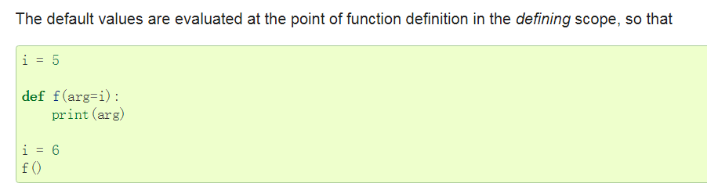
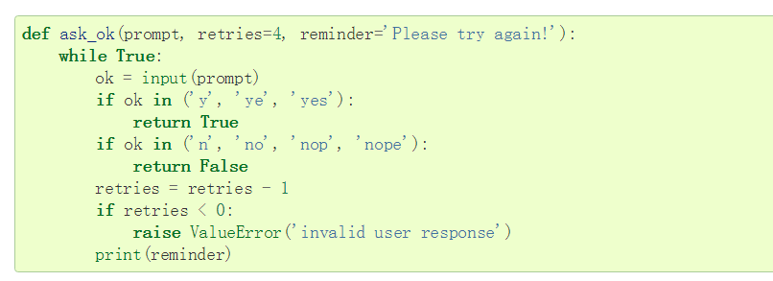
a try statement’s else clause runs when no exception occurs, and a loop’s else clause runs when no break occurs.
even functions without a return statement do return a value, albeit a rather boring one. This value is called None (it’s a built-in name).

Slide 6
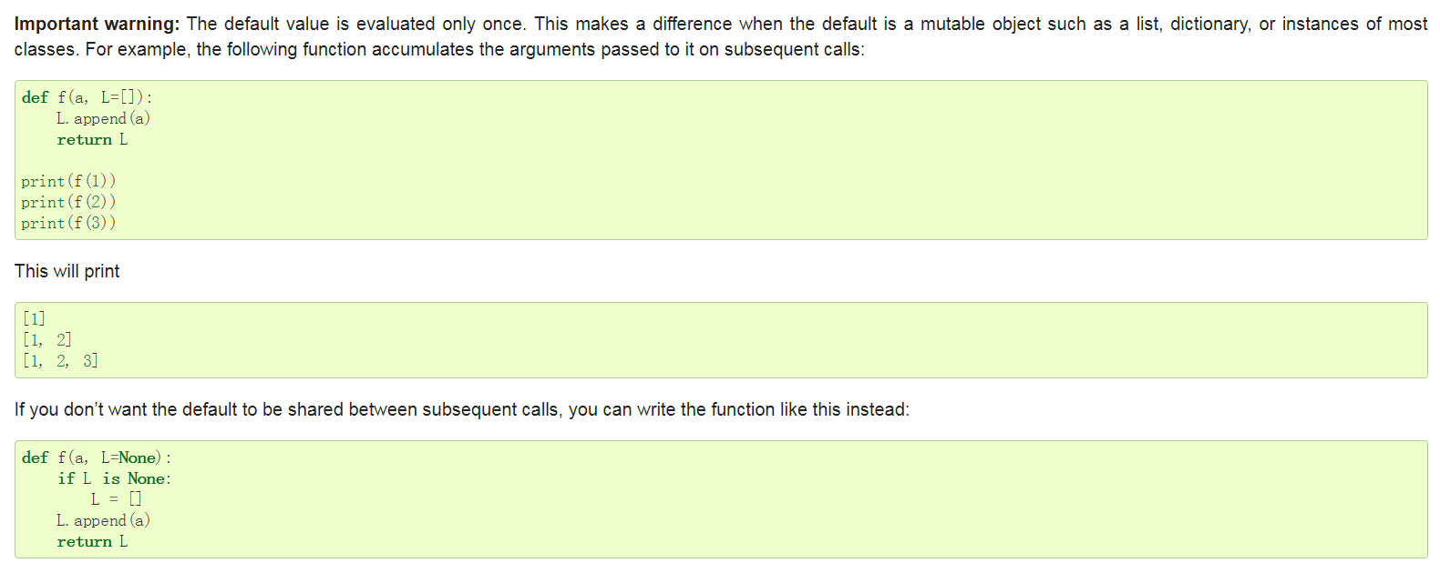
默认值也太蛋疼了

Slide 7
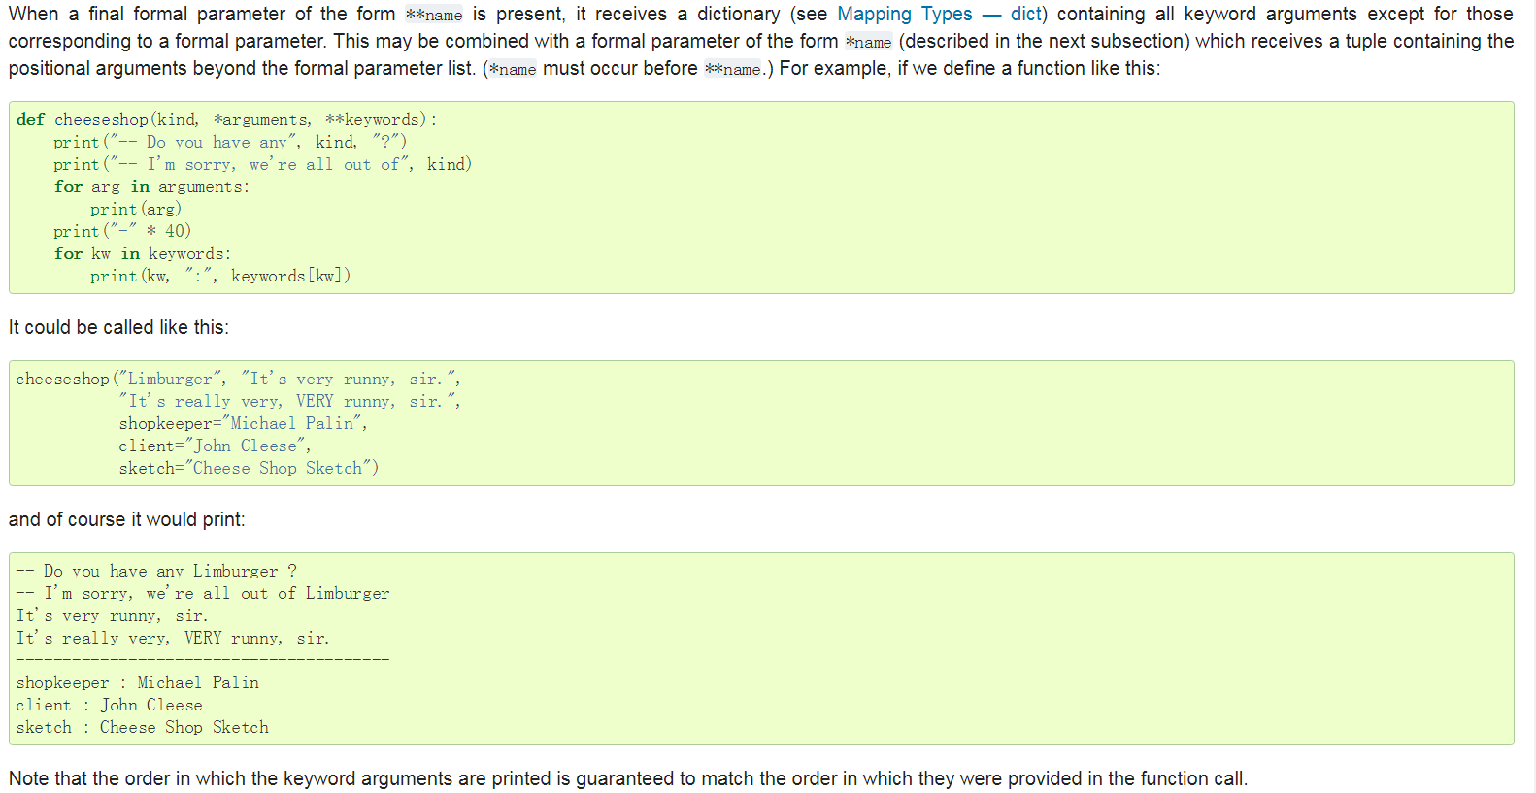

Slide 8
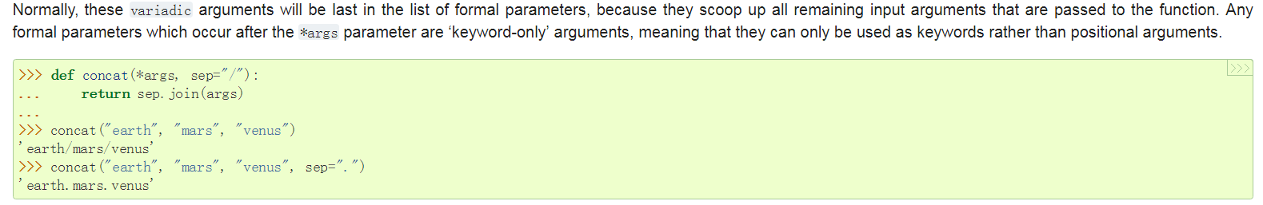
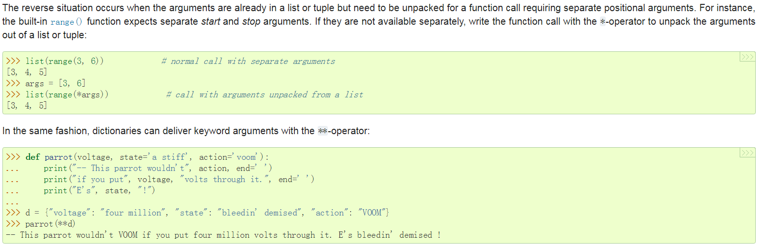

Slide 9
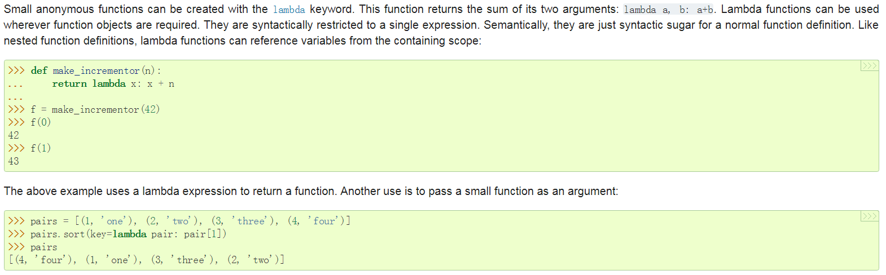

Slide 10
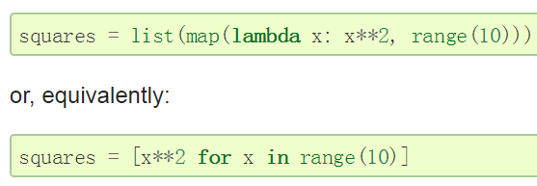
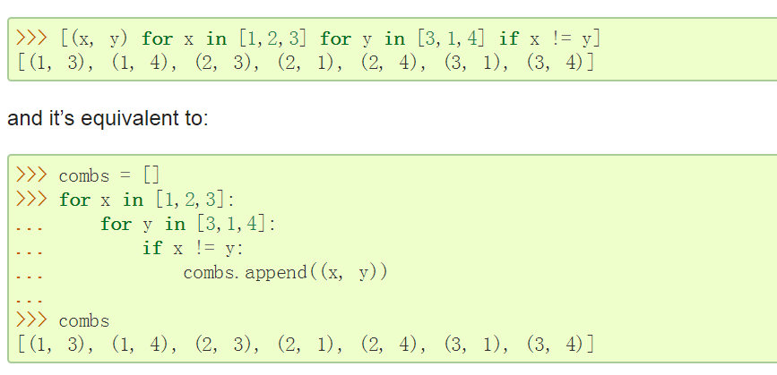
数据结构

Slide 11
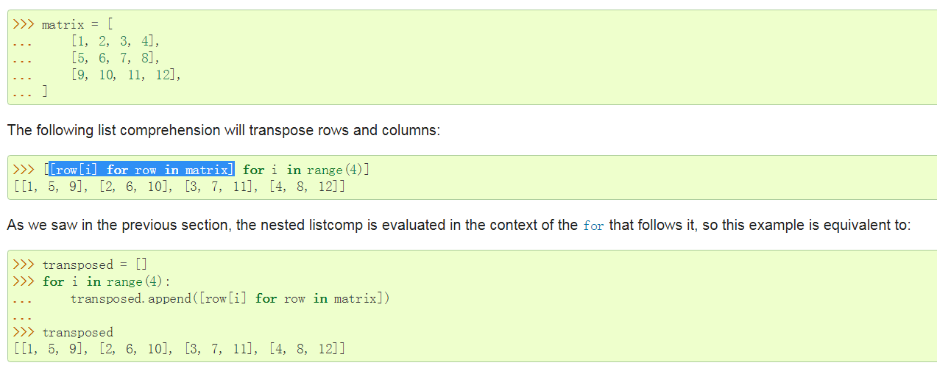
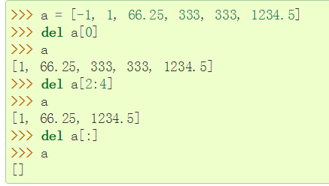

Slide 12
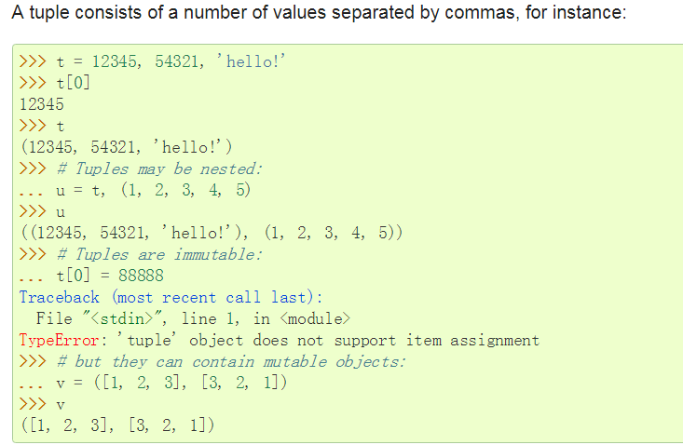

Slide 13
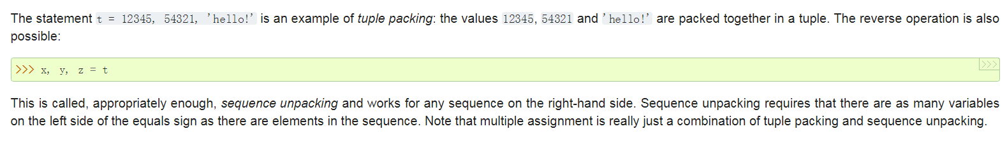
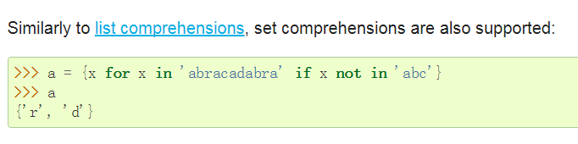
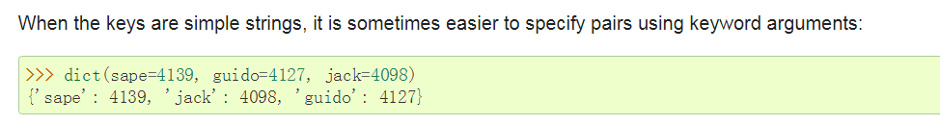
to create an empty set you have to use set(), not {}; the latter creates an empty dictionary

Slide 14
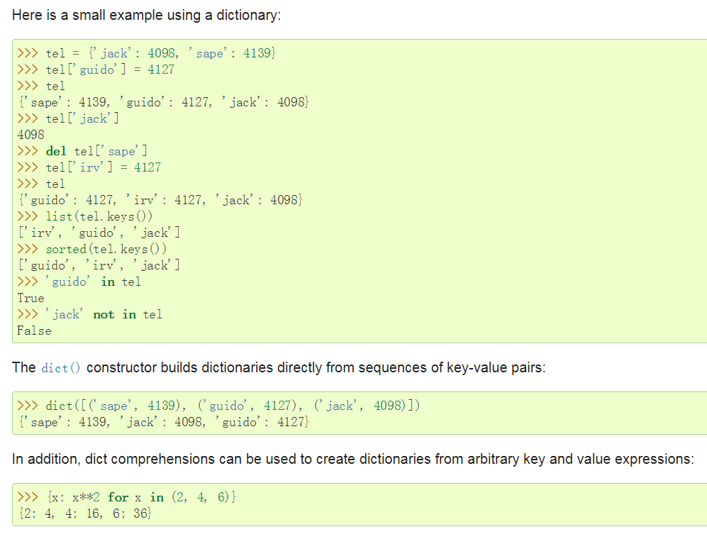
Key 必须是immutable

Slide 15
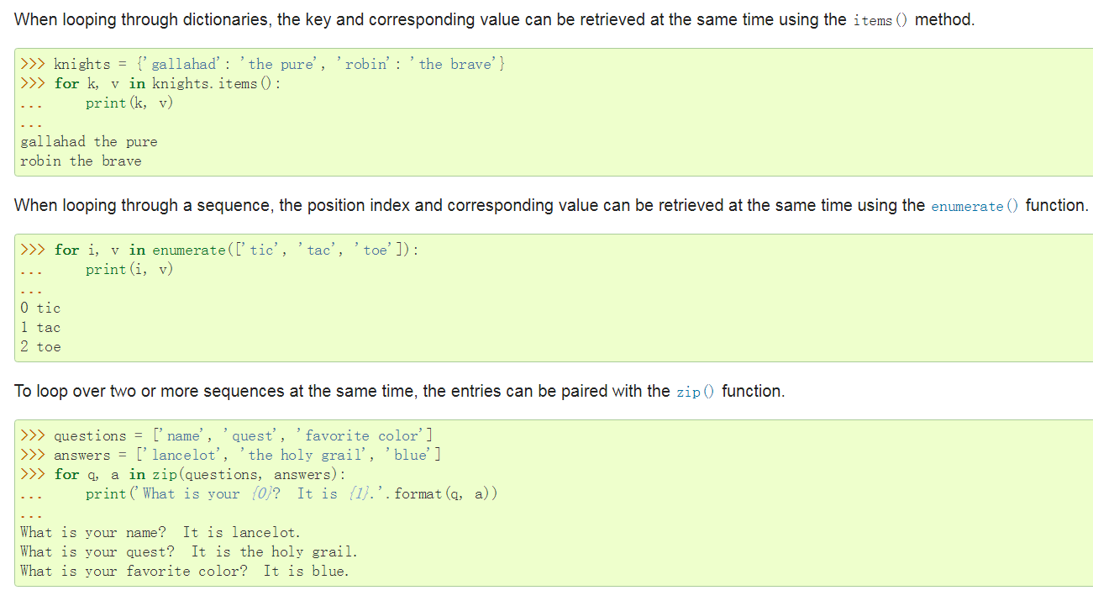

Slide 16
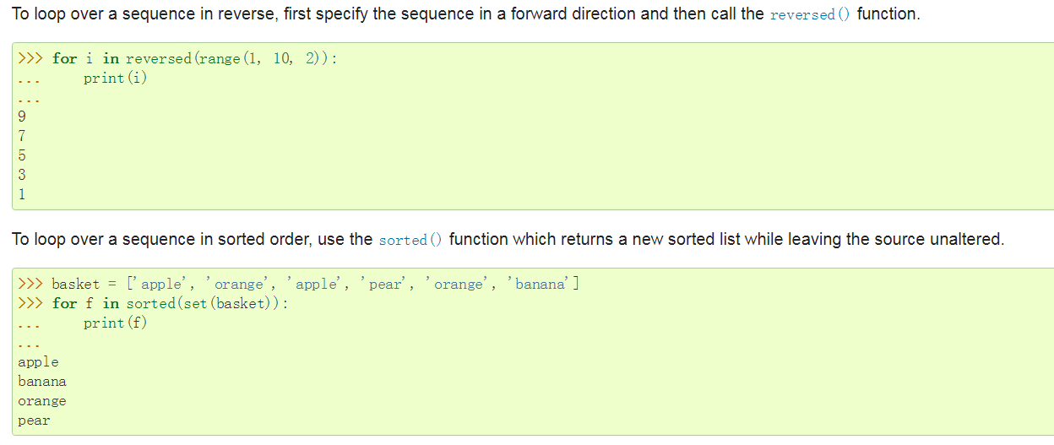
unlike C, assignment cannot occur inside expressions

Slide 17
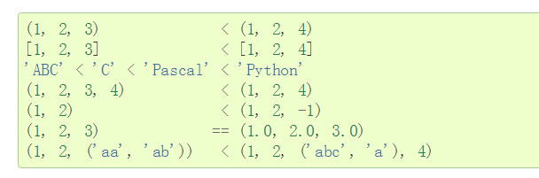
Sequence objects may be compared to other objects with the same sequence type. The comparison uses lexicographical ordering:

