Slide 1
std::unique_ptr
When a custom deleter is to be used, its type must be specified as the second typeargument to std::unique_ptr.
Attempting to assign a raw pointer (e.g., from new) to a std::unique_ptr won’t compile
when using the default deleter (i.e., delete), you can reason‐ably assume that std::unique_ptr objects are the same size as raw pointers. When custom deleters enter the picture, this may no longer be the case
Stateless function objects (e.g., from lambda expressions with no captures) incur no size penalty

Slide 2

std::shared_ptrs
Memory for the reference count must be dynamically allocated.
Increments and decrements of the reference count must be atomic
Deletor. For std::unique_ptr, the type of the deleter is part of the type of the smart pointer. For std::shared_ptr, it’s not:
In another difference from std::unique_ptr, specifying a custom deleter doesn’t change the size of a std::shared_ptr object.

Slide 3
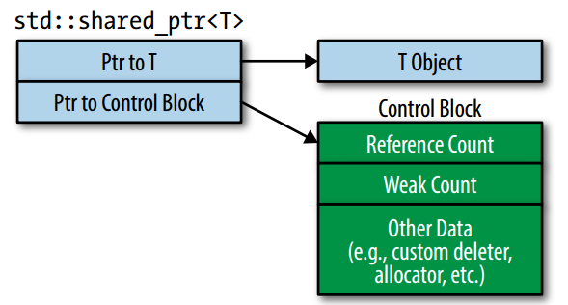
When a std::shared_ptr constructor is called with a raw pointer, it creates a control block
std::make_shared (see Item 21) always creates a control block
A control block is created when a std::shared_ptr is constructed from a
unique-ownership pointer

Slide 4
std::enable_shared_from_this.
std::enable_shared_from_this defines a member function that creates a std::shared_ptr to the current object, but it does it without duplicating control blocks.
shared_from_this looks up the control block for the current object, and it creates a new std::shared_ptr that refers to that control block
There must be an existing std::shared_ptr , If no such std::shared_ptr exists (i.e., if the current object has no associated control block), behavior is unde‐fined, although shared_from_this typically throws an exception

Slide 5
To prevent clients from calling member functions that invoke shared_from_this before a std::shared_ptr points to the object, classes inheriting from std::enable_shared_from_this often declare their constructors private and have clients create objects by calling factory functions that return std::shared_ptrs.

Slide 6
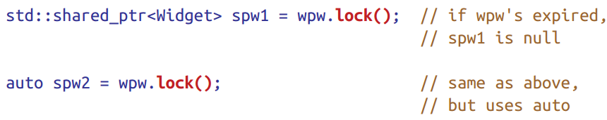

std::weak_ptr
std::weak_ptrs can’t be dereferenced, nor can they be tested for nullness. That’s because std::weak_ptr isn’t a standalone smart pointer. It’s an augmentation of std::shared_ptr

Slide 7
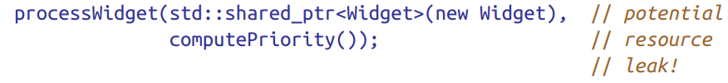
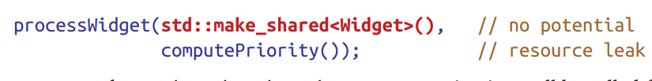

两次内存分配
一次
That means that within the make functions, the perfect forwarding code uses parentheses, not braces. The bad news is that if you want to construct your pointed-to object using a braced initializer, you must use new directly.

Slide 8
using make functions to create objects of types with class-specific versions of operator new and operator delete is typi‐cally a poor idea.

