Slide 1
基础
By default, Python source files are treated as encoded in UTF-8.
To declare an encoding other than the default one, a special comment line should be added as the first line of the file. The syntax is as follows:
# -*- coding: encoding -*-
>>> 8 / 5 # division always returns a floating point number 1.6
17 // 3 # floor division discards the fractional part 5
2 ** 7 # 2 to the power of 7 128
In interactive mode, the last printed expression is assigned to the variable _
>>> '"Isn\'t," she said.‘
'"Isn\'t," she said.'
>>> ('"Isn\'t," she said.')
"Isn't," she said.

Slide 2
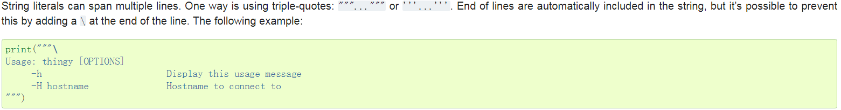
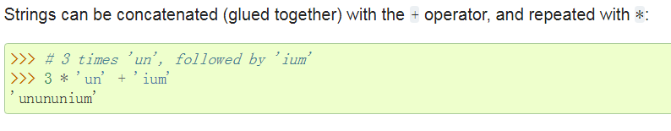
>>> ('C:\some\name') # here \n means newline!
C:\some ame
>>> (r'C:\some\name') # note the r before the quote
C:\some\name

Slide 3
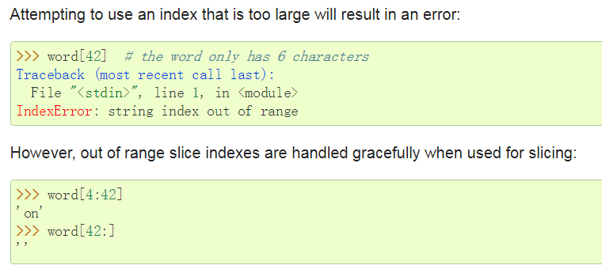
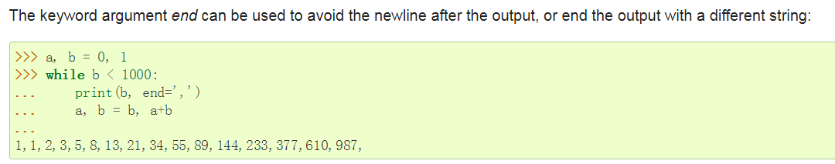

Slide 4
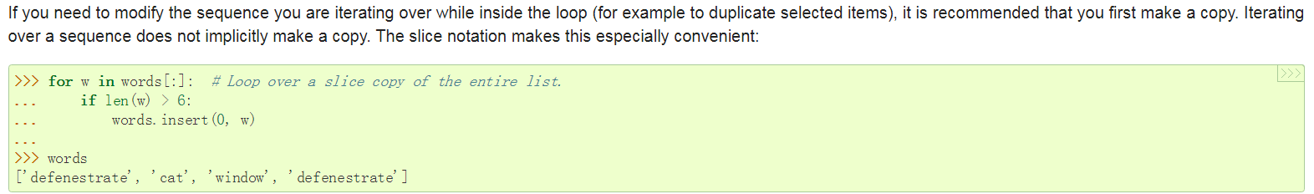
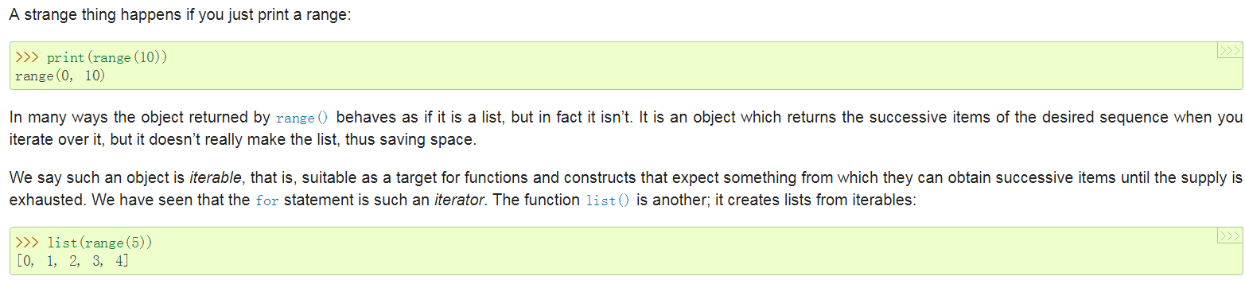

Slide 5
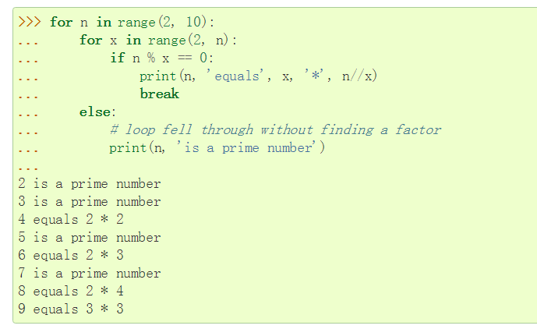
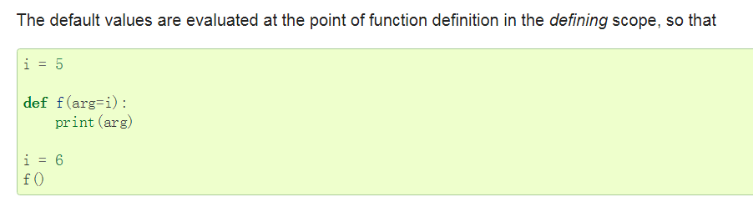
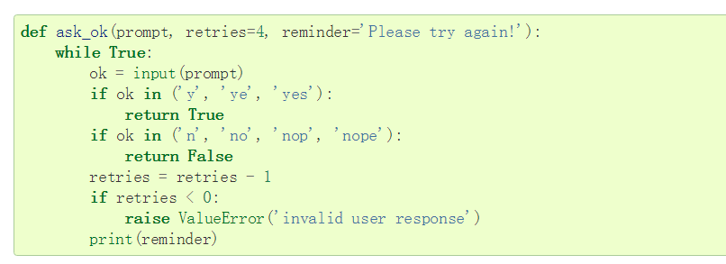
a try statement’s else clause runs when no exception occurs, and a loop’s else clause runs when no break occurs.
even functions without a return statement do return a value, albeit a rather boring one. This value is called None (it’s a built-in name).

Slide 6
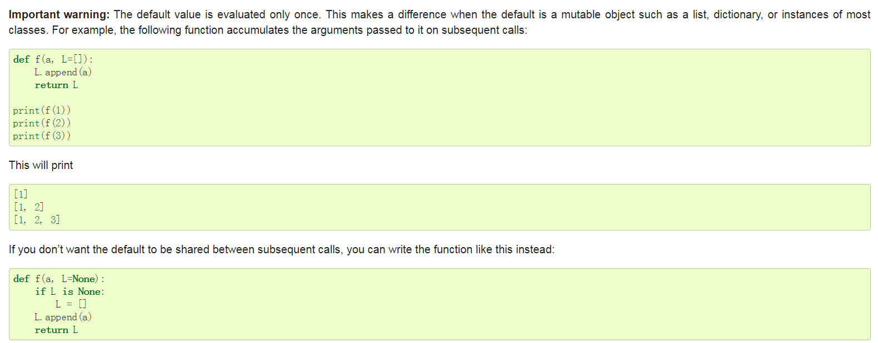
默认值也太蛋疼了

Slide 7
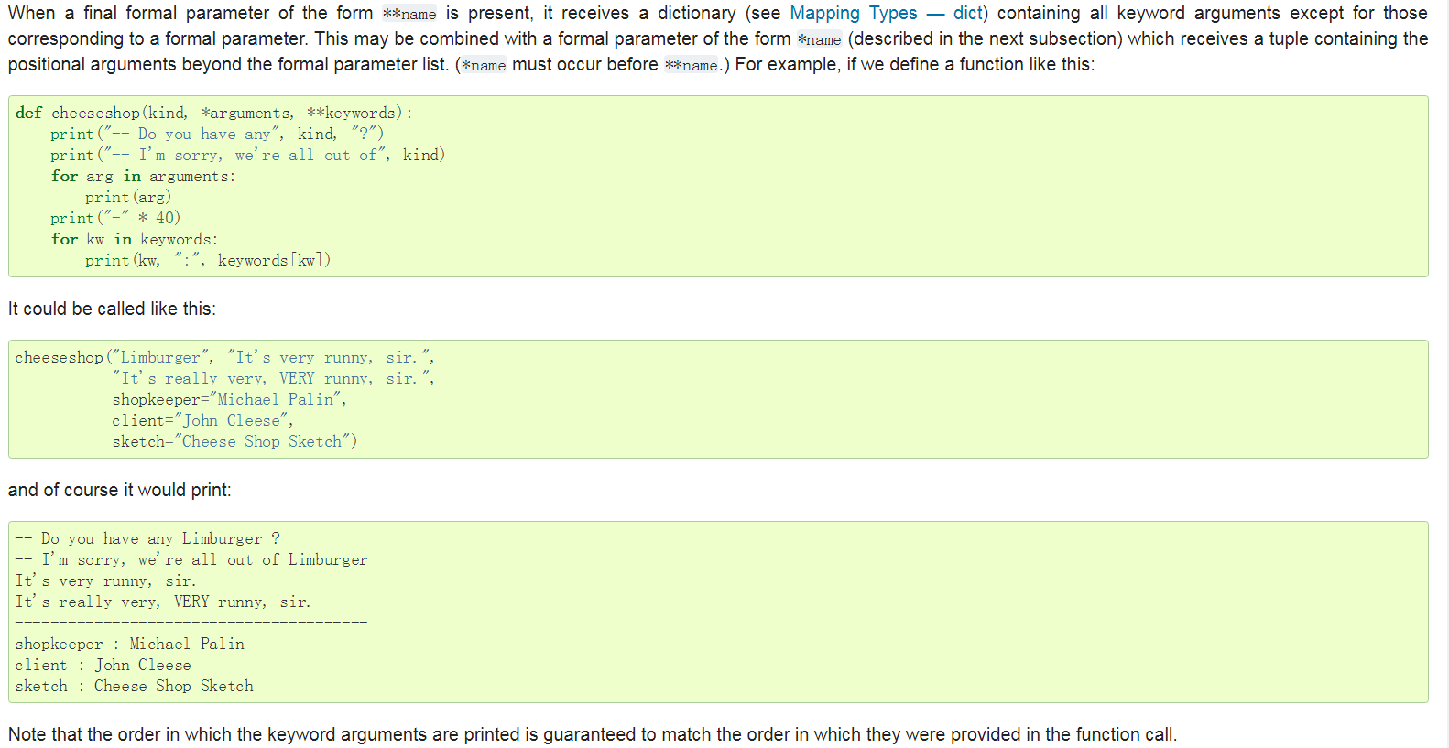

Slide 8
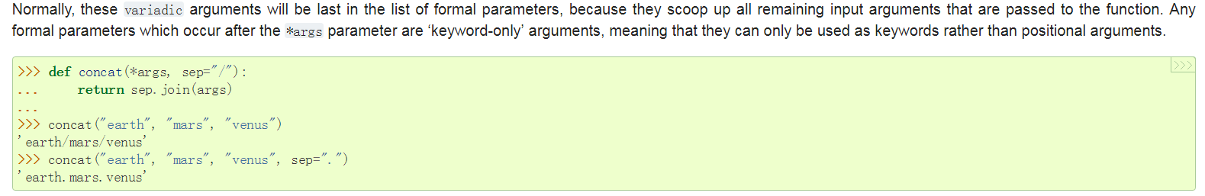
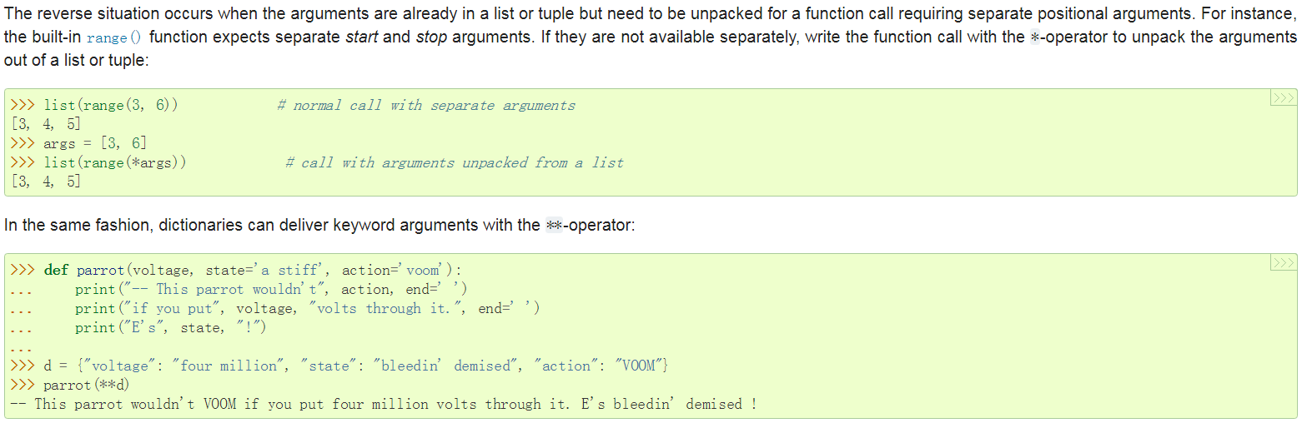

Slide 9
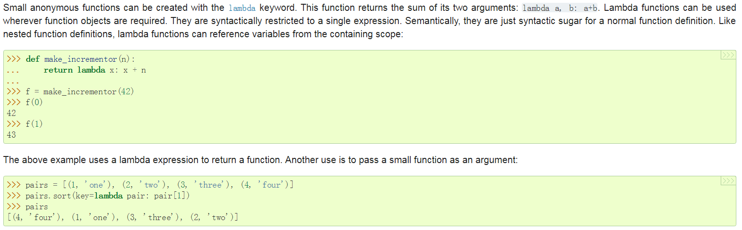

Slide 10
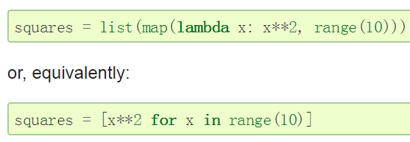
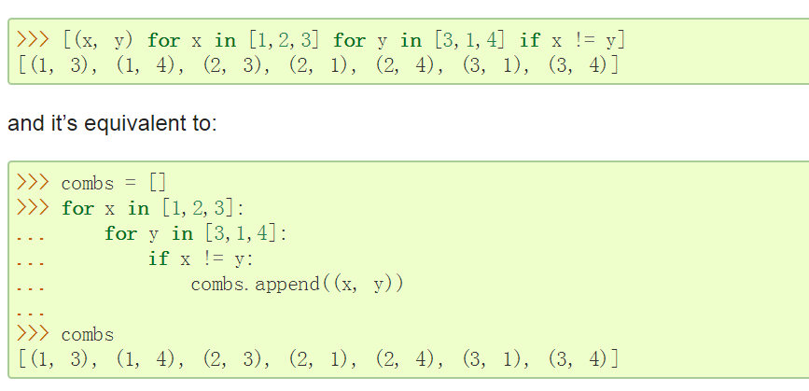
数据结构

Slide 11
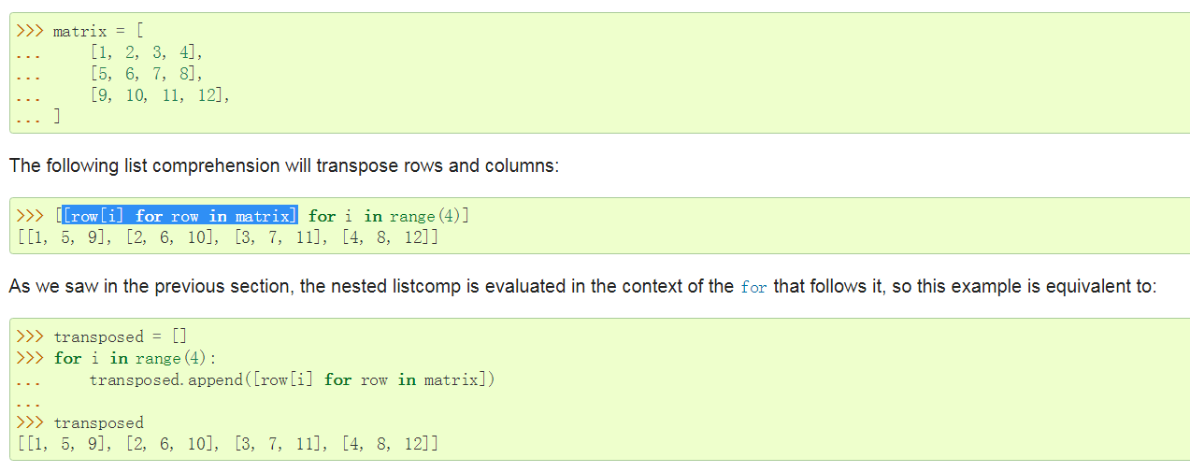
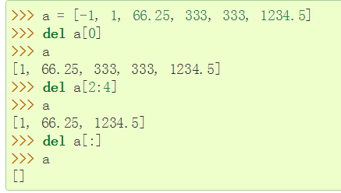

Slide 12
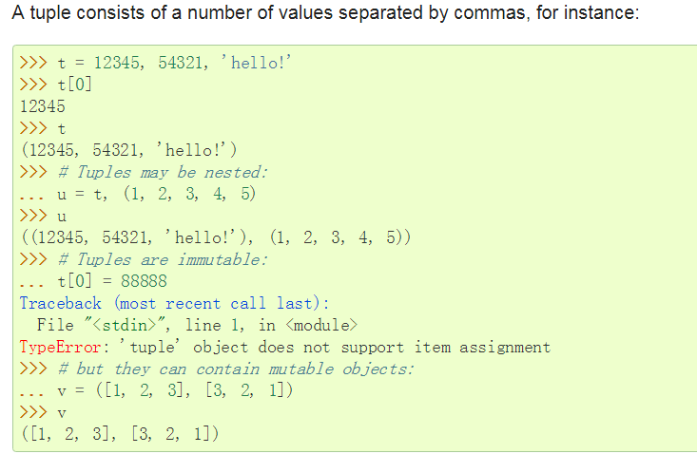

Slide 13
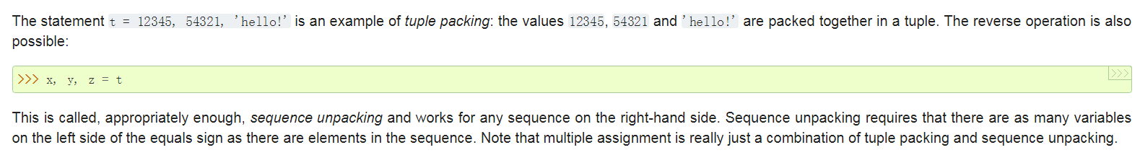
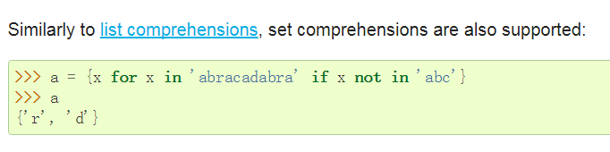
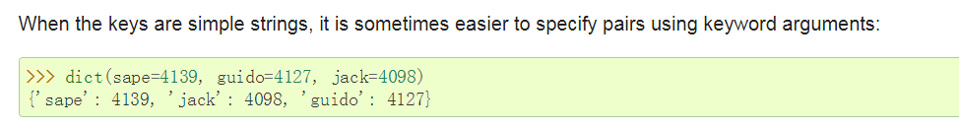
to create an empty set you have to use set(), not {}; the latter creates an empty dictionary

Slide 14
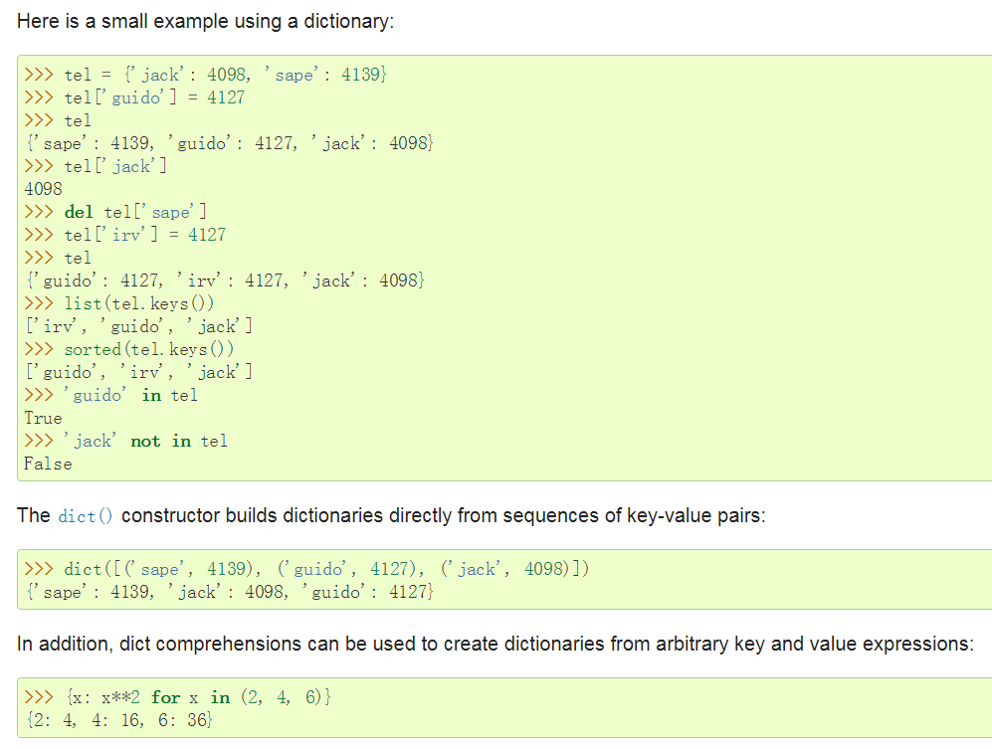
Key 必须是immutable

Slide 15
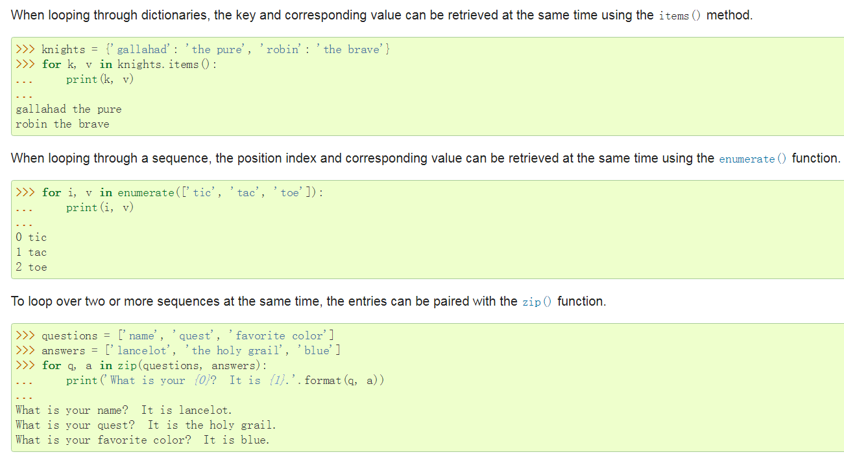

Slide 16
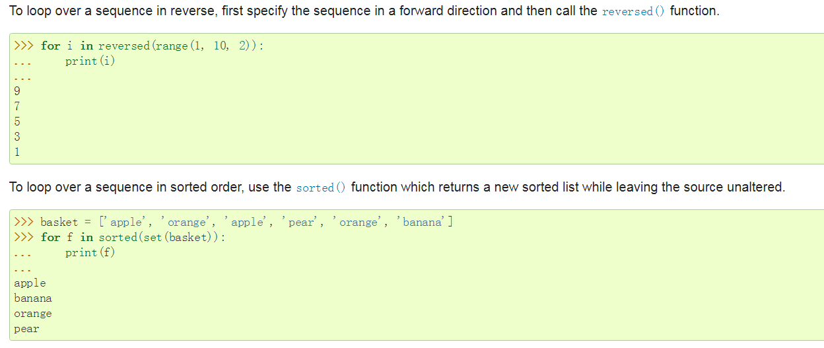
unlike C, assignment cannot occur inside expressions

Slide 17
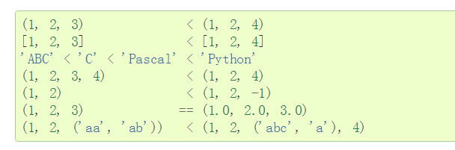
Sequence objects may be compared to other objects with the same sequence type. The comparison uses lexicographical ordering:

Slide 18
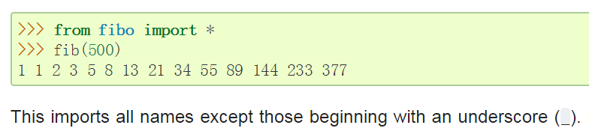
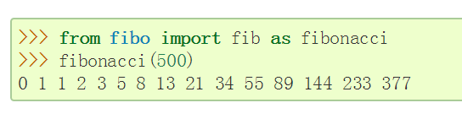
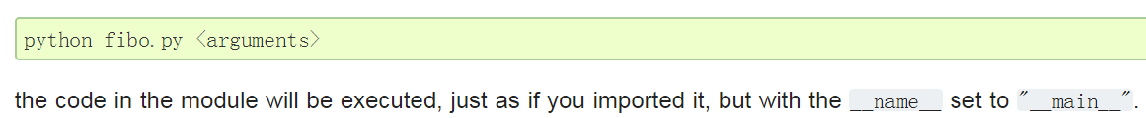
Modules
the module’s name (as a string) is available as the value of the global variable __name__.
The imported module names are placed in the importing module’s global symbol table.

Slide 19
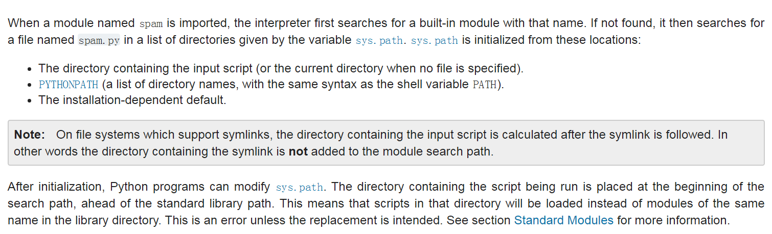
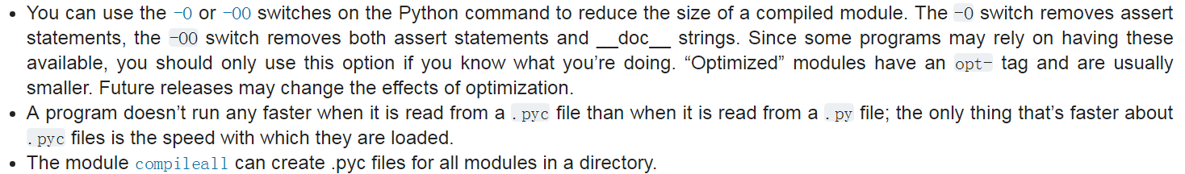

Slide 20
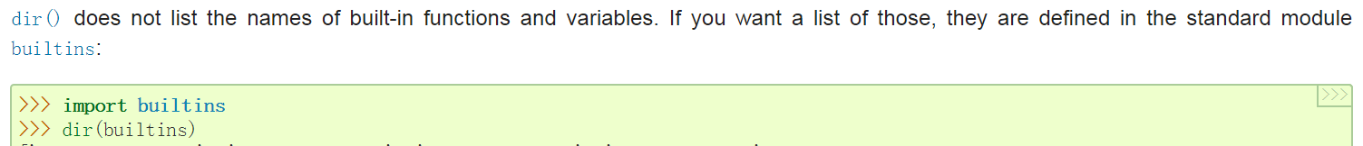
The built-in function dir() is used to find out which names a module defines. It returns a sorted list of strings
Without arguments, dir() lists the names you have defined currently
包
The __init__.py files are required to make Python treat the directories as containing packages

Slide 21
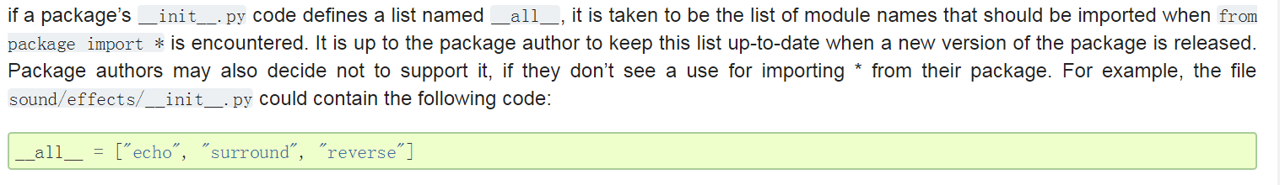
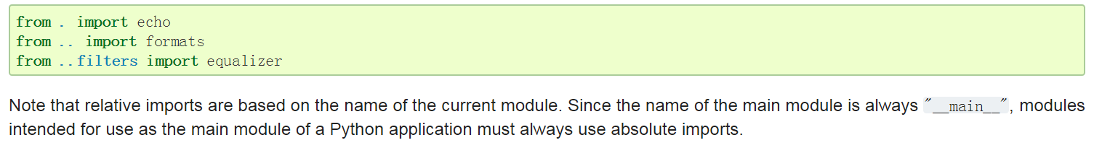

Slide 22
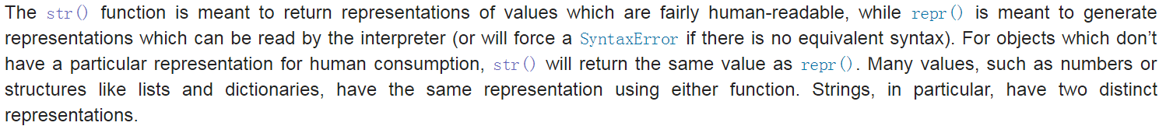
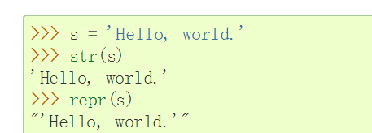
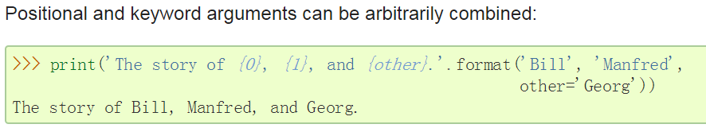
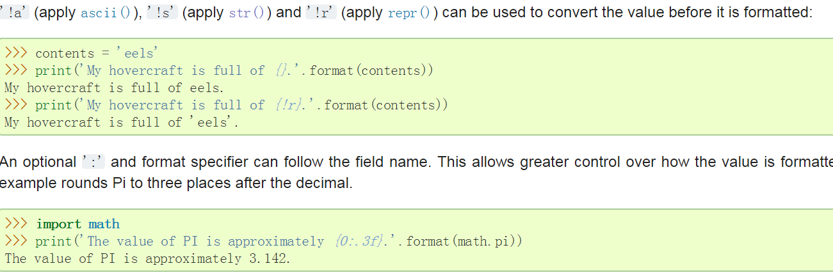
Input and Output

Slide 23
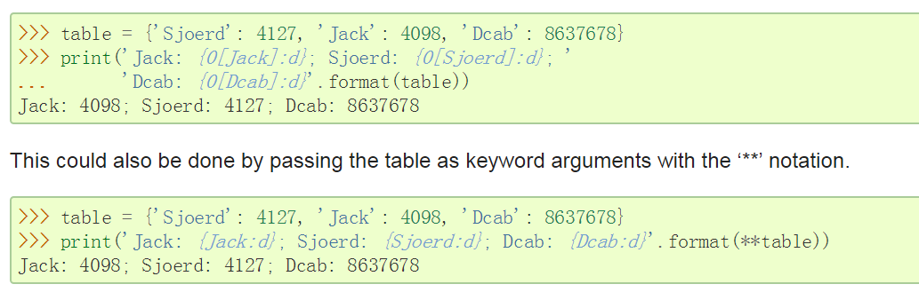
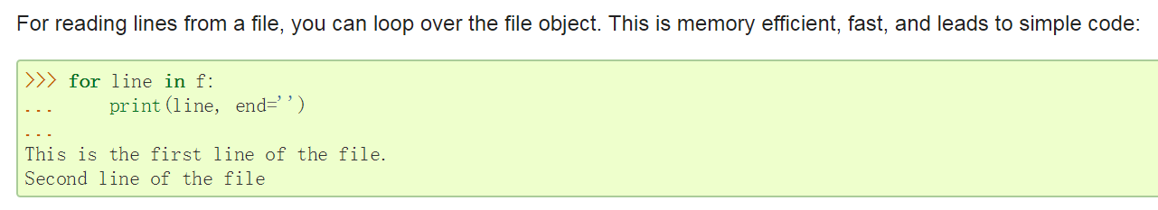

Slide 24
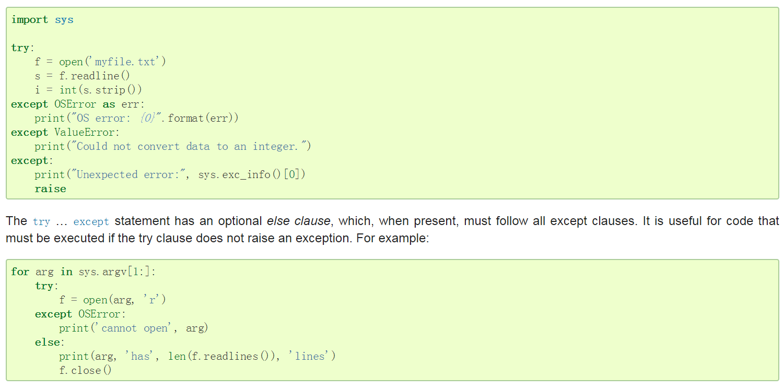
Errors and Exceptions

Slide 25
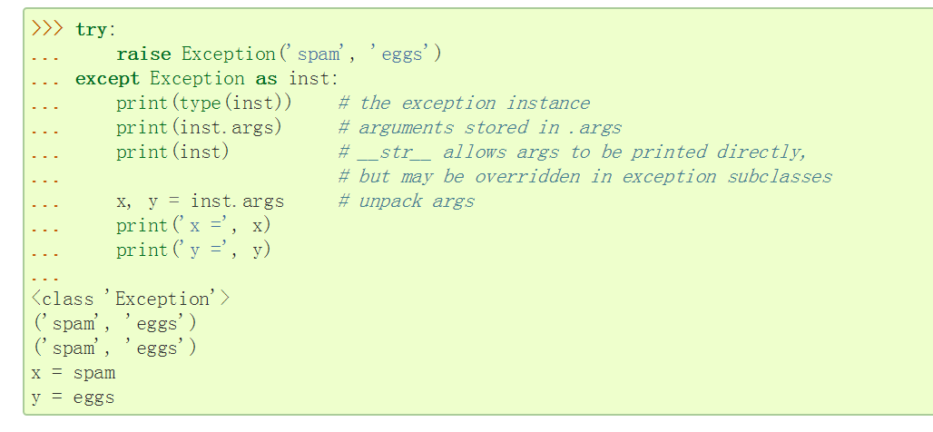
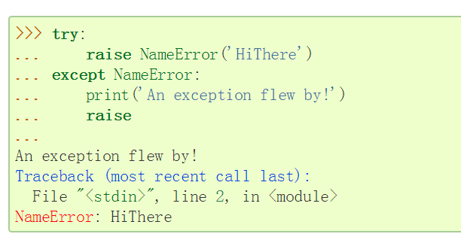

Slide 26
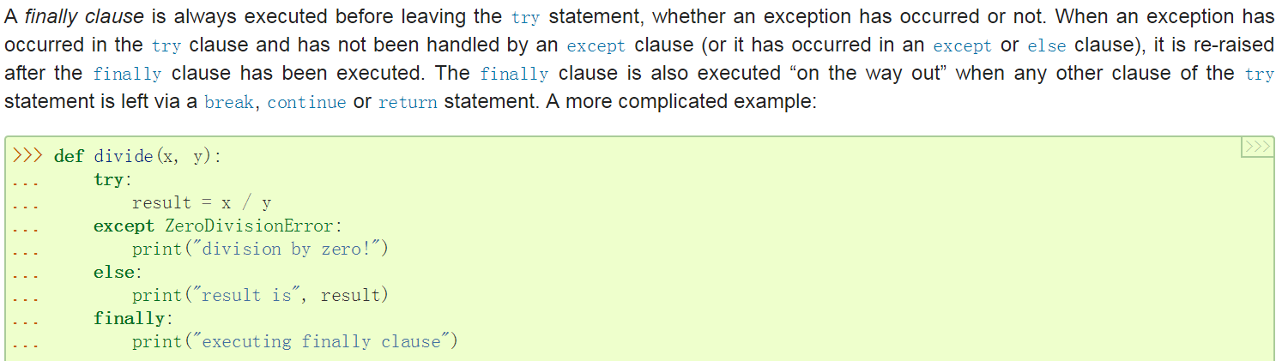
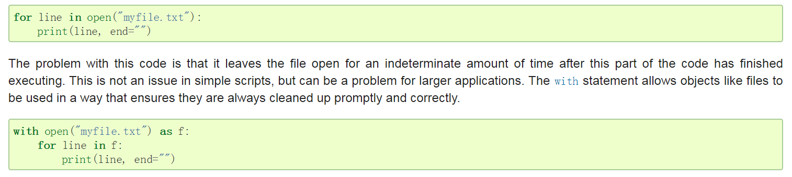

Slide 27
类
A namespace is a mapping from names to objects. Most namespaces are currently implemented as Python dictionaries
The local namespace for a function is created when the function is called, and deleted when the function returns or raises an exception that is not handled within the function.
A scope is a textual region of a Python program where a namespace is directly accessible. “Directly accessible” here means that an unqualified reference to a name attempts to find the name in the namespace.
If a name is declared global, then all references and assignments go directly to the middle scope containing the module’s global names. To rebind variables found outside of the innermost scope, the nonlocal statement can be used; if not declared nonlocal, those variables are read-only (an attempt to write to such a variable will simply create a new local variable in the innermost scope, leaving the identically named outer variable unchanged).（看文档吧，挺复杂的）

Slide 28
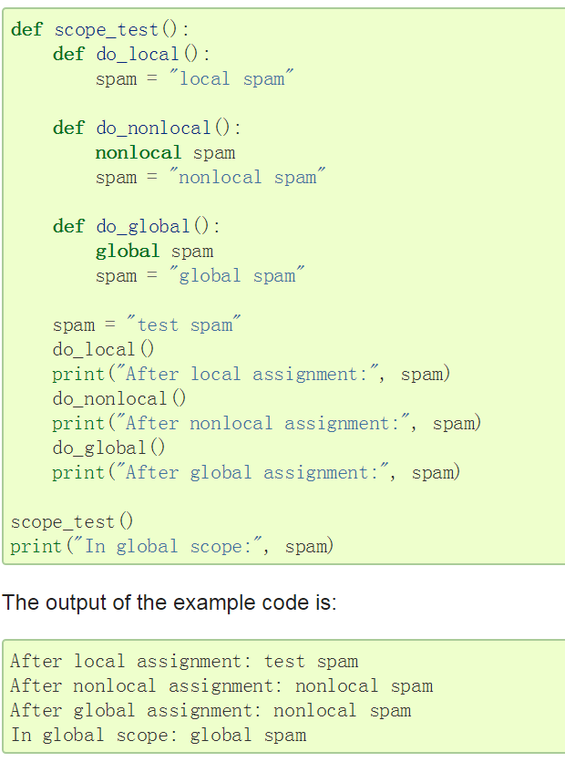

Slide 29
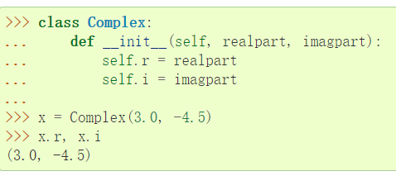
When a class definition is entered, a new namespace is created, and used as the local scope — thus, all assignments to local variables go into this new namespace. In particular, function definitions bind the name of the new function here.
When a class definition is left normally (via the end), a class object is created.
the class object is bound here to the class name
Class objects support two kinds of operations: attribute references and instantiation.
When a class defines an __init__() method, class instantiation automatically invokes __init__() for the newly-created class instance.

Slide 30
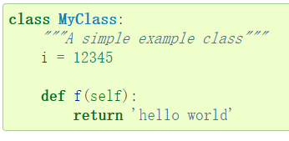
like local variables, they spring into existence when they are first assigned to.
But x.f is not the same thing as MyClass.f — it is a method object, not a function object.
the call x.f() is exactly equivalent to MyClass.f(x).
When an instance attribute is referenced that isn’t a data attribute, its class is searched. If the name denotes a valid class attribute that is a function object, a method object is created by packing (pointers to) the instance object and the function object just found together in an abstract object: this is the method object. When the method object is called with an argument list, a new argument list is constructed from the instance object and the argument list, and the function object is called with this new argument list.

Slide 31
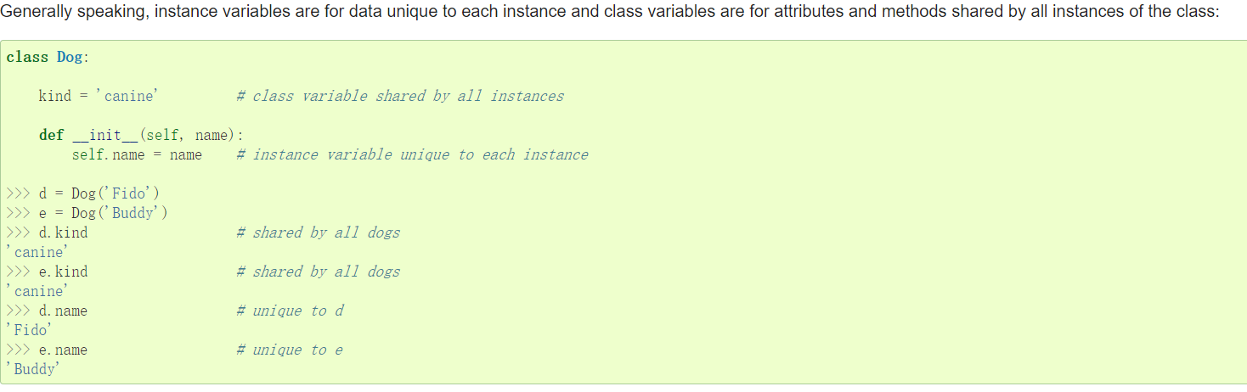
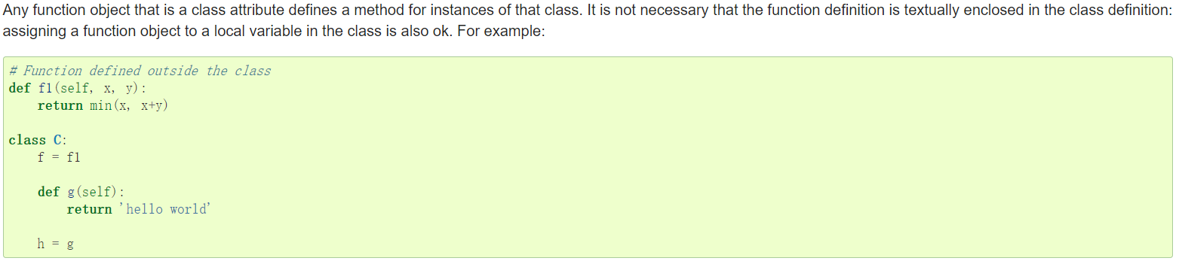

Slide 32

Each value is an object, and therefore has a class (also called its type). It is stored as object.__class__.
C++ programmers: all methods in Python are effectively virtual
Python has two built-in functions that work with inheritance:
Use isinstance() to check an instance’s type: isinstance(obj, int)
will be True only if obj.__class__ is int or some class derived from int.
Use issubclass() to check class inheritance: issubclass(bool, int) is True since bool is
a subclass of int. However, issubclass(float, int) is False since float is not a subclass
of int.

Slide 33

Instance method objects have attributes, too: m.__self__ is the instance object with the method m(), and m.__func__ is the function object corresponding to the method.

Slide 34


Slide 35


Slide 36


