Slide 1

What business to set-up in which part of the world ?
Don’t worry we will tell you ☺

Slide 2
Problem
You own a big multi-national company
You want to set-up in foreign markets
But you don’t know the cultural differences and the local customs

Slide 3
Inputs
You need to come with a list to city you consider investing in
For this study, we compared various cities mainly in Europe but also in the Middle-East
'Bayonne', 'Biarritz', 'Anglet', 'Bordeaux', 'Istanbul',
'London', 'Ankara', 'Bilbao', 'Barcelone', 'Birmingham',
'Dublin', 'Abu Dhabi', 'Dubai', 'Roma', 'Milan',
'Berlin', 'Zagreb', 'Budapest'

Slide 4
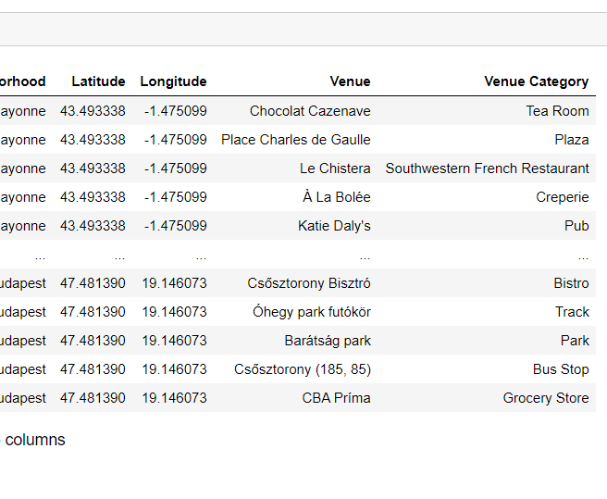
Data
We will be using the Foursquare API:
https://api.foursquare.com/v2/venues/explore?
It returns all the venues by city

Slide 5
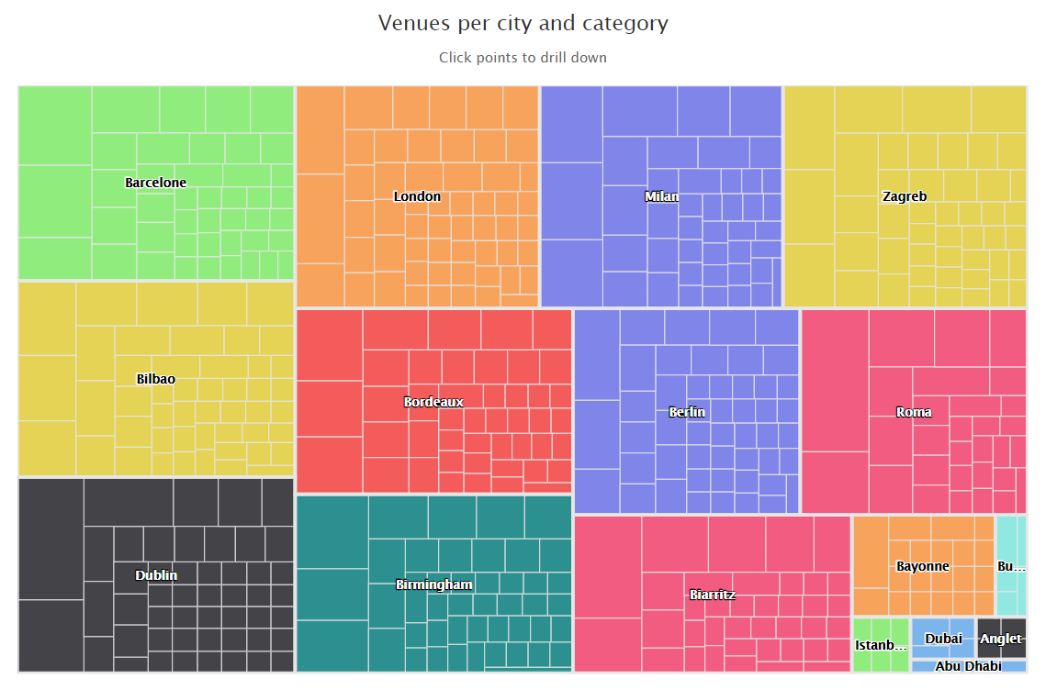
Data exploratory
Get the number of venues by city
Get the most common venues
Group the venues
Be able to drilldown and zoom

Slide 6
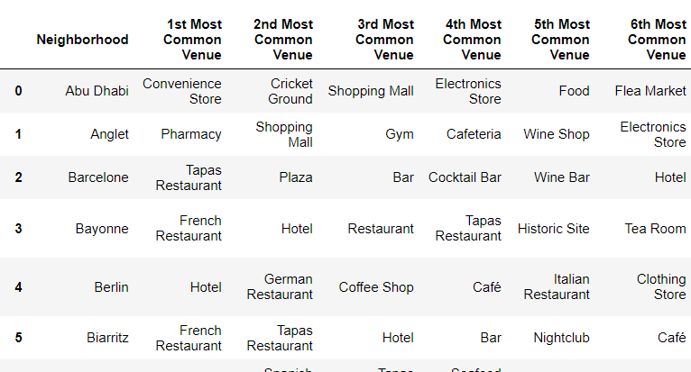
Data transformation and ML model
One hot-encoding
K-mean with 10 clusters based on the most common venues per city

Slide 7
Choice of the k-mean
lets you decide the number of cluster,
relatively simple to understand,
scales to large data sets,
guarantees convergence,
can warm-start the positions of centroids,
easily adapts to new examples,
generalizes to clusters of different shapes and sizes, such as elliptical clusters.

Slide 8
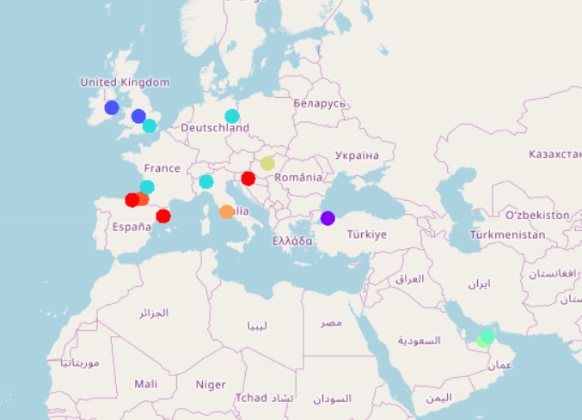
Results
When plotting the results on the map, we found out that the clusters were grouped according to their geography.
This is amazing because it emphasizes the cultural difference.
Mediterranean countries such as Spain, France, Italy have a great number of restaurants but Rome is specific with a lot
of historic sites.
Arabic countries have a lot of convenience stores and fat food (fast-food, yoghurt shops etc).
Northern countries have pubs, bars and live-music.
Capitals have more hotels and smaller town are more healthy with many gyms and pharmacies.

