Slide 1
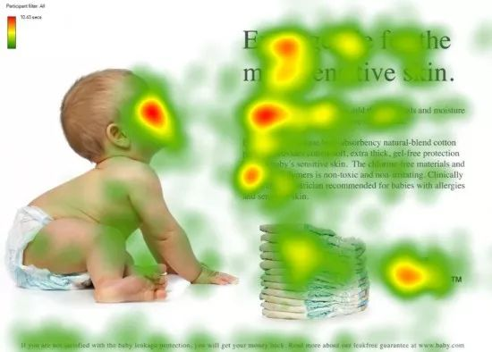
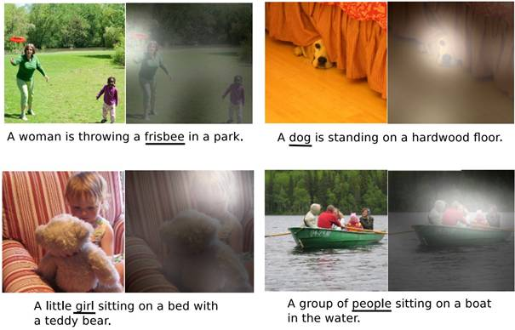
The origin and applications of Attention Mechanism

Slide 2
Which of the following statement about the mechanism of attention is true?
The real starting point for the mechanism of attention as we know it today is the field of computer vision
The structural model based on attention mechanism can only record the location relationship between information
It is in confrontation that the advantages of attention are initially realized
As attention techniques have improved, they have become increasingly popular for all kinds of tasks

