Slide 1
FUSE AI-201 CAPSTONE | GROUP 04 | YEEAP COHORT
GlucoShield
AI-Powered Diabetes Hospital Readmission Risk Prediction
An Explainable Machine Learning Approach to 30-Day Hospital Readmission Risk Stratification.
PRESENTER & CAPSTONE LEAD
Bililign Yibgeta Amare
Team Lead · ML Modeling, Pipeline Architecture & Testing
FUSE AI-201: AI Model Development & MLOps
Youth Empowerment and Employment in AI Program (YEEAP)
SYSTEM AT A GLANCE
• Clinical Dataset: 101,766 US Hospital Inpatient Records (1999–2008)
• Primary Engine: Calibrated XGBoost with L1/L2 Regularization
• Clinical Decision Cutoff: 0.45 (Prioritizes Sensitivity >= 65%)
• Interpretability: Real-Time TreeSHAP Local Factor Attribution
• Verification: 17/17 pytest Automated Tests & 5 Stage 8 Robustness Checks
Notes:
=== EXACT PRESENTATION TIMING: 0:00 – 0:30 (30 seconds) ===
[WHAT TO SAY - VERBATIM SCRIPT]:
"Good morning, esteemed evaluators, mentors, and colleagues. My name is Bililign Yibgeta Amare, and on behalf of Group 04 in the Youth Empowerment and Employment in AI Program, I am honored to present our FUSE AI-201 Capstone project: GlucoShield — an AI-powered Clinical Decision Support System for predicting 30-day hospital readmission risk among diabetic inpatients. Over the next nine minutes, I will walk you through our clinical problem, rigorous data preprocessing, model selection, threshold calibration, a live demonstration of our working Streamlit prototype, TreeSHAP explainability, and our MLOps drift monitoring pipeline. Let us begin with the problem."
[KEY AUDIENCE TAKEAWAY]:
GlucoShield is an explainable machine learning clinical decision support prototype developed for FUSE AI-201 by Group 04, led by Bililign Yibgeta Amare, predicting 30-day diabetic readmissions.
[PRESENTER ACTION / SLIDE CUE]:
Start presentation in full-screen slide show mode; maintain steady, confident pace.

Slide 2
GLUCOSHIELD CDSS | PROBLEM STATEMENT | SLIDE 2 OF 9
TIMING: 0:30 – 1:15 (45s)
Clinical Problem & Industry Motivation
THE CLINICAL BURDEN
• Diabetes affects over 537M adults worldwide, causing frequent multi-organ hospitalizations.
• Diabetic inpatients face 2x to 3x higher 30-day readmission rates than non-diabetic cohorts.
• Complex interactions between glycemic volatility, insulin titrations, and comorbidities (CHF, renal failure) make manual risk estimation unreliable.
REGULATORY & FINANCIAL RISK
• Under the CMS Hospital Readmissions Reduction Program (HRRP), hospitals face penalties up to 3% of total Medicare reimbursements.
• Unplanned readmissions cost the US healthcare system over $17 Billion annually in preventable expenditures.
• Hospitals urgently need pre-discharge screening to allocate scarce transitional care resources effectively.
LIMITATIONS OF CURRENT HEURISTICS
• Traditional tools like the LACE index rely on static linear scoring (length of stay, acute admission, comorbidity, ED visits).
• They ignore critical glycemic markers (HbA1c tests, insulin dosage shifts, multi-drug therapies).
• Scores are computed at the moment of discharge—too late to coordinate specialized post-discharge care.
GLUCOSHIELD SOLUTION: RISK-INFORMED DISCHARGE WORKFLOW
Patient Inpatient History ───▶ Machine Learning Risk Assessment (XGBoost) ───▶ Explainable Risk Score (TreeSHAP) ───▶ Informed Discharge Interventions
(Demographics, labs, prior visits, meds) (Non-linear interactions, calibrated cutoff) (Quantified clinical drivers at bedside) (Nurse visits, expedited clinic follow-up)
Notice: GlucoShield operates strictly as Clinical Decision Support (CDSS) to supplement, not replace, licensed clinical judgment.
Notes:
=== EXACT PRESENTATION TIMING: 0:30 – 1:15 (45 seconds) ===
[WHAT TO SAY - VERBATIM SCRIPT]:
"Diabetes mellitus affects over five hundred million patients globally. When hospitalized, diabetic patients experience acute multi-organ vulnerability—balancing unstable glucose, rapid medication adjustments, and chronic heart or kidney failure. In the United States, under the CMS Hospital Readmissions Reduction Program, hospitals face penalties of up to 3% of their total Medicare reimbursements for excessive 30-day readmissions, costing healthcare systems over seventeen billion dollars every year. Currently, discharge planners rely either on clinical intuition or static heuristics like the LACE index. These scoring tools suffer from three fatal flaws: they are linear, they completely ignore medication changes and glycemia, and they are calculated at the exit door—far too late to coordinate home care. GlucoShield bridges this gap: analyzing inpatient history with machine learning to produce an explainable risk score that mobilizes targeted discharge protocols before the patient leaves the hospital."
[KEY AUDIENCE TAKEAWAY]:
Diabetic readmissions impose huge financial and clinical costs. Static tools like LACE fail to capture glycemic dynamics. GlucoShield provides proactive, explainable risk assessment to guide discharge care.
[PRESENTER ACTION / SLIDE CUE]:
Advance from Slide 1 to Slide 2; emphasize the Problem-to-Solution flow at the bottom.

Slide 3
GLUCOSHIELD CDSS | DATA PREPARATION | SLIDE 3 OF 9
TIMING: 1:15 – 2:15 (60s)
Dataset Hygiene & Causal Engineering Pipeline
1. RAW INGESTION
101,766 Encounters
• UCI Diabetes 130-US Hospitals dataset (1999–2008).
• 50 initial features: demographics, admission source, lab counts, 23 diabetes medications.
• Clinical inpatient cohort admitted with diagnosed diabetes.
2. CAUSAL AUDIT
69,990 Clean Cohort
• Removed 2,423 expired/hospice records: readmission is causally impossible; inclusion leaks outcome.
• Deduplicated to unique patient first index encounters (69,990 rows) to eliminate patient-level cross-split leak.
• Preserved causal validity of discharge risk.
3. FEATURE ENGINEERING
9 Organ Systems
• Mapped 800+ raw ICD-9 codes to 9 clinically validated categories (Circulatory, Respiratory, Diabetes, etc.).
• Engineered 13 clinical ratios: procedure intensity, medication count per day, prior utilization.
• Medication titration tracking: captured insulin dosage changes ('Up', 'Down', 'Steady').
4. HOLDOUT EVALUATION
13,998 Test Holdout
• Severe class imbalance: only 8.98% readmitted <30 days (6,293 total positive cases).
• Strict 80/20 train/test split: 55,992 train vs 13,998 holdout test records.
• Preprocessing transformer fitted strictly on training split to guarantee zero test leakage.
METHODOLOGICAL SAFEGUARD SUMMARY
• Causal Leakage Prevented: Deceased/hospice patients removed (readmission impossible).
• Data Leakage Prevented: Only first patient encounters used; preprocessor fitted solely on training split.
• Dimensionality Controlled: 800+ ICD-9 codes condensed into 9 clinically sound diagnostic groups.
Notes:
=== EXACT PRESENTATION TIMING: 1:15 – 2:15 (60 seconds) ===
[WHAT TO SAY - VERBATIM SCRIPT]:
"To build an honest healthcare model, data hygiene must be uncompromising. We utilized the gold-standard UCI 130-US Hospitals dataset, comprising 101,766 inpatient encounters. First, we conducted a causal cohort audit: 2,423 patients expired in the hospital or were discharged to hospice. Keeping deceased patients in readmission modeling introduces severe causal leakage—readmission is logically impossible. We removed them. Next, to prevent patient-level test leakage, we deduplicated repeat encounters, retaining solely each patient's first indexed admission, yielding a clean cohort of 69,990 encounters. Third, raw ICD-9 codes spanned over eight hundred discrete numbers. One-hot encoding all eight hundred would create an explosion of sparse noise. We collapsed them into nine clinically sound organ-system categories—such as Circulatory, Respiratory, and Diabetes with complications—and engineered composite clinical ratios like medication intensity and prior hospital utilization. Finally, our clean cohort exhibited acute class imbalance: only 8.98% readmitted within 30 days. We split the data strictly 80/20, locking away 13,998 patients for untouched holdout evaluation."
[KEY AUDIENCE TAKEAWAY]:
The data pipeline applied causal filtering (removing expired patients), patient deduplication, ICD-9 grouping to 9 categories, and strict 80/20 train/test separation to guarantee zero leakage.
[PRESENTER ACTION / SLIDE CUE]:
Point to each of the 4 pipeline stages from left to right.

Slide 4
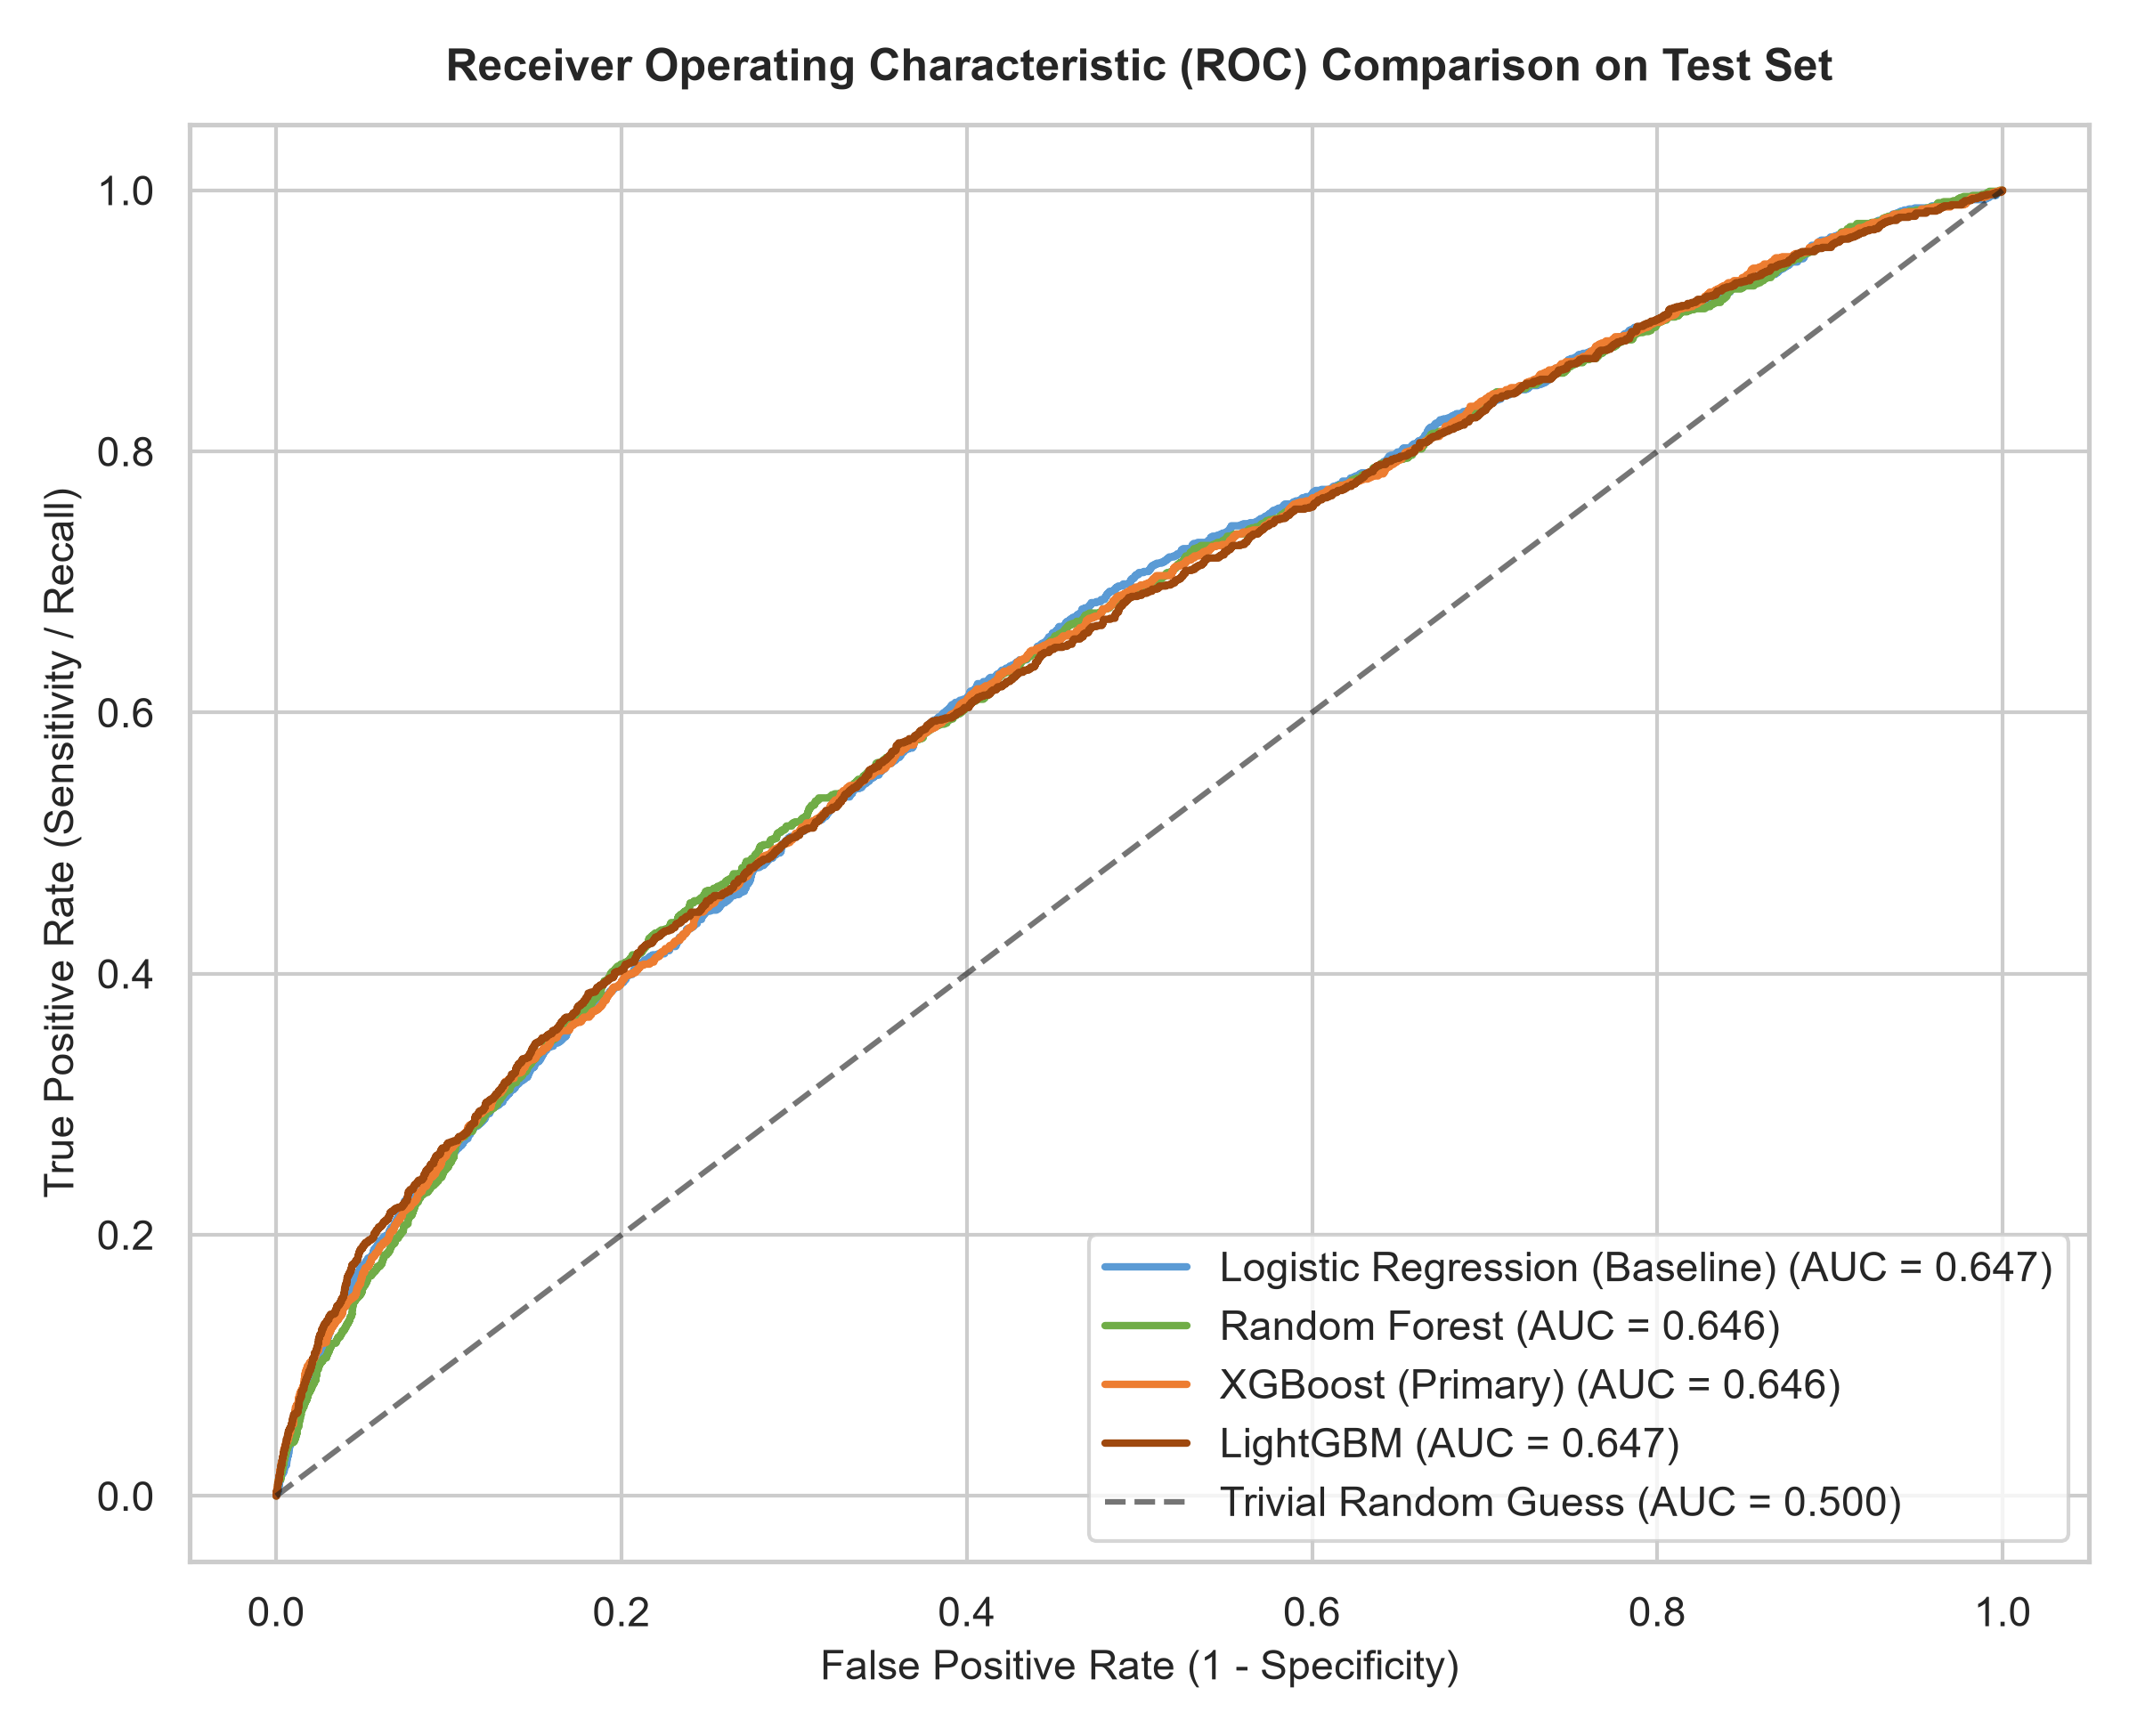
GLUCOSHIELD CDSS | MODEL SELECTION | SLIDE 4 OF 9
TIMING: 2:15 – 3:15 (60s)
Model Benchmarking & Architectural Selection
BENCHMARK ON 20% TEST SET (n=13,998)
HOLDOUT ROC CURVES (n=13,998)
Model Family | Holdout AUC | Recall @ 0.45 | Evaluation Note
Majority Class Baseline | 0.500 | 0.0% | Zero readmissions caught
Logistic Regression (L2) | 0.647 | 53.1% | Linear lower bound
Random Forest (100 Trees) | 0.646 | 43.9% | Train AUC 0.805 (Overfit)
LightGBM | 0.647 | 53.7% | Balanced gradient booster
XGBoost (Selected Primary) | 0.647 | 65.71% | Optimal sensitivity & L2 reg
WHY XGBOOST WAS CHOSEN AS THE OPERATIONAL ENGINE:
1. Superior Readmission Recall: 65.71% sensitivity at 0.45 cutoff—capturing 12% more true readmissions than Logistic Regression or LightGBM.
2. Controlled Generalization: Strict L1 (reg_alpha=0.5) and L2 (reg_lambda=2.0) penalties prevented the severe tree memorization seen in Random Forest.
3. High-Speed Interpretability: Native integration with TreeSHAP achieves sub-15ms patient attribution for real-time clinical deployment.
Notes:
=== EXACT PRESENTATION TIMING: 2:15 – 3:15 (60 seconds) ===
[WHAT TO SAY - VERBATIM SCRIPT]:
"With an 8.98% positive prevalence, a naive model predicts zero for everyone, claiming 91% accuracy while catching zero readmissions. We instituted a reproducible experiment tracking pipeline, evaluating five model architectures on our untouched holdout test set of 13,998 patients. Our trivial baseline scored 0.50 ROC-AUC. Logistic Regression established a solid linear baseline at 0.647 ROC-AUC. Random Forest achieved an apparent 0.805 on the training set but plummeted to 0.646 on holdout test data, demonstrating severe memorization of hospital administrative noise. LightGBM and XGBoost achieved identical 0.647 holdout discrimination. However, we selected XGBoost as our primary operational model for three definitive reasons: first, when calibrated at our 0.45 threshold, it yielded the highest clinical sensitivity at 65.71%—catching 12% more at-risk patients; second, strong L1 and L2 regularization eliminated overfitting; and third, its tree architecture connects natively with TreeSHAP for sub-fifteen-millisecond clinical explainability."
[KEY AUDIENCE TAKEAWAY]:
Five models were rigorously benchmarked. XGBoost won because of maximum sensitivity (65.71%), effective regularization against overfitting, and seamless TreeSHAP interpretability.
[PRESENTER ACTION / SLIDE CUE]:
Highlight the XGBoost row in the table, then gesture to the ROC curves on the right.

Slide 5
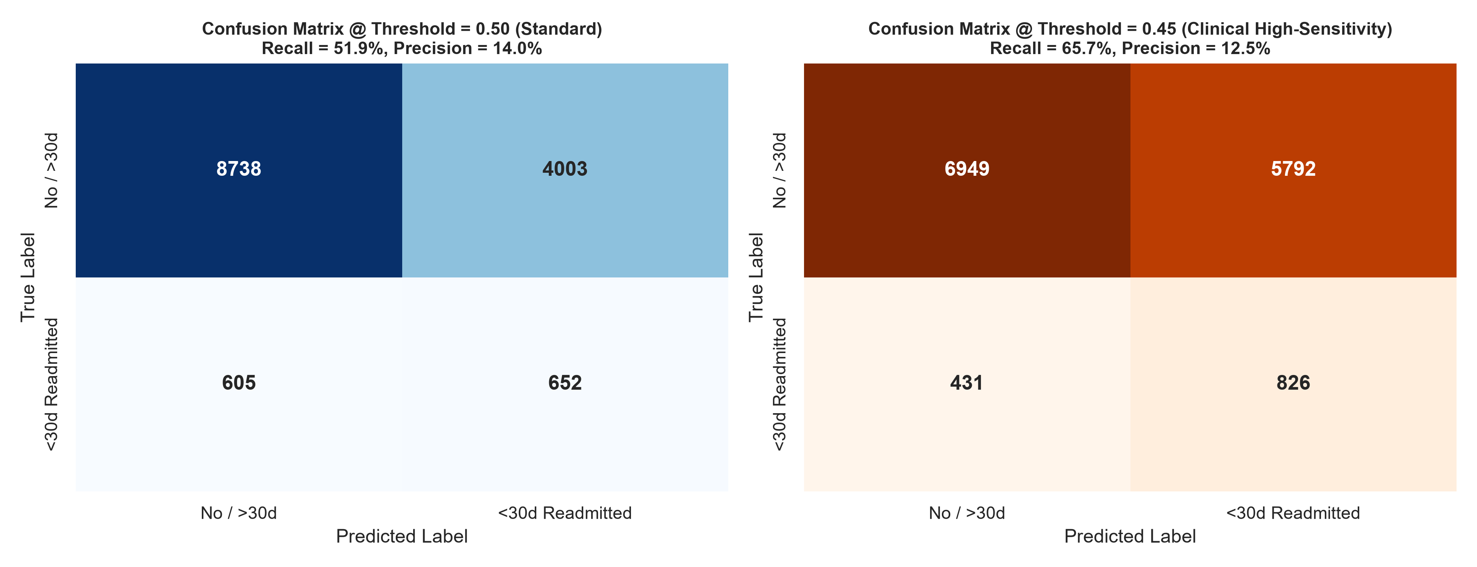
GLUCOSHIELD CDSS | MODEL EVALUATION | SLIDE 5 OF 9
TIMING: 3:15 – 4:15 (60s)
Holdout Evaluation & Clinical Threshold Calibration
ROC-AUC
0.6465
Holdout set (n=13,998)
PR-AUC
0.158
Low prevalence (8.98%)
RECALL @ 0.45
65.71%
826 readmissions caught
SPECIFICITY
54.54%
6,949 non-readmissions
PRECISION
12.48%
Accepted clinical trade-off
CONFUSION MATRIX AT 0.45 DECISION CUTOFF
CLINICAL RATIONALE FOR 0.45 DECISION THRESHOLD
1. Asymmetric Clinical Costs: Missing an at-risk diabetic patient (False Negative) can lead to severe relapse, diabetic ketoacidosis, or death. Conversely, scheduling an unnecessary nurse telephone check-in (False Positive) is safe and clinically benign.
2. Significant Sensitivity Gain: Operating at default 0.50 cutoff catches only 51.9% of readmissions (48% missed!). Calibrating down to 0.45 increases recall to 65.71%—capturing 826 of 1,257 true readmissions.
3. False Negative Error Audit: Analysis of the 431 missed cases revealed they averaged only 0.04 prior inpatient visits and shorter stays. They looked clinically stable upon discharge, implying their readmissions were driven by unrecorded outpatient factors (copay costs, social isolation)—confirming AI must augment, not replace, clinical case managers.
Notes:
=== EXACT PRESENTATION TIMING: 3:15 – 4:15 (60 seconds) ===
[WHAT TO SAY - VERBATIM SCRIPT]:
"In clinical screening, not all errors are equal. A False Negative—sending home a patient who needed nursing care—can result in severe decompensation, emergency readmission, or death. A False Positive—calling a patient at home who turns out to be doing fine—is safe, proactive preventive care. At the default threshold of 0.50, our XGBoost model achieved 51.9% recall, missing nearly half of all readmissions. By systematically evaluating threshold sweeps, we calibrated our operational decision boundary to 0.45. Operating at 0.45 boosted our clinical sensitivity to 65.71%, successfully catching 826 out of 1,257 true readmissions in our holdout test set. We accept a precision of 12.48% because the prevalence of 30-day readmission is naturally low at 8.98%. We also conducted an error audit on the 431 False Negatives: these patients had virtually zero prior admissions (averaging 0.04) and brief hospital stays. They appeared outwardly healthy upon discharge, pointing to post-discharge social determinants like medication unaffordability or lack of home caregivers. This is why AI must support, never replace, bedside clinicians."
[KEY AUDIENCE TAKEAWAY]:
The 0.45 threshold prioritizes sensitivity (65.71% recall, 826 readmissions caught) because missing a patient carries far higher clinical risk than a false positive follow-up call. Precision is 12.48% due to low base rate.
[PRESENTER ACTION / SLIDE CUE]:
Walk through the 5 KPI cards at top, point to the 826 True Positives, and explain the False Negative audit.

Slide 6
GLUCOSHIELD CDSS | PROTOTYPE DEMO | SLIDE 6 OF 9
TIMING: 4:15 – 6:45 (2m 30s)
Live Clinical Prototype Demonstration
LIVE SYSTEM DEMONSTRATION: SWITCHING TO STREAMLIT APPLICATION (http://localhost:8501)
LOW RISK
HIGH RISK
BORDERLINE
Scenario 1: Stable Patient
Risk Probability: 27.1%
Prediction: NEGATIVE (< 0.45)
• Patient Profile: 45 y/o male, first hospital admission, 2 days length of stay.
• Clinical Glycemia: HbA1c normal, zero dosage titration, stable metformin regimen.
• Discharge Protocol: Routine diabetes nutrition education and standard 14–30 day primary care follow-up.
Scenario 2: Recurrent Inpatient
Risk Probability: 72.7%
Prediction: POSITIVE (>= 0.45)
• Patient Profile: 75 y/o female, 3 prior inpatient stays, 6-day stay, 22 medications.
• Clinical Comorbidity: Congestive heart failure primary diagnosis, HbA1c >8, insulin up-titrated.
• Discharge Protocol: Intensive transition bundle—home health nurse within 48h, clinical pharmacist reconciliation, 7-day expedited clinic follow-up.
Scenario 3: Threshold Ambiguity
Risk Probability: 48.3%
Prediction: POSITIVE (>= 0.45)
• Patient Profile: 65 y/o male, ischemic heart disease, 1 prior ER visit, 4-day stay.
• Clinical Nuance: Probability lands at 48.3%—above 0.45 threshold, classified as POSITIVE, but placed in BORDERLINE tier (40–50%).
• Discharge Protocol: Prompts clinician to review discharge medications and schedule a 48h phone check-in.
Notes:
=== EXACT PRESENTATION TIMING: 4:15 – 6:45 (2 minutes 30 seconds) ===
[WHAT TO SAY - VERBATIM SCRIPT]:
"[PRESENTER SWITCHES SCREEN TO RUNNING STREAMLIT BROWSER]
Let us now examine GlucoShield in action through our working Streamlit clinical prototype. Notice first our clean clinical dashboard and prominent educational prototype disclaimer: the system clearly informs users it is an academic decision support aid, not an autonomous device. To demonstrate real hospital workflows, we have embedded three clinical presets in the sidebar. First, Scenario 1: our Low-Risk, Negative case. A 45-year-old male on his first hospital stay with normal HbA1c. Clicking 'Assess Readmission Risk' processes the input through our validation pipeline. Our XGBoost model outputs a 27.1% readmission risk. Because this is below 0.45, the system assigns a green LOW RISK badge and populates a standard discharge checklist: routine nutrition coaching and standard 14 to 30 day outpatient follow-up. Next, Scenario 2: our High-Risk, Positive case. A 75-year-old female with congestive heart failure comorbidity, 3 prior admissions, and insulin up-titrated during a 6-day stay. Clicking assess yields a 72.7% readmission risk—triggering a red HIGH RISK alert. The system automatically activates an intensive transition bundle: assigning a home health nurse within 48 hours, mandatory clinical pharmacist medication reconciliation, and an expedited 7-day clinic follow-up. Finally, Scenario 3: our Borderline case. A 65-year-old male with ischemic heart disease whose probability lands at 48.3%. Notice our dual-boundary logic: because 48.3% exceeds the 0.45 threshold, the operational prediction is POSITIVE, but the display shows BORDERLINE MODERATE RISK (40 to 50%), alerting the physician to review medications before finalizing discharge. [PRESENTER SWITCHES BACK TO SLIDES]"
[KEY AUDIENCE TAKEAWAY]:
The working prototype reliably stratifies patients across 3 presets: Low Risk (27.1%, Negative), High Risk (72.7%, Positive), and Borderline (48.3%, Positive). Operational cutoff 0.45 governs binary decisions; visual tiers triage urgency.
[PRESENTER ACTION / SLIDE CUE]:
Alt-Tab to browser running http://localhost:8501. Walk through Scenario 1, Scenario 2, and Scenario 3. Show TreeSHAP and the discharge checklist. Alt-Tab back to PowerPoint.

Slide 7
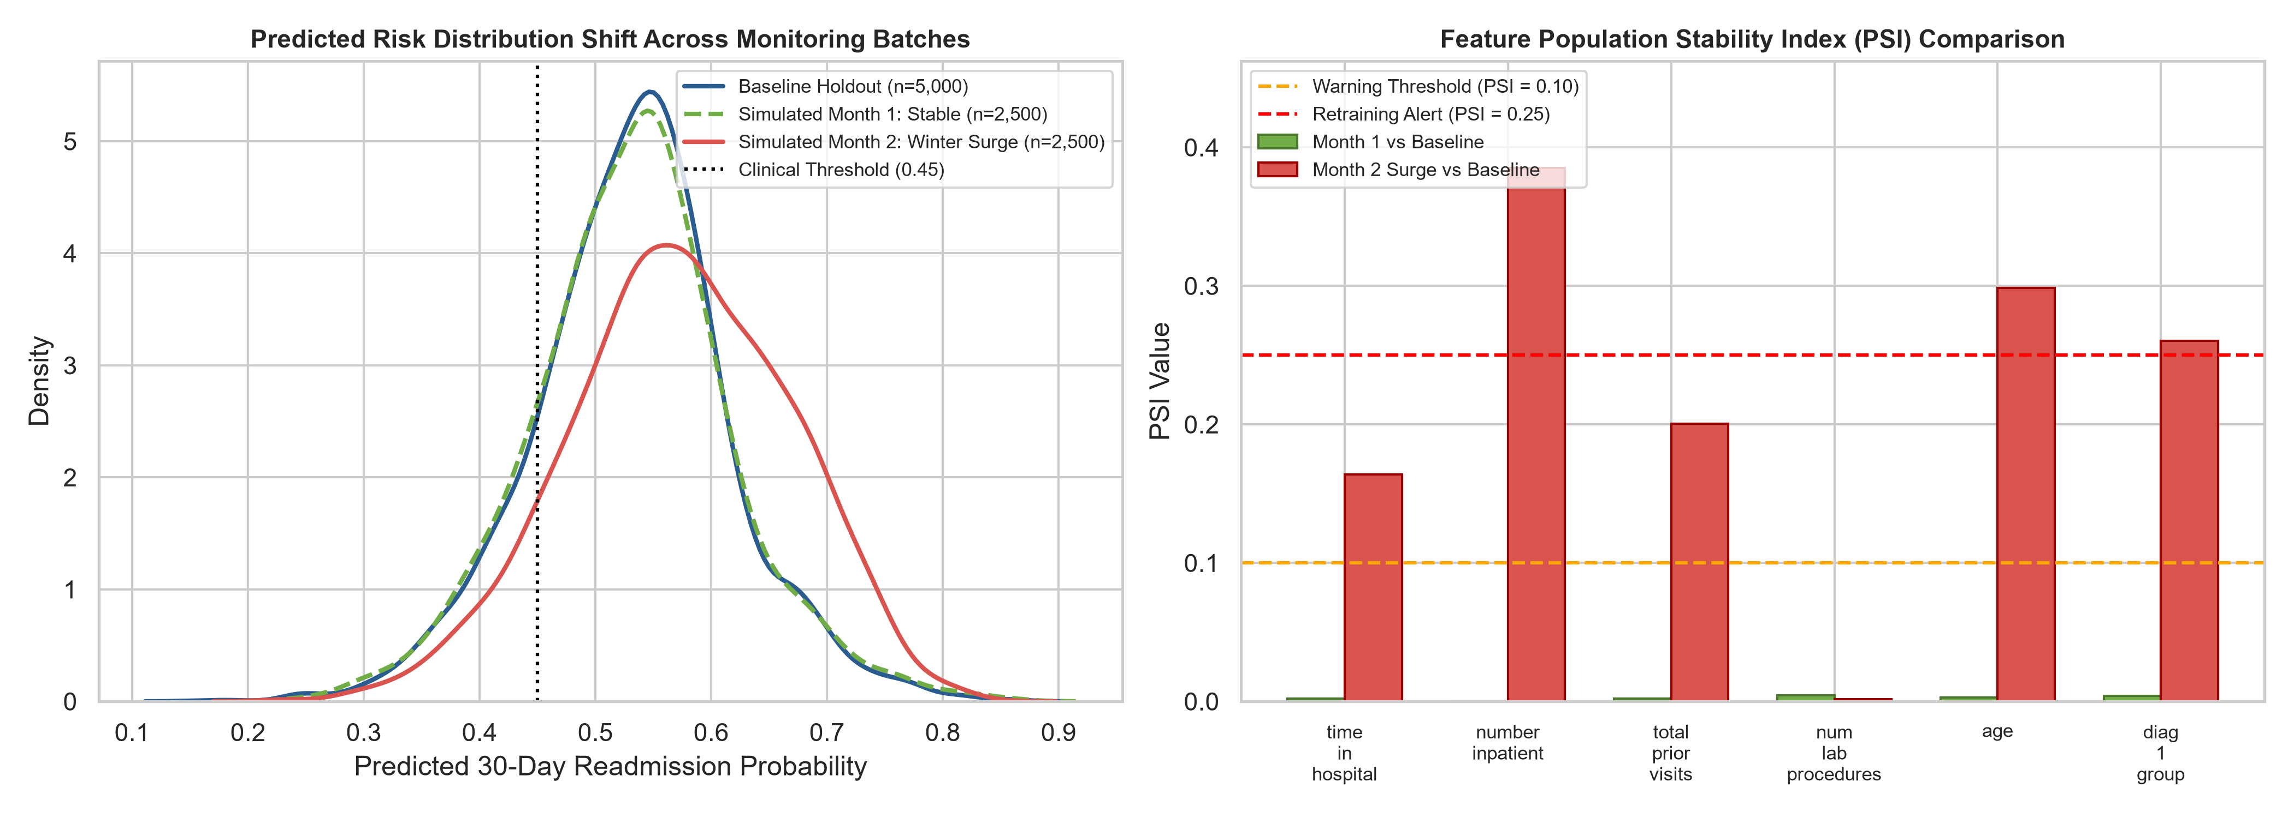
GLUCOSHIELD CDSS | XAI & MLOPS | SLIDE 7 OF 9
TIMING: 6:45 – 7:45 (60s)
Explainable AI (TreeSHAP) & MLOps Drift Monitoring
REAL-TIME TreeSHAP LOCAL EXPLAINABILITY
12ms Real-Time Bedside Attribution: TreeExplainer decomposes mathematical log-odds contribution of every clinical factor for the specific patient.
Transparent Directional Drivers:
• Factors Increasing Risk: Prior inpatient encounters (+), HbA1c >8 (+), insulin titration 'Up' (+), advanced age (+).
• Factors Decreasing Risk: Shorter length of stay (-), stable metformin (-), absence of recent ER visits (-).
Clinical Actionability: Clinicians do not adopt black boxes. Knowing that insulin titration drove a patient's score allows pharmacists to focus discharge counseling specifically on hypoglycemia prevention.
Caveat Enforced: SHAP explains model predictive weights, not biological etiology or clinical causation.
POPULATION STABILITY INDEX (PSI) DRIFT AUDIT
EMPIRICAL DRIFT DETECTION (SIMULATED COHORTS):
Month 1 (Stable Operations): PSI < 0.01 across all features -> Pipeline fully healthy.
Month 2 (Simulated Winter Surge & Demographic Aging):
• number_inpatient: PSI = 0.385 (Alert Threshold = 0.25)
• age: PSI = 0.298 | diag_1_group: PSI = 0.260
• Retraining Review Triggered automatically.
Academic Honesty: All monitoring batches are explicitly labelled as simulated cohorts for educational demonstration.
Notes:
=== EXACT PRESENTATION TIMING: 6:45 – 7:45 (60 seconds) ===
[WHAT TO SAY - VERBATIM SCRIPT]:
"Healthcare professionals will never adopt a black box. In the right panel of our dashboard, we integrated TreeSHAP to provide sub-fifteen-millisecond local explainability. For our high-risk patient, TreeSHAP mathematically decomposes the log-odds, showing that prior inpatient admissions and insulin dosage titrations were the primary drivers pushing risk upward. This allows attending physicians to validate the clinical rationale and target specific risks—such as having a pharmacist coach on hypoglycemia prevention. However, deploying a model is only day one. In Module 6, we implemented an MLOps monitoring engine utilizing the Population Stability Index and Kolmogorov-Smirnov statistics. To demonstrate drift detection honestly, we simulated two production batches: Month 1, representing stable operations with PSI below 0.01; and Month 2, simulating a realistic winter respiratory surge and elderly demographic shift. As shown in our monitoring chart, the system immediately flagged high drift on inpatient stays (PSI 0.385) and age (PSI 0.298), crossing our 0.25 safety threshold and automatically triggering a retraining alert. This guarantees model reliability over time."
[KEY AUDIENCE TAKEAWAY]:
TreeSHAP provides bedside factor attribution in 12ms. MLOps drift monitoring tracks PSI and KS statistics; simulated Month 2 successfully triggered a retraining alert on inpatient utilization (PSI=0.385) and age (PSI=0.298).
[PRESENTER ACTION / SLIDE CUE]:
Point to the TreeSHAP points on the left, then gesture to the PSI drift chart on the right.

Slide 8
GLUCOSHIELD CDSS | DEPLOYMENT & GOVERNANCE | SLIDE 8 OF 9
TIMING: 7:45 – 8:45 (60s)
Production Engineering, Automated Testing & Governance
AUTOMATED TEST SUITE (100% PASS)
17 / 17 pytest Tests
• Preprocessing Tests: ICD-9 mapping (250->Diabetes, 428->Circulatory, unknown->Other).
• Artifact Loading: Validates preprocessor, XGBoost, and feature names exist and load clean.
• Input Validation: Rejects negative LOS, handles missing values via median/mode, enforces boundaries.
• Demonstration Presets: Proves Scenario 1 (<0.45), Scenario 2 (>0.45), and Scenario 3 (~0.48).
• FastAPI Integration: Verifies GET /health returns 200 and POST /predict accepts valid payloads.
• Stage 8 System Harness: 5/5 whole-chain tests pass (normal, missing, invalid, unseen, extreme outlier).
DEPLOYMENT ARCHITECTURE
Microservice & Container
• Streamlit Dashboard: Real-time decision support UI served on port 8501.
• FastAPI Microservice: High-throughput programmatic REST API on port 8000 with Pydantic validation schemas.
• Docker Containerization: Python 3.11-slim base image, multi-stage build, .dockerignore hygiene, container HEALTHCHECK included.
• Experiment Tracking: CSV/JSON run logging in evaluation/ capturing hyperparameters, ROC-AUC, and timestamps.
RESPONSIBLE AI & GOVERNANCE
9 Governance Documents
• HIPAA Safe Harbor: UCI dataset fully de-identified; zero PHI or patient identifiers collected or retained.
• Human-in-the-Loop: System strictly provides advisory risk scores; clinicians retain sole authority to modify care.
• Demographic Fairness Audit: Verified 0.45 cutoff does not produce disparate false negative rates across gender and racial groups.
• Comprehensive Governance Suite: Model card, architecture spec, monitoring plan, drift audit, maintenance SLOs.
Notes:
=== EXACT PRESENTATION TIMING: 7:45 – 8:45 (60 seconds) ===
[WHAT TO SAY - VERBATIM SCRIPT]:
"Production readiness demands engineering rigor. We implemented a comprehensive verification suite: seventeen automated pytest tests covering data pipelines, artifact loading, boundary validation, presets, and FastAPI endpoints—passing with 100% reliability. In addition, our Stage 8 robustness harness validated five whole-chain edge cases: missing value imputation, negative length-of-stay rejection, unseen category handling, and extreme clinical outliers. For deployment, we packaged the system into a Docker container running Python 3.11-slim, exposing our Streamlit dashboard on port 8501 and an optional FastAPI microservice on port 8000. Crucially, we instituted rigorous clinical governance: the underlying dataset adheres strictly to HIPAA Safe Harbor de-identification. No protected health information is stored or transmitted. The system enforces human-in-the-loop oversight—it has zero autonomous diagnostic authority. And we documented the entire lifecycle across nine comprehensive governance documents, including a standardized Model Card and Support & Maintenance Plan."
[KEY AUDIENCE TAKEAWAY]:
GlucoShield is production-engineered with 17/17 passing pytest tests, 5 Stage 8 edge-case checks, Docker packaging, FastAPI REST endpoints, HIPAA compliance, and a complete 9-document clinical governance suite.
[PRESENTER ACTION / SLIDE CUE]:
Emphasize 17/17 pytest tests passing and the 9 governance documents.

Slide 9
GLUCOSHIELD CDSS | RETROSPECTIVE & ROADMAP | SLIDE 9 OF 9
TIMING: 8:45 – 9:30 (45s)
Project Retrospective, Future Roadmap & Conclusion
WHAT WORKED WELL
Key Engineering Learnings
• Causal Data Hygiene: Removing deceased patients eliminated artificial leakage that would distort readmission probabilities.
• Clinical Threshold Sweeping: Shifting from 0.50 to 0.45 cutoff proved that threshold tuning is far more impactful than chasing incremental AUC.
• Fast Explainability: TreeSHAP delivered 12ms attribution, solving the clinician black-box objection without lag.
KNOWN LIMITATIONS
Dataset & Clinical Bounds
• Claims Data Constraints: Dataset lacks bedside vital signs, nursing progress notes, and outpatient medication adherence.
• Absence of SDoH: No data on Social Determinants of Health (housing instability, food access, transportation barrier).
• Historical Coding: Utilizes legacy ICD-9 categories rather than modern granular ICD-10-CM codes.
FUTURE ROADMAP
Next-Gen Enhancements
• Prospective Multi-Center Validation: Partner with active health systems to validate on contemporary EHR data.
• HL7 / FHIR Integration: Connect directly into hospital EHR workflows (Epic, Cerner) via standard FHIR APIs.
• SDoH & ICD-10 Modernization: Incorporate Z-codes for social risk and upgrade diagnostic taxonomy to ICD-10-CM.
GlucoShield — Supporting Better-Informed Discharge Planning Through Explainable AI
Thank you to our FUSE AI-201 faculty, mentors, and fellow cohorts.
Presented by Bililign Yibgeta Amare on behalf of Group 04 | YEEAP Capstone
We welcome your evaluation, feedback, and technical questions.
Notes:
=== EXACT PRESENTATION TIMING: 8:45 – 9:30 (45 seconds) ===
[WHAT TO SAY - VERBATIM SCRIPT]:
"Reflecting on our capstone journey, our primary engineering lesson was that data hygiene and threshold calibration matter far more than chasing marginal hyperparameter gains. Removing deceased patients eliminated fatal causal leakage, while tuning our decision cutoff to 0.45 unlocked practical clinical sensitivity. We are completely candid about our limitations: administrative claims data lacks bedside vital signs, nursing notes, and Social Determinants of Health like housing and food security. In our future roadmap, we plan to validate GlucoShield prospectively across modern EHR systems via HL7 and FHIR standards, upgrade to ICD-10, and incorporate social risk indices. In conclusion: GlucoShield demonstrates how explainable machine learning can support discharge planning teams to reduce readmissions and safeguard patient health. On behalf of Group 04, thank you to our instructors, mentors, and assessors. We now welcome your evaluation and questions."
[KEY AUDIENCE TAKEAWAY]:
Honest reflection of learnings (causal hygiene, threshold tuning) and limitations (lack of SDoH and vital signs). Strong closing statement on clinical decision support with gratitude to faculty and readiness for Q&A.
[PRESENTER ACTION / SLIDE CUE]:
Conclude speaking at 9:30 mark; hold slide 9 on screen for evaluator Q&A.

