Slide 1
DBMS MINI PROJECT • FACULTY REVIEW II
Examination Scheduling and
Result Processing System
Entity–Relationship Diagram and Database Design
Lade Bilvesh Datta • 25WU0102135
B.Tech – Artificial Intelligence & Machine Learning
Woxsen University

Slide 2
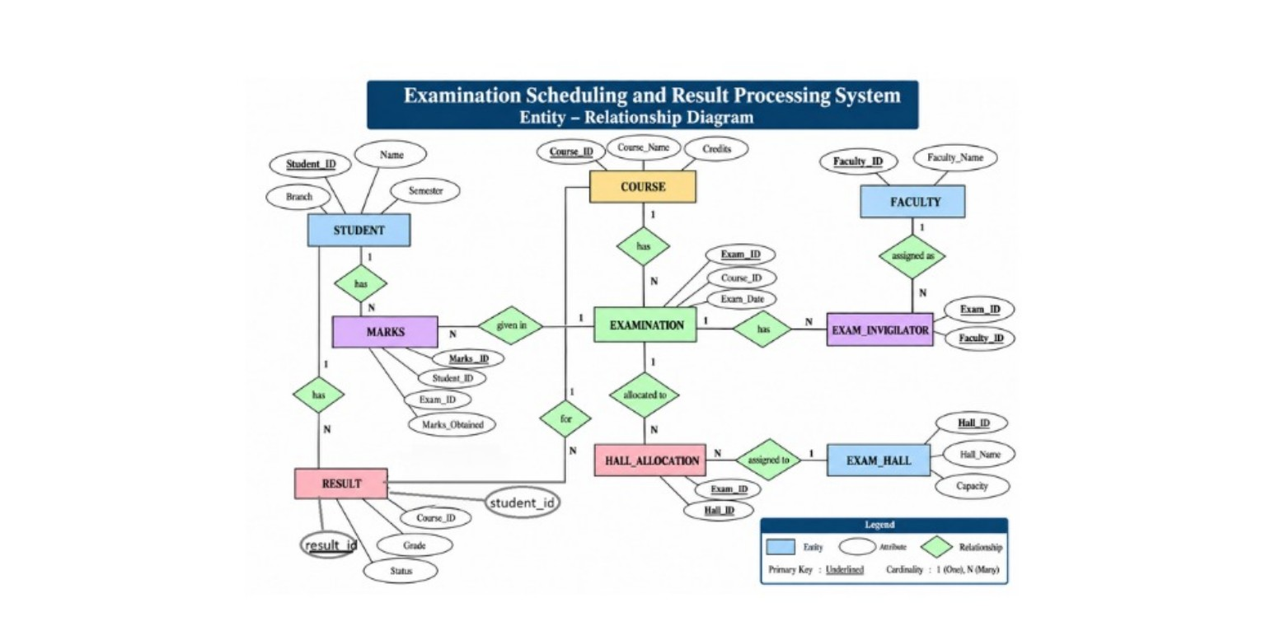
DATABASE DESIGN
2
Entity–Relationship Diagram
Examination Scheduling and Result Processing System

Slide 3
ER MODEL
3
Entities and Main Attributes
1
STUDENT
2
COURSE
3
EXAMINATION
Student_ID, Name, Branch, Semester
Course_ID, Course_Name, Credits
Exam_ID, Course_ID, Exam_Date
4
FACULTY
5
EXAM_HALL
6
MARKS
Faculty_ID, Faculty_Name
Hall_ID, Hall_Name, Capacity
Marks_ID, Student_ID, Exam_ID, Marks_Obtained
7
RESULT
8
EXAM_INVIGILATOR
9
HALL_ALLOCATION
Result_ID, Student_ID, Course_ID, Grade, Status
Exam_ID, Faculty_ID
Exam_ID, Hall_ID
Examination Scheduling and Result Processing System

Slide 4
RELATIONSHIPS
4
Relationships and Cardinality
STUDENT → MARKS
1 : N
EXAMINATION → MARKS
1 : N
COURSE → EXAMINATION
1 : N
One student can have many marks records.
One examination can have many marks records.
A course can have multiple examinations.
STUDENT → RESULT
1 : N
COURSE → RESULT
1 : N
EXAMINATION → EXAM_INVIGILATOR
1 : N
A student can have multiple result records.
A course can appear in multiple result records.
An examination can have multiple invigilator records.
FACULTY → EXAM_INVIGILATOR
1 : N
EXAMINATION → HALL_ALLOCATION
1 : N
EXAM_HALL → HALL_ALLOCATION
1 : N
A faculty member can be assigned to multiple examinations.
An examination can have allocation records.
A hall can appear in allocation records.
Examination Scheduling and Result Processing System

Slide 5
RELATIONSHIP RESOLUTION
5
Associative Entities
1
EXAM_INVIGILATOR
2
HALL_ALLOCATION
Connects EXAMINATION and FACULTY.
Attributes: Exam_ID, Faculty_ID
Composite primary key: (Exam_ID, Faculty_ID).
Connects EXAMINATION and EXAM_HALL.
Attributes: Exam_ID, Hall_ID
Composite primary key: (Exam_ID, Hall_ID).
Purpose
These tables represent allocation/assignment links between examinations and other entities.
Examination Scheduling and Result Processing System

Slide 6
DATABASE STRUCTURE
6
Relational Schema
STUDENT (Student_ID PK, Name, Branch, Semester)
COURSE (Course_ID PK, Course_Name, Credits)
EXAMINATION (Exam_ID PK, Course_ID FK, Exam_Date)
FACULTY (Faculty_ID PK, Faculty_Name)
EXAM_HALL (Hall_ID PK, Hall_Name, Capacity)
MARKS (Marks_ID PK, Student_ID FK, Exam_ID FK, Marks_Obtained)
RESULT (Result_ID PK, Student_ID FK, Course_ID FK, Grade, Status)
EXAM_INVIGILATOR (Exam_ID PK/FK, Faculty_ID PK/FK)
HALL_ALLOCATION (Exam_ID PK/FK, Hall_ID PK/FK)
Examination Scheduling and Result Processing System

Slide 7
DATABASE INTEGRITY
7
Keys and Constraints
PK
Primary Keys
FK
Foreign Keys
CK
Composite Keys
Uniquely identify records such as Student_ID, Course_ID, Exam_ID and Marks_ID.
Link related tables, for example Course_ID in EXAMINATION and Student_ID in MARKS.
EXAM_INVIGILATOR uses (Exam_ID, Faculty_ID); HALL_ALLOCATION uses (Exam_ID, Hall_ID).
✓
Referential Integrity
✓
Structured Relationships
Foreign-key relationships keep related examination, student, course, faculty and hall records connected.
The ER model represents entities, attributes, relationships and 1:N cardinalities required by the project.
Examination Scheduling and Result Processing System

Slide 8
DESIGN QUALITY
8
Normalization and Database Design
1
Separation of Entities
2
Reduced Redundancy
Students, courses, examinations, faculty, halls, marks and results are stored in separate relations.
Related information is linked using primary and foreign keys instead of repeating the same data.
3
Many-to-Many Links
4
Consistent Structure
Junction tables resolve examination–faculty and examination–hall associations.
The relational schema follows the entity structure shown in the ER diagram.
The ER model provides the database blueprint for the implementation.
Examination Scheduling and Result Processing System

Slide 9
CONCLUSION
9
Review II Summary
1
ER Model
2
Relational Design
3
Implementation Base
Defines the entities, attributes, relationships and cardinalities of the system.
Maps the ER model into nine related tables with primary and foreign keys.
Provides the database structure used for the later UI and CRUD implementation.
Next Step
Database implementation and user-interface demonstration.
Thank You
Examination Scheduling and Result Processing System

