Slide 1

EPAM Final Project Presentation
DevOps External Online Course
Illia Bogush
18 years old
Some experience in close area(NOT COMMERCIAL):
System administrator: maintenance of system units,
equipment preparation(ethernet cables, routers, switches, (sometimes just wifi-adapters)),
connecting devices to the network, basic configuration devices.

Slide 2


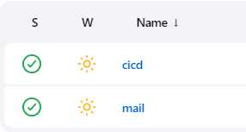

About Project
Send you email by click button
Recording inputting emails in the database(MySQL)
Dumping database by timer (crontab)
CI/CD conveyor (GIT)
http://mail.bim-cv.live/

Slide 3
reasons for choosing the project
Studding e-mail system – protocols, configuration
Understanding of configuration the connection of web services to user requests
Using knowledge obtained during the course

Slide 4
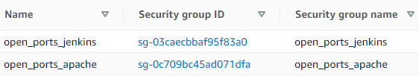
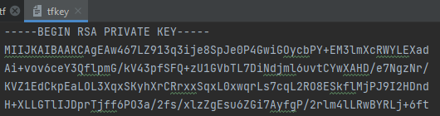

Step 1 - Terraform
Terraform: AWS
Built 2 instances
Creation 2 security groups
Creation ssh key
Outputting ip addresses(for next step Ansible)

Slide 5

Step 2 - Ansible
Ansible:
Writing ip addresses to hosts
Run playbooks:
playbook_apache for Apache instance
playbook_docker for Jenkins instance

Slide 6
Step 3 - Jenkins through docker
Jenkins - sudo docker run -p 8080:8080 -p 50000:50000 -v jenkins_home:/var/jenkins_home jenkins/jenkins:lts
Creation jobs:
CI/CD conveyor
Connect git and apache server
Email sender
Configurate mail system

Slide 7
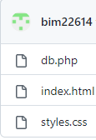



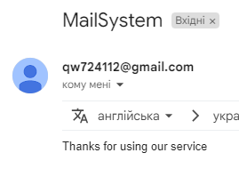

Deploy page and Testing
Deploy to git
Change button color
Check
Sending email to bim22082004@gmail.com
Check
Check DB

Slide 8
Dumping db
crontab -e 0 1 * * * /home/ubuntu/dump/dump.sh
dump.sh mysqldump -u root -proot mails > dump_`date +"%d-%m-%y"`.sql

Slide 9
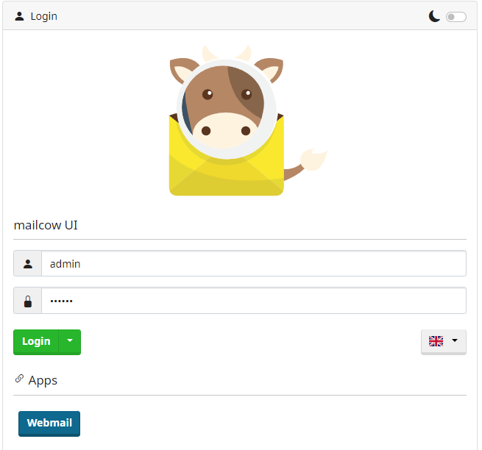
conclusion
Improving ideas:
Own mail service:
mailcow
problems
cost of servers, that has enough power to work with these loads
configuration DNS-records of free domains – take very much time
TRY IT BY YOURSELF
http://mail.bim-cv.live/

