Slide 1
Day-1 Agenda:
Introduction to Java
JDK / JRE / JVM
JVM Architecture
OOPs Concept
Data Types & Variables
Operators
Control Flow Statements
Array
Enum
Introduction to Classes
Different ways of creating Objects
Access Specifier / Modifiers
Polymorphism
Inheritance
Presenter:
Tanmay Pal (Batch 1)
Suneel Kumar Gudipati (Batch 2)
GitHub:
https://github.com/tanmay-pal

Slide 2
Introduction to Java:
Simple.
Object-Oriented Programming Language.
Platform Independent.
Robust.
Secure.
Distributed.
Multithreading.
High Performance.
Write Once Run Anywhere.

Slide 3
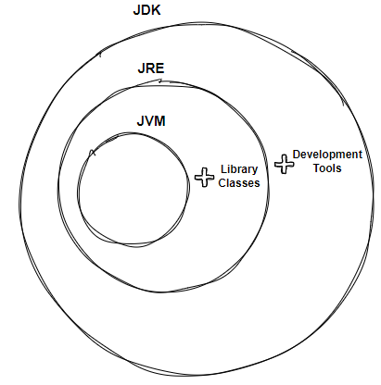
JDK vs JRE vs JVM:
JDK: Java Development Kit aka JDK is the core component of Java Environment and provides all the tools, executables, and binaries required to compile, debug, and execute a Java Program. JDK is a platform-specific software and that’s why we have separate installers for Windows, Mac, and Unix systems. We can say that JDK is the superset of JRE since it contains JRE with Java compiler, debugger, and core classes.
JRE: It provides a platform to execute java programs. JRE consists of JVM, Java binaries, and other classes to execute any program successfully. JRE doesn’t contain any development tools such as Java compiler, debugger, JShell, etc.
JVM: JVM is the heart of Java programming language. When we execute a Java program, JVM is responsible for converting the byte code to the machine-specific code. JVM is also platform-dependent and provides core java functions such as memory management, garbage collection, security, etc.

Slide 4
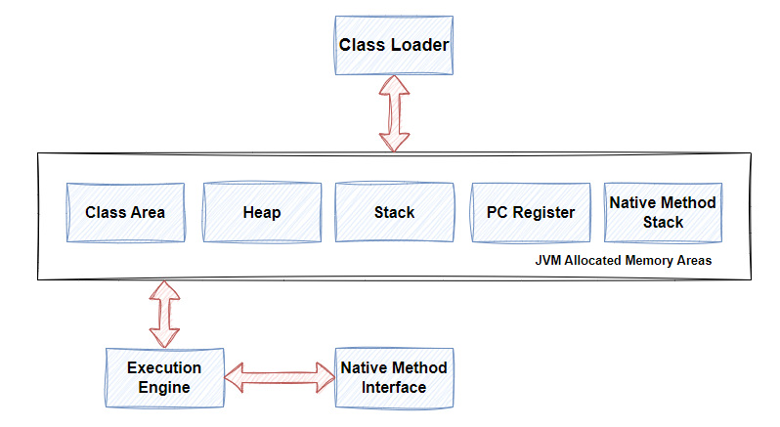
JVM Architecture:

Slide 5
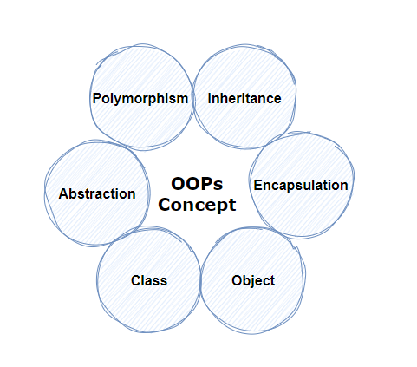
OOPs Concept:
Class.
Object.
Polymorphism.
Inheritance.
Abstraction.
Encapsulation.

Slide 6
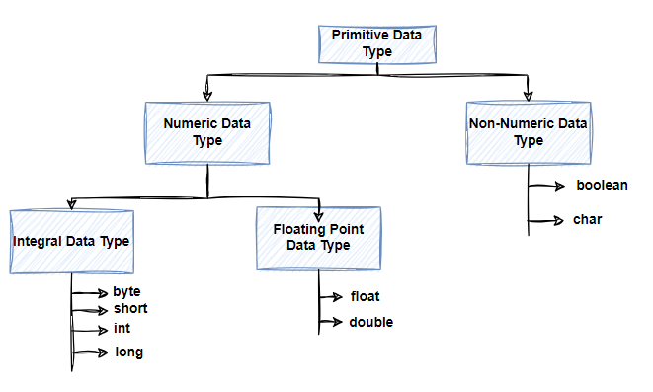
Data Types and Variables:
Primitive Data Type:
boolean, char, int, short, byte, long, float, and double.
Non-Primitive Data Type or Object Data type:
String, Array, etc.

Slide 7
Operators:
Unary Operator.
Arithmetic Operator.
Relational Operator.
Logical Operator.
Ternary Operator.
Assignment Operator.
etc.

Slide 8
Control Flow Statements:
§ Decision Making:
o if
o switch
§ Loop Statements:
o do-while
o while
o for
§ Jump Statements:
o break
o continue

Slide 9
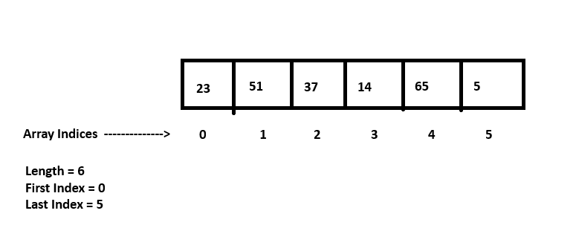
Arrays:
Contains elements of a similar data type.
Can store only fixed set of elements.
Declared like other variables with [] after the data type.
The variables in the array are ordered, and each has an index beginning with 0.
Can be used as a static field, a local variable, or a method parameter.

Slide 10
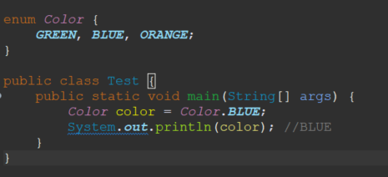
Enum:
Every enum is internally implemented by using Class.
Every enum constant represents an object of type enum.
Enum type can be passed as an argument to switch statements.
Every enum constant is always implicitly public static final. Since it is static, we can access it by using the enum Name. Since it is final, we can’t create child enums.

Slide 11

Classes, Interfaces & Objects
Everything in Java is associated with classes and objects A class is a blueprint or prototype to create objects and to define attributes and methods. Class in Java does not consume memory on its own.
Object is an instance of a Java class, it is a copy of a specific class. All objects in a given class will have the same methods or properties.
Objects are created from classes at runtime. Object in Java occupies memory when instantiated.
Interface is a reference type, similar to a class, that can contain only constants, method signatures and default methods.

Slide 12
Classes
A class is a blueprint to create objects and to define attributes and methods. Class is created in Java by using keyword "class".
Class Signature :: <Access Specifier> class <Class name> { }
Example : public class Car {
String type;
String color;
int speed;
public int increaseSpeed(int increment) {
this.speed = this.speed + increment;
return this.speed;
}
}

Slide 13
Classes
Different types of classes available in Java
Inner class – Are like subtopics Concrete class – can be instantiated and used to create objects POJO class – Encapsulates data and provide setter and getters. Static class – Used to create nested class Final class – Used to create immutable classes Abstract class – Cannot be instantiated, but used as base class SingleTon class – Allows only one instance of itself to be created Superclass – From which other classes inherit properties Subclass - inherits properties and methods from a superclass

Slide 14
Interface
Interface is created with keyword interface. It cannot be used to create objects.
Interface methods do not have a body - the body is provided by the "implement" class
On implementation of an interface, you must override all its methods.
Interface methods are by default abstract and public.
Interface attributes are by default public, static and final.
An interface cannot contain a constructor as it cannot be used to create objects.

Slide 15
Interface
Ex: public interface Language {
void getName(String name);
}
class ProgrammingLanguage implements Language {
public void getName(String name) {
System.out.println("Programming Language: " + name);
}
public static void main(String[] args) {
ProgrammingLanguage lang = new ProgrammingLanguage();
lang.getName("Java");
}
}

Slide 16
Creating Objects
In Java, classes and objects are initialized through different ways based on the program’s specific needs.
Using the ‘new’ keyword. ClassName objectName = new ClassName();
Objects can be created and initialized through methods.
public ClassName createObject() {
ClassName objectName = new ClassName();
return objectName;
}
Initializing objects using Constructors Object can be created using parameterized constructor.
Every class has default constructor which is called on object creation.

Slide 17
Variables
Member variables in a class - these are called fields/attributes.
Variables in a method or block of code - these are called local variables.
Variables in method declarations - these are called parameters.
Ex : public class Car {
String type;
String color;
int speed;
public int increaseSpeed(int increment) {
int gear;
this.speed = gear + this.speed + increment;
return this.speed;
}
}

Slide 18
Methods
A method in Java is a block of code, performs specific actions mentioned in it when called. The methods that can be called directly are class or static methods. The methods called with object of the class are referred as instance or non-static methods.
Method Signature :: <Access Specifier> <ReturnType> <methodName> (<arguments>) { }
Ex : public class Car {
String type;
String color;
int speed;
public int increaseSpeed(int increment) {
int gear;
this.speed = gear + this.speed + increment;
return this.speed;
}
}

Slide 19
Classes, Objects, Variables and Methods
public class Person {
private String name;
private int age;
public Person() {
}
public Person(String name, int age) {
this.name = name;
this.age = age;
}
public void displayInfo() {
System.out.println("Name: " + name);
System.out.println("Age: " + age);
}

Slide 20
Classes, Objects, Variables and Methods
public static void main(String[] args) {
Person person1 = new Person();
person1.name = "Rahul";
person1.age = 25;
person1.displayInfo();
Person person2 = new Person("Rohit", 30);
person2.displayInfo();
Person person3 = createPerson("Singh", 40);
person3.displayInfo();
}
public static Person createPerson(String name, int age) {
Person person = new Person();
person.name = name;
person.age = age;
return person;
}
}

Slide 21
Polymorphism
Performing same action in different ways. Polymorphism can be achieved in java using 1. Method Overloading 2. Method Overriding Method Overloading
---------------------------
Having same name for multiple methods with different parameters (different number of parameters, different types of parameters, or both).

Slide 22
Method Overloading
public class MethodOverloadingExample {
private void displayData(int value) {
System.out.println("Got Integer data "+value);
}
private void displayData(String value) {
System.out.println("Got String data " +value);
}
private void displayData(int value1, int value2) {
System.out.println("Got Two Integers data "+value1+" -- "+value2);
}
public static void main(String[] args) {
MethodOverloadingExample ex = new MethodOverloadingExample();
ex.displayData(1);
ex.displayData("Example");
ex.displayData(3,4);
}
}

Slide 23
Constructor Overloading
public class Person {
private String name;
private int age;
public Person() {
name = "";
age = 0;
}
public Person(String name) {
this.name = name;
age = 0;
}
public Person(String name, int age) {
this.name = name;
this.age = age;
}
public String toString(){
return name + " " + age;
}
public static void main(String args[]){
Person p1 = new Person();
Person p2 = new Person("Rahul");
Person p3 = new Person("Rohit", 18);
System.out.println(p1.toString());
System.out.println(p2.toString());
System.out.println(p3.toString());
}
}

Slide 24
"this" keyword
"this" keyword in java refers to the current object.
In other words, "this" represents the instance of the class where it's used.
It's commonly used to access or modify the fields of the current object, especially when field names are the same as local variable names.
public class Person {
private String name;
private int age;
public Person(String name, int age) {
this.name = name;
this.age = age;
}
public String toString() {
return name+" "+age;
}
public static void main(String args[]){
Person p = new Person("Bbc", 18);
System.out.println(p.toString());
}
}

Slide 25
Inheritance
Acquiring properties from one class to other classes. One object can acquire all properties and actions of a parent object through the technique of inheritance in Java Programming.
Java Inheritance is used when we have is-a relationship between objects.
Ex : KIA is-a Car. KIWI is-a Fruit.

Slide 26
Inheritance
public class Employee {
private int empId;
private String empName;
private String role;
public Employee() {}
public Employee(int empId, String empName, String role) {
this.empId = empId;
this.empName = empName;
this.role = role;
}
public int getEmpId() {
return this.empId;
}
public void setEmpId(int empId) {
this.empId = empId;
}

Slide 27
Inheritance
public String getEmpName() {
return this.empName;
}
public void setEmpName(String empName) {
this.empName = empName;
}
public String getRole() {
return this.role;
}
public void setRole(String role) {
this.role = role;
}
public String toString() {
return "Employee Details :: " +
"\n Emp ID - " +empId +
"\n Employee Name - "+ empName +
"\n Role of Employee is - "+role;
}
}

Slide 28
Inheritance
public class Programmer extends Employee{
public Programmer(int empId, String empName, String role) {
super(empId, empName, role);
}
} public class Manager extends Employee{
public Manager(int empId, String empName, String role) {
super(empId, empName, role);
}
}

Slide 29
Inheritance
public class InheritanceExample {
public static void main(String[] args) {
Programmer prog = new Programmer(1, "Rohit", "Programmer - Coding");
System.out.println(prog.toString());
Manager mgr = new Manager(2, "Rahul", "Manager - Management");
System.out.println(mgr.toString());
}
}

Slide 30
Runtime or Dynamic Polymorphism Super Keyword
Polymorphism (Performing same action in different ways) occurs at run time.
Java Compiler resolves the object at run time and then it decides which function call should be associated with that object. In method overriding, the child class has the same method as that of the parent class. The main use of this is to achieve runtime polymorphism.
Method Overriding is used to provide specific implementation of a particular method which was provided by the parent’s class.
The super keyword refers to superclass (parent) objects. It is used to call superclass methods, and to access the superclass constructor.

Slide 31
Runtime or Dynamic Polymorphism
Ex : public class Employee {
private int empId;
private String empName;
private String role;
public Employee() {}
public Employee(int empId, String empName, String role) {
this.empId = empId;
this.empName = empName;
this.role = role;
}
public int getEmpId() {
return this.empId;
}
public void setEmpId(int empId) {
this.empId = empId;
}

Slide 32
Runtime or Dynamic Polymorphism
public String getEmpName() {
return this.empName;
}
public void setEmpName(String empName) {
this.empName = empName;
}
public String getRole() {
return this.role;
}
public void setRole(String role) {
this.role = role;
}
public String toString() {
return null;
}
}

Slide 33
Runtime or Dynamic Polymorphism
public class Programmer extends Employee{
int teams;
public Programmer(int empId, String empName, String role, int teams) {
super(empId, empName, role);
this.teams = teams;
}
@Override
public String toString() {
return "Programmer Details :: " +
"\n Emp ID - " +super.getEmpId() +
"\n Employee Name - "+ super.getEmpName() +
"\n Role of Employee is - "+super.getRole() +
"\n Working with no of teams - "+ teams;
}
}

Slide 34
Runtime or Dynamic Polymorphism
public class Manager extends Employee{
int teams;
public Manager(int empId, String empName, String role, int teams) {
super(empId, empName, role);
this.teams = teams;
}
@Override
public String toString() {
return "Manager Details :: " +
"\n Emp ID - " +super.getEmpId() +
"\n Employee Name - "+ super.getEmpName() +
"\n Role of Employee is - "+super.getRole()+
"\n Working with no of teams - "+ teams;
}
}

Slide 35
Runtime or Dynamic Polymorphism
public class InheritanceExample {
public static void main(String[] args) {
Employee prog = new Programmer(1, "Rohit", "Programmer - Coding", 1);
System.out.println(prog.toString());
Employee mgr = new Manager(2, "Rahul", "Manager - Management", 4);
System.out.println(mgr.toString());
}
}

Slide 36
Classcast Exception
Thrown to indicate that the code has attempted to cast an object to a subclass of which it is not an instance.
Object i = Integer.valueOf(42);
String s = (String)i;
public class InheritanceExample {
public static void main(String[] args) {
Programmer prog = new Programmer(1, "Rohit", "Programmer - Coding", 1);
Employee emp = prog;
Manager m1 = (Manager)emp;
System.out.println(m1.toString());
}
}

