Slide 1

Day 3 STREAMS
https://lumen.percipio.com/courses/f10c7fab-3c97-4d14-8c61-c1ab7cb82180/videos/d7b91d48-2d34-4d2d-b737-5ce6f2fb2c1d Source code link:
https://github.com/VeerannaGoud/Streams.git By Veeranna Goud

Slide 2
Streams
java.util.streams
Introduction to Streams API
Collections vs Streams
Creating Streams and types of streams
Intermediate Operations on Streams
Using map(), filter(),sort(),limit(), flatmap() methods
Terminal Operations on Streams Using forEach(), iterator(),findFirst(),findAny(), OrElseThrow(), toArray(), collect() methods
Understanding the Optional class and its usage.

Slide 3
Streams
An Interface defined in java.util.stream package.
Streams are a sequence of elements from a source that supports aggregate operations.
filter, map, reduce, find, match, sort.
Operations can be executed in series or in parallel.
The source can be a Collection, IO Operation or Arrays
Java collections has methods that return Stream.
- These Methods are added as default methods.

Slide 4
Characteristics of Streams
Not related to InputStreams, OutputStreams, etc.
These are NOT data structures
Wrappers around Collection that carry values from a source through a pipeline of operations.
More powerful, faster and more memory efficient than Lists
Designed for lambdas
Employ lazy evaluation
Streams are parallelizable

Slide 5
Collections vs Streams
Collections are in-memory data structures which hold elements within it.
- Each element in the collection is computed before it actually becomes a part of that collection.
- On the other hand, Streams are data computed on-demand basis.
Streams are lazily constructed Collections, where the values are computed when user demands for it.
Collections are eagerly computed values

Slide 6
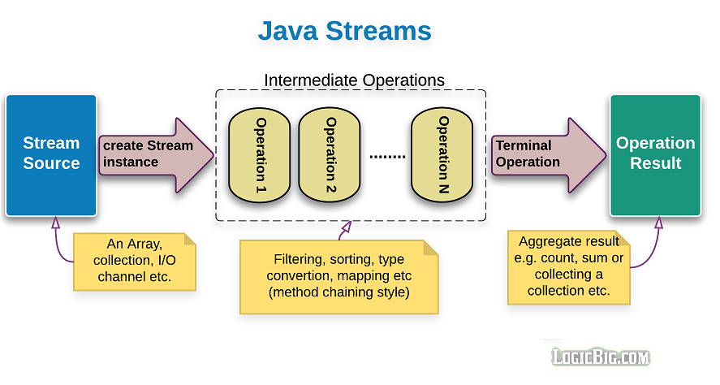
Structure of Java 8 Stream Operations
The three important components to make it work.
- A source
- one or more intermediate operations
- A terminal operation
The three are pipelined in a sequence to make a stream work.

Slide 7
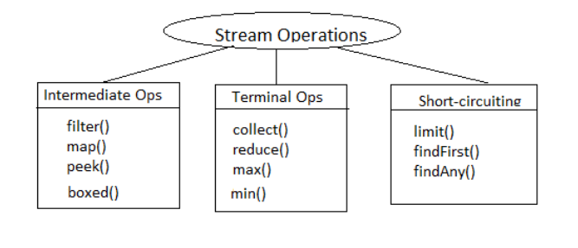
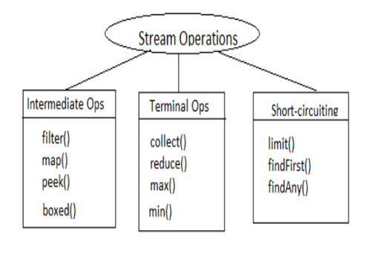
Stream Operations

Slide 8
Operation Categories
Two types of Operations
Intermediate operations
Terminal Operations.
Intermediate operations
intermediate operations are lazy.
- They will not be invoked until the terminal operation is invoked.
- Streams become accessible when intermediate operations were called.
Return streams can pipeline of operations.
- map, filter, and limit

Slide 9
Operation Categories
The terminal operations
Used at the end of a pipeline
They close the stream in some meaningful way.
Eagerly executed
Collects the results of stream operations
Can be collected like lists, integers or simply nothing.
Stream become inaccessible when a terminal operation is called
Will trigger the IllegalStateException which is a RuntimeException
Example : collect() ,count() ,forEach(), min() ,max()

Slide 10
Types of Intermediate Operations
Intermediate operations can be classified into Stateful and Stateless
Stateful Operations
Operations which maintain information from a previous invocation internally
It can be used again in a future invocation of the method
State storage can become huge for instances of infinite streams
Can potentially affect performance of the whole system.
Example : distinct() , sorted()

Slide 11
Stateless Intermediate Operations:
Operations do not store any state across passes.
Improves the performance of these operations
Stream operation can be in parallel
No information to shared, no need for order
Example : filter(), map(), findAny()

Slide 12
Filter()
Takes predicate as an argument
Applies to the whole stream and returns a filtered stream
Containing elements which match the Predicate.
List<Customer> filteredList= customerList.stream().filter((Customer cust ) -> cust.getCustomerId() >200).collect(toList());
System.out.println("After applying filter method");
filteredList.forEach(System.out::println);

Slide 13
Map()
Takes an instance of Function <T, R> as parameter
Converts the type of elements in the stream from the current type T to the new type R.
Returns as output a stream of type R or Stream<R>
List<Customer> customerList = HandleCustomers.getCustomers();
List<Long> phoneBook = customerList.stream().
map((eachCust)->eachCust.getPhoneNumber()).collect(toList());
phoneBook.forEach(System.out::println);

Slide 14
Distinct()
returns a stream instance which has all elements unique/distinct.
The uniqueness is determined by the equals & hashcode
List<Long> custIds= customerList.stream().map(e -> e.getCustomerId()).distinct().collect(toList());

Slide 15
Sorted
sorted()
Sorts the elements using natural ordering.
The element class must implement Comparable interface.
List<Customer> sortedList = customerList.stream().sorted().collect(toList());
sorted(Comparator<? super T> comparator)
Sorted using an instance of Comparator using lambda expression.
Comparator.comparing
A static function that accepts a sort key Function
Returns a Comparator for the type which contains the sort key:

Slide 16
Limit(n)
Puts an upper-limit cap purely based on the number of elements in the stream.
If the stream had less than n elements, and limit of n has been applied on the stream, then there is no affect on the stream
Skip(n)
returns a truncated version of the original stream such that the first n elements in the list are skipped and the remaining elements are returned in the resulting stream.

Slide 17
limit(n) & skip(n)
These two are complimentary
While limit(n) gives the first n elements from positions 1 to n;
skip(n) gives elements from positions n+1 to k.
Given a stream of size k, streams obtained from limit(n) & skip(n) applied on the original stream (where, n<=k) when aggregated together give us the original stream back.
Joining the streams obtained from limit(n) & skip(n) gives the original stream back
.

Slide 18
Terminal operations

Slide 19
Stream Reduction
count(), max(), min(), sum()
Predefined Terminal Operation implementation.
Used to aggregate a stream to a type or to a primitive
Can create a custom Stream’s reduction mechanism by using two methods
reduce()
collect()

Slide 20
Max , Min ,Count
count()
returns the count of elements of a stream.
max()
returns the maximum element of a stream according to the provided Comparator.
min()
returns the minimum element of a stream according to the provided Comparator.

Slide 21
Count
long countresult= catalog.stream().
filter((Product prod ) -> prod.getProductName().equalsIgnoreCase(itemType)).count();
System.out.println(countresult);

Slide 22
Collect()
Collectors.toCollection()
To use a custom implementation
List<String> result = givenList.stream()
.collect(toCollection(LinkedList::new))
Collectors.toMap()
Used to collect Stream elements into a Map instance.
Map<Long, String> map = customerList.stream()
.collect(Collectors.toMap(Customer::getPhoneNumber, Customer::getCustomerName));
map.forEach((x, y) -> System.out.println("Key: " + x +", value: "+ y));

Slide 23
Lab Exercises
Lab exercises using Java streams:
1)Filtering and Collecting: Create a list of integers. Use a stream to filter out the even numbers and collect them into a new list.
2)Mapping: Create a list of strings. Use a stream to convert all the strings to uppercase and collect them into a new list.
3)Finding and Matching: Create a list of integers. Use a stream to find the first number that is divisible by 3.
4)Reducing: Create a list of integers. Use a stream to calculate the product of all the numbers.
5)Grouping: Create a list of strings. Use a stream to group the strings by their length.
6)Find the maximum and minimum number in a list of integers.
7)Count the number of strings in a list that have a certain length.
8)Convert a list of strings to a single string, separated by commas.

