Slide 1

rethink_bot
IBM Responsible AI Hackathon
Group Beige
A fact-checker that trains you to need it less.
Angelica Pippow
Tehseen Ali
Abimbola Ogunsakin
Mona Imam
Notes:
On screen while you walk up and get set. Don’t present it: no team intro, no reading names. The jury can read them. As soon as you’re ready, click straight to the four posts and start with “Four posts from Instagram…”.

Slide 2


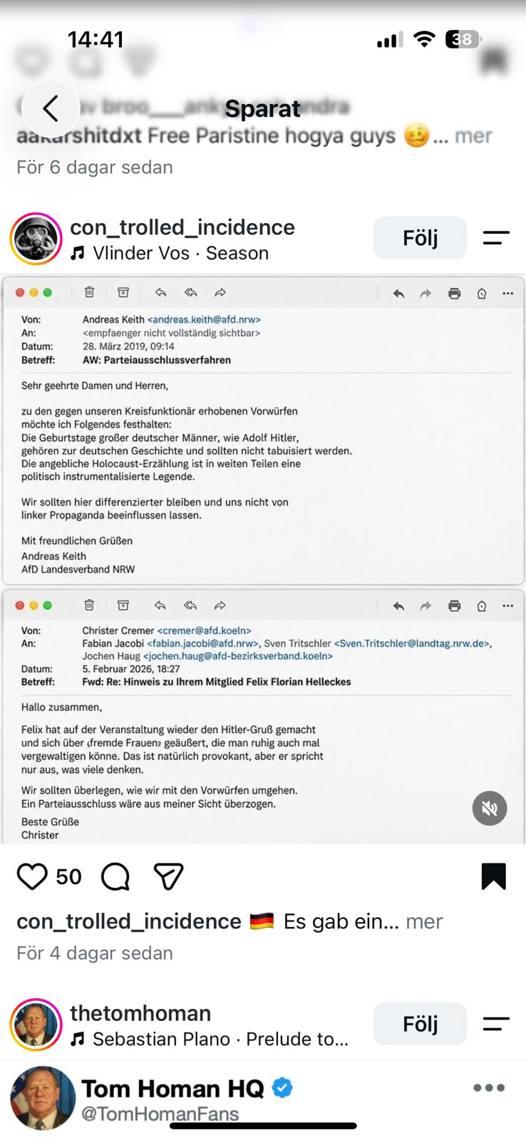
Real or fake?
Seen on Instagram this week
1
2
3
Notes:
0:00–0:25. No greeting, no team intro. Start straight away. Say: “Four posts from Instagram. Hands up if you believe the first one… the second… the third… the fourth.” Go fast, about 3 seconds per post. Roughly count out loud. HOW TO FILL: replace each [Photo] box with your image (drag it onto the box in the editor, then delete the placeholder), and fill in account, likes, caption and comments. Keep captions to one or two lines.

Slide 3

All three were fake.
The answer
Notes:
0:25–0:35. Say: “All four were fake. We made them in five minutes. And most of you believed at least one. That’s not because you’re naive. That’s how fast a believable post works.” If you mix real and fake posts, change the headline, e.g. “Only one was real.”

Slide 4

News now lives where
nobody checks it.
The problem
01
02
03
52%
#1
2025
of 18–24s get their news mainly from social media, video or AI chatbots
Instagram is their biggest social platform for news
Meta ended third-party fact-checking on Instagram in the US
Sources: Reuters Institute Digital News Report 2026 · Meta announcement, January 2025
Notes:
0:35–1:00. Say: “More than half of 18 to 24 year olds now get their news mainly from social media, video or AI. Their biggest platform for news: Instagram. And last year Meta stopped third-party fact-checking there in the US. When a post is false, the correction is buried somewhere in the comments.” Do NOT say Meta’s change applies worldwide. It’s the US.

Slide 5


Fact-checkers hand you a verdict. So you stop thinking.
The trap
AI decides
You trust it
You need it for every post
People who trust AI more report doing less critical thinking. That is the “falling asleep behind the wheel” effect.
Source: Lee et al., Microsoft Research and Carnegie Mellon, CHI 2025 (survey of 319 knowledge workers)
Notes:
1:00–1:15. Say: “The obvious fix is a fact-checker. But fact-checkers hand you a verdict. The AI decides, you trust it, and soon you need it for every single post. Research from Microsoft and Carnegie Mellon shows: the more people trust AI, the less critically they think. That’s exactly the ‘falling asleep behind the wheel’ effect from today’s brief.”

Slide 6
We flip it. You think first.
Our idea
01
02
03
Think
Evidence
Learn
One question that makes you look at the post again. Before we tell you anything.
What 13 named fact-checkers and newsrooms say, with quotes checked word for word.
One tip you can reuse next time. On your own.
Notes:
1:15–1:35. Say: “So we flipped it. You think first: the coach asks you one question that makes you look at the post again. Only then you see the evidence: what six named outlets like Reuters, AP and BBC Verify say, with quotes checked word for word. And you leave with one tip you can use next time, without us.” Then: “Let me show you.”

Slide 7
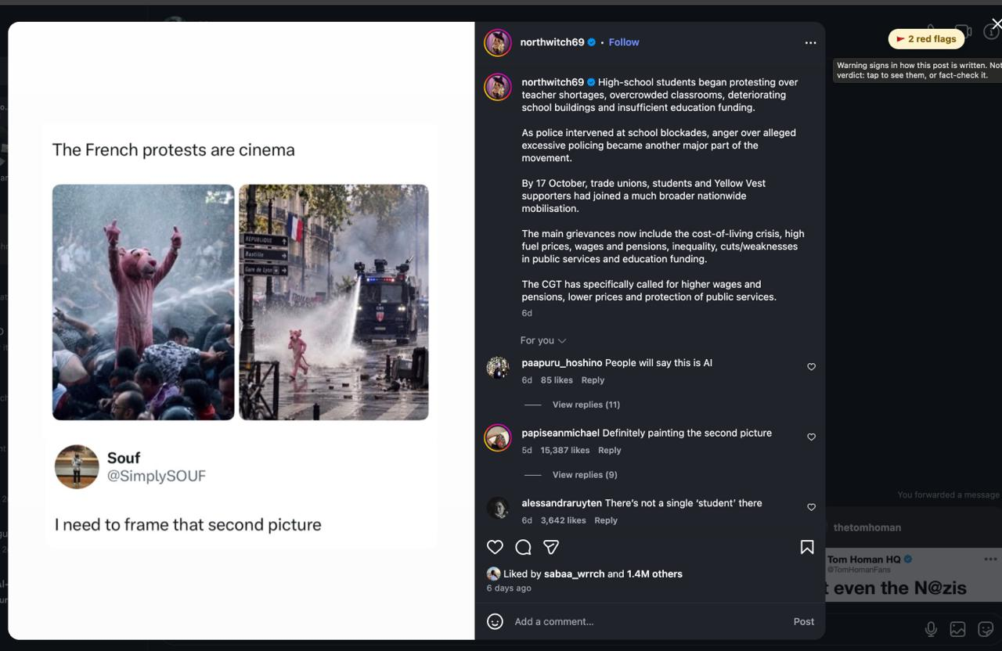
1 · The extension spots red flags
Live demo
Notes:
1:35–2:25. Switch to the mirrored phone, or play the recording in the frame on the right. 1. Instagram post → Share → Telegram. “A caption, some emojis, ‘link in bio’. This is how most people see news.” 2. Bot shows the claim and a question. “It doesn’t tell me anything yet. It asks me.” 3. Answer → verdict, confidence, “4 of 6 outlets cover it”, quotes, tip. “Every quote was checked word for word. If the AI makes one up, we throw it out.” IF ANYTHING BREAKS: “Here’s the offline version, same pipeline with saved data.” Run make demo. Apologise once at most. IF INSTAGRAM BLOCKS THE LINK: “Instagram doesn’t always let tools read posts, so it just asks you to paste it. We don’t scrape or log in.” Demo claim: a REAL claim that at least 2 of the 6 outlets have fact-checked, not one of the invented posts. HOW TO FILL: drag a screen recording or screenshot onto the dashed frame in the editor, then delete the placeholder.

Slide 8
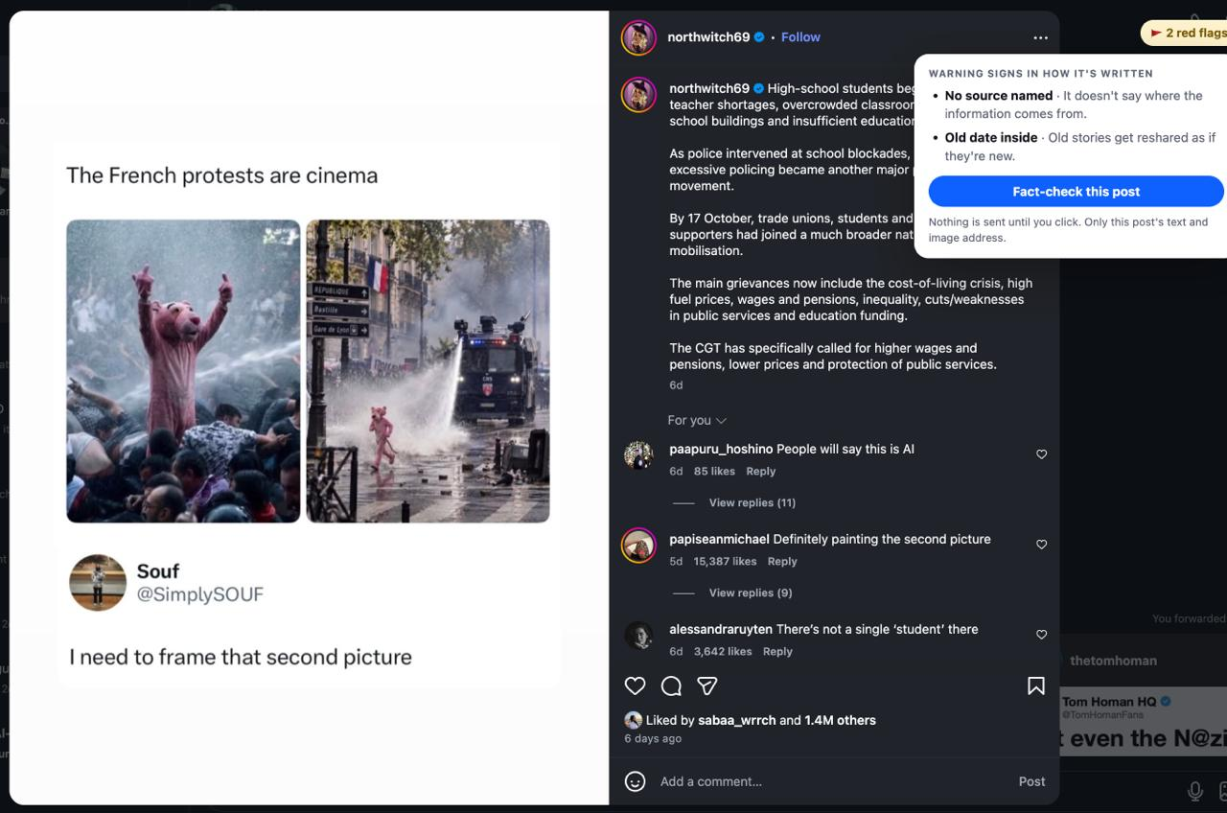
2 · You think first
Live demo
Notes:
1:35–2:25. Switch to the mirrored phone, or play the recording in the frame on the right. 1. Instagram post → Share → Telegram. “A caption, some emojis, ‘link in bio’. This is how most people see news.” 2. Bot shows the claim and a question. “It doesn’t tell me anything yet. It asks me.” 3. Answer → verdict, confidence, “4 of 6 outlets cover it”, quotes, tip. “Every quote was checked word for word. If the AI makes one up, we throw it out.” IF ANYTHING BREAKS: “Here’s the offline version, same pipeline with saved data.” Run make demo. Apologise once at most. IF INSTAGRAM BLOCKS THE LINK: “Instagram doesn’t always let tools read posts, so it just asks you to paste it. We don’t scrape or log in.” Demo claim: a REAL claim that at least 2 of the 6 outlets have fact-checked, not one of the invented posts. HOW TO FILL: drag a screen recording or screenshot onto the dashed frame in the editor, then delete the placeholder.

Slide 9
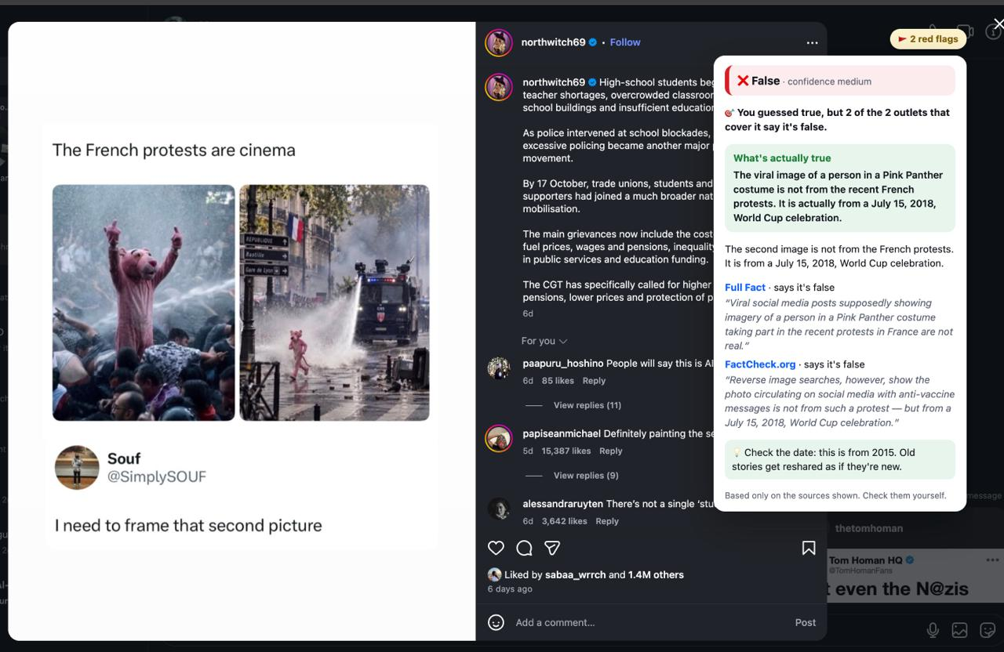
3 · Evidence, then one tip
Live demo
Notes:
1:35–2:25. Switch to the mirrored phone, or play the recording in the frame on the right. 1. Instagram post → Share → Telegram. “A caption, some emojis, ‘link in bio’. This is how most people see news.” 2. Bot shows the claim and a question. “It doesn’t tell me anything yet. It asks me.” 3. Answer → verdict, confidence, “4 of 6 outlets cover it”, quotes, tip. “Every quote was checked word for word. If the AI makes one up, we throw it out.” IF ANYTHING BREAKS: “Here’s the offline version, same pipeline with saved data.” Run make demo. Apologise once at most. IF INSTAGRAM BLOCKS THE LINK: “Instagram doesn’t always let tools read posts, so it just asks you to paste it. We don’t scrape or log in.” Demo claim: a REAL claim that at least 2 of the 6 outlets have fact-checked, not one of the invented posts. HOW TO FILL: drag a screen recording or screenshot onto the dashed frame in the editor, then delete the placeholder.

Slide 10
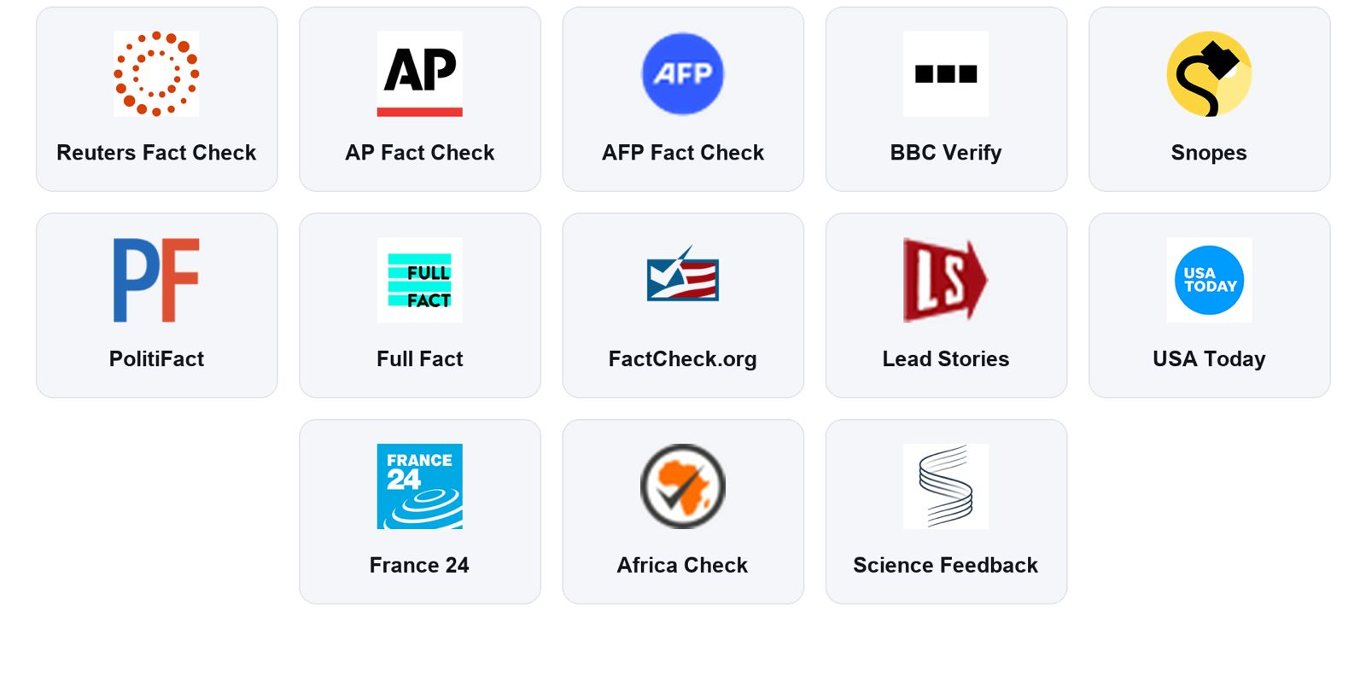
13 named fact-checkers. One vote each.
Our sources
Notes:
1:35–2:25. Switch to the mirrored phone, or play the recording in the frame on the right. 1. Instagram post → Share → Telegram. “A caption, some emojis, ‘link in bio’. This is how most people see news.” 2. Bot shows the claim and a question. “It doesn’t tell me anything yet. It asks me.” 3. Answer → verdict, confidence, “4 of 6 outlets cover it”, quotes, tip. “Every quote was checked word for word. If the AI makes one up, we throw it out.” IF ANYTHING BREAKS: “Here’s the offline version, same pipeline with saved data.” Run make demo. Apologise once at most. IF INSTAGRAM BLOCKS THE LINK: “Instagram doesn’t always let tools read posts, so it just asks you to paste it. We don’t scrape or log in.” Demo claim: a REAL claim that at least 2 of the 6 outlets have fact-checked, not one of the invented posts. HOW TO FILL: drag a screen recording or screenshot onto the dashed frame in the editor, then delete the placeholder.

Slide 11
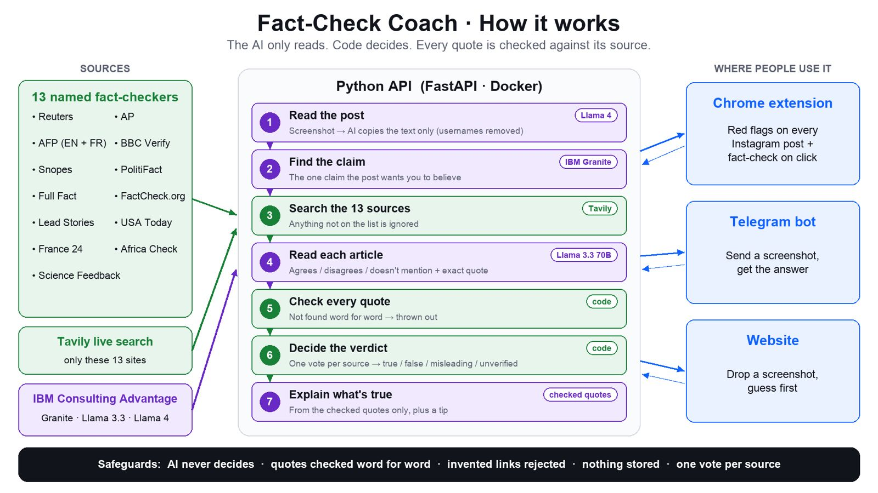
13 named fact-checkers. One vote each.
Our sources
Notes:
1:35–2:25. Switch to the mirrored phone, or play the recording in the frame on the right. 1. Instagram post → Share → Telegram. “A caption, some emojis, ‘link in bio’. This is how most people see news.” 2. Bot shows the claim and a question. “It doesn’t tell me anything yet. It asks me.” 3. Answer → verdict, confidence, “4 of 6 outlets cover it”, quotes, tip. “Every quote was checked word for word. If the AI makes one up, we throw it out.” IF ANYTHING BREAKS: “Here’s the offline version, same pipeline with saved data.” Run make demo. Apologise once at most. IF INSTAGRAM BLOCKS THE LINK: “Instagram doesn’t always let tools read posts, so it just asks you to paste it. We don’t scrape or log in.” Demo claim: a REAL claim that at least 2 of the 6 outlets have fact-checked, not one of the invented posts. HOW TO FILL: drag a screen recording or screenshot onto the dashed frame in the editor, then delete the placeholder.

Slide 12
The AI only reads. You decide.
01
Keep humans engaged
Built for this challenge
You think first. The verdict never comes before your own judgement.
02
Prevent skill degradation
Every check ends with one tip you can reuse on your own.
03
Build trustworthy AI
Every quote is matched against the real article. Made-up quotes are thrown out and shown.
Nothing you send is stored · Repeat checks need zero AI calls · Small open model: IBM Granite on watsonx
Notes:
2:25–2:40. Say: “We built this straight from your three dimensions. You stay engaged, because you think first. Your skills grow, because every check ends with a tip. And it’s trustworthy, because the AI never decides what’s true. It only reads the articles we fetched, and every quote is matched word for word. If it hallucinates a quote, we throw it out and show you.”

Slide 13




Beyond captions and pictures
What’s next
Videos
Memos
Regional outlets
Reels and short videos: what’s said and what’s shown on screen.
Voice memos forwarded in group chats, where rumours spread fastest.
Local and non-English news outlets, so local claims get checked too.
Our success metric: your own judgement gets better over time. You need us less.
Notes:
2:40–2:52. Say: “Next, we go beyond captions: videos, voice memos forwarded in group chats, and regional news outlets, so local claims get checked too. And we measure success differently from everyone else: not by how much you use us, but by how much better your own judgement gets.”

Slide 14

A fact-checker that trains you to need it less.
rethink_bot
Earlier, most of you believed at least one fake. Next time, fewer will.
Notes:
2:52–3:00. Say slowly: “Earlier, most of you believed at least one of our fakes. With rethink_bot, next time fewer of you will. A fact-checker that trains you to need it less. Thank you.” Stop talking. Don’t add “any questions?”. Let the last line land.

