Slide 1
Real-time Web-based Clearance System with Violation Management using QR Code in CHCCI for BSCS4A
By:
Arvin Gomez
Jerald Cutchon
Nicole Ballesteros

Slide 2
Introduction
In many institutions, a person who is ready to leave an institution must go through a clearance procedure in order to find out if they will be allowed to leave or not. The researcher conducts a study entitled Real-time Web-based Clearance System with Violation Management using QR Code in CHCC for BSCS4A

Slide 3


Department 1
Department 2
Department 3
Department 4
Office of Student Affairs
Student
Get Clearance Form
Clearance Approved

Slide 4
Problems
Physical presence is required
Time Consuming
Students can easily cheat signature

Slide 5
Purpose and Description
The purpose of this study is to develop a Real-time Web-based Clearance System with Violation Management using QR Code in CHCC for BSCS4A. The researcher wants to develop it to improve the clearance system of Concepcion Holy Cross College Inc which will be utilized by the department heads, office of student affairs, students, and school guards.
Notes:
Roles per user

Slide 6
Main Objective / Goal of the study
The Main objective was to develop a reliable, effective, efficient, and real-time Online Clearance System
This system enables final-year students to monitor the progress/status of their clearance forms online as long as the technologies they use can access the internet.
This system has a QR Code feature that lets users access the website quickly.

Slide 7
Project scope
This system creates student and department QR Codes for daily use. These QR Codes have a URL that can be used to get to their own webpage. Once there, a PIN keeps people from getting in without permission.
The system manages student clearance as well as student violations.
This will be exclusive to students enrolled in BSCS4A at Concepcion Holy Cross College Inc.; it will not be extended to students at other college departments.

Slide 8
FUNCTIONAL FEATURE MATRIX
Software | 1 | 2 | 3 | 4 | 5 | 6 | 7 | 8 | 9
Moving Towards Global Technological Advancement: Basis for the E-Clearance Program Development | ✔ | ✖ | ✔ | ✔ | ✔ | ✖ | ✖ | ✖ | ✖
Secured Cotabato City State Polytechnic College Web-Based Student Clearance System | ✔ | ✖ | ✖ | ✔ | ✔ | ✖ | ✔ | ✖ | ✖
Development of Online Clearance System for an Educational Institution | ✔ | ✖ | ✔ | ✔ | ✔ | ✔ | ✔ | ✖ | ✔
A Responsive Web-Based QR Code for Laboratory Clearance Form | ✔ | ✖ | ✔ | ✔ | ✔ | ✔ | ✖ | ✔ | ✖
ONLINE CLEARANCE SYSTEM | ✔ | ✖ | ✔ | ✔ | ✔ | ✖ | ✖ | ✖ | ✖
Design and Implementation of a Web-Based Sms-Notification Clearance System: A Case Study of Federal Polytechnic,Ile – Oluji, Ondo State. | ✖ | ✖ | ✔ | ✔ | ✔ | ✖ | ✖ | ✖ | ✖
Real-time Web-based Clearance System with Violation Management using QR Code in CHCC for BSCS4A | ✔ | ✔ | ✔ | ✔ | ✔ | ✔ | ✔ | ✔ | ✔
Student’s Information Management
Violation Management
Log-In System
User/Admin Module
Web Based
Mobile Responsive
Data Encryption
QR Code
Real-time data

Slide 9
Software and Hardware Development
Software | Hardware
Windows 10
Visual Studio Code
HTML
CSS
JAVASCRIPT
PHP
SQL
MYSQL
XAMPP
GIT
GITHUB
CHROME
POSTMAN
QR CODE API
FIGMA
Personal Computer
Laptop
Smart Phone
Printer

Slide 10
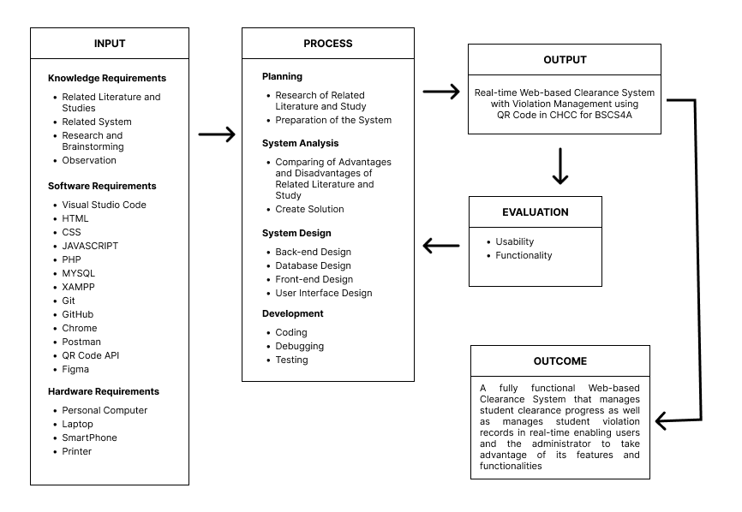
Conceptual Framework

Slide 11






Office of Student Affairs
Department 3
Guard
Department 2
Department 4
Department 1
Request Clearance
Enter Pin
Admin
Student
Violation Records

Slide 12
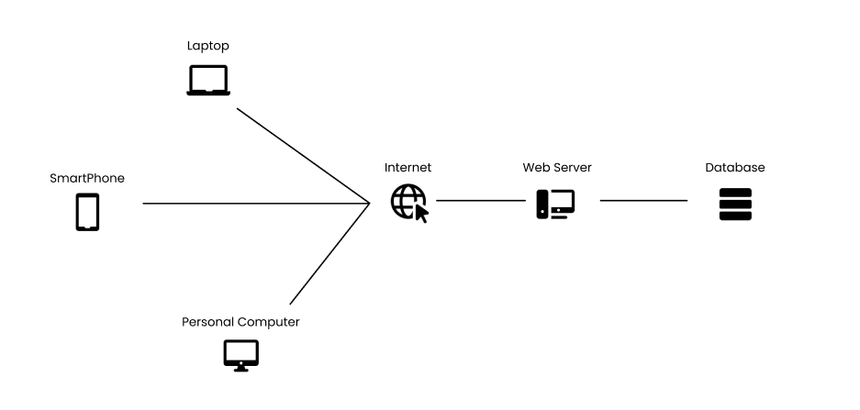
Network architecture

Slide 13
Thank you!

