Slide 1
Web-based paperless Clearance System with Violation Management using QR Code in Concepcion Holy Cross College Inc.
By:
Nicole Ballesteros
Jerald Cutchon
Arvin Gomez

Slide 2
Introduction
Many schools are enhancing their administrative functions by automating nearly all manual procedures.
A person who is ready to leave an institution must go through a clearance procedure in order to find out if they will be allowed to leave or not.
The researchers conducted a study entitled Web-based Paperless Clearance System with Violation Management using QR Code in Concepcion Holy Cross College Inc

Slide 3
Project Context
Traditional Clearance forms are made accessible by academic institutions to students upon graduation or leaving the school. To determine if the student has no current liabilities to departments.
Concepcion Holy Cross College Inc. is currently implementing a clearance system, but this clearance they are implementing is still a manual procedure.
Records of violation are kept only on paper

Slide 4


Department 1
Department 2
Department 3
Department 4
Office of Student Affairs
Student
Get Clearance Form
Clearance Approved

Slide 5
Statement of the Problem
Physical presence is required
Time Consuming
Students can easily forge cheat signature

Slide 6
Main Objective / Goal of the study
The primary objective was to create an online clearance system that eliminates the need for physical presence during the checking of clearance.
This system enables students to monitor the progress/status of their clearance forms online as long as the technologies they use can access the internet.
This system has a QR Code feature that lets users access the website quickly.

Slide 7
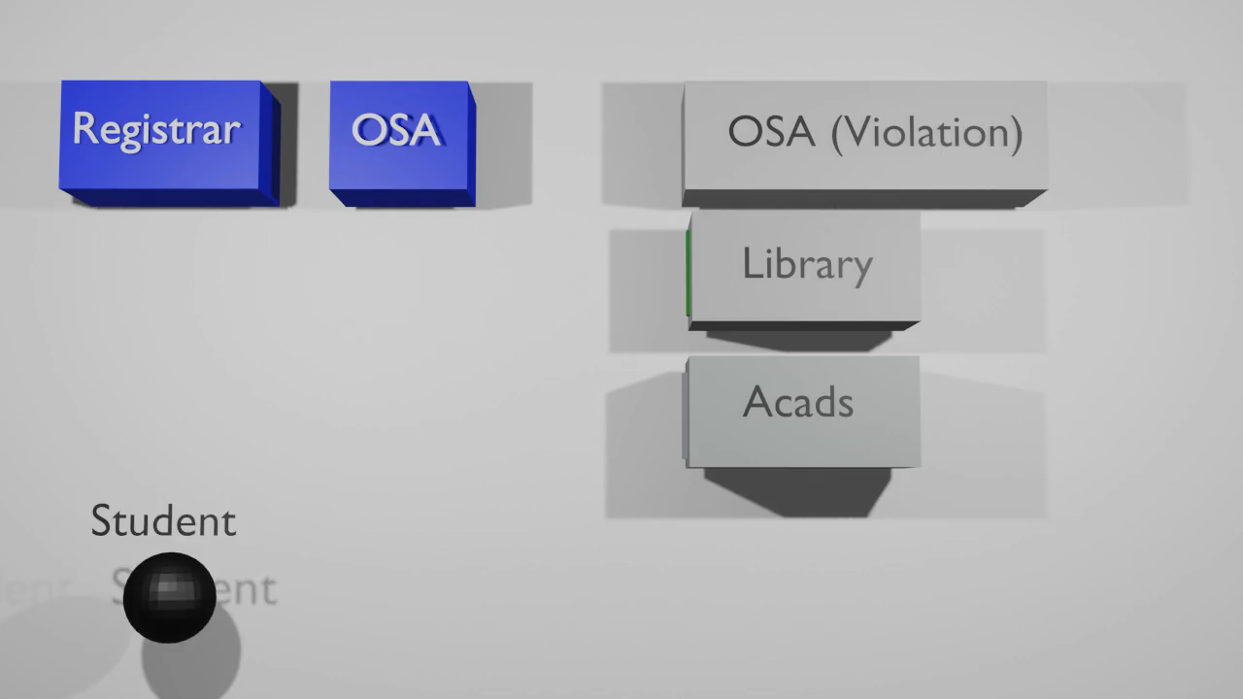

Slide 8
Thank you!

