Slide 1

NOTE TAKING APP
A Secure Full-Stack CRUD Web Application
BSc.CSIT Project Presentation
Presented by: Bimochan Limbu

Slide 2
Introduction
The Note Taking App is a full-stack web application that lets authenticated users create, view, edit, organize, search, pin, and delete personal notes — a secure, private digital workspace inspired by tools like Google Keep and Apple Notes.
Built With
• React + Vite
• Node.js + Express
• MongoDB + Mongoose
2
9
100%
• Session Auth (bcryptjs)
Core Concepts
(Auth + CRUD)
REST API
Endpoints
Session-Based
Security
Note Taking App
2

Slide 3




Problem Statement
People need a fast, simple way to capture and manage short pieces of information — but that data must remain private, organized, and accessible only to its owner.
Data Privacy
Easy Retrieval
Simple Organization
Personal notes must never be visible to other users of the system.
Users need to quickly find notes among many, without friction.
Important notes should be easy to prioritize and revisit.
Note Taking App
3

Slide 4





Objectives
Secure Authentication
Full CRUD for Notes
Develop session-based login with hashed password storage.
Allow users to create, view, edit, and delete notes via REST API.
Strict Data Ownership
Search & Pin
Ensure users can only access and modify their own notes.
Provide note organization through search and pinning.
Clean UI
Design a minimal, professional interface using React + Tailwind.
Note Taking App
4

Slide 5




Proposed Solution
A full-stack web application pairing a React single-page frontend with a secure Express + MongoDB backend, using server-side sessions instead of tokens for authentication.
React Client
Express API
MongoDB
Sessions are stored in MongoDB via connect-mongo, and only a userId is kept in the session — never passwords or tokens.
Note Taking App
5

Slide 6






Features
Signup & Login
Secure Sessions
Create Notes
Edit Notes
Delete Notes
Search Notes
Pin Notes
Ownership Protection
Note Taking App
6

Slide 7
Technology Stack
Frontend
Backend
Database
Security & Tools
React
Node.js
MongoDB
bcryptjs
Vite
Express
Mongoose
Git + GitHub
Tailwind CSS
express-session
Postman
lucide-react
connect-mongo
Note Taking App
7

Slide 8
System Architecture
Client Layer
React SPA — Login, Register, Dashboard pages
API Layer
Express REST API — Auth routes & Note routes, protected by session middleware
Data Layer
MongoDB — Users, Notes, and Sessions collections
Note Taking App
8

Slide 9
Database Design (ER Overview)
NOTE
USER
_id (ObjectId)
_id (ObjectId)
userId (ref: User)
name (String)
1
many
title (String)
email (String, unique)
content (String)
passwordHash (String)
tags (String[])
createdAt / updatedAt
pinned (Boolean)
createdAt / updatedAt
One user owns many notes, linked via Note.userId → User._id
Note Taking App
9

Slide 10


Authentication Flow
1. Signup
2. Login
3. Session
4. Protected Routes
Password hashed
with bcryptjs
Credentials
verified
userId stored in
session (MongoDB)
requireAuth checks
session on every request
Session cookies are httpOnly and stored server-side — passwords are never sent back to the client after login.
Note Taking App
10

Slide 11
CRUD & API Architecture
POST
/api/notes
Create a note
GET
/api/notes
Get all notes
GET
/api/notes/:id
Get one note
PUT
/api/notes/:id
Update a note
DELETE
/api/notes/:id
Delete a note
Note Taking App
11

Slide 12
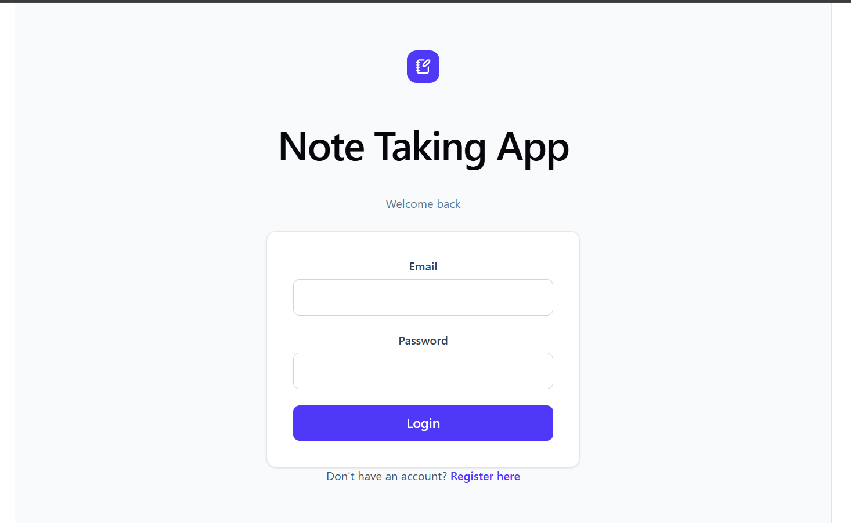
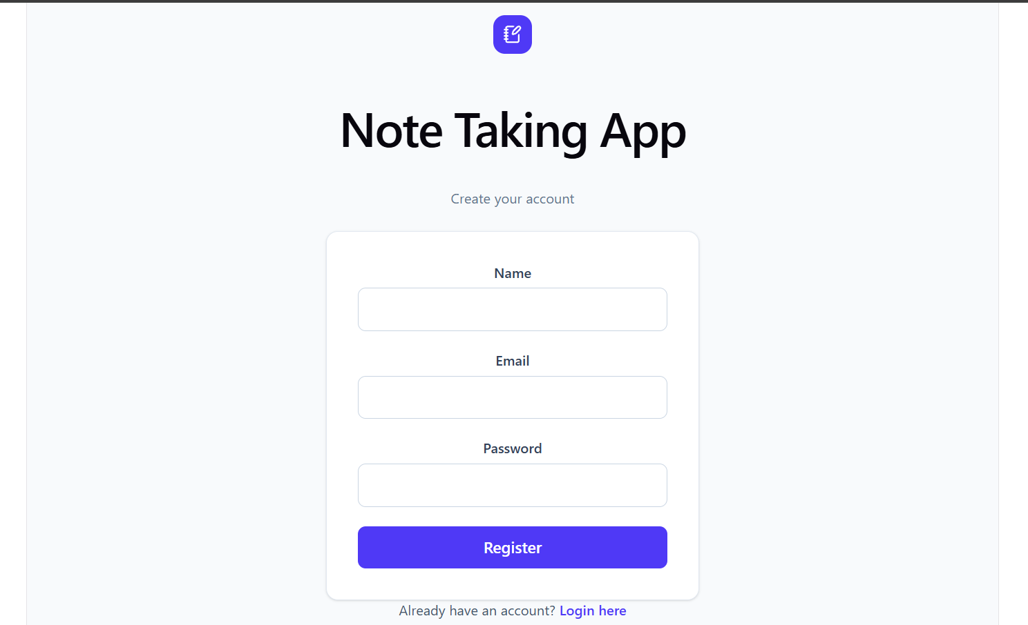
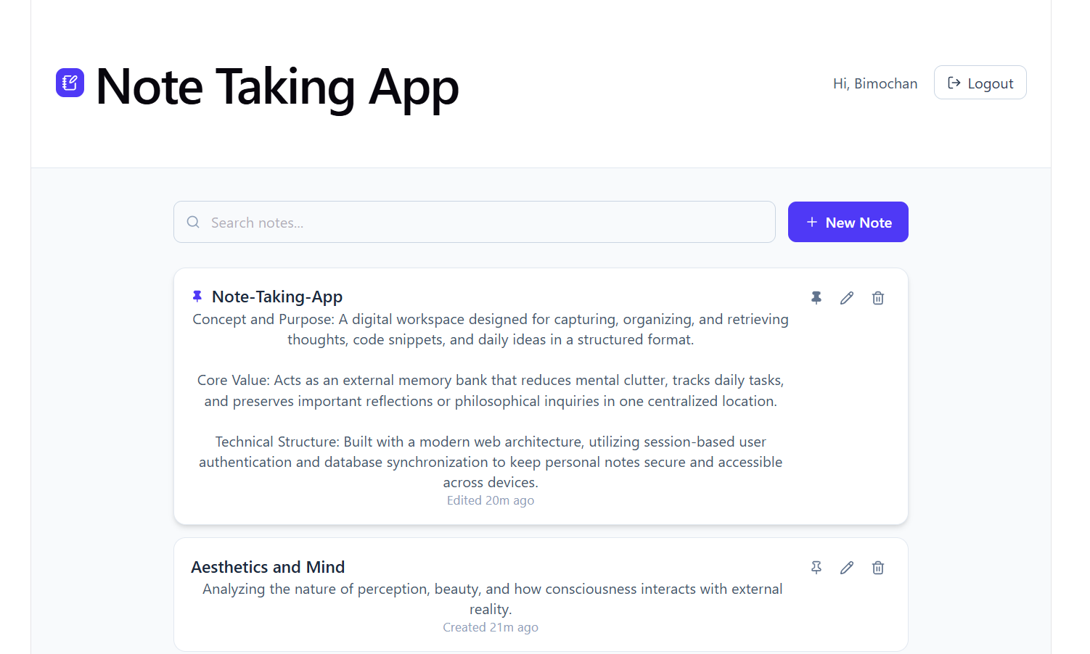

UI Screenshots
[ Screenshots of Login, Register, and Dashboard ]
Login Page
Register Page
Dashboard
Note Taking App
12

Slide 13


Testing
Authentication Tests
CRUD Tests
Signup with valid & missing data
Create, read, update, delete a note
Duplicate email rejected
Invalid note ID handling
Login with correct / incorrect password
Unauthenticated request blocked
/api/auth/me while logged in & out
Access to another user's note blocked
Note Taking App
13

Slide 14
Challenges & Solutions
Requests failing silently due to a URL/baseURL mismatch between frontend and backend
Standardized the axios baseURL and relative request paths across the app
Session cookies not persisting across requests
Configured CORS with credentials and connect-mongo for persistent session storage
Preventing access to other users’ notes
Added ownership checks (userId match) in every note controller and requireAuth middleware
Note Taking App
14

Slide 15




Future Enhancements
Tag-based filtering
Note sharing
Expose the existing tags field in the UI for filtering notes.
Allow controlled sharing of notes between users.
Password reset
Mobile app
Add email-based password recovery.
Extend the React frontend into a mobile-friendly PWA.
Note Taking App
15

Slide 16

Conclusion
The Note Taking App successfully demonstrates secure, session-based authentication and complete CRUD functionality with strict per-user data ownership — meeting every mandatory requirement of the project brief.
Hands-on experience with the full MERN-style stack
Practical understanding of session vs. token authentication
Real-world debugging of full-stack integration issues
Note Taking App
16

Slide 17
Thank You
Live Demo & Questions
Bimochan Limbu | BSc.CSIT

