Slide 1

BEST PLACE WITH GOOD INFRASTRUCTURE IN TORONTO
Bimo Satrio Aji
Data Science Capstone-IBM

Slide 2
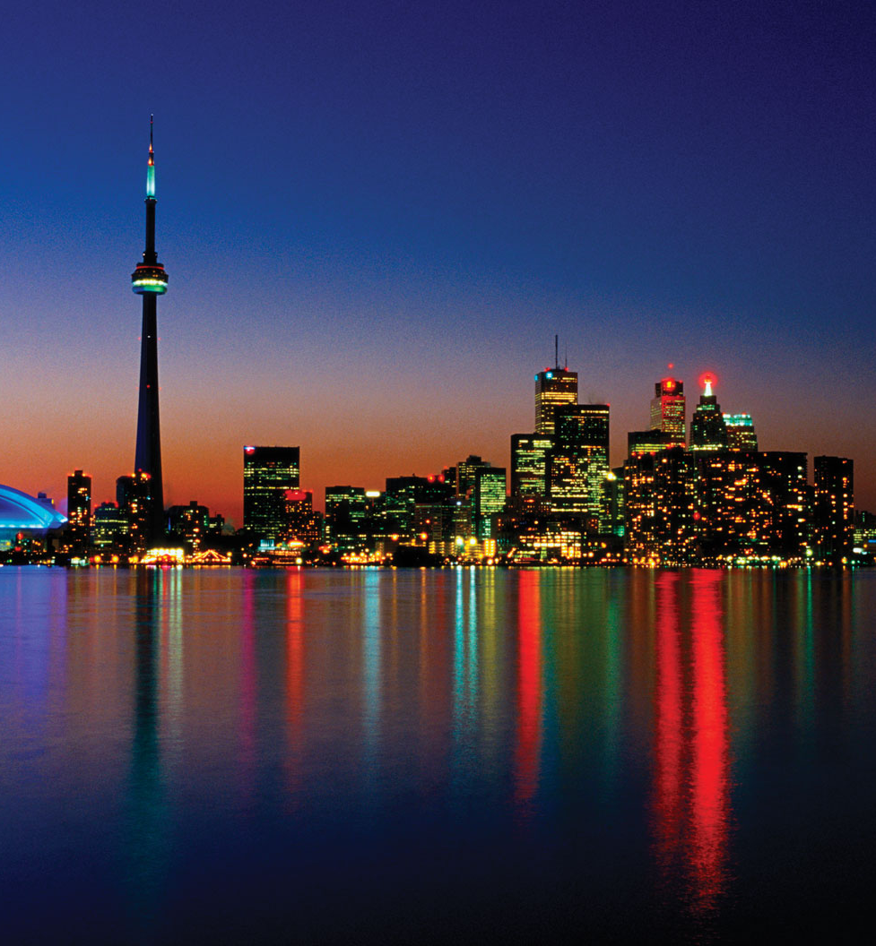
Intoduction
Toronto City is a prominent center for music, theatre, motion picture production, and television production, and is home to the headquarters of Canada's major national broadcast networks and media outlets. Its varied cultural institutions, which include numerous museums and galleries, festivals and public events, entertainment districts, national historic sites, and sports activities,[38] attract over 43 million tourists each year. Toronto is known for its many skyscrapers and high-rise buildings, in particular the tallest free-standing structure in the Western Hemisphere, the CN Tower.

Slide 3

Business Problem
1. List and visualize all major parts of Toronto City with top existing infrastructure.
2. List the best locations in Toronto City as per infrastructure.
3. List of all areas lacking infrastructure facilities.
4. Best place to stay in Toronto City by Clustering.

Slide 4
Data Description
This project uses the following data:
List of postal codes of Canada: M
Source: https://en.wikipedia.org/wiki/List_of_postal_codes_of_Canada:_M
Description: This is a list of postal codes in Canada where the first letter is M. Postal codes beginning with M are located within the city of Toronto in the province of Ontario. Only the first three characters are listed, corresponding to the Forward Sortation Area.
Geospatial data of Toronto
Source: Lab week 3
Description: Toronto geospatial data obtained from the third week of the Lab, this data is in accordance with the data obtained from the wiki page.

Slide 5
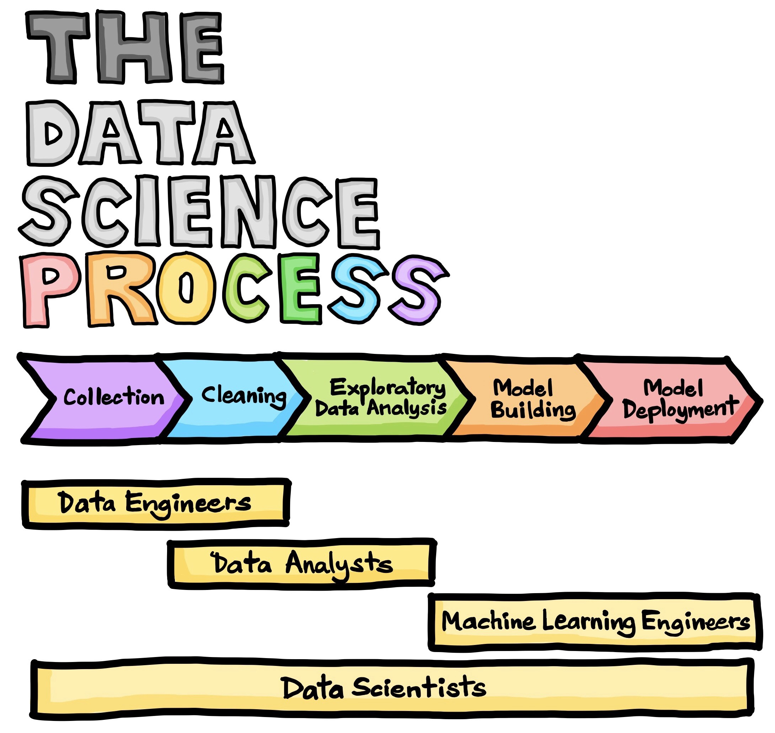
Methodology

Slide 6
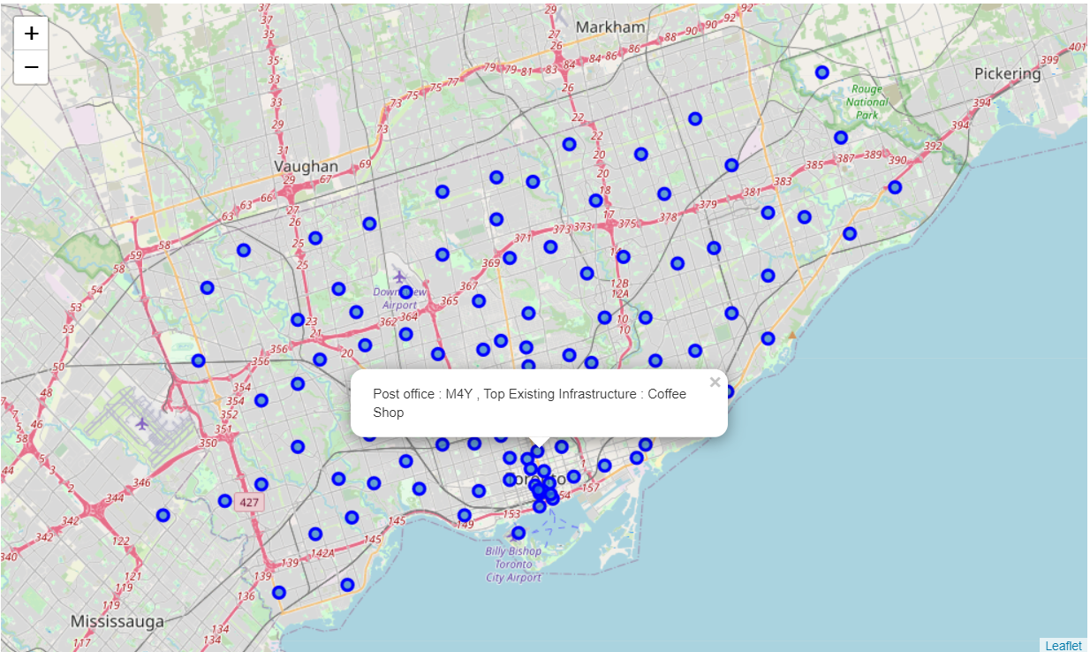
Result

Slide 7
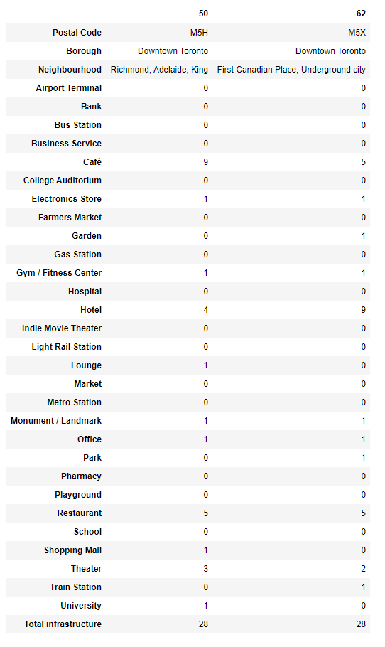
The best locations in Toronto as per Infrastructure

Slide 8
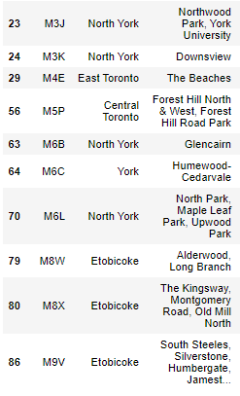
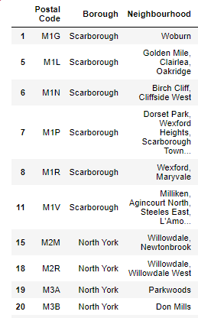
Areas with Lack the Infrastructure Facilities

Slide 9
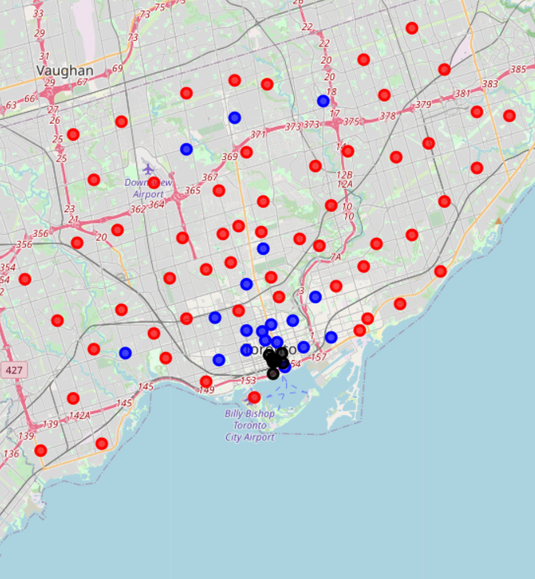
Cluster 1: Neighbourhoods with a high number of infrastructures.
Cluster 2: Neighbourhoods with a low number to no existence of infrastructures.
Cluster 3: Neighbourhoods with a moderate number of infrastructures.

Slide 10

Discussion
Most of the infrastructures are spread in Toronto, with the highest number in cluster 1 and moderate number in cluster 3. On the other hand, cluster 2 has a very low number of infrastructures in the neighbourhoods. This represents a great opportunity and high potential areas to open new infrastructures as it is very little to no competition from existing varied infrastructures. Meanwhile, one can specifically check the infrastructure of choice against the postal office choice area. Infrastructures in cluster 1 are likely suffering from intense competition due to oversupply and high concentration of already established Infrastructures.

Slide 11
Conclusion
In this project, I have gone through the process of identifying the business problems, specifying the data required, extracting, and preparing the data, visualizing the results, performing machine learning to build cluster, tackling and reaching to a definitive solution to business problems. The project is providing recommendations to relevant stakeholders i.e., property business regarding the best locations to open new infrastructure. This project also provides visitors and immigrants to the city regarding Postal Code areas for growth and living prosperously.

