Slide 1
Database Purpose & Overview
Eggshell Home Builder Database Project Overview
Presented by: Team2
Team member: Tim Yeung CHAN, Xun Yi LIM, Taiyuan ZHANG
Date: 2024/10/10

Slide 2
Agenda
1. Database Purpose & Overview
2. Entity Relational Diagram
3. Key Business Rules
4. Database Functionality & Screenshots
5. Reports & Outputs
6. Summary and Benefits

Slide 3
Database Purpose & Overview
Purpose:
To support Eggshell Home Builders' operations by managing customer orders, construction projects, sales, and financial transactions.
Enhance information flow between sales agents, sales representatives, and construction managers.
Motivations:
Support sales agents in handling paperwork.
Provide buyers with up-to-date information via the web on houses and customization options.
Keep sales representatives updated on construction progress.
Assist construction managers in tracking and updating project progress efficiently.

Slide 4
Current Situation
Challenges:
Sales agents handle significant paperwork, including forms for house styles, options, and sales.
Sales representatives must visit subdivisions to update buyers on house progress.
Construction managers are responsible for tracking progress and reporting it to sales reps.
Customers face difficulties browsing available decorator options, limiting their experience.

Slide 5
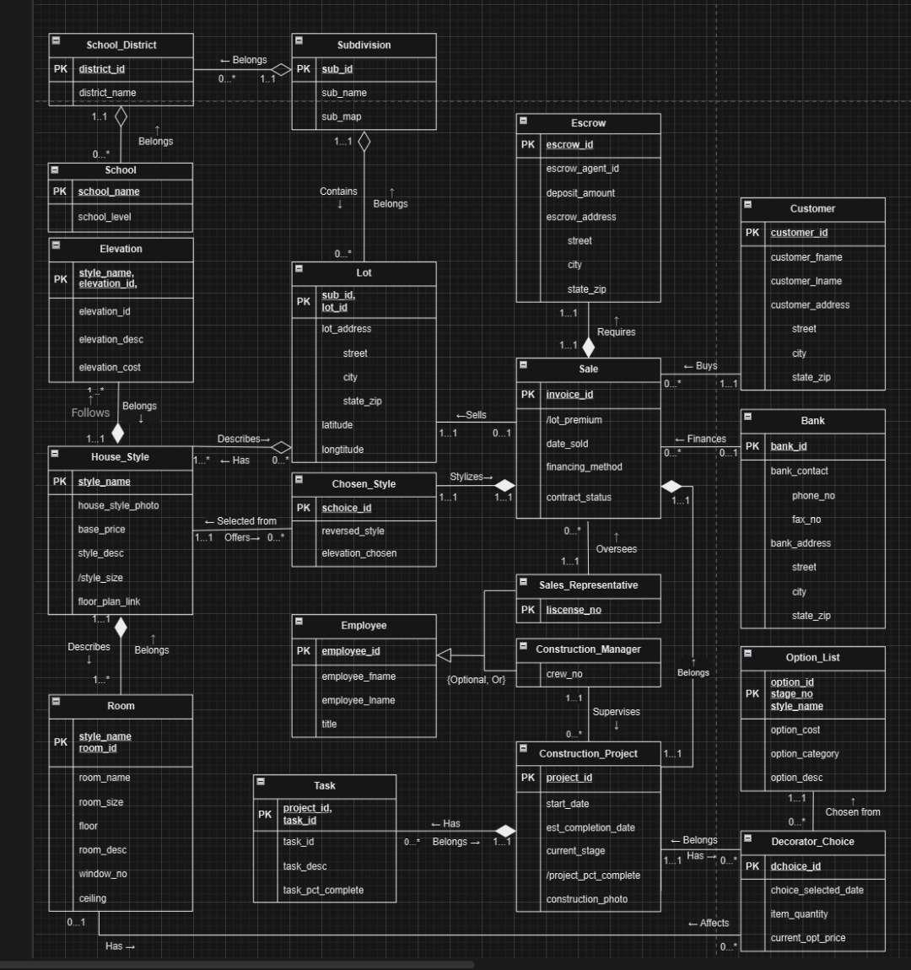
ERD

Slide 6
Core Assumptions
1. Each school belongs to one district and has unique levels: elementary, middle, high.
2. House styles have at least one elevation as a base design.
3. Lots can be built in regular or reversed styles.
4. Construction projects have 7 defined stages, visible to managers, limited for customers.
5. Option list updated by stages, with additional costs based on stage availability.

Slide 7
Additional Assumptions
1. School names are unique and serve as primary keys.
2. House styles can share lots; elevations are weak entities identified by IDs.
3. Sales records include escrow, financing, and calculated lot premiums.
4. Construction project completion is calculated from task completion rates.
5. Decorator choices are fixed-price, can be revised only before task start.

Slide 8
Database Setup
1. Download and unzip Team2_eggshell.zip.
2. SQLDeveloper Database Connection:
- Username: Team2
- Password: Password99
- Hostname: Heinz-db-03.andrew.local.cmu.edu
- Port: 1561
- Service Name: https://heinzdb3.andrew.cmu.edu/
3. Edit 'main.sql' to set base_path.
4. Execute 'main.sql' to create database tables.

Slide 9
Views and Procedures
1. ACCESSIBLE_PROJECTS view: Customer visibility on project stages.
2. PROJECT_OPTIONS_VIEW: Limits decorator options based on stage.
3. Filter Options By Category: Procedure filters options by category.
4. Create_Sale_Record: Links customer and sale data into Sales table.
5. Sale_Operations Package: Handles operations for Sale table.

Slide 10
Functions and Triggers
1. CALC_REFUND: Calculates refundable deposit amount based on progress.
2. VOID_SALE: Trigger to nullify sale data when contract status is voided.
3. UPDATE_PROJECT_PCT_COMPLETE: Updates project completion based on tasks.
4. CP_DEL_CASCADE: Cascade deletes associated tasks when a project is deleted.
5. Scheduled Job: Yearly job to remove inactive customers.

Slide 11
Customer Role
Access to their own sales record via CustomerSaleRecord view.
Restricted view of SalesRepresentative and ConstructionManager data.
-Access to limited tables: Option_List, Decorator_Choice, Construction_Project, and Lot.

Slide 12
Employee Role
General access with permissions to select, update, delete on most tables.
Access to customer data is restricted based on specific responsibilities.
Specialized views for managing project-related tasks and choices.

Slide 13
Sales Representative and Construction Manager Roles
Sales Representatives have access to customer addresses for their own sales records.
Construction Managers have access to project-specific entries in Task and Decorator_Choice.
Specific views provided to manage projects and decorator choices.

Slide 14
Restricted Database Access
Scenario: Restricted access for customers to project stages.
1. Stages 1-3 displayed as Stage 1
2. Stages 4-6 displayed as Stage 4
3. Stage 7 displayed as Stage 7
Customers can only view and filter their own sales records and project progress.

Slide 15
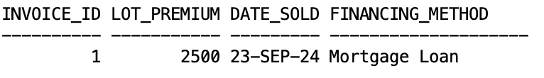
Restricted Database Access
expected output of CustomerSaleRecord
check our project progress via ACCESSIBLE_PROJECTS view(Project_Stage is displayed as 1, while actual project stage inserted in the Construction_Project table is 2 )
filter and view the options available by PROJECT_OPTIONS_VIEW:

Slide 16
Sale Cancellation Process
1. Deleting a sale triggers cascading deletions.
2. Entities affected: Construction_Project, Escrow, Chosen_Style.
3. Refund is calculated based on escrow and project completion.
Example: $2000 escrow, 25% completion results in $500 refund.

Slide 17
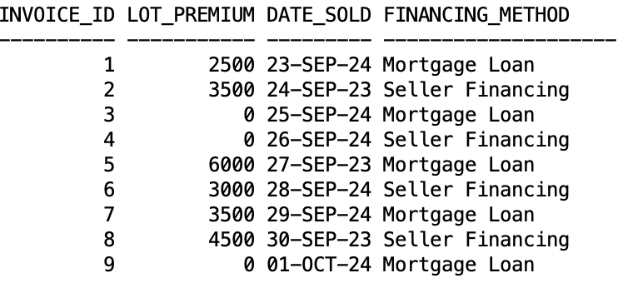
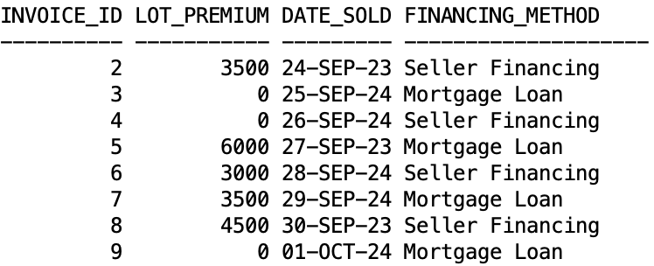
Sale Cancellation Process
performs the deletion of a sale record with invoice_id = 1 by calling cancel_sale_record procedure and contrasts the Sale tables before and after the deletion.
escrow deposit associated with the deleted sale record is 2000 and the percentage of project completed is 25%. The amount of refund is calculated as: 2000 * 0.25 = 500

Slide 18
Filtering Options by Category
1. Use 'FilterOptionsByCategory' procedure to sort options.
2. Categories include: Electrical, Exterior, Interior, Plumbing.
3. Input NULL to display all options, or specify a category to filter.

Slide 19
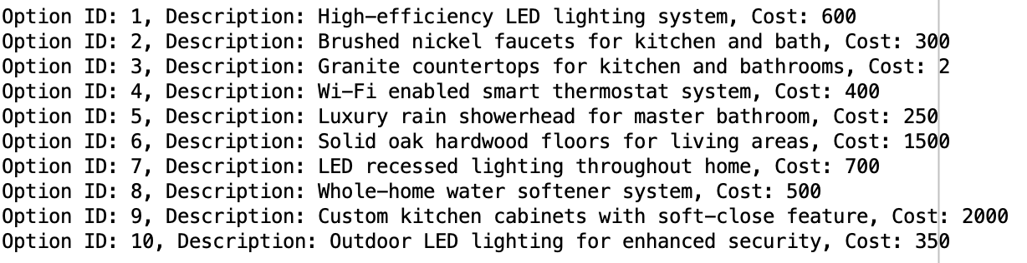
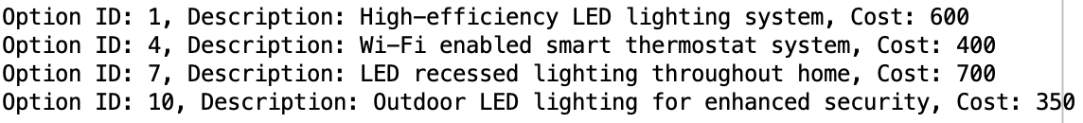
Filtering Options by Category
Insert ‘Electrical’

Slide 20
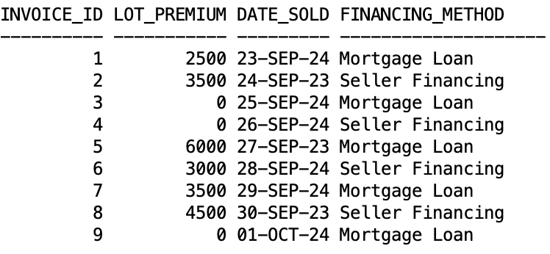
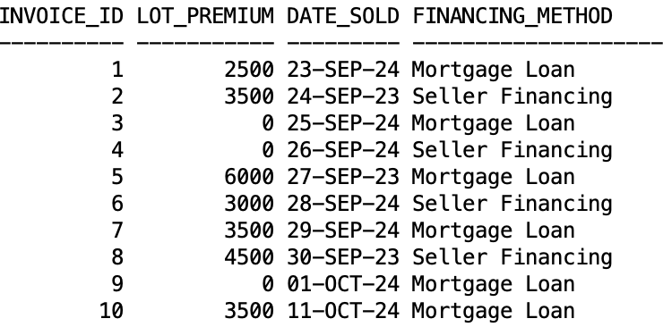
Sale Record Creation
Create a sale record using 'create_sale_record' procedure.

Slide 21
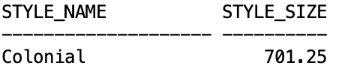

Style Size Derivation
Style size is derived from summing room sizes.
After a new room with size of 100 is added for the Colonial style

Slide 22
Summary and Benefits
The Eggshell Home Builders Database provides robust functionality to streamline operations.
Improves operational efficiency.
Ensures secure access to sensitive data.
Supports customization for user-specific needs.

