Slide 1


Paper ID: PD104
New Parallel Order Maintenance Data Structure
Bin Guo (binguo@trentu.ca, Trent University, ON Canada)
Emil Sekerinski (emil@mcmaster.ca, McMaster University, ON Canada)

Slide 2

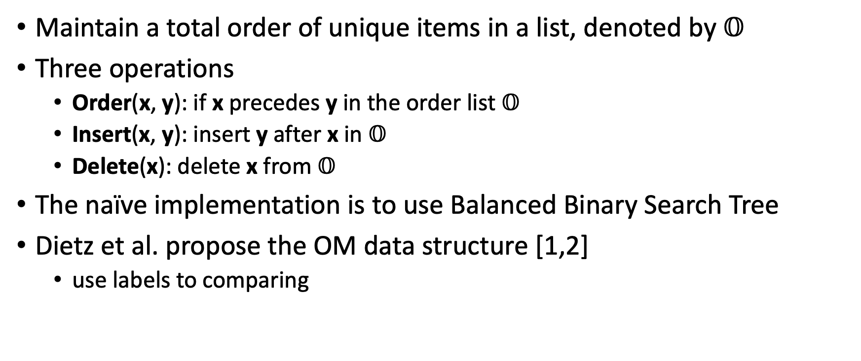
Parallel Order Maintenance (OM) Data Structure
Maintain a total order of unique items in a list, denoted by $𝕆$
Three operations
Order(x, y): if x precedes y in the order list $𝕆$
Insert(x, y): insert y after x in $𝕆$
Delete(x): delete x from $𝕆$
The naïve implementation is to use Balanced Binary Search Tree
Dietz et al. propose the OM data structure [1,2]
use labels to comparing
Author Information

Slide 3
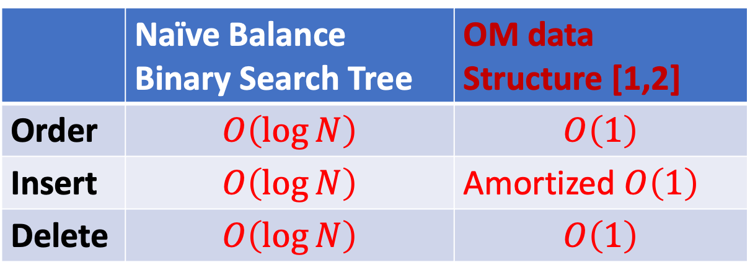
Compare The time complexities
 | Naïve Balance Binary Search Tree | OM data Structure [1,2]
Order | $$O\left(\log{N}\right)$$ | $$O\left(1\right)$$
Insert | $$O\left(\log{N}\right)$$ | Amortized $O\left(1\right)$
Delete | $$O\left(\log{N}\right)$$ | $$O\left(1\right)$$
For N items in total

Slide 4


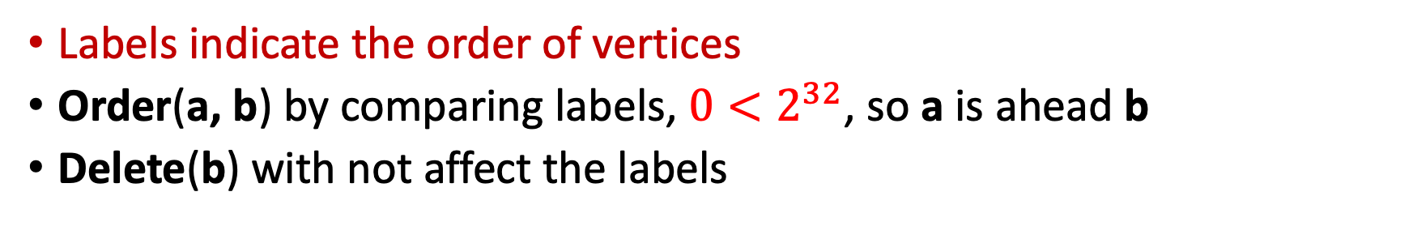



Examples: Order and Delete
a
Initial Labels (64 bits) with interval $2^{32}$
Graph Topological Sorting
$$0$$
$$2^{32}$$
$${2∙2}^{32}$$
$${3∙2}^{32}$$
b
c
d
a
b
c
d
…
directed acyclic graph
OM data structure with Ordered List
Labels indicate the order of vertices
Order(a, b) by comparing labels, ${0<2}^{32}$, so a is ahead b
Delete(b) with not affect the labels

Slide 5






Examples: Insert
x₃₃
$$0$$
$$2^{0}=1$$
$$2^{1}=2$$
$$2^{29}$$
$$2^{30}$$
$$2^{31}$$
$$2^{32}$$
$${2∙2}^{32}$$
$${3∙2}^{32}$$
a
x₃₂
x₃₁
…
x₃
x₂
x₁
b
c
d
…
insert x_{1 ,} x_{2,} x_{3, … ,} x_{31,} x₃₂
Insert(a, x): x is in the middle between a and a.next
At most 32 items can Insert after a, without changing labels
It will trigger the Relabel operation when insert
x₃₃

Slide 6







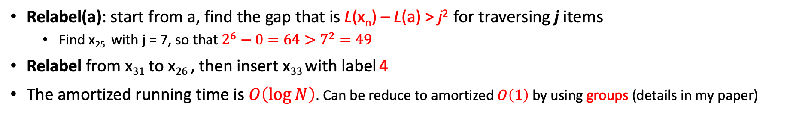












Examples: Relabel
x₃₃
$$0$$
$$2^{0}$$
$$2^{29}$$
$$2^{30}$$
$$2^{31}$$
$$2^{32}$$
$${2∙2}^{32}$$
$${3∙2}^{32}$$
a
x₃₂
…
x₃
x₂
x₁
b
c
d
…
$$0$$
$$2^{0}$$
$$2^{1}$$
$$2^{2}$$
$$2^{3}$$
$$2^{4}$$
$$2^{5}$$
$$2^{6}$$
a
x₃₂
x₃₀
x₂₉
x₂₈
x₂₇
x₂₆
x₂₅
…
j=1
j=2
j=3
j=4
j=5
j=6
j=7
$$4$$
x₃₃
$$0$$
9
18
27
$$36$$
$$45$$
$$54$$
$$2^{6}$$
a
x₃₂
x₃₀
x₂₉
x₂₈
x₂₇
x₂₆
x₂₅
…
Relabel(a): start from a, find the gap that is L(x_{n}) – L(a) > j² for traversing j items
Find x₂₅ with j = 7, so that $2^{6}−0=64>7^{2}=49$
Relabel from x₃₁ to x₂₆ , then insert x₃₃ with label 4
The amortized running time is $O\left(\log{N}\right)$. Can be reduce to amortized $O\left(1\right)$by using groups (details in my paper)

Slide 7







Our Contribution: Parallel OM data structure
Parallel-Delete and Parallel-Insert
In the double-linked list, we lock the related items
delete
Insert
x₃₃
$$0$$
$$2^{0}$$
$$2^{29}$$
$$2^{30}$$
$$2^{31}$$
$$2^{32}$$
$${2∙2}^{32}$$
$${3∙2}^{32}$$
a
x₃₂
…
x₃
x₂
x₁
b
c
d
…
lock
lock
lock
lock
lock
Both lock a and x₃₂ when inserting x₃₃
Assign x₃₃ a new label
The relabel process is triggered, which also need to lock related vertices
We lock x₁ , b and c when deleting b
The labels are not affected

Slide 8
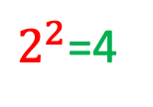



Our Contribution: Parallel OM data structure (2)
We desire lock-free Parallel-Order Operation
The Relabel may create labels that not correctly represent the order.
$$0$$
9
18
$2^{2}$=4
$$2^{3}$$
$$2^{4}$$
$$2^{5}$$
$$2^{6}$$
a
x₃₂
x₃₁
x₂₉
x₂₈
x₂₇
x₂₆
x₂₅
…
j=7
Relabel not finish, only updating x₃₁ and x_{30,}
The labels are incorrect to show order
$$4$$
x₃₃
$$0$$
9
18
27
$$36$$
$$45$$
$$54$$
$$2^{6}$$
a
x₃₂
x₃₀
x₂₉
x₂₈
x₂₇
x₂₆
x₂₅
…
j=7
When Relabel finish, labels correctly show the order
For parallel Order and Insert operations, the labels must correctly show the order at any time

Slide 9
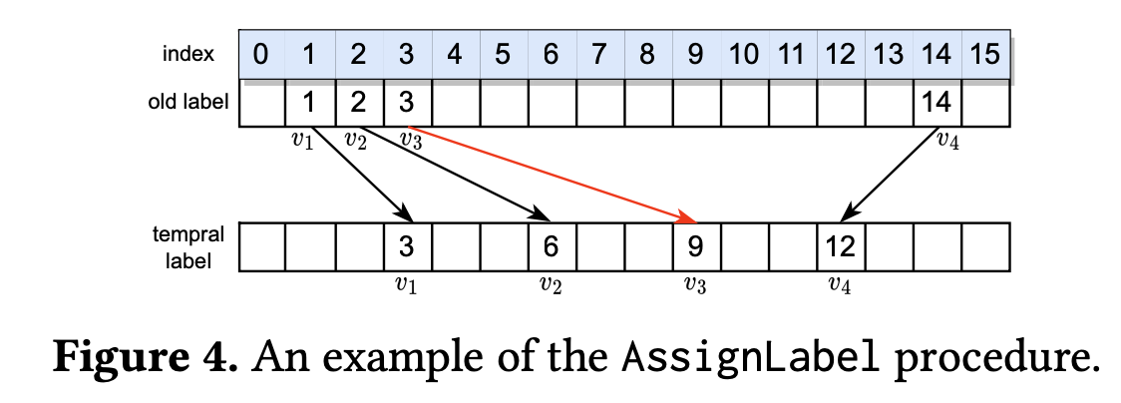
Our Contribution: Parallel OM data structure (3)
We propose a new Relabel operation
The Relabel with reverse order from the later item
All labels can be correctly indicating the order at any time snap
The Parallel Order is lock free

Slide 10
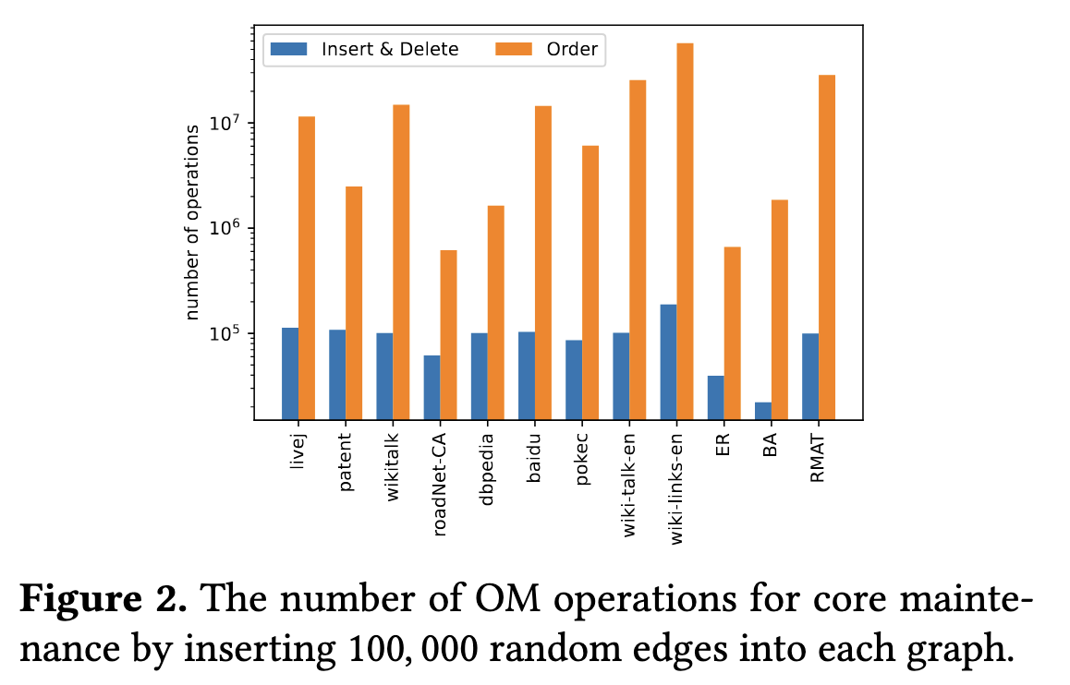
Application: Core Maintenance
Typically, a large portion (more than 90%) is Order operations
Only small portion (less than 10%) are Insert and Delete Operations
This is why lock-free Order is meaningful
It is a break-through for real applications

Slide 11
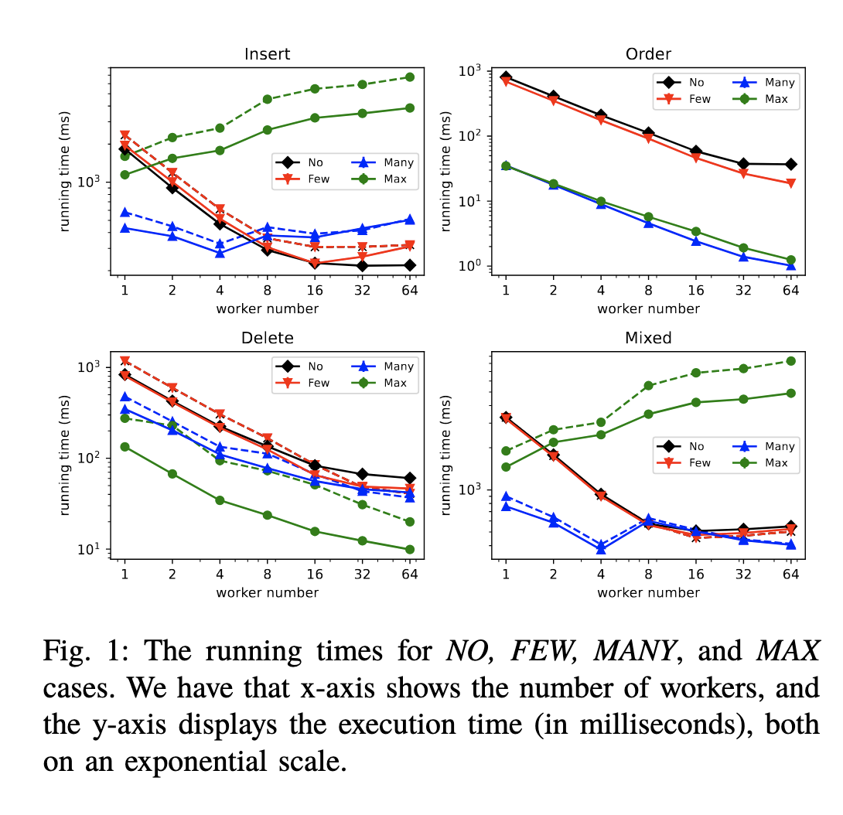
Experiments with 64 workers
Insert: insert 10 million items into O.
Order: compare its order of 10 million time.
Delete: delete all inserted items, a total of 10 million
Mixed: insert 10 million items, mixed with 100 million Order operations (simulate in applications)
No relabel case: insert 10 million items into 10 million positions
Few relabel case: insert 10 million items into 1 million positions
Many relabel case: insert 10 million items into 1000 positions
Max relabel case: insert 10 million items into 1 positions

Slide 12
Conclusion
The parallel Order operations achieve the best speedups
In future, we attempt to make Insert and Delete as lock-free
By using Muti-CAS
Also, apply parallel OM data structure to many other applications
like Ordered Set
UML
Notes:
In No, Few, Many relabel case, all operations have good speedups
In the Max relabel case, the Insert performance is decreased with multiple workers
As it is reduced to sequential, and the contention is high

Slide 13
Reference
[1] Paul Dietz and Daniel Sleator. Two algorithms for maintaining order in a list. In Proceedings of the nineteenth annual ACM symposium on Theory of computing, pages 365–372, 1987.
[2] Michael A Bender, Richard Cole, Erik D Demaine, Martin Farach- Colton, and Jack Zito. Two simplified algorithms for maintaining order in a list. In European Symposium on Algorithms, pages 152–164. Springer, 2002.

