Slide 1


On the Evaluation of Pattern Match Queries in Large Graph Databases
Thesis defense by Bin Guo supervised by Pro. Yandjun Chen
Applied Computer Science
March 12, 2018

Slide 2
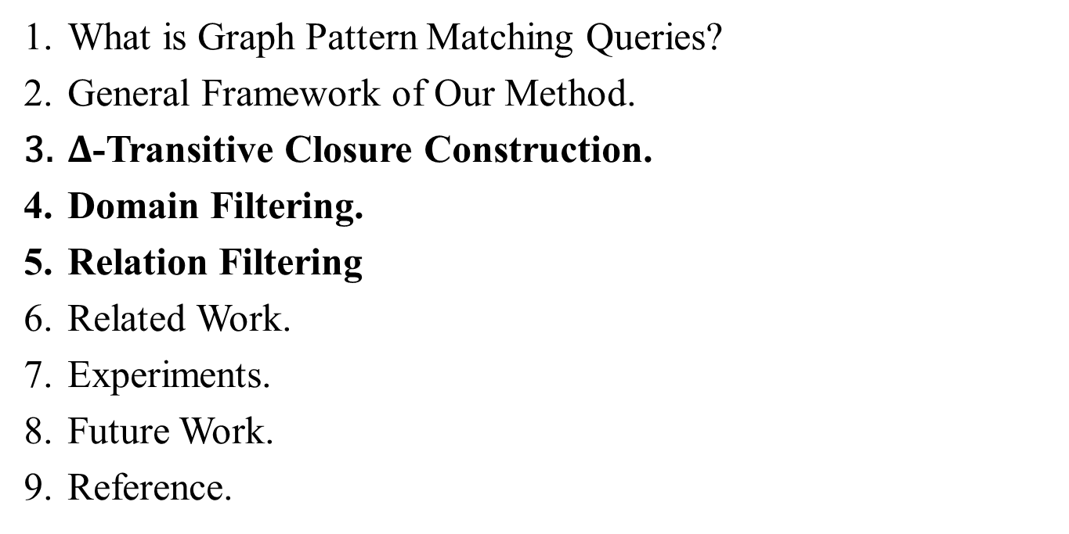
OUT LINE
What is Graph Pattern Matching Queries?
General Framework of Our Method.
$Δ$-Transitive Closure Construction.
Domain Filtering.
Relation Filtering
Related Work.
Experiments.
Future Work.
Reference.

Slide 3

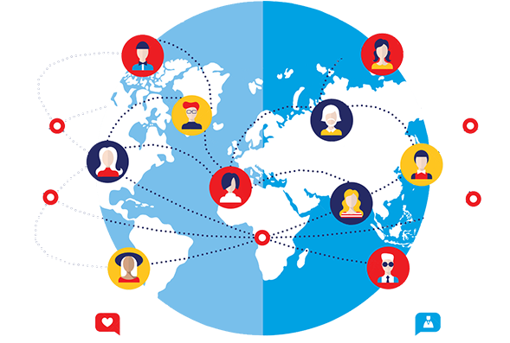
1. What Is Graph Pattern Match Queries?
Graph is an important data structure for many applications like social network.
For example, “Facebook” is one of the largest social network which has 2.2 billion monthly active users.
Notes:
Doing pattern match queries on this large social network graphs would be very meaningful. Let’s see a simple example for good understanding.

Slide 4





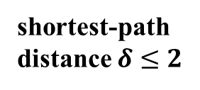
Pattern Matching Queries
CFO
CFO
CEO
Doctor
CFO
CEO
Doctor
Doctor
CEO
shortest-path
distance $δ≤2$
Manager
Student
Query
Student
Student
Manager
A example of social network Graph
A successful CEO’s circle of friends.
Notes:
0. imaging we have a network graph like this in which all people are labeled with different job titles: CEO, CFO, Doctor, Manager and Student.
1. A query pattern have 4 types of labels among them connected like this.
2. And the constrains are setup on the shortest-path distance <= 2 between any pair of matched labels in data graphs.
3. Finding such patterns may help social scientist discover some connections between successful CEOs and their circle of friends.
4. In this example, we can find the these 4 vertices in the graphs that is similar to the query.
5. However, it is not easy to doing such pattern matching queries in large data graphs. In our research, we propose a general framework to handle this problem.

Slide 5

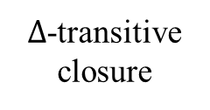






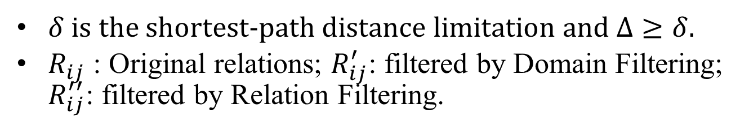

2. General Framework of Our Method
$Δ$-transitive closure
$$G$$
$Δ$
$G^{Δ}$
$Σ$
R(l, l′)
offline (index)
$$R_{ij}$$
Relation Construction
Relation Filtering
Domain Filtering
Matching Result Construction
$Q$ & $δ$
$$R_{ij}^{′}$$
Natural Join
Matching Results
$$R_{ij}^{′′}$$
$δ$ is the shortest-path distance limitation and $Δ≥δ$.
$R_{ij}$ : Original relations; $R_{ij}^{′}$: filtered by Domain Filtering; $R_{ij}^{′′}$: filtered by Relation Filtering.
Notes:
It include two main parts: Relation Construction and Matching Result Construction.
Gdelta can generate the relations offline as index.
in online stage,….
Now , we begin to discuss how to construct the delta-transitive c

Slide 6

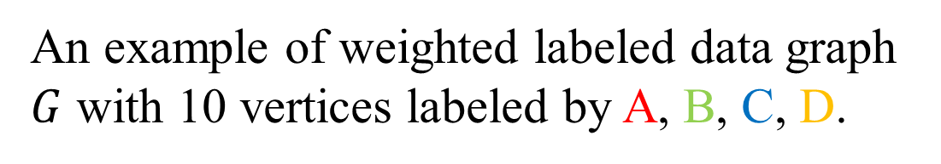
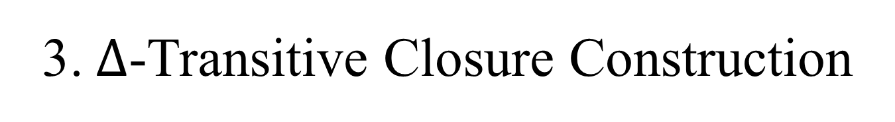
3. $Δ$-Transitive Closure Construction
D
B
C
B
C
2
1
4
1
3
2
5
4
2
3
2
1
$$G$$
3
C
A
A
A
B
6
1
8
1
7
1
9
2
10
1
An example of weighted labeled data graph $G$ with 10 vertices labeled by A, B, C, D.
Notes:
let’s see a example graph.
it has 10 vertices labeled by ABCD with different color.

Slide 7
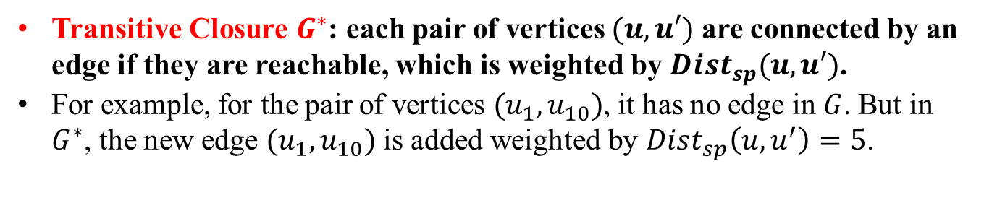

D
B
C
B
C
2
1
1
3
2
5
4
2
3
1
$$G^{∗}$$
4
2
3
A
A
A
B
C
6
1
8
1
7
1
9
2
10
1
Transitive Closure $G^{∗}$: each pair of vertices $(u,u′)$ are connected by an edge if they are reachable, which is weighted by $Dist_{sp}(u, u′)$.
For example, for the pair of vertices $(u_{1},u_{10})$, it has no edge in $G$. But in $G^{∗}$, the new edge $(u_{1},u_{10})$ is added weighted by $Dist_{sp}\left(u, u^{′}\right)=5$.
Notes:
before introduce the delta-tc, we firstly introduce the tc. that is .
by using this tc, we can check the shortest distance path between any pair of vertices very fast within constant time O(1), if tc is generated before checking.

Slide 8
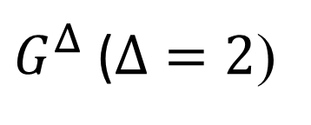
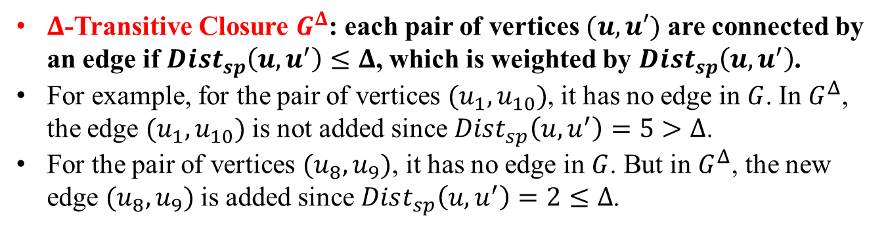
D
B
C
B
C
2
1
4
1
3
2
5
$G^{Δ}$ ($Δ=2$)
4
2
3
2
1
3
C
A
A
A
B
6
1
8
1
7
1
9
2
10
1
$Δ$-Transitive Closure $G^{Δ}$: each pair of vertices $(u,u′)$ are connected by an edge if $Dist_{sp}\left(u, u^{′}\right)≤Δ$, which is weighted by $Dist_{sp}\left(u, u^{′}\right)$.
For example, for the pair of vertices $(u_{1},u_{10})$, it has no edge in $G$. In $G^{Δ}$, the edge $(u_{1},u_{10})$is not added since $Dist_{sp}\left(u, u^{′}\right)=5>Δ$.
For the pair of vertices $(u_{8},u_{9})$, it has no edge in $G$. But in $G^{Δ}$, the new edge $(u_{8},u_{9})$is added since $Dist_{sp}\left(u, u^{′}\right)=2≤Δ$.
Notes:
Not to talk.

Slide 9
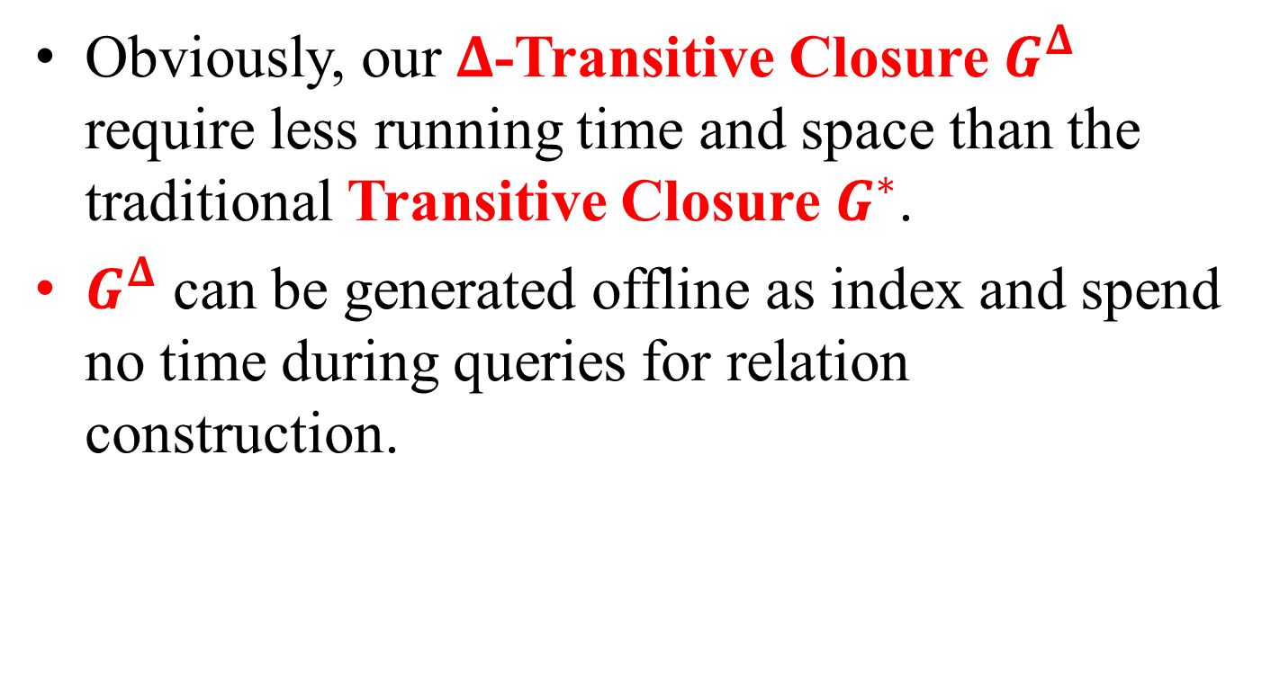
Obviously, our $Δ$-Transitive Closure $G^{Δ}$ require less running time and space than the traditional Transitive Closure $G^{∗}$.
$G^{Δ}$ can be generated offline as index and spend no time during queries for relation construction.
Notes:
Not to talk.

Slide 10




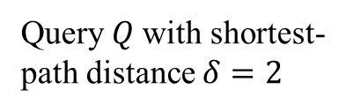





4. Domain Filtering
D
B
C
B
C
C
2
1
4
3
1
3
2
5
2
$G^{Δ}$ ($Δ=2$)
A
B
4
2
3
3
1
A
A
A
B
C
1
2
6
1
8
1
7
1
9
2
10
Query $Q$ with shortest-path distance $δ=2$
1
$$\left(v_{1},v_{2}\right)∈E(Q)$$
$$\left(v_{1},v_{2}\right)∈E(Q)$$
$$\left(v_{1},v_{2}\right)∈E(Q)$$
$$R_{12}$$
$$R_{23}$$
$$R_{31}$$
A | B
6 | 3
8 | 5
8 | 9
7 | 9
B | C
3 | 2
5 | 4
9 | 10
9 | 4
C | A
10 | 6
10 | 8
4 | 7
$$⋈$$
$$⋈$$
Naïve Natural Join of Relations
Notes:
1, after the G-delta, we can easily get all the relations.
2, we can do the natural join to obtain all the matching results.

Slide 11

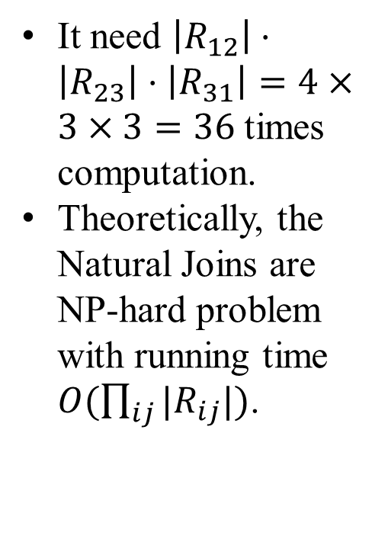



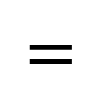




$$R_{123}$$
$$R_{12}$$
$$R_{23}$$
A | B | C
6 | 3 | 2
8 | 5 | 4
8 | 9 | 10
8 | 9 | 4
7 | 9 | 10
7 | 9 | 4
A | B
6 | 3
8 | 5
8 | 9
7 | 9
B | C
3 | 2
5 | 4
9 | 10
9 | 4
It need $\left|R_{12}\right|⋅\left|R_{23}\right|⋅\left|R_{31}\right|=4×3×3=36$ times computation.
Theoretically, the Natural Joins are NP-hard problem with running time $O(\prod_{ij}{{|R}_{ij}|})$.
$$⋈$$
$$=$$
$$R_{31}$$
C | A
10 | 6
10 | 8
4 | 7
$$R_{123}$$
$$⋈$$
$$=$$
A | B | C
8 | 9 | 10
7 | 9 | 4
We can do better!
2 matching results
Notes:
We want to reduce the size of relations participating the join operations.

Slide 12




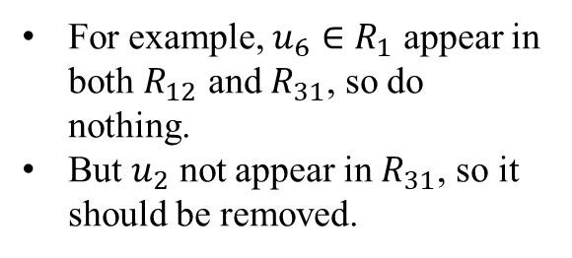

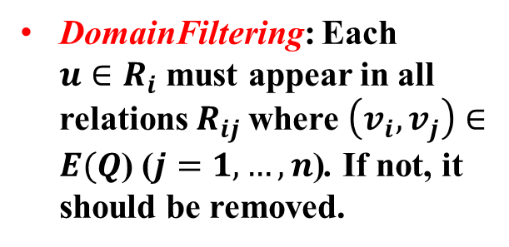


$$R_{12}$$
$$R_{23}$$
$$R_{31}$$
C
A | B
6 | 3
8 | 5
8 | 9
7 | 9
B | C
3 | 2
5 | 10
9 | 4
C | A
10 | 6
10 | 8
4 | 7
3
A
B
Relations
1
2
Query $Q$
DomainFiltering: Each ${u∈R}_{i}$ must appear in all relations $R_{ij}$where $\left(v_{i}, v_{j}\right)∈E(Q$) ($j=1, …, n$). If not, it should be removed.
$$R_{1}$$
$$R_{2}$$
$$R_{3}$$
6
3
2
Relation Graph.
For example, $u_{6}∈R_{1}$ appear in both $R_{12}$ and $R_{31}$, so do nothing.
But $u_{2}$ not appear in $R_{31}$, so it should be removed.
8
5
10
7
9
4
Notes:
1 again, lets see all the relations.
2. If u not appear in any Relaiton Rij, the u does not contribute to the final matching results. So this u should be removed from its domain Ri.
Let’s the details.

Slide 13











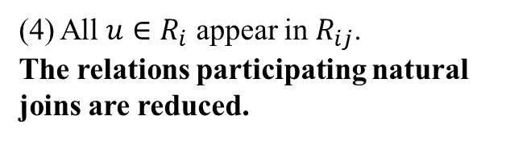


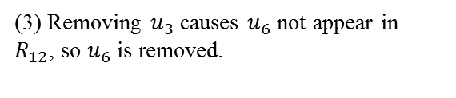

$$R_{1}$$
$$R_{2}$$
$$R_{3}$$
$$R_{1}$$
$$R_{2}$$
6
3
2
6
3
$$R_{3}$$
8
5
10
8
5
10
7
9
4
7
9
4
(1) $u_{2}$ not appear in $R_{31}$, so $u_{2}$ is removed.
(2) Removing $u_{2}$ causes $u_{3}$ not appear in $R_{23}$, so $u_{3}$ is removed.
$$R_{1}$$
$$R_{1}$$
$$R_{2}$$
$$R_{3}$$
6
$$R_{2}$$
$$R_{3}$$
8
5
10
8
5
10
7
9
4
7
9
4
(4) All $u∈R_{i}$ appear in $R_{ij}$.
The relations participating natural joins are reduced.
(3) Removing $u_{3}$ causes $u_{6}$ not appear in $R_{12}$, so $u_{6}$ is removed.

Slide 14
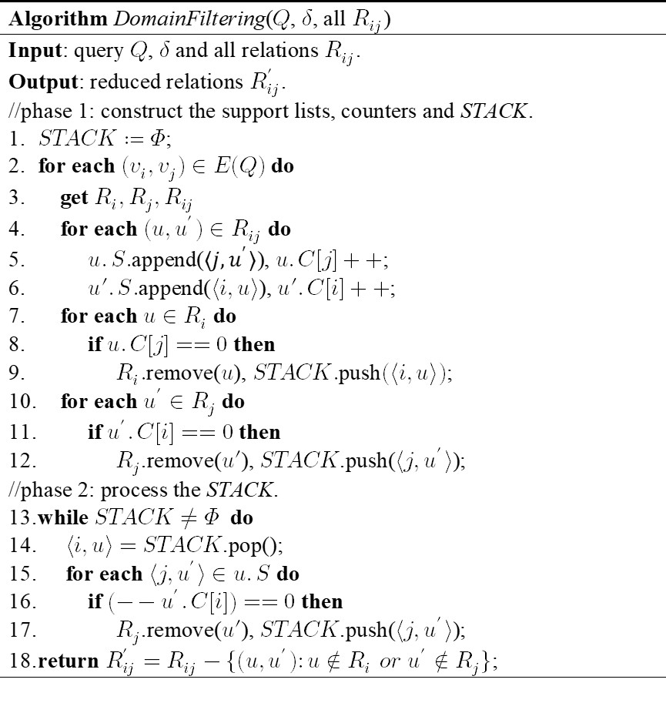
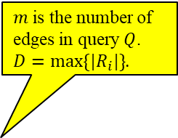
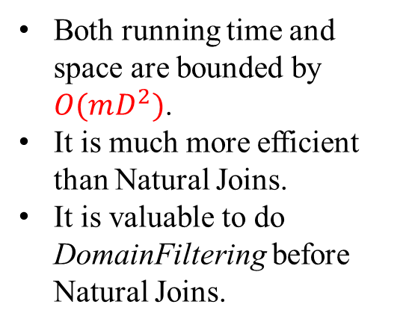
$m$ is the number of edges in query $Q$.
$D=max\{|R_{i}|\}$.
Both running time and space are bounded by $O(mD^{2})$.
It is much more efficient than Natural Joins.
It is valuable to do DomainFiltering before Natural Joins.
We can further do better!

Slide 15
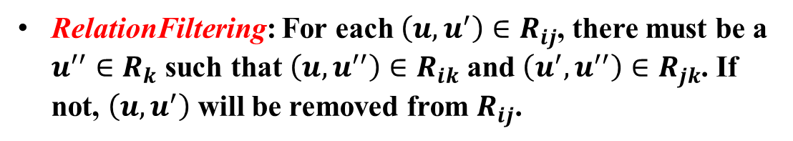




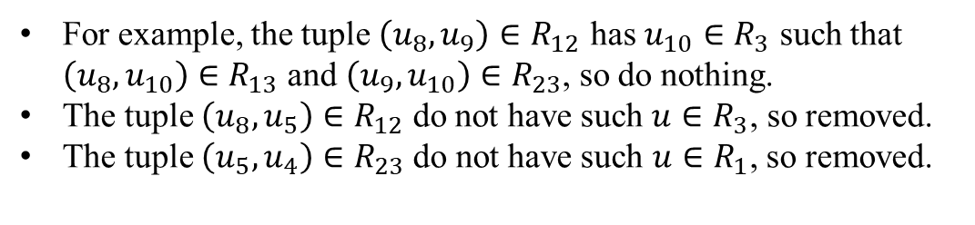
5. Relation Filtering
$$R_{1}$$
$$R_{2}$$
$$R_{3}$$
C
3
8
5
10
A
B
7
9
4
1
2
query Q has triangle edges$.$
The relation graph after DomainFiltering
RelationFiltering: For each $\left(u,u^{′}\right)∈R_{ij}$, there must be a $u^{′′}∈R_{k}$ such that $\left(u,u^{′′}\right)∈R_{ik}$ and $\left(u^{′},u^{′′}\right)∈R_{jk}$. If not, $\left(u,u^{′}\right)$ will be removed from $R_{ij}$.
For example, the tuple $\left(u_{8},u_{9}\right)∈R_{12}$ has $u_{10}∈R_{3}$ such that $\left(u_{8},u_{10}\right)∈R_{13}$ and $\left(u_{9},u_{10}\right)∈R_{23}$, so do nothing.
The tuple $\left(u_{8},u_{5}\right)∈R_{12}$ do not have such $u∈R_{3}$, so removed.
The tuple $\left(u_{5},u_{4}\right)∈R_{23}$do not have such $u∈R_{1}$, so removed.
Notes:
If such a tuple does not satisfy such condition, it cannot make contribution to the final result.

Slide 16
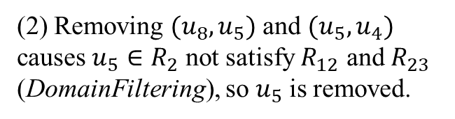
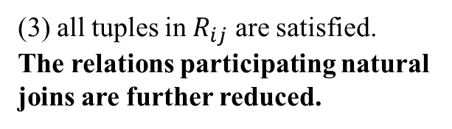
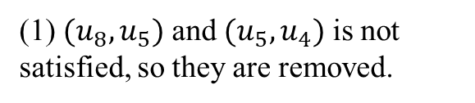




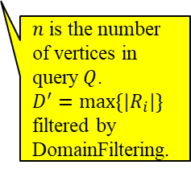



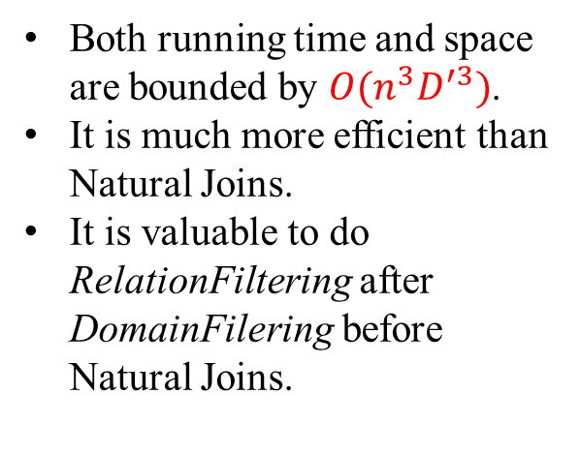
$$R_{1}$$
$$R_{2}$$
$$R_{3}$$
$$R_{1}$$
$$R_{2}$$
$$R_{3}$$
8
5
10
8
5
10
7
9
4
7
9
4
(1) $(u_{8},u_{5})$ and $(u_{5},u_{4})$ is not satisfied, so they are removed.
(2) Removing $(u_{8},u_{5})$ and $(u_{5},u_{4})$ causes $u_{5}∈R_{2}$ not satisfy $R_{12}$ and $R_{23}$ (DomainFiltering), so $u_{5}$ is removed.
$$R_{1}$$
$$R_{3}$$
Both running time and space are bounded by $O(n^{3}D^{′3})$.
It is much more efficient than Natural Joins.
It is valuable to do RelationFiltering after DomainFilering before Natural Joins.
8
10
$$R_{2}$$
7
9
4
$n$ is the number of vertices in query $Q$.
$D^{′}=max\{|R_{i}|\}$ filtered by DomainFiltering.
(3) all tuples in $R_{ij}$ are satisfied.
The relations participating natural joins are further reduced.

Slide 17









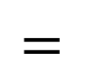


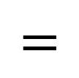

$$R_{12}$$
$$R_{23}$$
$$R_{31}$$
$$R_{123}$$
A | B
6 | 3
8 | 5
8 | 9
7 | 9
B | C
3 | 2
5 | 4
9 | 10
9 | 4
C | A
10 | 6
10 | 8
4 | 7
A | B | C
8 | 9 | 10
7 | 9 | 4
Naïve Natural Joins
$$⋈$$
$$⋈$$
$$=$$
The relation Natural Joins becomes much easer and faster.
$$R_{12}$$
$$R_{23}$$
$$R_{31}$$
$$R_{123}$$
A | B
8 | 9
7 | 9
B | C
9 | 10
9 | 4
C | A
10 | 8
4 | 7
A | B | C
8 | 9 | 10
7 | 9 | 4
A | B | C
8 | 9 | 10
7 | 9 | 4
Filtered Natural Joins
$$⋈$$
$$⋈$$
$$=$$

Slide 18
6. Related Work
R-join (Reachability Join) [1]：
The 2-hop labeling [3,4] is used to calculate the reachability relations, which can be extended to shortest-path distance relations.
The 2-hop labeling need too much indexing time and space.
MD-join (Multi Distance-based Join) [2].
the filtering technique LLR-embedding [5] is used to speedup the shortest-path distance calculation.
The 2-hop labeling is used to verify the shortest-path distance.
The LLR-embedding and 2-hop labeling need too much indexing time and space.
Both R-join and MD-join has no filtering and speed-up in Natural joins.

Slide 19
6. Experiments
All methods are implemented by C++ on Visual Studio 2013.
All methods run on a desktop computer with win10 64-bit operating system, Intel I7-7700 3.6GHz CPU and 14G RAM.
All methods are evaluated over a variety of real data graphs.
We expect to see our method has less index time and space, and also better performance, compared with other methods.

Slide 20
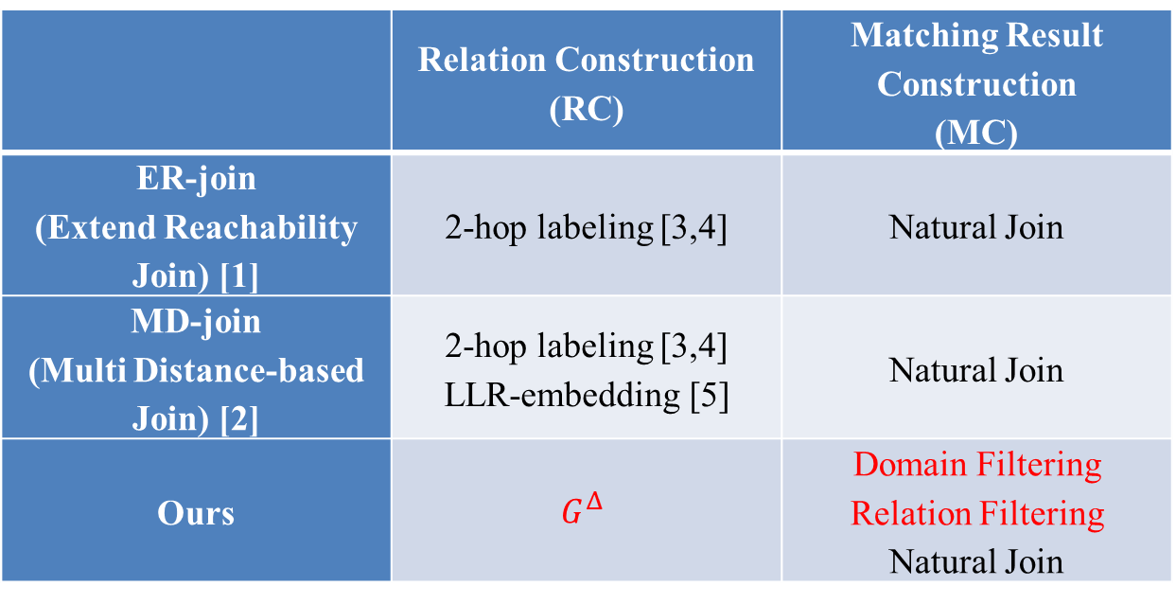
 | Relation Construction (RC) | Matching Result Construction (MC)
ER-join (Extend Reachability Join) [1] | 2-hop labeling [3,4] | Natural Join
MD-join (Multi Distance-based Join) [2] | 2-hop labeling [3,4] LLR-embedding [5] | Natural Join
Ours | $$G^{Δ}$$ | Domain Filtering Relation Filtering Natural Join
All tested methods each include two parts: Relation construction and Matching Result Construction.

Slide 21
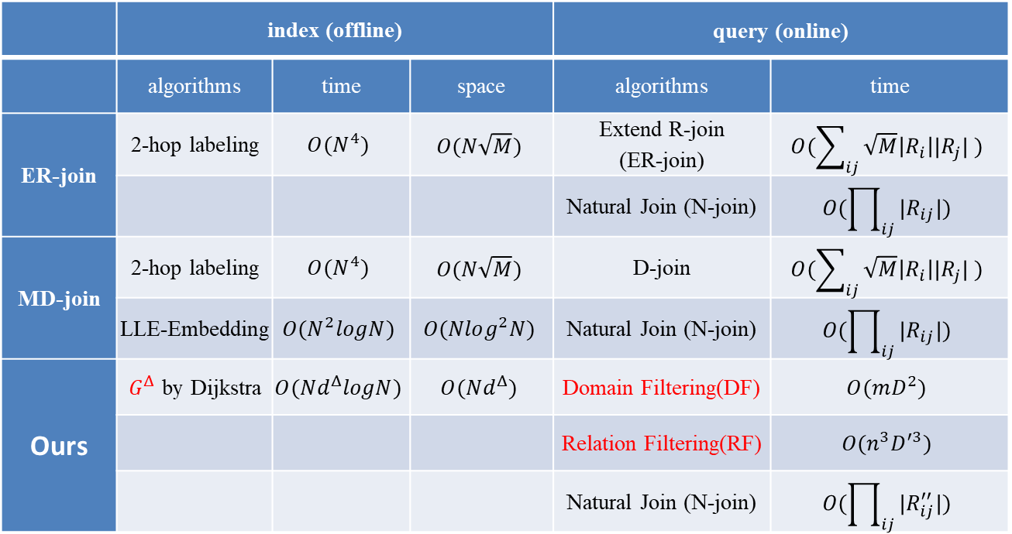
 | index (offline) |  |  | query (online)
 | algorithms | time | space | algorithms | time
ER-join | 2-hop labeling | $$O(N^{4})$$ | $$O(N\sqrt{M})$$ | Extend R-join (ER-join) | $$O(\sum_{ij}{\sqrt{M}\left|R_{i}\right||R_{j}| })$$
 |  |  |  | Natural Join (N-join) | $$O(\prod_{ij}{|R_{ij}|})$$
MD-join | 2-hop labeling | $$O(N^{4})$$ | $$O(N\sqrt{M})$$ | D-join | $$O(\sum_{ij}{\sqrt{M}\left|R_{i}\right||R_{j}| })$$
 | LLE-Embedding | $$O(N^{2}logN)$$ | $$O(Nlog^{2}N)$$ | Natural Join (N-join) | $$O(\prod_{ij}{|R_{ij}|})$$
Ours | $G^{Δ}$ by Dijkstra | $$O(Nd^{Δ}logN)$$ | $$O(Nd^{Δ})$$ | Domain Filtering(DF) | $$O(mD^{2})$$
 |  |  |  | Relation Filtering(RF) | $$O(n^{3}D^{′3})$$
 |  |  |  | Natural Join (N-join) | $$O(\prod_{ij}{|R_{ij}^{′′}|})$$
The theoretical running index and query time.
Our DomainFiltering and RelationFiltring are much faster than Natural Joins.

Slide 22
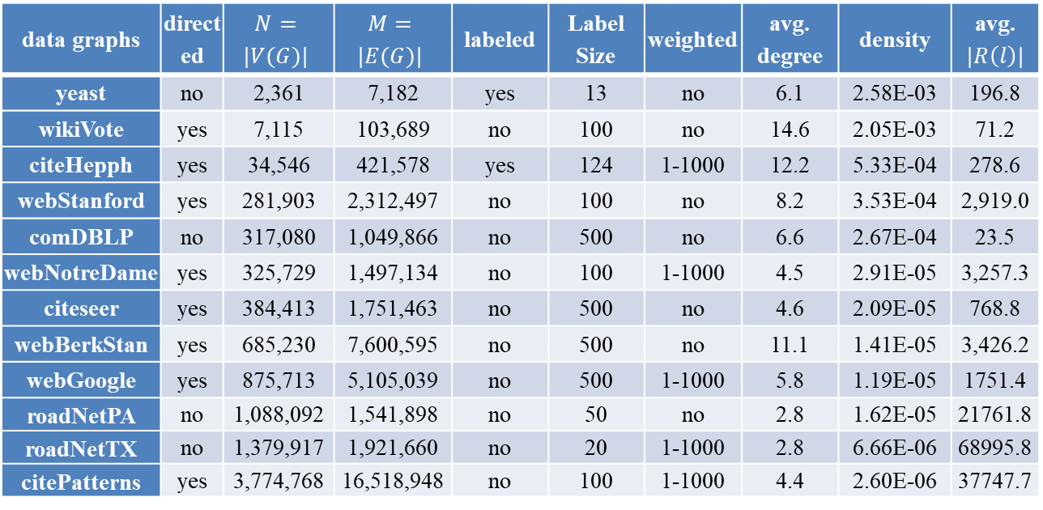
data graphs | directed | $$N=$$ $$|V(G)|$$ | $$M=$$ $$|E(G)|$$ | labeled | Label Size | weighted | avg. degree | density | avg. $$|R\left(l\right)|$$
yeast | no | 2,361 | 7,182 | yes | 13 | no | 6.1 | 2.58E-03 | 196.8
wikiVote | yes | 7,115 | 103,689 | no | 100 | no | 14.6 | 2.05E-03 | 71.2
citeHepph | yes | 34,546 | 421,578 | yes | 124 | 1-1000 | 12.2 | 5.33E-04 | 278.6
webStanford | yes | 281,903 | 2,312,497 | no | 100 | no | 8.2 | 3.53E-04 | 2,919.0
comDBLP | no | 317,080 | 1,049,866 | no | 500 | no | 6.6 | 2.67E-04 | 23.5
webNotreDame | yes | 325,729 | 1,497,134 | no | 100 | 1-1000 | 4.5 | 2.91E-05 | 3,257.3
citeseer | yes | 384,413 | 1,751,463 | no | 500 | no | 4.6 | 2.09E-05 | 768.8
webBerkStan | yes | 685,230 | 7,600,595 | no | 500 | no | 11.1 | 1.41E-05 | 3,426.2
webGoogle | yes | 875,713 | 5,105,039 | no | 500 | 1-1000 | 5.8 | 1.19E-05 | 1751.4
roadNetPA | no | 1,088,092 | 1,541,898 | no | 50 | no | 2.8 | 1.62E-05 | 21761.8
roadNetTX | no | 1,379,917 | 1,921,660 | no | 20 | 1-1000 | 2.8 | 6.66E-06 | 68995.8
citePatterns | yes | 3,774,768 | 16,518,948 | no | 100 | 1-1000 | 4.4 | 2.60E-06 | 37747.7
There are totally 12 tested real graphs.
All sorted by the number of vertices.
The last 3 graphs are much larger than others.

Slide 23
Exp. 1.1
Index Time
Our method has much less index time.
The index times of ER-join and MD-join for 3 largest graphs are not listed here. All of them over 3 hours.

Slide 24
Exp. 1.2
Index Size
Our method has much less index size.
The index size of 3 largest graphs are not listed, since they over 3 hours.

Slide 25
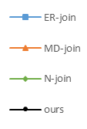
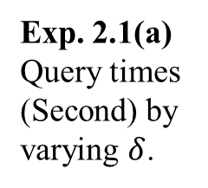
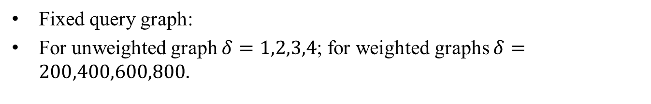
(a) yeast | (b) wikiVote | (c) citeHepph
(d) webstanford | (e) comDBLP | (f) webNotreDame
Exp. 2.1(a)
Query times (Second) by varying $δ$.
Fixed query graph:
For unweighted graph $δ=1,2,3,4$; for weighted graphs $δ=200,400,600,800.$

Slide 26
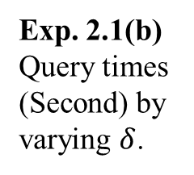
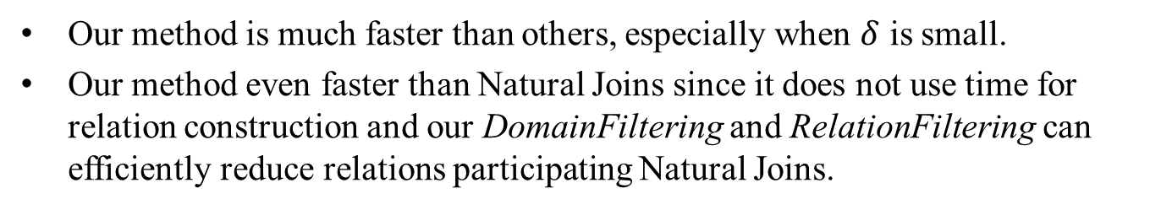
(g) citeseer | (h) webBerkStan | (i) webGoogle
(j) roadNetPA | (k) roadNetTX | (l) citePatterns
Exp. 2.1(b)
Query times (Second) by varying $δ$.
Our method is much faster than others, especially when $δ$ is small.
Our method even faster than Natural Joins since it does not use time for relation construction and our DomainFiltering and RelationFiltering can efficiently reduce relations participating Natural Joins.
Notes:
the ER-join and MD-join are not listed because of the long index time.

Slide 27
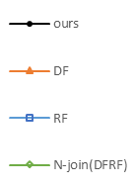
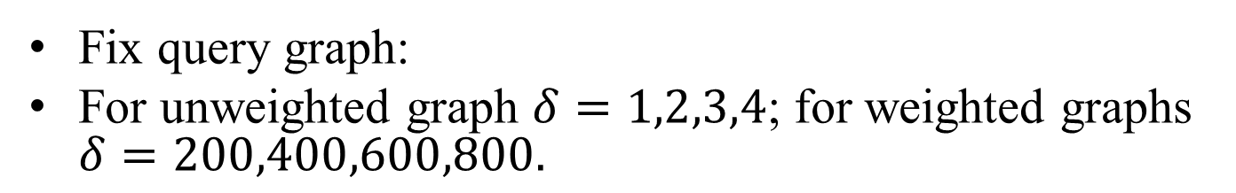
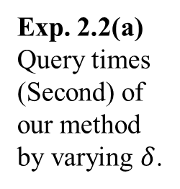
(a) yeast | (b) wikiVote | (c) citeHepph
(d) webstanford | (e) comDBLP | (f) webNotreDame
Exp. 2.2(a)
Query times (Second) of our method by varying $δ$.
Fix query graph:
For unweighted graph $δ=1,2,3,4$; for weighted graphs $δ=200,400,600,800.$

Slide 28
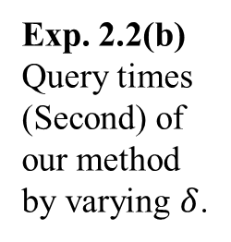
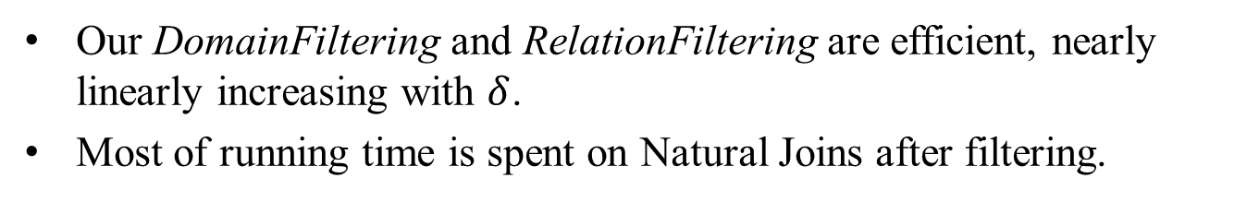
(g) citeseer | (h) webBerkStan | (i) webGoogle
Exp. 2.2(b)
Query times (Second) of our method by varying $δ$.
(j) roadNetPA | (k) roadNetTX | (l) citePatterns
Our DomainFiltering and RelationFiltering are efficient, nearly linearly increasing with $δ$.
Most of running time is spent on Natural Joins after filtering.

Slide 29
 | δ = 1(200) |  |  | δ = 2(400) |  |  | δ = 3(600) |  |  | δ = 4(800)
graphs | total | after DF | after RF | total | after DF | after RF | total | after DF | after RF | total | after DF | after RF
yeast | 540 | 9 | 9 | 7440 | 3220 | 2822 | 44442 | 22113 | 22049 | 125000 | 62470 | 62470
wikiVote | 60 | 0 | 0 | 1407 | 1266 | 1145 | 6233 | 5794 | 5774 | 10461 | 9794 | 9794
citeHepph | 308 | 0 | 0 | 2146 | 1386 | 392 | 7011 | 6347 | 4356 | 15417 | 14893 | 12954
webStanford | 388 | 18 | 18 | 1466 | 127 | 127 | 3214 | 1092 | 632 | 6628 | 3819 | 2407
comDBLP | 108 | 0 | 0 | 1140 | 14 | 14 | 12926 | 4832 | 3257 | 120904 | 59709 | 58617
webNotreDame | 134 | 12 | 12 | 600 | 267 | 25 | 1886 | 1196 | 66 | 4296 | 3165 | 170
citeseer | 45 | 0 | 0 | 536 | 5 | 5 | 4268 | 2626 | 504 | 28259 | 27217 | 22774
webBerkStan | 264 | 0 | 0 | 1215 | 159 | 150 | 2782 | 693 | 529 | 5449 | 2090 | 1342
webGoogle | 175 | 9 | 9 | 929 | 68 | 68 | 3359 | 1168 | 843 | 9161 | 5924 | 4397
roadNetPA | 12380 | 0 | 0 | 35144 | 98 | 98 | 71500 | 1114 | 1113 | 125004 | 5488 | 5405
roadNetTX | 3776 | 0 | 0 | 9624 | 0 | 0 | 18200 | 42 | 42 | 29860 | 131 | 131
citePatterns | 5538 | 5 | 5 | 18378 | 40 | 30 | 44625 | 3515 | 446 | 92373 | 24361 | 2818
Exp. 2.3 The total tuple numbers of relations by varying $δ$.
The DomainFiltering can remove much more useless tuples than RelationFiltering.
When δ is smaller only a few tuples are left after DF&RF, which leads to great speed-up to the Natural Joins.

Slide 30
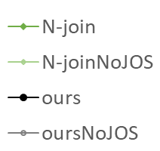
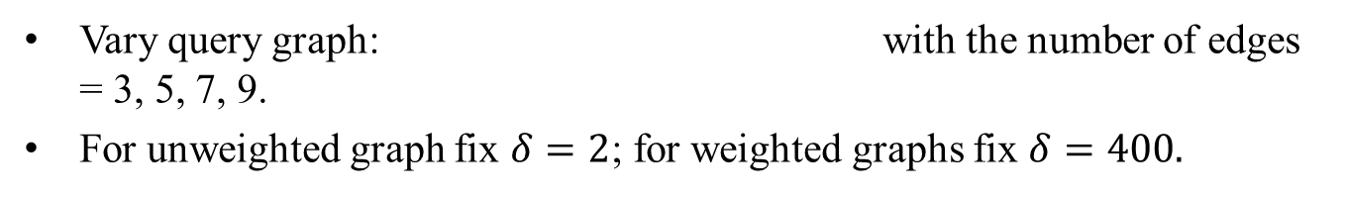
(a) yeast | (b) wikiVote | (c) citeHepph
Exp. 3.1(a) Query times (Second) of our method by varying the number of query edges.
(d) webstanford | (e) comDBLP | (f) webNotreDame
Vary query graph: with the number of edges = 3, 5, 7, 9.
For unweighted graph fix $δ=2$; for weighted graphs fix $δ=400.$

Slide 31
(g) citeseer | (h) webBerkStan | (i) webGoogle
Exp. 3.1(b) Query times (Second) of our method by varying the number of query edges.
(j) roadNetPA | (k) roadNetTX | (l) citePatterns
Our method has a higher speed-up over Natural Joins with the increasing of query edges.

Slide 32
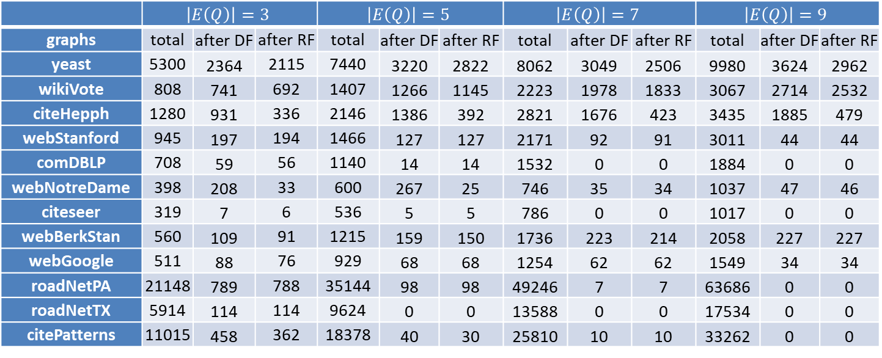
 | $$\left|E\left(Q\right)\right|=3$$ |  |  | $$\left|E\left(Q\right)\right|=5$$ |  |  | $$\left|E\left(Q\right)\right|=7$$ |  |  | $$\left|E\left(Q\right)\right|=9$$
graphs | total | after DF | after RF | total | after DF | after RF | total | after DF | after RF | total | after DF | after RF
yeast | 5300 | 2364 | 2115 | 7440 | 3220 | 2822 | 8062 | 3049 | 2506 | 9980 | 3624 | 2962
wikiVote | 808 | 741 | 692 | 1407 | 1266 | 1145 | 2223 | 1978 | 1833 | 3067 | 2714 | 2532
citeHepph | 1280 | 931 | 336 | 2146 | 1386 | 392 | 2821 | 1676 | 423 | 3435 | 1885 | 479
webStanford | 945 | 197 | 194 | 1466 | 127 | 127 | 2171 | 92 | 91 | 3011 | 44 | 44
comDBLP | 708 | 59 | 56 | 1140 | 14 | 14 | 1532 | 0 | 0 | 1884 | 0 | 0
webNotreDame | 398 | 208 | 33 | 600 | 267 | 25 | 746 | 35 | 34 | 1037 | 47 | 46
citeseer | 319 | 7 | 6 | 536 | 5 | 5 | 786 | 0 | 0 | 1017 | 0 | 0
webBerkStan | 560 | 109 | 91 | 1215 | 159 | 150 | 1736 | 223 | 214 | 2058 | 227 | 227
webGoogle | 511 | 88 | 76 | 929 | 68 | 68 | 1254 | 62 | 62 | 1549 | 34 | 34
roadNetPA | 21148 | 789 | 788 | 35144 | 98 | 98 | 49246 | 7 | 7 | 63686 | 0 | 0
roadNetTX | 5914 | 114 | 114 | 9624 | 0 | 0 | 13588 | 0 | 0 | 17534 | 0 | 0
citePatterns | 11015 | 458 | 362 | 18378 | 40 | 30 | 25810 | 10 | 10 | 33262 | 0 | 0
Exp. 3.2 The total tuple numbers of relations by varying the number of query edges.
More query edges produce more total tuples in all relations.
But more query edges lead to more restrictions. Therefore, DomainFiltering and RelationFiltering can filter more useless tuples.

Slide 33
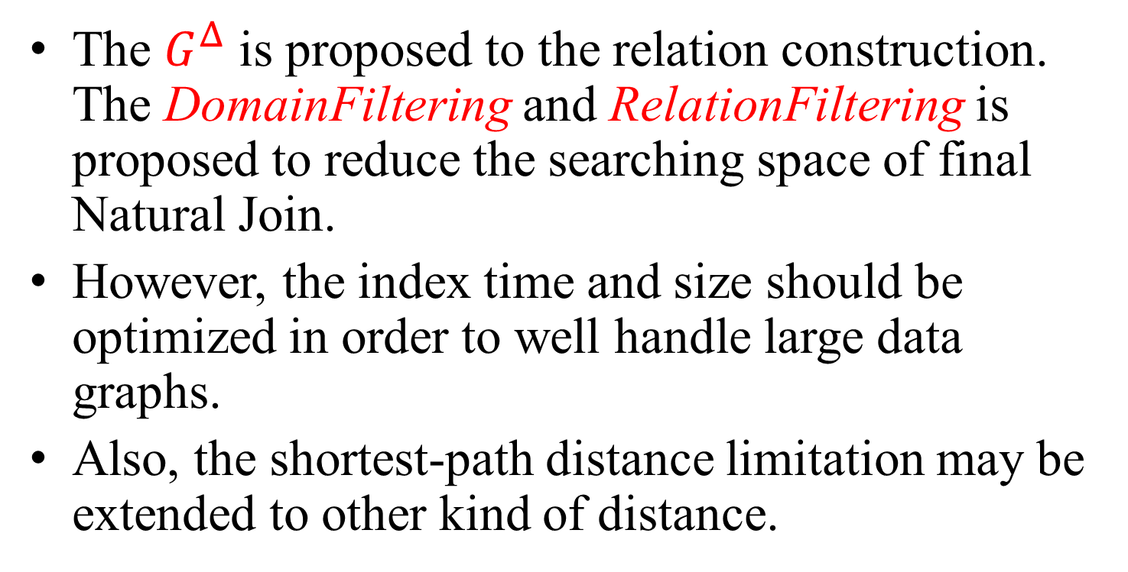
9. Future Work
The $G^{Δ}$ is proposed to the relation construction. The DomainFiltering and RelationFiltering is proposed to reduce the searching space of final Natural Join.
However, the index time and size should be optimized in order to well handle large data graphs.
Also, the shortest-path distance limitation may be extended to other kind of distance.

Slide 34
10. Reference
[1] J. Cheng, J. X. Yu, B. Ding, P. S. Yu, and H. Wang, “Fast graph pattern matching,” Proc. - Int. Conf. Data Eng., pp. 913–922, 2008.
[2] L. Chen, “Distance-Join : Pattern Match Query In a Large Graph,” Vldb, vol. 2, no. 1, pp. 886–897, 2009.
[3] E. Cohen, E. Halperin, H. Kaplan, and U. Zwick, “Reachability and Distance Queries via 2-Hop Labels,” SIAM J. Comput., vol. 32, pp. 1338–1355, 2003.
[4] J. Cheng and J. X. Yu, “On-line exact shortest distance query processing,” Proc. 12th Int. Conf. Extending Database Technol. Adv. Database Technol. EDBT 09, p. 481, 2009.
[5] C. Shahabi, M. R. Kolahdouzan, and M. Sharifzadeh, “A road network embedding technique for K-nearest neighbor search in moving object databases,” Geoinformatica, vol. 7, no. 3, pp. 255–273, 2003.

Slide 35
Thanks! Bin Guo

