Slide 1
Anisotropic flow and the valence quark skeleton of hadrons
Meijian Li
meijian.li@usc.es
Instituto Galego de Física de Altas Enerxías (IGFAE),
Universidade de Santiago de Compostela, Spain
In collaborations with:
Bin Wu (IGFAE), Wenyang Qian (IGFAE), and Hong Zhang (Shandong U.)
QCD seminar, IGFAE, 2022.10.03

Slide 2
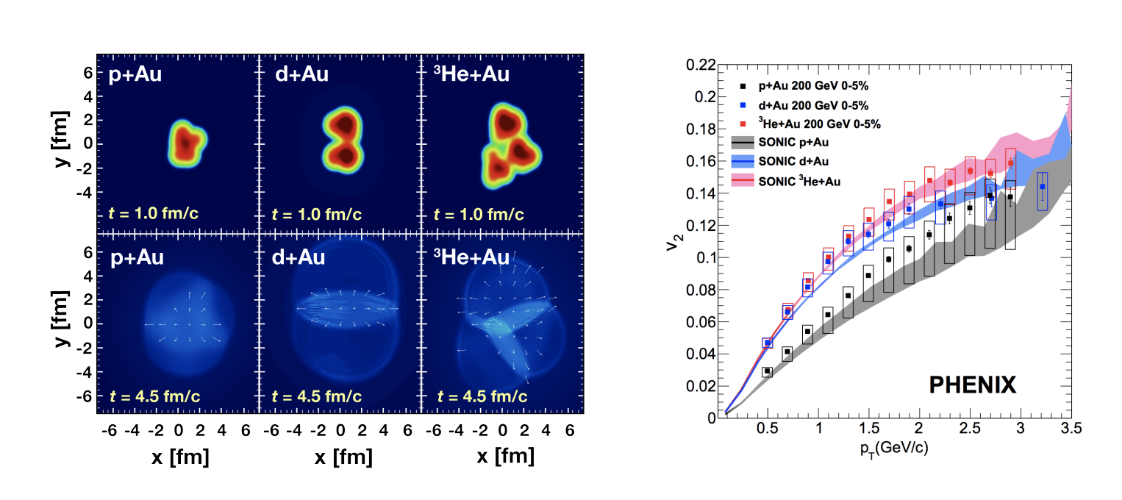
Introduction
In heavy ion collisions, the azimuthal distributions of outgoing particles reveal information of the initial inhomogeneities in matter and medium properties. Momentum anisotropies have also been observed in small system experiments^{1,2},
Could momentum anisotropies also develop in the dilute-dilute limit of small systems, e.g., 𝜋+𝜋→𝑔+𝑋?
[1] J. L. Nagle1 and W. A. Zajc, Annu. Rev. Nucl. Part. Sci. 2018. 68:1–36, arXiv: 1801.03477. [2] J.L. Nagle, A. Adare, S. Beckman, T. Koblesky, J. Orjuela Koop, D. McGlinchey, P. Romatschke, J. Carlson, J. Lynn, M. McCumber, Phys. Rev. Lett. 113, 112301 (2014), arXiv:1312.4565.

Slide 3
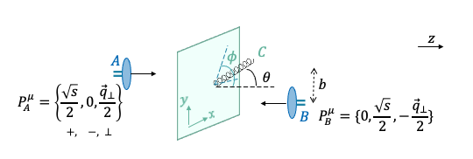
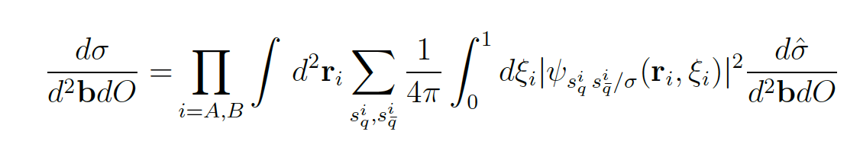

Anisotropic flow in $π+π→g+X$
We consider the process of two ultra-relativistic pions (A and B) colliding at the impact parameter b, producing one gluon (C).
The cross section can be factorized into pion light-front wavefunction (LFWF) and dipole cross section,¹
with observable $O$ as the gluon ${\vec{k}}_{⊥}=\left\{k_{T},φ\right\}$ to study anisotropies.
[1] B. Wu, JHEP 07 (2021) 002, arXiv: 2102.12916.
Notes:
Motivation on basis functions

Slide 4
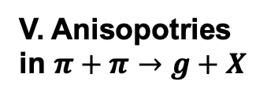
Outline
I. Dipole cross section
$q\overline{q}+q\overline{q}→X$ at LO
𝑞𝑞 ̅+𝑞𝑞 ̅→𝑋 at LO
$q\overline{q}+q\overline{q}→g+X$
𝑞𝑞 ̅+𝑞𝑞 ̅→𝑔+𝑋
II. Momentum anisotropies
Harmonic spectrum
IV. $π$ LFWF
IV. 𝝅 LFWF
Valence quark skeleton
Flow patterns $v_{n}$ and $ψ_{n}$
Flow patterns 𝑣_𝑛 and 𝜓_𝑛
III.
V. Anisopotries in $π+π→g+X$

Slide 5
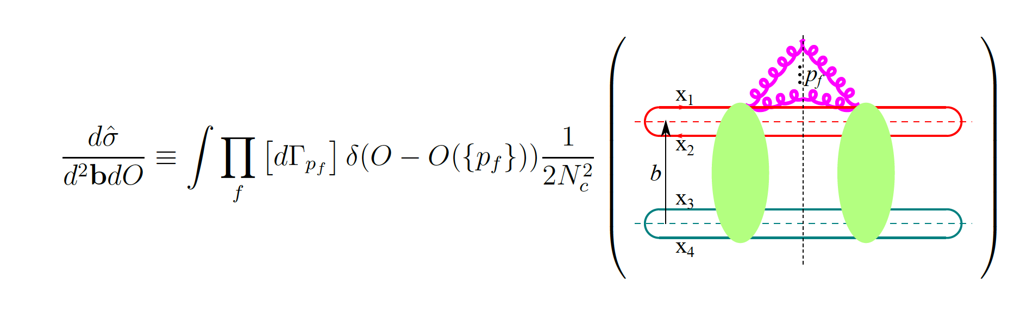
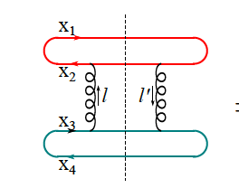
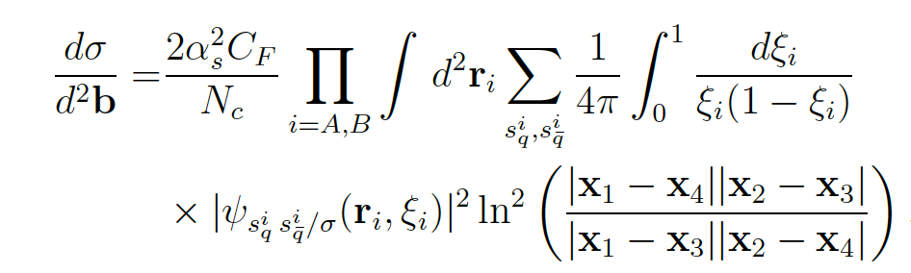


I. The dipole scattering
The $q\overline{q}+q\overline{q}→g+…+g+X$ cross section:
at leading order (LO), no gluon radiation,
$$A$$
$$B$$
#16 cut diagrams
Notes:
Motivation on basis functions

Slide 6
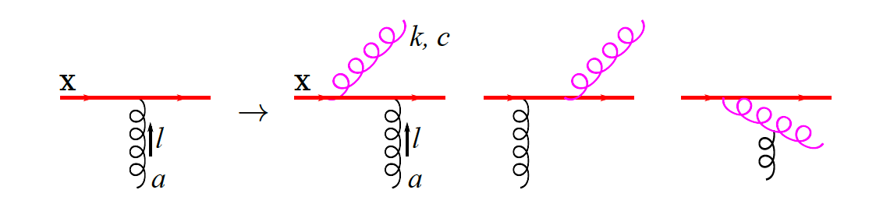
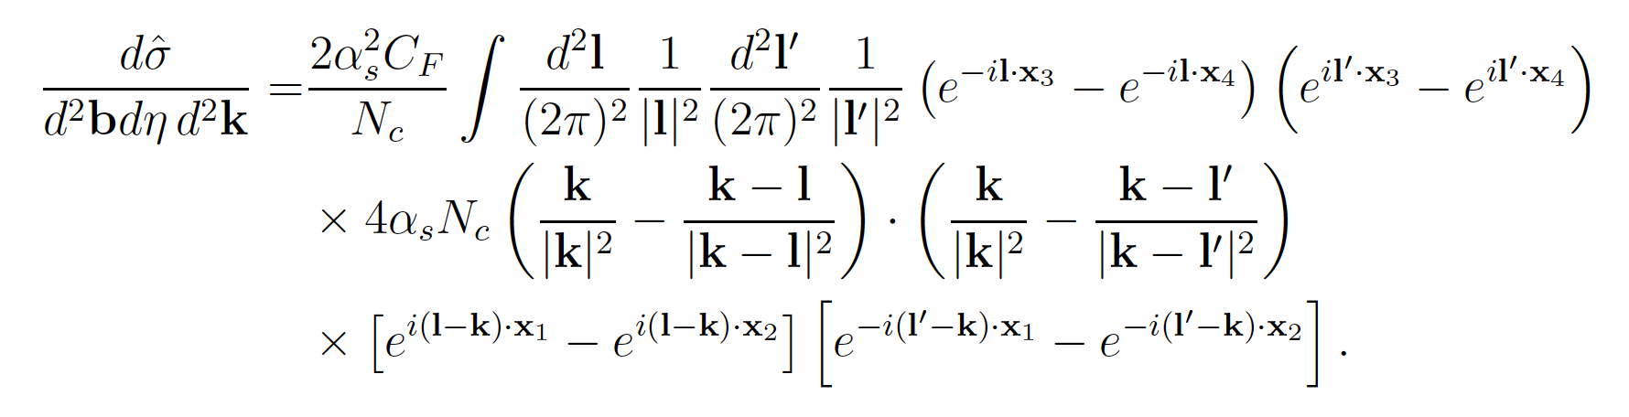



I. The dipole scattering
one gluon radiation, $q\overline{q}+q\overline{q}→g+X$
$$A$$
with
$$B$$
(light-cone gauge $A^{+}=0$, no radiation from B)
Notes:
Motivation on basis functions

Slide 7
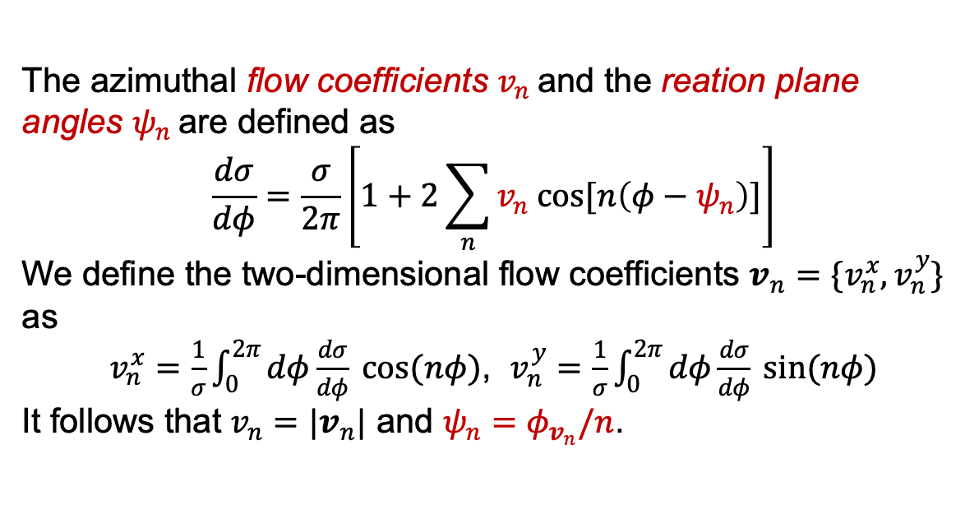
II. The harmonic spectrum
The azimuthal flow coefficients $v_{n}$and the reation plane angles $ψ_{n}$are defined as
$$\frac{dσ}{dφ}=\frac{σ}{2π}\left[1+2\sum_{n}{v_{n} cos[n\left(φ−ψ_{n}\right)]}\right]$$
We define the two-dimensional flow coefficients $v_{n}=\{v_{n}^{x},v_{n}^{y}\}$ as
$v_{n}^{x}=\frac{1}{σ}\int_{0}^{2π}{dφ\frac{dσ}{dφ} cos(nφ)}$, $v_{n}^{y}=\frac{1}{σ}\int_{0}^{2π}{dφ\frac{dσ}{dφ} sin(nφ)}$
It follows that $v_{n}=|v_{n}|$ and $ψ_{n}=φ_{v_{n}}/n$.
Notes:
Motivation on basis functions

Slide 8
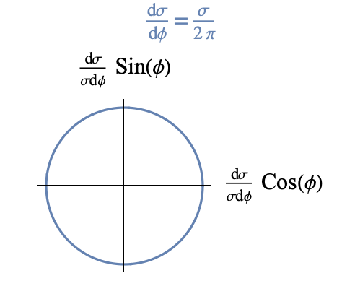
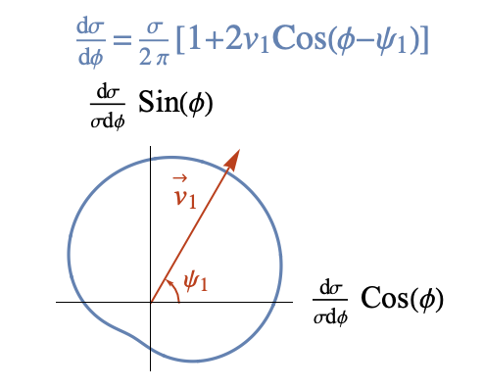
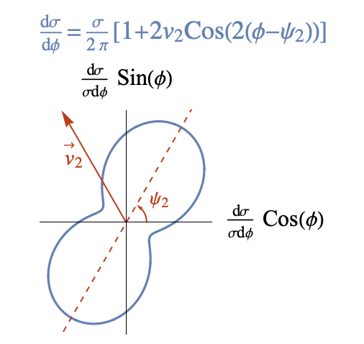
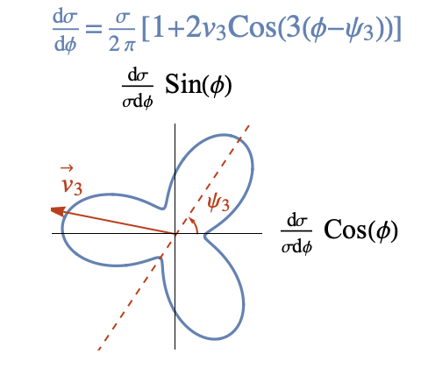




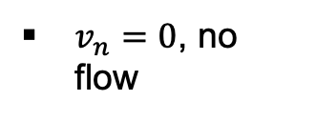
II. The harmonic spectrum$, v_{n}$ and $ψ_{n}$
$v_{n}=0$, no flow
$v_{1}$, directed flow
$v_{2}$, elliptic flow
$v_{3}$, triangular flow
Notes:
Motivation on basis functions

Slide 9
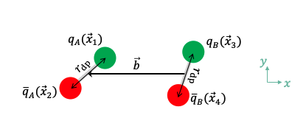

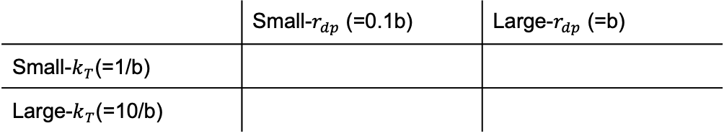


III. Momentum anisotropies in $q\overline{q}+q\overline{q}→g+X$
Symmetries in the dipole cross section:
$q_{i}↔$ ${\overline{q}}_{i}(i=A,B)$: ${\vec{x}}_{1}↔{\vec{x}}_{2}$ or ${\vec{x}}_{3}↔{\vec{x}}_{4}$
Gauge symmetry ($A^{+}=0↔$ $A^{−}=0$): {${\vec{x}}_{1},{\vec{x}}_{2}\}↔{\{\vec{x}}_{3 },{\vec{x}}_{4}\}$
Rotational symmetry($φ↔φ−Δφ$): $\frac{dσ}{dφ} (φ)↔\frac{dσ}{dφ} (φ−Δφ)$
To explore: $v_{2}$ in different scenaria
 | Small-$r_{dp}$ (=0.1b) | Large-$r_{dp}$ (=b)
Small-$k_{T}$(=1/b)
Large-$k_{T}$(=10/b)
Notes:
Motivation on basis functions

Slide 10
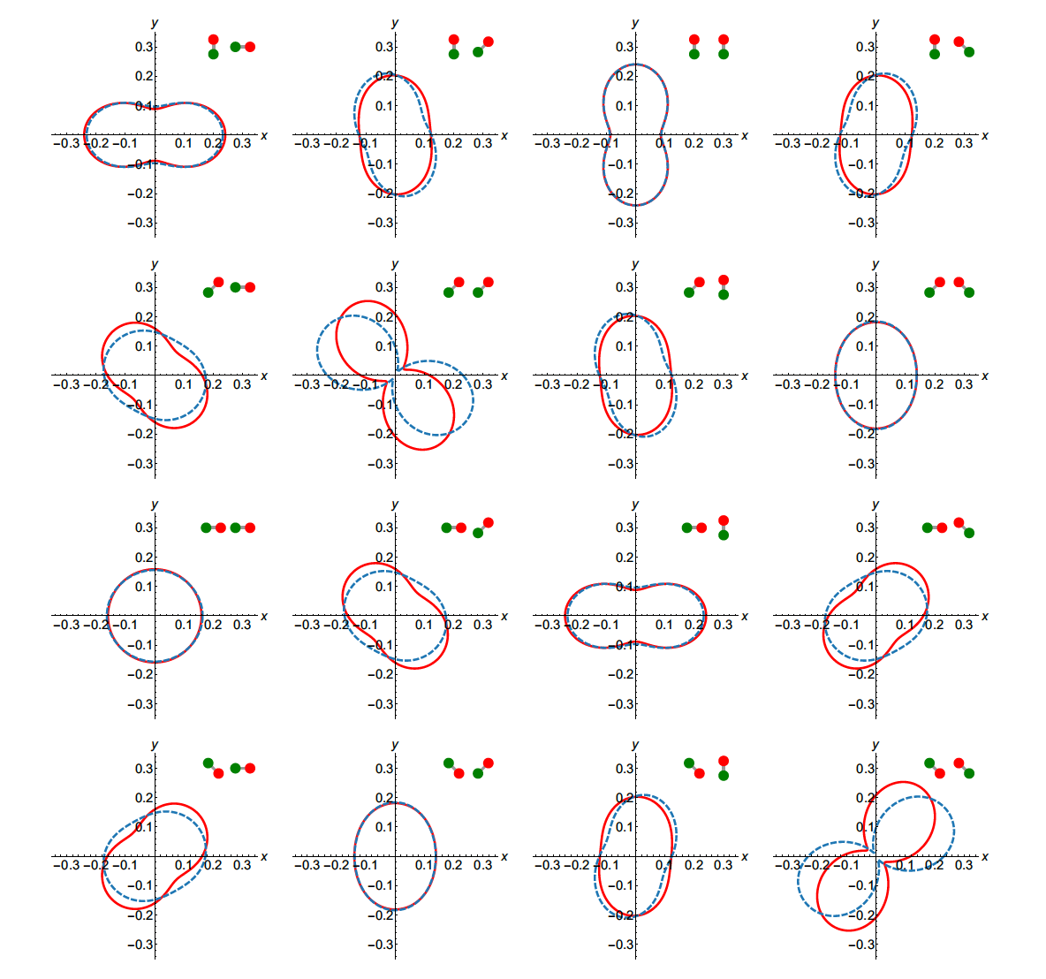
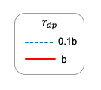


III. Momentum anisotropies in $q\overline{q}+q\overline{q}→g+X$
Small- $k_{T}$(=1/b) regime
Observation:
$v_{2}$ is not sensitive to $r_{dp}$ at small $k_{T}$
Notes:
Motivation on basis functions

Slide 11

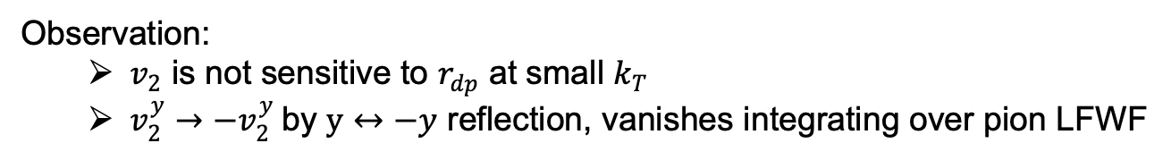
III. Momentum anisotropies in $q\overline{q}+q\overline{q}→g+X$
Small-$k_{T}$(=1/b) regime, ($y↔−y$ reflection)
Observation:
$v_{2}$ is not sensitive to $r_{dp}$ at small $k_{T}$
$v_{2}^{y}→−v_{2}^{y}$by $y↔−y$ reflection, vanishes integrating over pion LFWF
Notes:
Motivation on basis functions

Slide 12
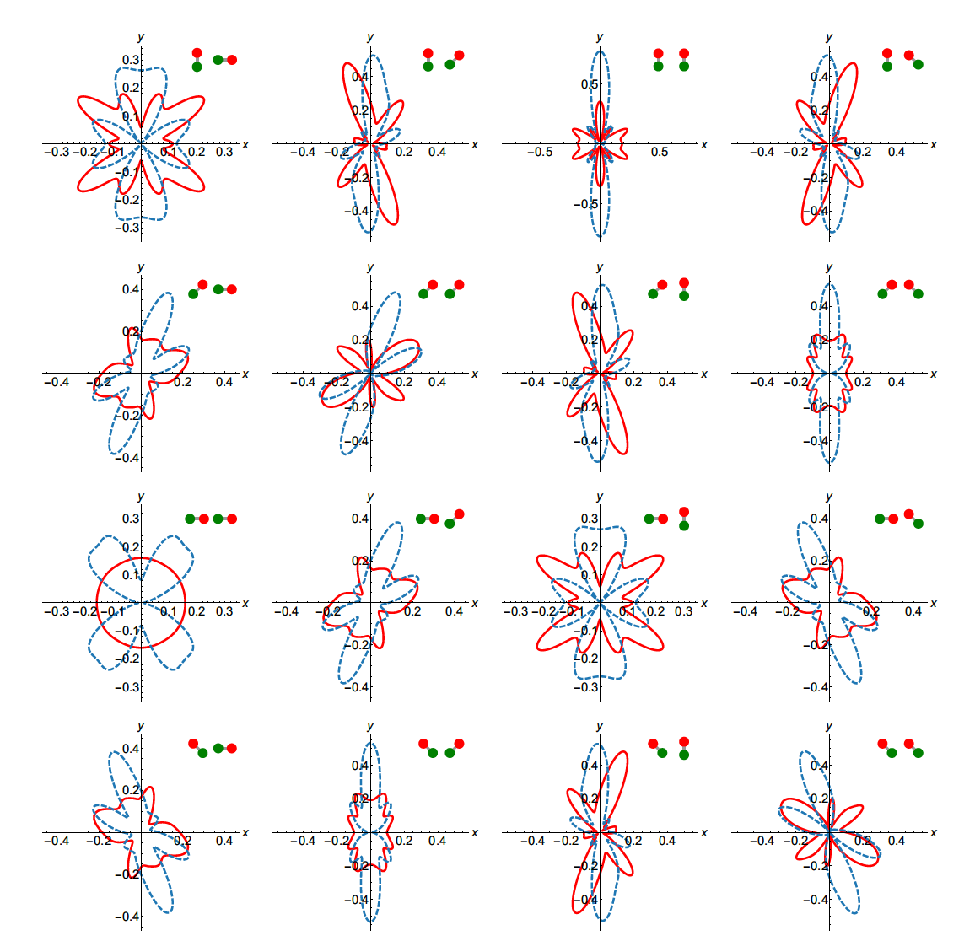

III. Momentum anisotropies in $q\overline{q}+q\overline{q}→g+X$
Large-$k_{T}$(=10/b) regime
Observation:
the distribution is more oscillatory at larger $r_{dp}$ at large $k_{T}$
Notes:
Motivation on basis functions

Slide 13
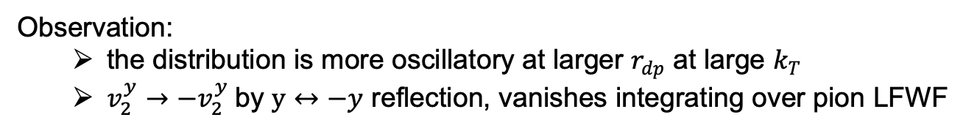
III. Momentum anisotropies in $q\overline{q}+q\overline{q}→g+X$
Large-$k_{T}$(=10/b) regime, ($y↔−y$ reflection)
Observation:
the distribution is more oscillatory at larger $r_{dp}$ at large $k_{T}$
$v_{2}^{y}→−v_{2}^{y}$by $y↔−y$ reflection, vanishes integrating over pion LFWF
Notes:
Motivation on basis functions

Slide 14
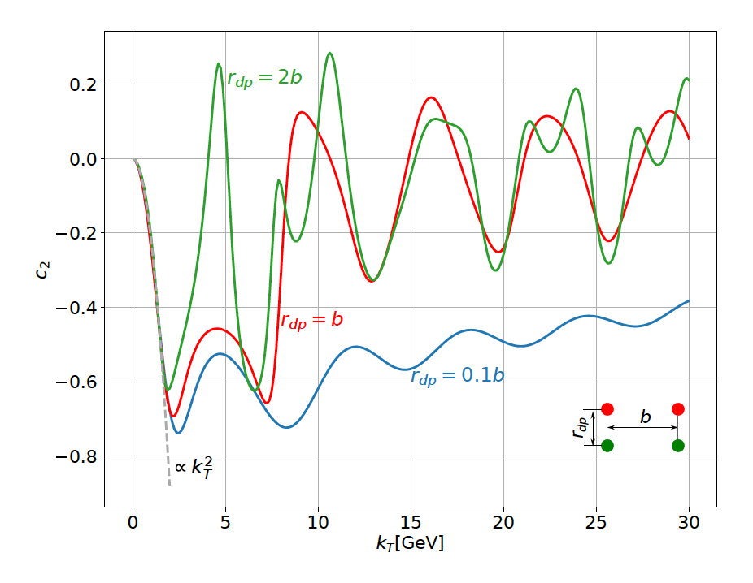
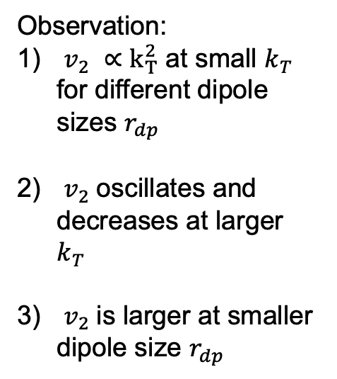
III. Momentum anisotropies in $q\overline{q}+q\overline{q}→g+X$
$v_{2}^{x}$as a function of gluon momentum $k_{T}$at $b=1 GeV^{−1}$
Observation:
$v_{2} ∝k_{T}^{2}$ at small $k_{T}$ for different dipole sizes $r_{dp}$
$v_{2}$oscillates and decreases at larger $k_{T}$
$v_{2}$is larger at smaller dipole size $r_{dp}$
Notes:
≈Motivation on basis functions

Slide 15
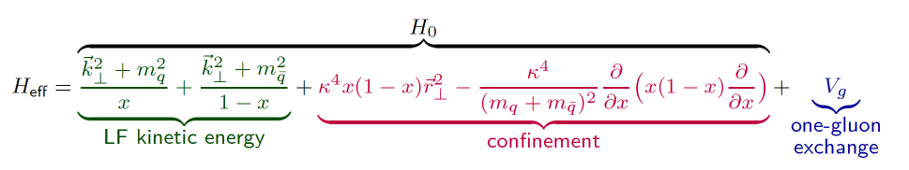

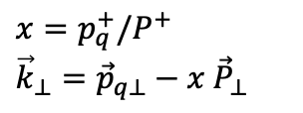
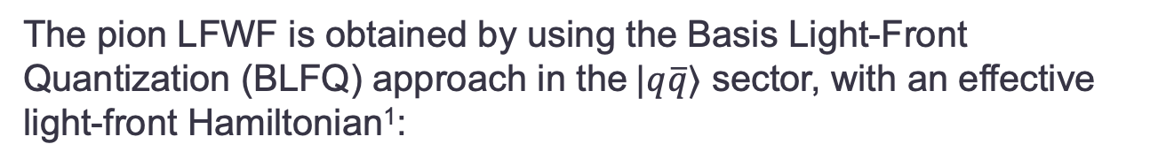
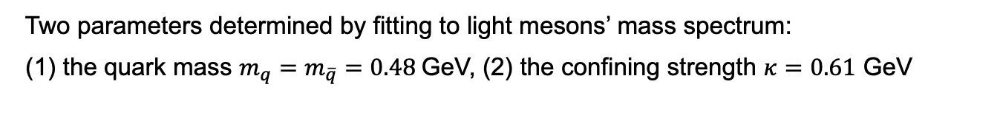


IV. The pion light-front wavefunction (LFWF)
The pion LFWF is obtained by using the Basis Light-Front Quantization (BLFQ) approach in the $|q\overline{q}⟩$ sector, with an effective light-front Hamiltonian¹:
+ ${ H}_{γ5}$
Confinement
Transverse (QCD holography)²
Longitudinal (completes the transverse confinement, and produces desirable distribution amplitudes)³
One-gluon exchange
Pseudoscalar contact interaction
$$x=p_{q}^{+}/P^{+}$$
$${\vec{k}}_{⊥}={\vec{p}}_{q⊥}−x {\vec{P}}_{⊥}$$
Two parameters determined by fitting to light mesons’ mass spectrum:
(1) the quark mass $m_{q}=m_{\overline{q}}=0.48$GeV, (2) the confining strength $κ=0.61$ GeV
[1] W. Qian, S. Jia, Y. Li, and J.P. Vary, Phys.Rev.C 102 (2020) 5, 055207. [2] S. J. Brodsky, G. F. de Teramond, H. G. Dosch, and J. Erlich, Phys. Rept. 584, 1 (2015). [3] Y. Li, P. Maris, and J. P. Vary, Phys. Rev. D96, 016022 (2017).

Slide 16
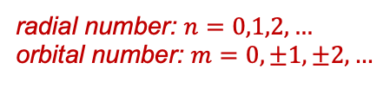
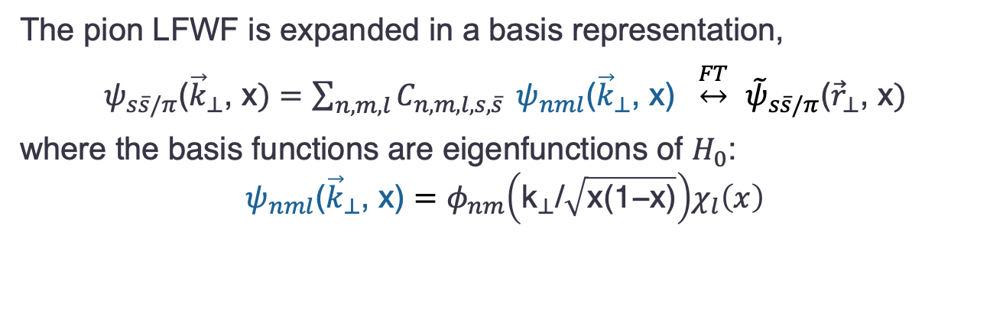

IV. The pion light-front wavefunction (LFWF)
The pion LFWF is expanded in a basis representation,
$ψ_{s\overline{s}/π}\text{(}{\vec{k}}_{⊥}\text{, }\text{x})=\sum_{n,m,l}{C_{n,m,l,s,\overline{s}}} ψ_{nml}\text{(}{\vec{k}}_{⊥}\text{, }\text{x}\text{) }\underset{↔}{FT}$ ${\tilde{ψ}}_{s\overline{s}/π}\text{(}{\vec{r}}_{⊥}\text{, }\text{x})$
where the basis functions are eigenfunctions of $H_{0}$:
$$ψ_{nml}\text{(}{\vec{k}}_{⊥}\text{, }\text{x}\text{)}=φ_{nm}{\left({\text{k}}_{⊥}\text{/}\sqrt{\text{x}\text{(1−}\text{x}\text{)}}\right)χ}_{l}\left(x\right)$$
2D harmonic oscillator functions in the transverse direction
modified Jacobi polynomials in the longitudinal direction
radial number: $n=0,1,2,…$
orbital number: $m=0,±1,±2,…$
longitudinal number: $l=0,1,2,…$

Slide 17
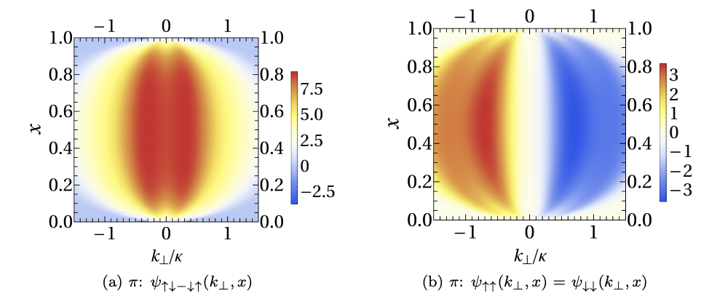
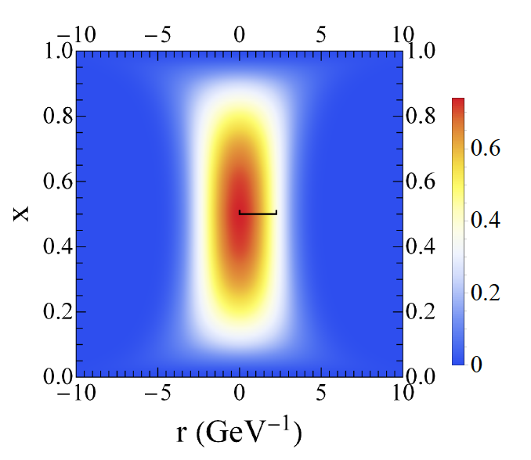

IV. The pion light-front wavefunction (LFWF)
LFWF spin components, $ψ_{s\overline{s}/π}\text{(}{\vec{k}}_{⊥}\text{, }\text{x})$:
Spin-summed probability, $\sum_{s\overline{s}}{\left|{\tilde{ψ}}_{{s\overline{s}}/π}\text{(}{\vec{r}}_{⊥}\text{, }\text{x}\right){\left.​\right|}^{2} }$
that enters the b-dependent cross section

Slide 18
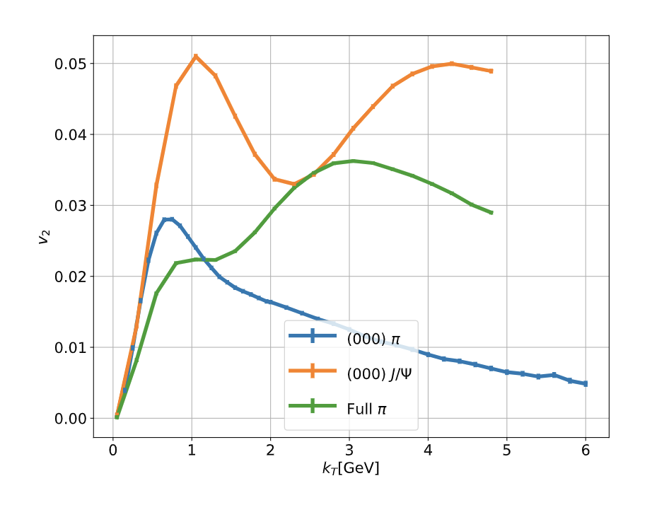


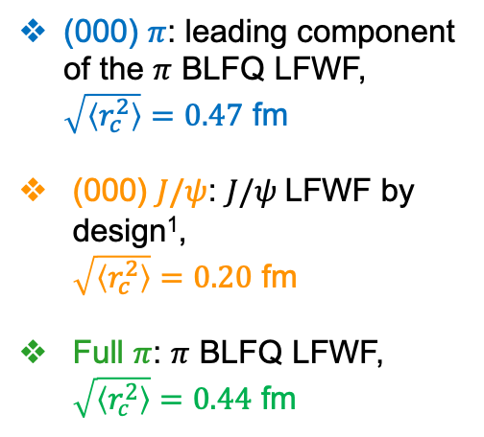
V. Momentum anisotropies in $π+$ $π→g+X$
$v_{2}$as a function of gluon momentum $k_{T}$at $b=1 GeV^{−1}$
(000) $π$: leading component of the $π$ BLFQ LFWF, $\sqrt{\left\langle r_{c}^{2}\right\rangle }=0.47$ fm
(000) $J/ψ$: $J/ψ$LFWF by design¹,
$\sqrt{\left\langle r_{c}^{2}\right\rangle }=0.20$ fm
Full $π$: $π$ BLFQ LFWF, $\sqrt{\left\langle r_{c}^{2}\right\rangle }=0.44$ fm
Observation: (1) smaller charge radius $\sqrt{\left\langle r_{c}^{2}\right\rangle }$, larger $v_{2}$
(2) $v_{2}$oscillates (“shoulder” shape) at large $k_{T}$
[1] M. Li, Y. Li, G. Chen, T. Lappi, J. P. Vary, arXiv: 2111.07087
Notes:
Motivation on basis functions

Slide 19
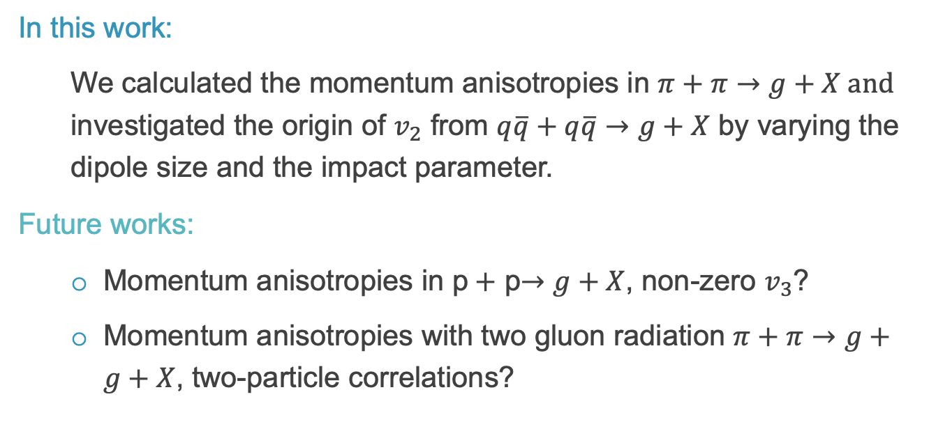
Summary
In this work:
We calculated the momentum anisotropies in $π+π→g+X and$ investigated the origin of $v_{2}$ from $q\overline{q}+q\overline{q}→g+X$ by varying the dipole size and the impact parameter.
Future works:
Momentum anisotropies in p$+$ p$→g+X$, non-zero $v_{3}$?
Momentum anisotropies with two gluon radiation $π+π→g+g+X$, two-particle correlations?
Notes:
Color layer

