Slide 1



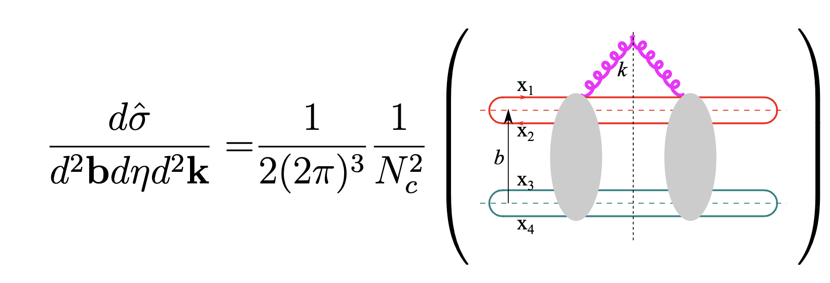
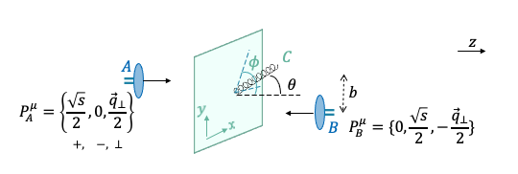
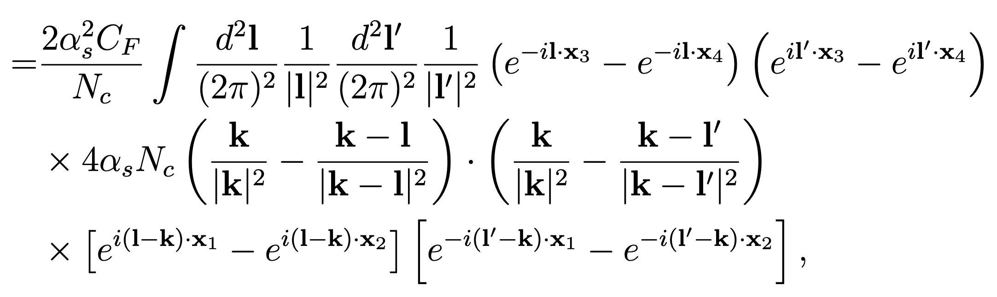
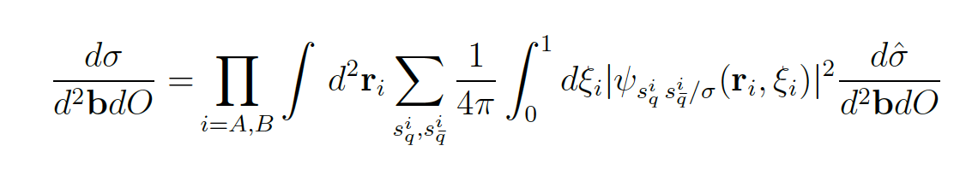
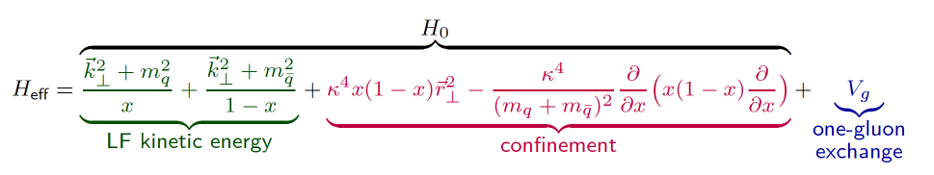
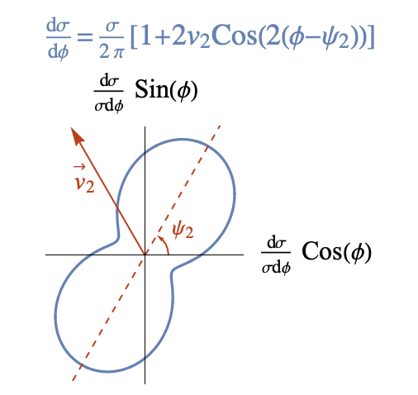
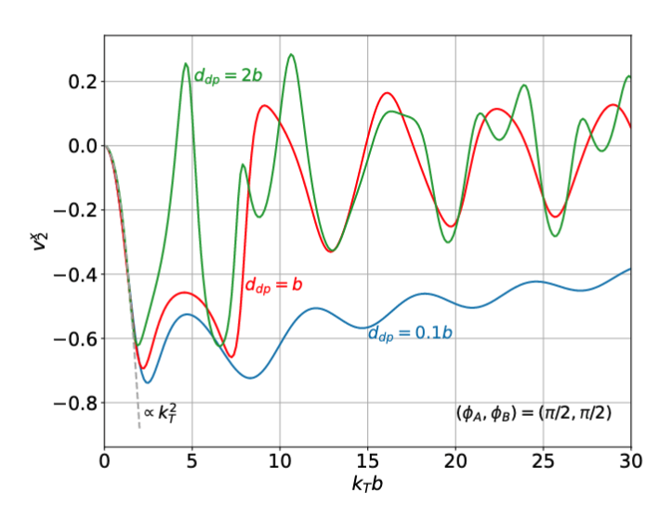
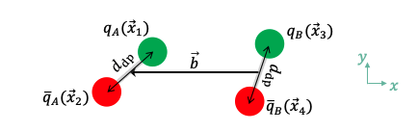
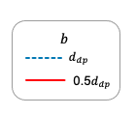
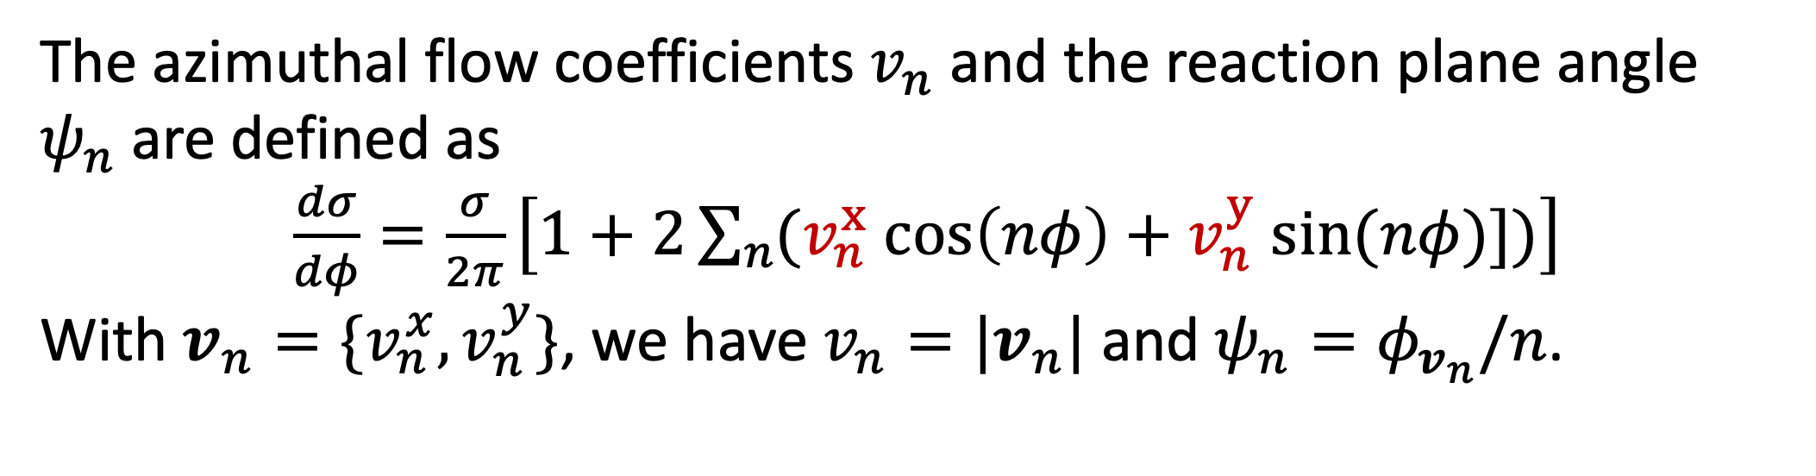
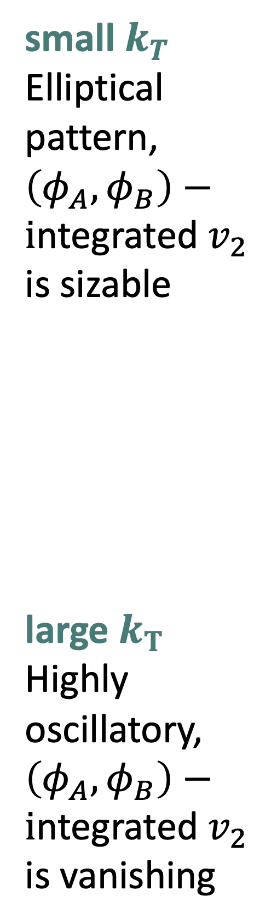

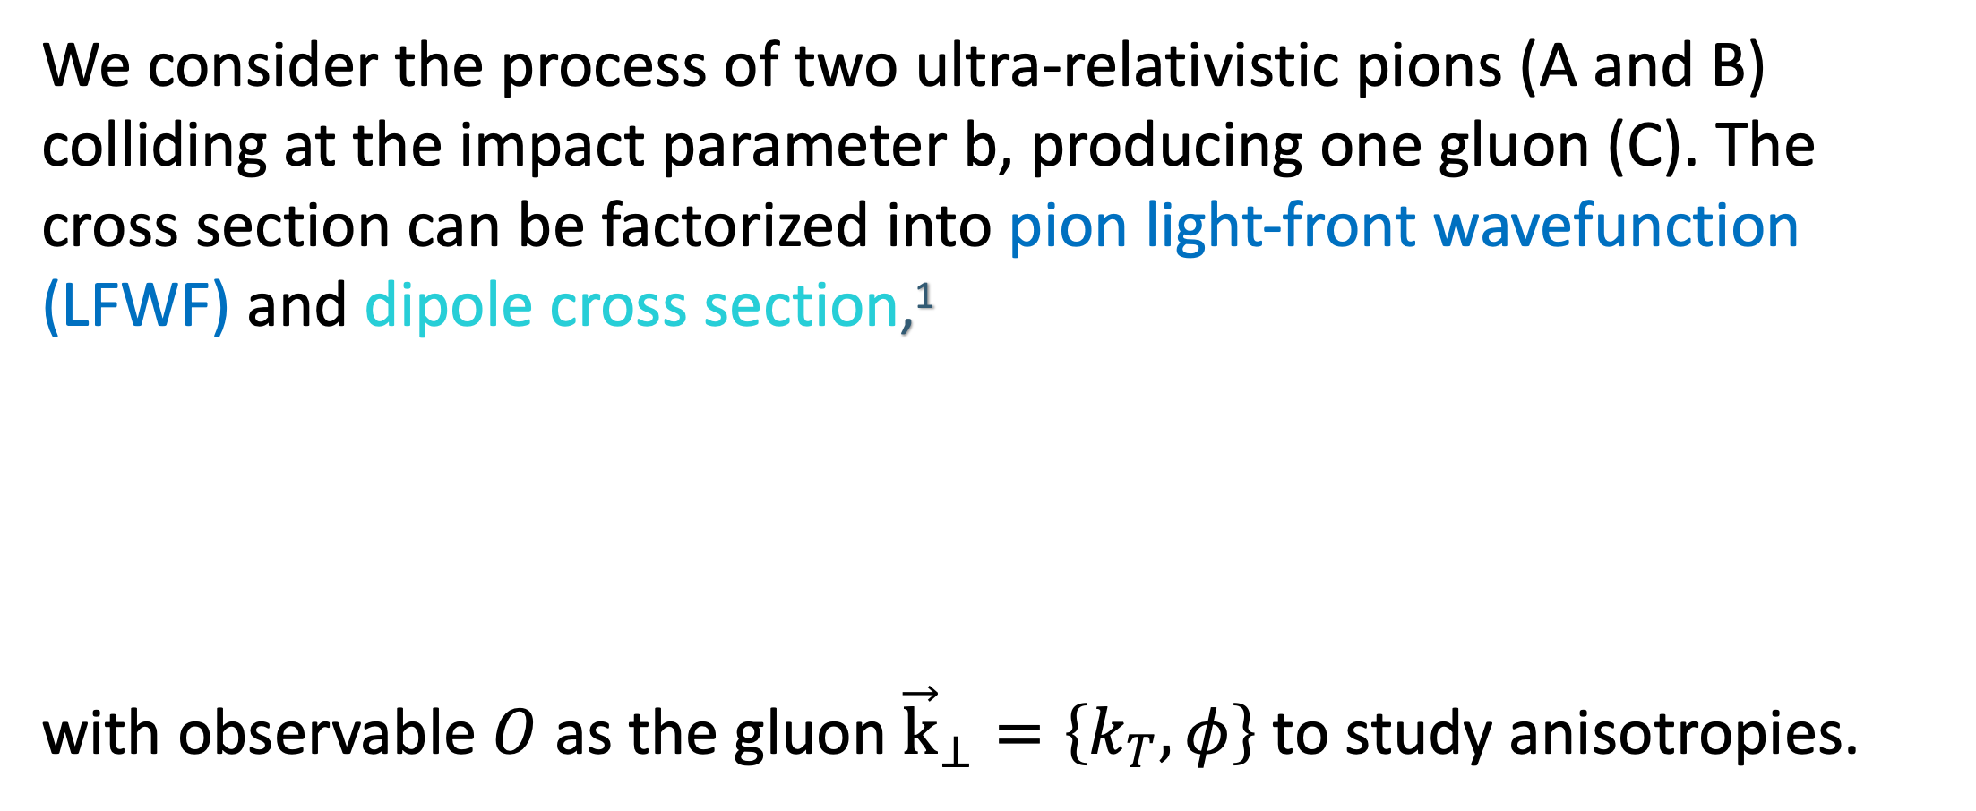

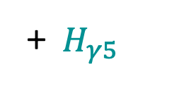



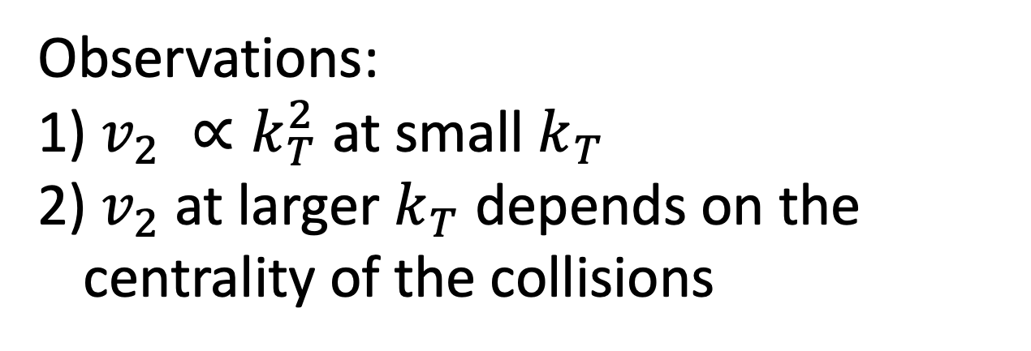

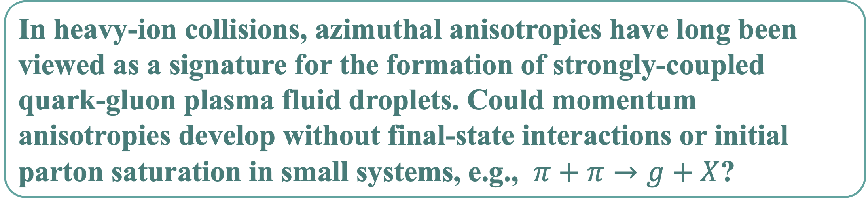

Anisotropic flow and the valence quark skeleton of hadrons
Meijian Li¹, Wenyang Qian¹, Bin Wu¹, and Hong Zhang²
1. Instituto Galego de Física de Altas Enerxías, Universidade de Santiago de Compostela, E-15782 Galicia, Spain
2. Institute of Frontier and Interdisciplinary Science, Key Laboratory of Particle, Physics and Particle Irradiation (MOE), Shandong University, Qingdao, Shandong 266237, China
I. Introduction
II. Methodology
In heavy-ion collisions, azimuthal anisotropies have long been viewed as a signature for the formation of strongly-coupled quark-gluon plasma fluid droplets. Could momentum anisotropies develop without final-state interactions or initial parton saturation in small systems, e.g., $π+π→g+X$?
The dipole-dipole cross section
We derive the impact-parameter dependent dipole cross section for radiating one gluon
We consider the process of two ultra-relativistic pions (A and B) colliding at the impact parameter b, producing one gluon (C). The cross section can be factorized into pion light-front wavefunction (LFWF) and dipole cross section,¹
with observable $O$ as the gluon ${\vec{k}}_{⊥}=\left\{k_{T},φ\right\}$ to study anisotropies.
with $η$the (pseudo)rapidity of the gluon.
The pion LFWF
Obtained from the Basis Light-Front Quantization (BLFQ) approach, with an effective light-front Hamiltonian²:
+ ${ H}_{γ5}$
III. The azimuthal distribution
V. $v_{2}$
The flow coefficients
The elliptic flow $v_{2}$
$q\overline{q}+q\overline{q}→g+X$
The azimuthal flow coefficients $v_{n}$ and the reaction plane angle $ψ_{n}$are defined as
$\frac{dσ}{dφ}=\frac{σ}{2π}\left[1+2\sum_{n}{(v_{n}^{x} cos\left(nφ\right)+v_{n}^{y} sin(nφ)])}\right]$
With $v_{n}=\{v_{n}^{x},v_{n}^{y}\}$, we have $v_{n}=|v_{n}|$ and $ψ_{n}=φ_{v_{n}}/n$.
At different dipole configurations and $k_{T}$ regimes
The azimuthal distribution $\frac{1}{\hat{σ}} \frac{d\hat{σ}}{dφ}(cosφ,sinφ)$at $k_{T}d_{dp}=2, 5, 10$.
Observations:
$v_{2} ∝k_{T}^{2}$ at small $k_{T}$
$v_{2}$oscillates and decreases at larger $k_{T}$
$v_{2}$is larger at smaller $d_{dp}$ or equivalently larger b
small $k_{T}$
Elliptical pattern,
$\left(φ_{A},φ_{B}\right)−i$ntegrated $v_{2}$ is sizable
large $k_{T}$
Highly oscillatory,
$\left(φ_{A},φ_{B}\right)−i$ntegrated $v_{2}$ is vanishing
$π+π→g+X$
Observations:
$v_{2} ∝k_{T}^{2}$ at small $k_{T}$
$v_{2}$at larger $k_{T}$ depends on the centrality of the collisions
References
[1] B. Wu, JHEP 07 (2021) 002, arXiv: 2102.12916.
[2] W. Qian, S. Jia, Y. Li, and J.P. Vary, Phys. Rev. C102 (2020) 5, 055207.
Notes:
1with

Slide 2

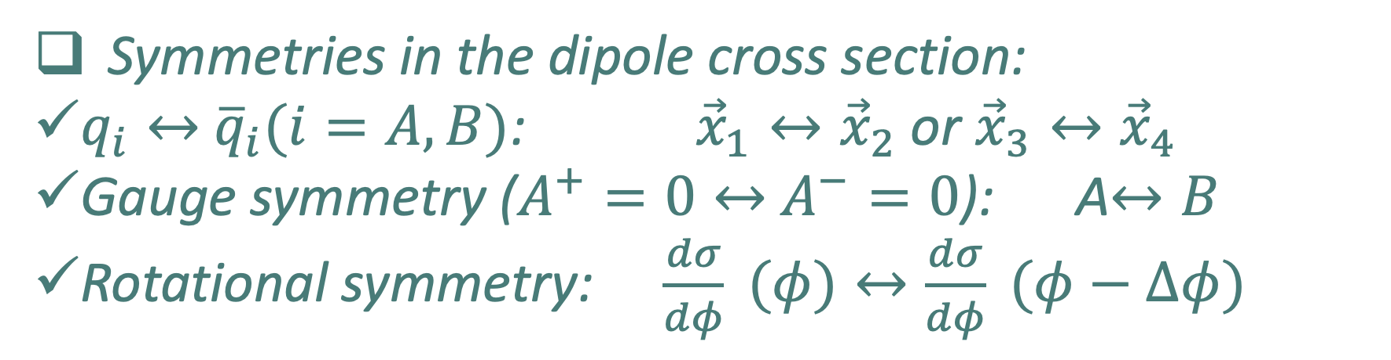
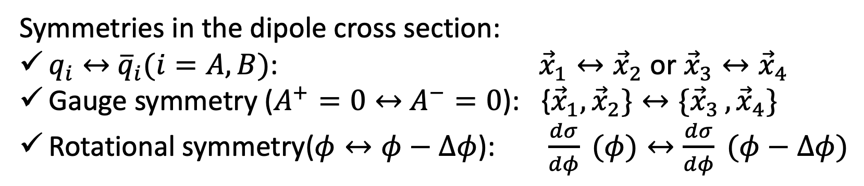
Symmetries in the dipole cross section:
$q_{i}↔$ ${\overline{q}}_{i}(i=A,B)$: ${\vec{x}}_{1}↔{\vec{x}}_{2}$ or ${\vec{x}}_{3}↔{\vec{x}}_{4}$
Gauge symmetry ($A^{+}=0↔$ $A^{−}=0$): {${\vec{x}}_{1},{\vec{x}}_{2}\}↔{\{\vec{x}}_{3 },{\vec{x}}_{4}\}$
Rotational symmetry($φ↔φ−Δφ$): $\frac{dσ}{dφ} (φ)↔\frac{dσ}{dφ} (φ−Δφ)$
The elliptic flow $v_{2}$
Symmetries in the dipole cross section:
$q_{i}↔$ ${\overline{q}}_{i}(i=A,B)$: ${\vec{x}}_{1}↔{\vec{x}}_{2}$ or ${\vec{x}}_{3}↔{\vec{x}}_{4}$
Gauge symmetry ($A^{+}=0↔$ $A^{−}=0$): A$↔B$
Rotational symmetry: $\frac{dσ}{dφ} (φ)↔\frac{dσ}{dφ} (φ−Δφ)$
preliminary

